Slide 1
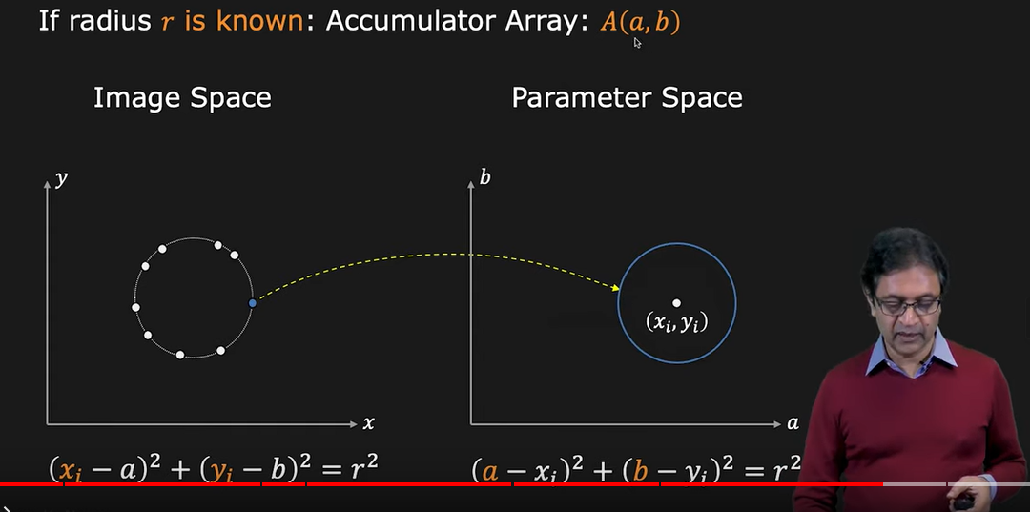
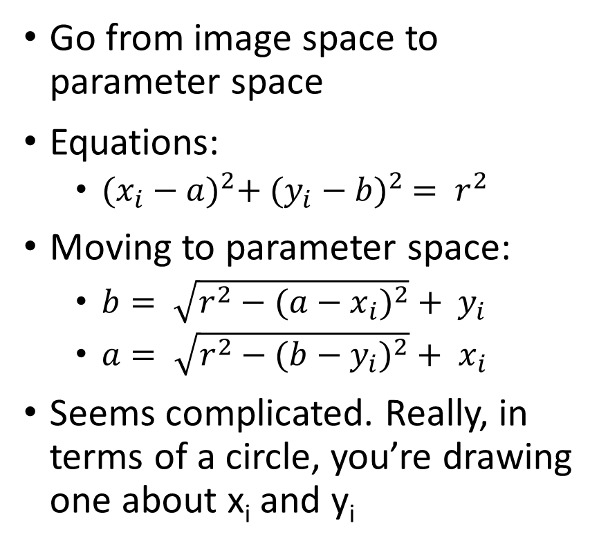
Finding circles
Go from image space to parameter space
Equations:
${(x_{i}−a)}^{2}+ {(y_{i}−b)}^{2} = r^{2}$
Moving to parameter space:
$b= \sqrt{r^{2}−{(a−x_{i})}^{2}} + y_{i}$
$a= \sqrt{r^{2}−{(b−y_{i})}^{2}} + x_{i}$
Seems complicated. Really, in terms of a circle, you’re drawing one about x_{i} and y_{i}

Slide 2
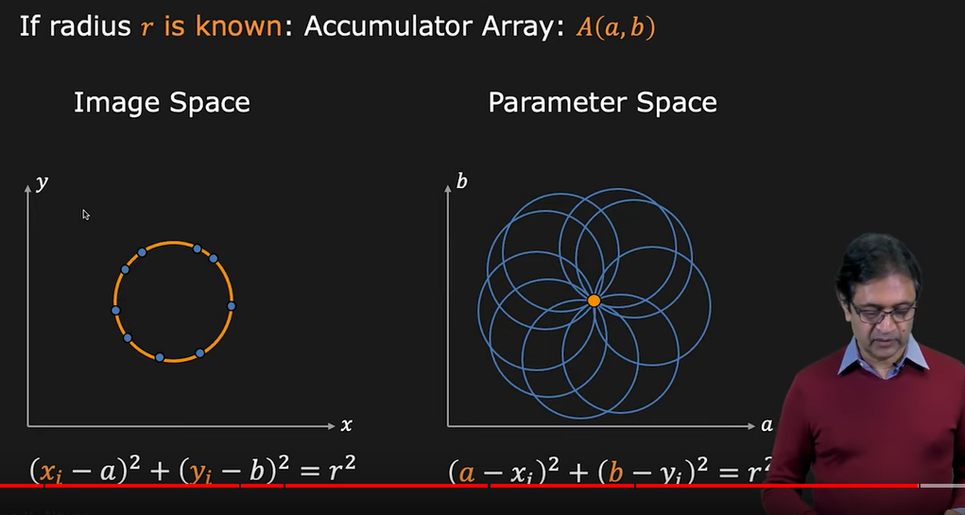
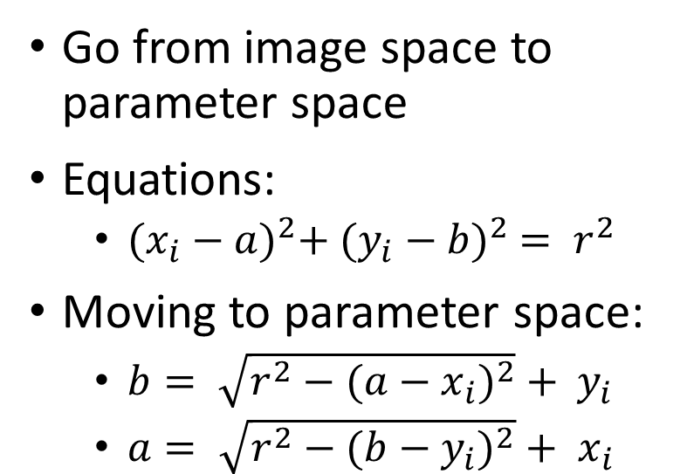
Finding circles
Go from image space to parameter space
Equations:
${(x_{i}−a)}^{2}+ {(y_{i}−b)}^{2} = r^{2}$
Moving to parameter space:
$b= \sqrt{r^{2}−{(a−x_{i})}^{2}} + y_{i}$
$a= \sqrt{r^{2}−{(b−y_{i})}^{2}} + x_{i}$

Slide 3
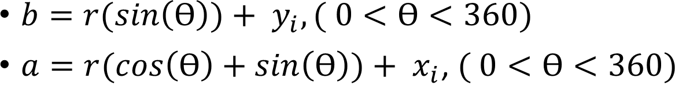
Finding circles
$b=r(sin\left(Ɵ\right))+ y_{i}, ( 0<Ɵ<360)$
$a=r(cos\left(Ɵ\right)+sin\left(Ɵ\right))+ x_{i}$, $( 0<Ɵ<360)$

