Slide 2
Fashion shop Project
Team One

Slide 3
Contents
About Project fashion shop
1
Step to make project
2
Project structure
3
The requirements of the problem and solutions.
Steps to create a website that meets the topic requirements.
The specific structure of the site.

Slide 4
1. About Project fashion shop
Basic information about project

Slide 5
Important information
We define this as a Website to build a country.

Slide 6




Requirements analysis
Customer
Admin and management
Those who want to buy need to buy used clothes.
Will open an app for sales management business for second hand clothing store

Slide 7
Components with which users can interact
View product
See catalog and pictures of products
Use cart Use shopping cart, to select products by quantity or cancel purchase
Check order and payment
Choose a payment method and edit your order
Open account
Open an account to manage individual functions

Slide 8
Store manager
Merchandise Management
Manage all information of items
Order Management
Track and manage orders, order status
Personnel, account management
Track and manage employees and customers
Store statistics
The data of the upper parts of the row are managed by the admin

Slide 9





Technology

Slide 10
2. Step to make website
Specific steps to build a website

Slide 11
A timeline always works fine
STEP 1
STEP 3
STEP 5
Analyze and understand the assigned topics
Choose the main topic and direction
Editing and finishing
webpage
STEP 2
STEP 4
Create ideas and demo ideas
Make a to-do list and assign

Slide 12
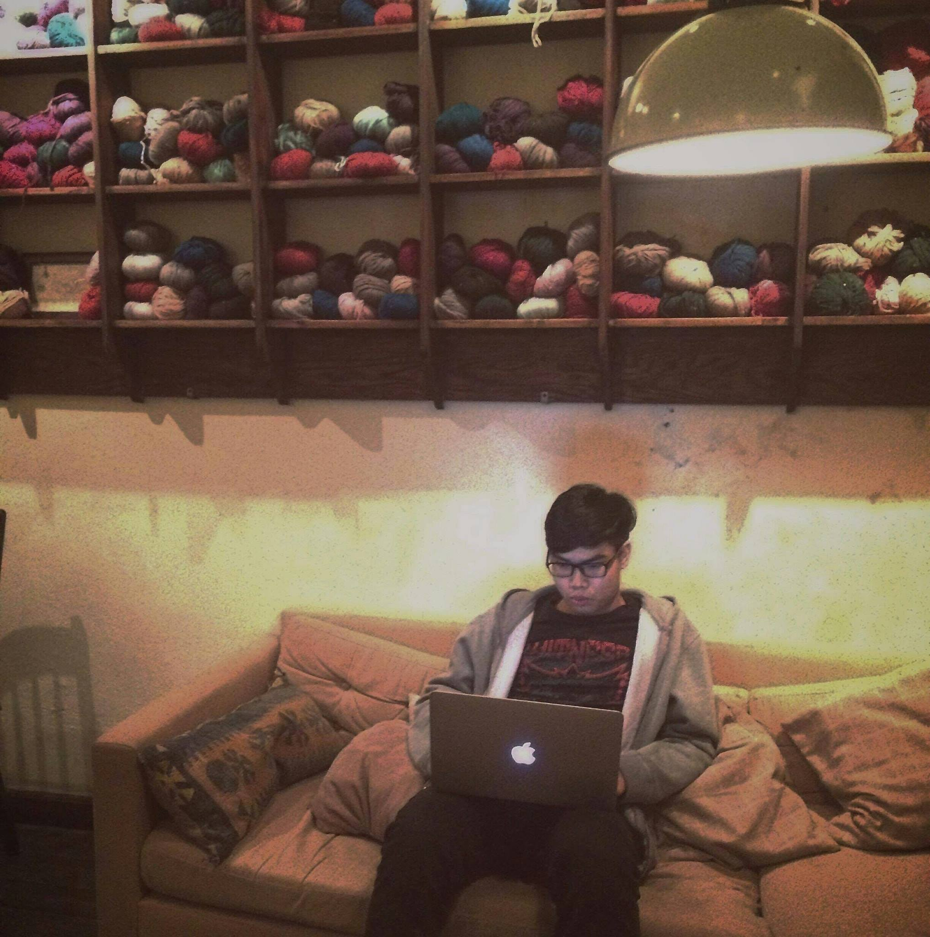
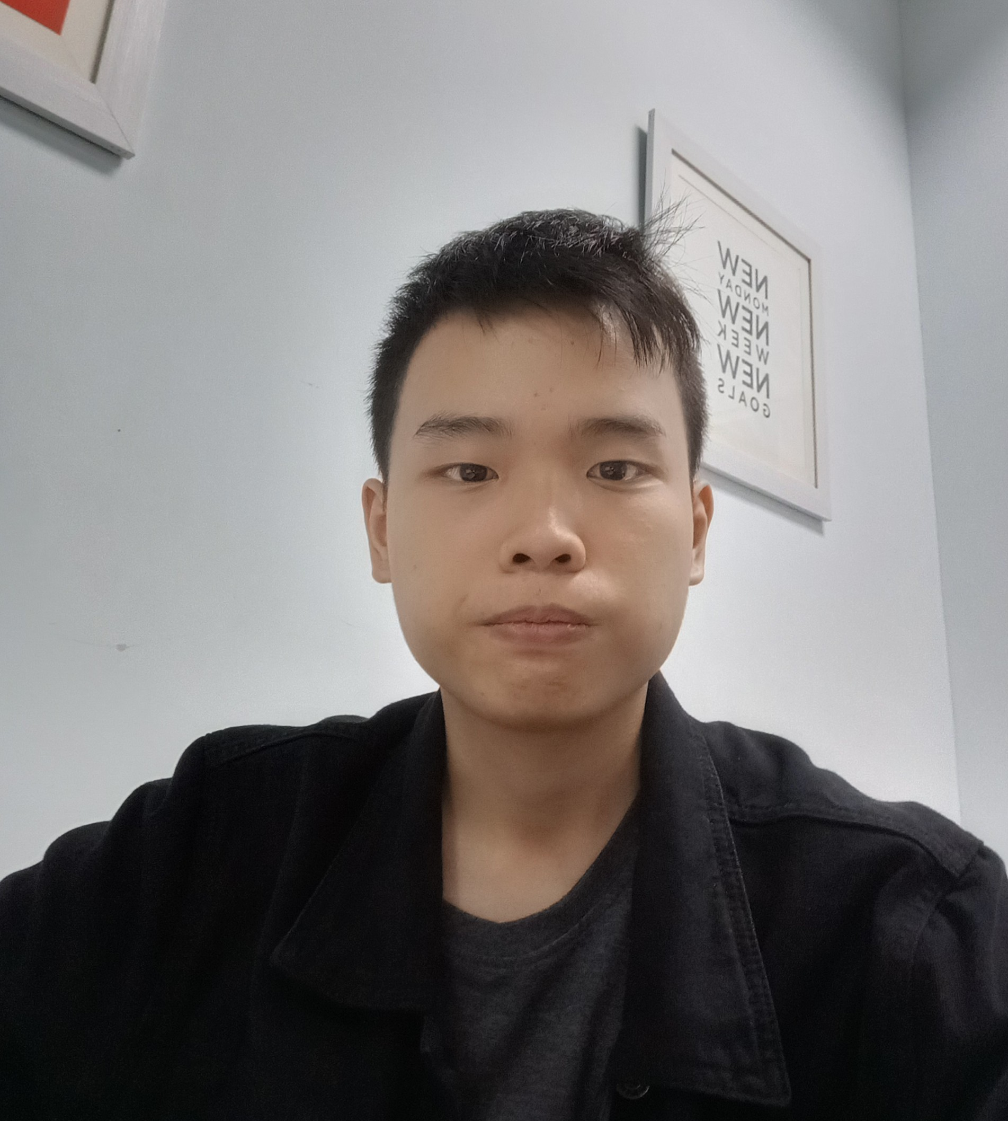
Talk about your TEAM 1
MEMBER
MEMBER
Le Hoang Minh
Nguyen van Thinh

Slide 13


Slide 14
3.Website structure

