Slide 1
Resource Pack: Design II Dark Patterns
© Melanie Baljko

Slide 2
Intellectual Property Notice
This presentation is protected by Canadian and international copyright laws. Reproduction and distribution of the presentation without the written permission of the copyright holder is prohibited.
These course materials are designed for use as part of the EECS3461 course at York University and are the intellectual property of the instructor unless otherwise stated. Third party copyrighted materials (such as book chapters, journal articles, music, videos, etc) have either been licensed for use in this course or fall under an exception or limitation in Canadian Copyright law.
Copying this material for distribution (e.g., uploading material to a commercial third-party website) may lead to a charge of misconduct under York’s Code of Student Rights and Responsibilities and the Senate Policy on Academic Honesty and/or legal consequences for violation of copyright law if copyright law has been violated.
© Melanie Baljko, 2021

Slide 3
Dependencies
This resource pack assumes that you are already familiar with:
R-Humans-I

Slide 4
Inquiry
1. Is teamwork the norm in UX design?
2. What are some project management basics? 3. How can I be a good team member?

Slide 5
1. What is a dark pattern? But first, what is a non-dark pattern?

Slide 6
who has heard of the term dark pattern?

Slide 7
Interaction Design Patterns
A design patterns is a way of thinking about an approach to common design situations
A design patterns is not a plug-and-play solution or a recipes; rather, it is approach that is generalizable to other situations
A design patterns is an abstraction; it needs to be implemented in specific contexts
Each implementation of a design pattern will differ a little bit from other implementations

Slide 8
Interaction Design Patterns
If you see the term design pattern, it is assumed to be a ‘good’ design pattern.
Interaction design patterns are a means of capturing ‘good’ design solutions and generalizing them to address similar problems [Cooper et al, 2014]
Design patterns are meant to capture ‘good’ design solutions, the not-good design ’solutions’ are called dark patterns
the phrase “non-dark design pattern” is not used; I made it up!
Of course, the distinction really boils down to what one considers ‘good’

Slide 9
Example: The Drawer
on mobile devices, there is limited screen real-estate relative to the content
an approach to this common design situation is the use of a drawer
the drawer is a design pattern, also the double drawer
drawers are exposed and hidden by swiping gestures
considered a good design solution

Slide 10
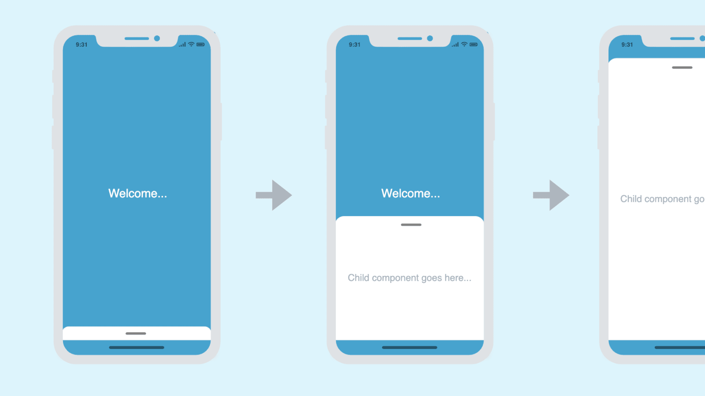
Examples of Drawers
swipe up

Slide 11
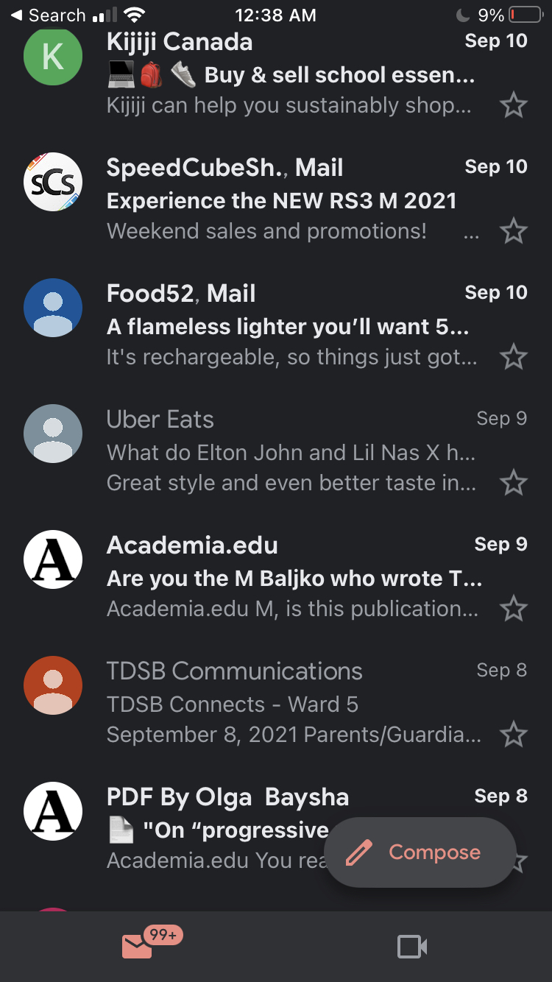
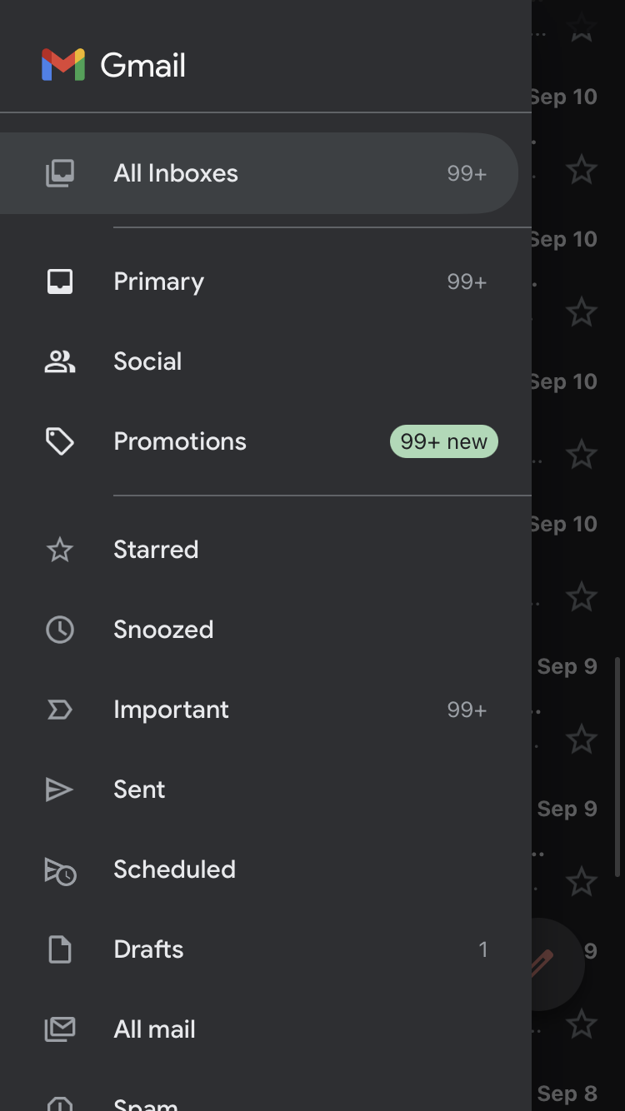
Examples of Drawers
screen capture of gmail app on my mobile device
screen capture of gmail, after swiping right

Slide 12
1. What is a dark pattern?

Slide 13
Dark Patterns
a dark pattern refers to a design approach that is intended to influence user behaviour through means such as:
coercion
steering/guiding
misleading
deception
the purpose of a dark pattern is to get users to make decisions or to undertake actions that they might not otherwise make (if they were fully informed and fully capable of selecting an alternative)

Slide 14
Dark Patterns Are Increasingly Common
increasingly common occurrence on digital platforms
social media websites
Frobrukerrådet. 2018. Deceived by design: How tech companies use dark patterns to discourage us from exercising our rights to privacy. (2018)
shopping websites
Harry Brignull. 2018. Dark Patterns. https://darkpatterns.org/.
mobile apps
2018. Facebook has been collecting call history and SMS data from Android devices. https://www.theverge.com/2018/3/25/17160944/facebook-call-history-sms-data-collection-android. Accessed April 2, 2019.
Christoph Bösch, Benjamin Erb, Frank Kargl, Henning Kopp, and Stefan Pfattheicher. 2016. Tales from the dark side: Privacy dark strategies and privacy dark patterns. Proceedings on Privacy Enhancing Technologies 2016, 4 (2016), 237–254.
video games
José P Zagal, Staffan Björk, and Chris Lewis. 2013. Dark patterns in the design of games. In Foundations of Digital Games 2013.
source: Mathur et al. 2019. Dark Patterns at Scale: Findings from a Crawl of 11K Shopping Websites. Proc. ACM Hum.-Comput. Interact. 3, CSCW, Article 81 (November 2019), 32 pages. DOI:https://doi.org/10.1145/3359183

Slide 15
Why are Dark Patterns Problematic?
annoy users
frustrate users
mislead and deceive users
cause financial loss
trick users into giving up vast amounts of personal data
induce compulsive and addictive behavior in adults and children
these range from mild to severe problems

Slide 16
Do Dark Patterns Represent ‘Good’ Design Solutions?
one could argue that dark patterns are good for someone, just not the users
there are beneficiaries to dark patterns:
increased sales
increased subscribers
reduced de-subscribers
access to private information
…
labelling something ‘good’ or ‘bad’ depends on perspective, better to use a more nuanced framework for inquiry

Slide 17
Types of Dark Patterns
Mathur et al. 2019. Dark Patterns at Scale: Findings from a Crawl of 11K Shopping Websites. Proc. ACM Hum.-Comput. Interact. 3, CSCW, Article 81 (November 2019), 32 pages. DOI:https://doi.org/10.1145/3359183
There are many different lists of types of dark patterns
There are different categorization schemes for dark patterns
Here is the scheme from Mathur et al (2019)
Sneaking
Urgency
Misdirection
Social Proof
Scarcity
Obstruction
Forced Action
all of the following examples are from Mathur et al (2019)

Slide 18
Sneaking
this category of dark patterns refers to attempts to misrepresent user actions, or hide/delay information
if the full information were made available to users, they would likely choose otherwise
For example
sneak purchase into shopping basket
add in a hidden cost
add in a hidden subscription

Slide 19
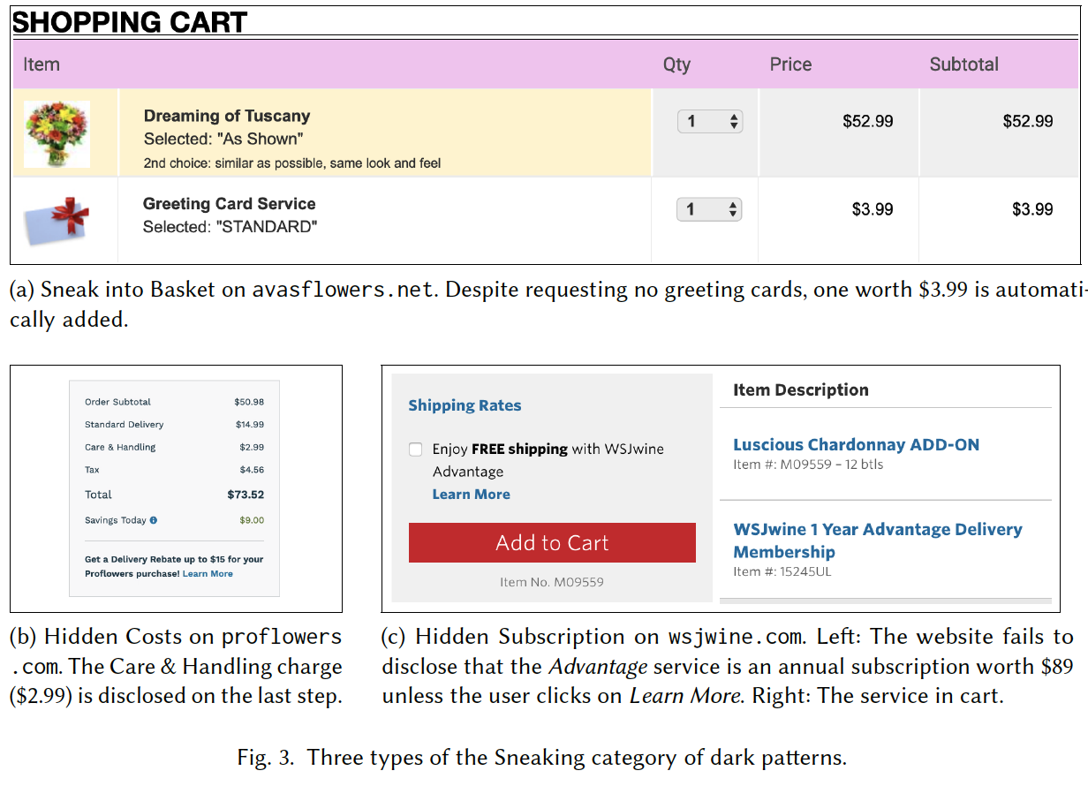

Slide 20
Urgency
this category of dark pattern is a design approach of imposing a deadline on a sale or deal, thereby accelerating user decision-making and purchases
For example:
countdown timers
limited-time messages

Slide 21
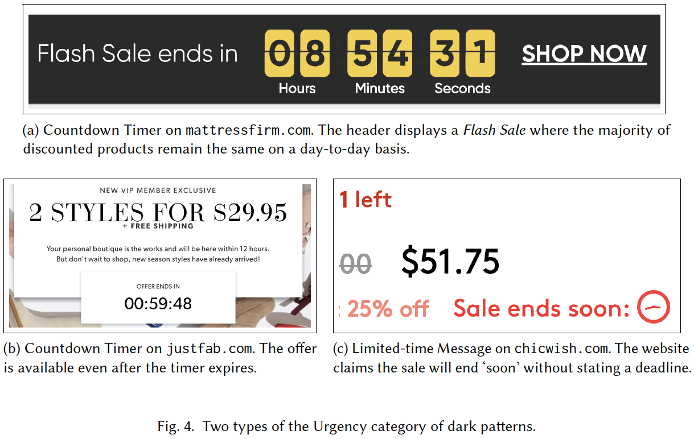

Slide 22
Misdirection
the category of dark patterns uses visuals, language, and emotion to steer users toward or away from making a particular choice
For example:
Confirmshaming
Visual Interference
Trick Questions
Pressured Selling

Slide 23
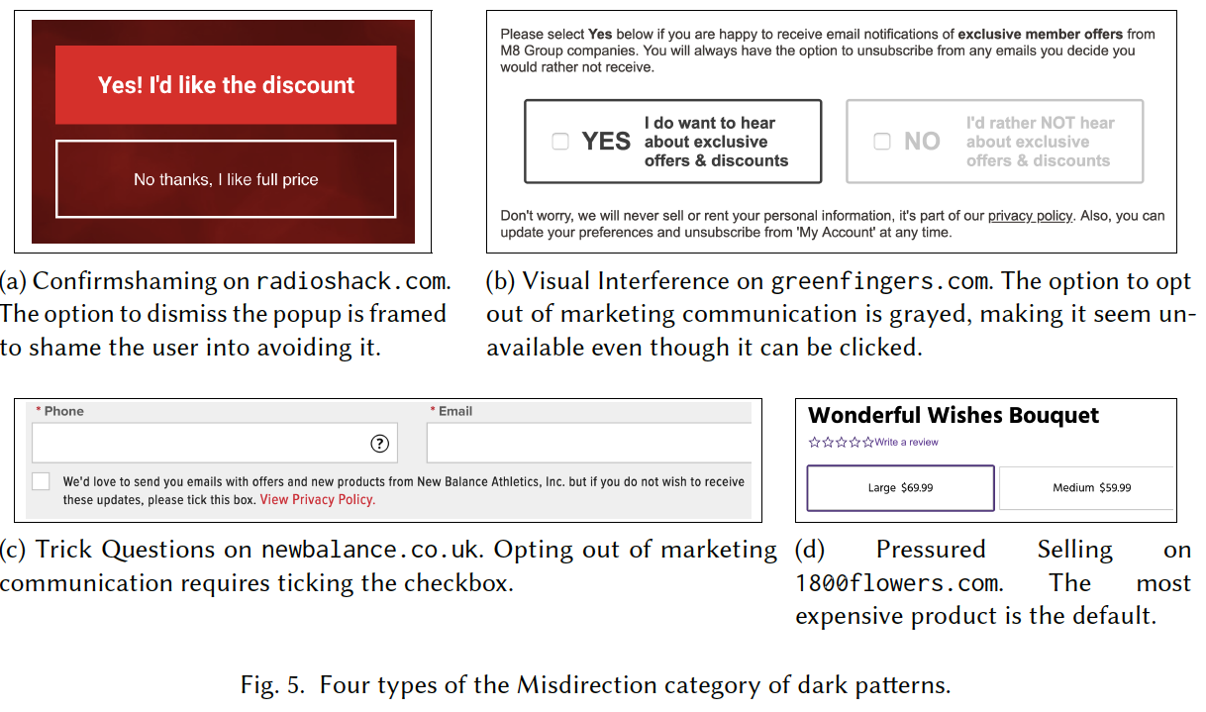

Slide 24
Social Proof
this category of dark pattern uses the social proof principle to influence to accelerate user decision-making and purchases; it exploits the cognitive bias of bandwagon effect to its advantage
studies have shown that individuals are more likely to impulse buy when shopping with their peers and families.
For example:
activity notifications
testimonials

Slide 25
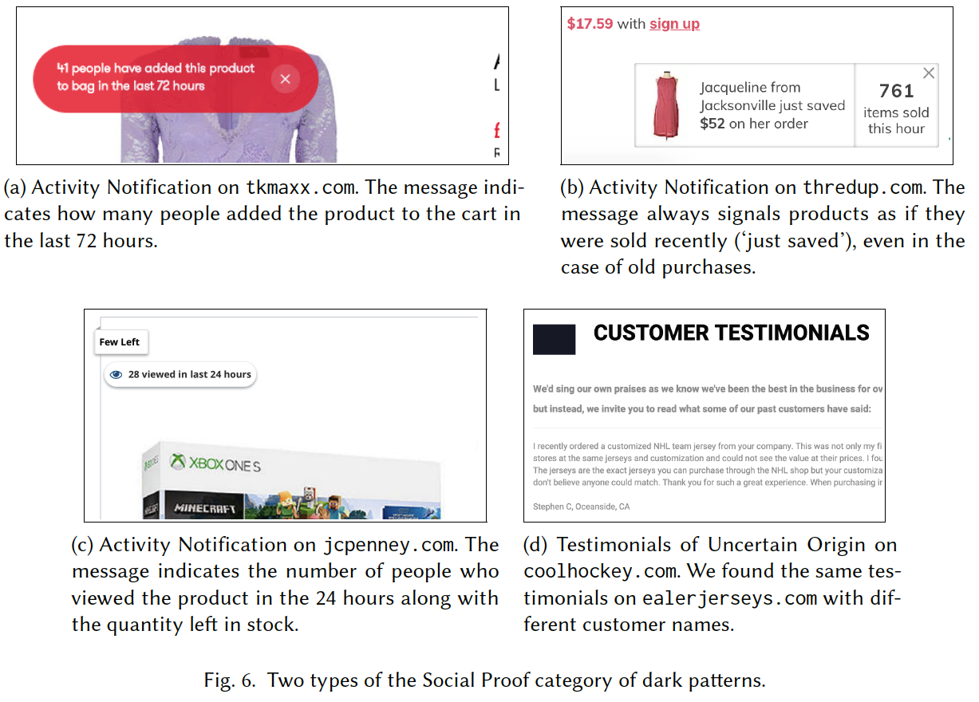

Slide 26
Scarcity
this category of dark patterns uses signals of limited availability or high demand of a product, thus increasing its perceived value and desirability
For example:
‘Low-stock Messages’
‘High-demand Messages’

Slide 27
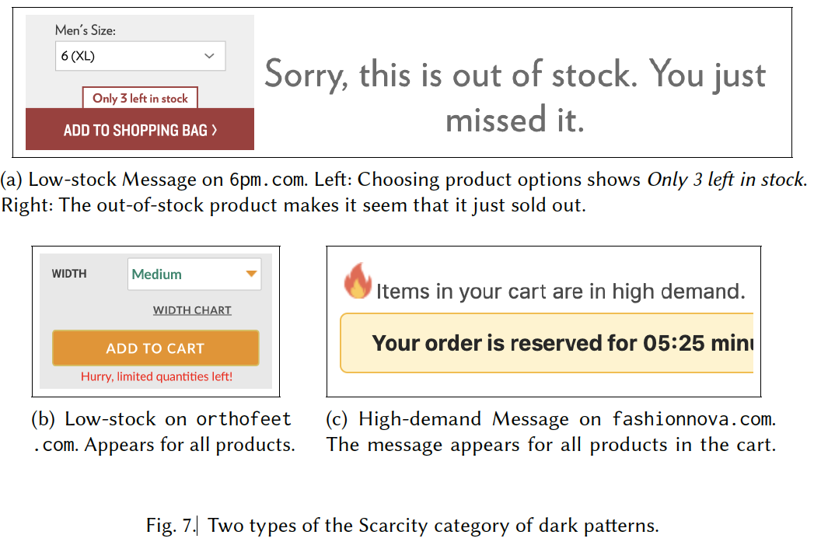

Slide 28
Obstruction
this category of dark patterns refers to approaches that make a certain action harder than it should be, this serves to dissuade users from taking that action.
Example:
‘Hard to Cancel’

Slide 29
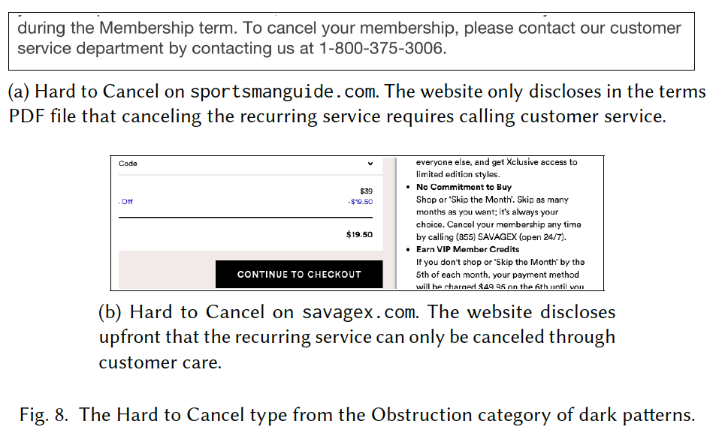

Slide 30
Forced Action
this category of dark pattern refers to approaches that require users to take certain additional and tangential actions to complete their tasks
this type of dark pattern explicitly coerces users into action, such as signing up for marketing communication, creating accounts (so users surrender their information)
For Example:
‘Forced Enrollment’

Slide 31
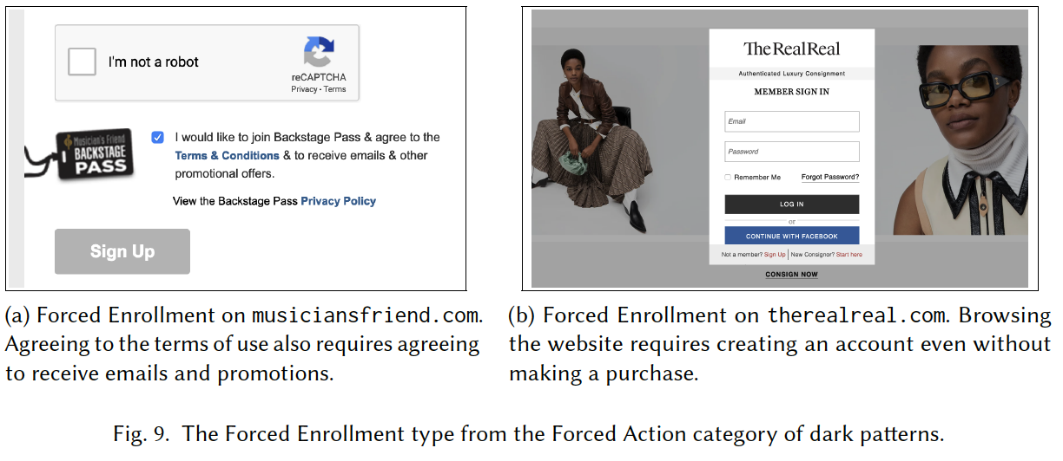

Slide 32
In Sum
a dark pattern is a deceptive approach to user experience design
dark patterns have beneficiaries
for users, dark patterns at best are a source of annoyance and frustration, and at worst mislead and deceive

