Slide 1
Resource Pack: Design III UX Design and User Experience
© Melanie Baljko

Slide 2
Intellectual Property Notice
This presentation is protected by Canadian and international copyright laws. Reproduction and distribution of the presentation without the written permission of the copyright holder is prohibited.
These course materials are designed for use as part of the EECS3461 course at York University and are the intellectual property of the instructor unless otherwise stated. Third party copyrighted materials (such as book chapters, journal articles, music, videos, etc) have either been licensed for use in this course or fall under an exception or limitation in Canadian Copyright law.
Copying this material for distribution (e.g., uploading material to a commercial third-party website) may lead to a charge of misconduct under York’s Code of Student Rights and Responsibilities and the Senate Policy on Academic Honesty and/or legal consequences for violation of copyright law if copyright law has been violated.
© Melanie Baljko, 2021

Slide 3
Dependencies
This resource pack assumes that you are already familiar with:
R-Knowledge-I

Slide 4
Inquiry
1. What is design?
2. What is UX design?
3. What is user experience?

Slide 5
1. What is design?

Slide 6
The Term ‘Design’
the term design refers both to artefacts and a process
design
the way that something is made so that it works in a certain way or has a certain appearance
design as a countable noun
e.g., “here is the new design, which we’re about to deploy within the company”
design
the process of deciding how something will be made, including how it will work and what it will look like
design as an uncountable noun
e.g., “design can be difficult to do, but is so important”

Slide 7
Design as a basic human activity
Friedman and Stotlerman, 2012, “Design Thinking, Design Theory”, pp. ix-x, series forward to “Adversarial Design” DiSalvo 2012
design activity is traceable back to the earliest humans, who manufactured the first tools
“the practice of design [is] making things to serve a useful goal, making tools” [Friedman and Stotlerman, 2012]
in this view, “a designer is as designer does”

Slide 8
‘Interventions’ vs ’Solutions’
Friedman and Stotlerman, 2012, “Design Thinking, Design Theory”, pp. ix-x, series forward to “Adversarial Design” DiSalvo 2012
Herbert Simon writes in ‘The Sciences of the Artificial’ (1996, 111), that to design is to "[devise] courses of action aimed at changing existing situations into preferred ones."
“At a highly abstract level, Herbert Simon's definition covers nearly all imaginable instances of design.”
Design, defined in this way, is the entire process across the full range of domains required for any given outcome. [Friedman and Stotlerman, 2012]
at this level of abstraction, design creates interventions
a design intervention is more general than a design solution

Slide 9
Deficit Thinking
a way of thinking organized around deficits
needs driven
problems focused
what is missing that we must address?
design as finding solutions
example: MyFitnessPal
people want to lose weight/be healthy and find it difficult to do so, how can we solve the problems they encounter?
tech innovation; start-up

Slide 10
Asset Thinking
a way of thinking organized around assets
strengths driven
opportunity focused
What is present that we can build upon?
can lead to new, unexpected responses
design as creating opportunity
example: Jeremijenko’s Live Wire (Dangling String), 1995
how can we make visible what is invisible?

Slide 11
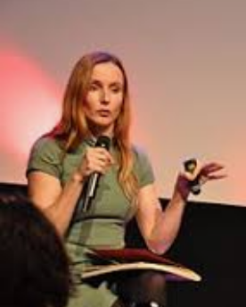
Natalie Jeremijenko
an artist and engineer whose background includes biochemistry, physics, neuroscience and precision engineering
works in the field of experimental design, calls herself as a "thingker", a combination of thing-maker and thinker
her work primarily explores the interface between society, the environment and technology
was artist-in-residence at Xerox PARC, worked with Mark Weiser (widely considered to be the father of ubiquitous computing, a term he coined in 1988)
currently associate professor at New York University (Visual Arts, Computer Science)

Slide 12
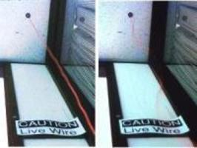

Slide 13
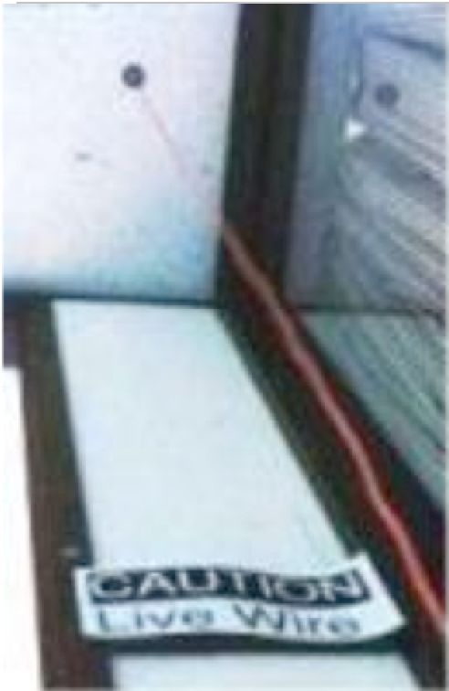
Live Wire (Dangling String), 1995
an art installation created Natalie Jeremijenko, created while artist-engineer was artist-in-residence at Xerox PARC
no video available, was an 8 foot piece of plastic spaghetti that hung from a small electric motor mounted in the ceiling, which was electrically connected to a nearby Ethernet cable
for each bit of information that went past the cable, the motor was activated for a short time, which caused a tiny twitch in the string
network traffic very busy -> caused string to madly whirl, made characteristic noises
network traffic very quiet -> caused a small twitch every few seconds
it was placed in an unused corner of a hallway of an office space, was visible and audible from many offices without being obtrusive
this interactive system was a piece of ‘experimental design’, recognized as one of the first pieces of ‘calm technology’

Slide 14
Asset+Deficit
sometimes both frameworks come together:
example: reCAPTCHA:
how can we leverage the human capacity that is already deployed in CAPTCHA tasks? (asset)
given that we want to digitize the archives of The New York Times and books from Google Books in 2011 and this material is too illegible to be scanned by computers, how can we get this done? (deficit)

Slide 15
“un-dreamed-of” needs
you can’t simply ask people “What do you need?”and then supply it, because people don’t necessarily know what is possible
Suzanne and James Robertson (2013) refer to “un-dreamed-of” needs, which are those that users are unaware they might have.

Slide 16
2. What is UX design? What is UI design? etc…

Slide 17
UI vs UX vs IxD Design
User Interface (UI) design - focuses on an interface’s look and function
Interaction Design (IxD) - focuses on the interactive experience
User eXperience (UX) design - focuses on the user’s entire experience with something
can apply to anything can be experienced

Slide 18
UX Designer
https://www.interaction-design.org/literature/article/the-ultimate-guide-to-understanding-ux-roles-and-which-one-you-should-go-for
also known as Interaction Designer; UI/UX Designer; and Experience Designer
conducts user research and analyses experience from the users’ perspective
generates ideas through ideation techniques; refines ideas through criteria
prototypes designs (range from low to high fidelity; reflects on and critiques design prototypes)
conducts evaluation (usability testing and types of evaluation approaches)

Slide 19
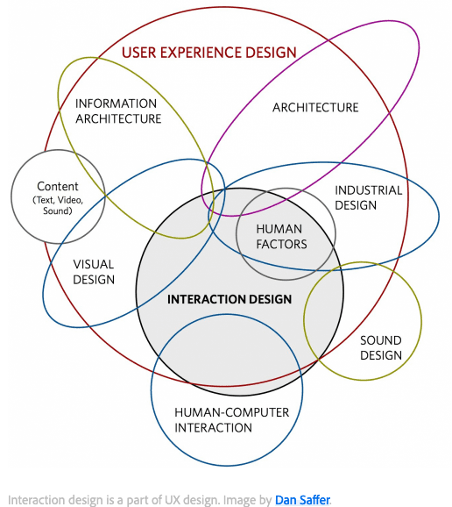

Slide 20
UX Design as a Practice/Profession
practicing UX design can mean different things…
you can work as a paid or unpaid practitioner
you can work with or without a specific job title
you can work within or outside of an organizational context
if you work in an organizational context, it can be in the public sector, the private sector, or the “third sector”
some organizations (e.g., design consultancies, agencies, studios) focus on providing UX design as a service to clients

Slide 21
UI Designer
UI, UX: Who Does What? A Designer’s Guide To The Tech Industry https://www.fastcodesign.com/3032719/
is concerned with how the product is laid out
ensures that the product logically flows from one step to the next
ensures the UI visually communicates the path that has been laid out by the UX designer has laid out
ensures a consistent design language is applied across the product
develops preliminary designs: wireframes, flows, mock-ups
tools: Sketch, Illustrator, InVision, etc

Slide 22
Front-End Developer (UI Developer)
UI, UX: Who Does What? A Designer’s Guide To The Tech Industry https://www.fastcodesign.com/3032719/
creates functional implementations of a product’s interface, working from a specification such as a prototype (consisting of wireframes and flows)
uses tools such as… React.js, Angular, JavaFX, html5, Ruby on Rails, etc constantly changing and evolving

Slide 23
Consultancies, Agencies, and Studios
many large, established companies
a small sample:
Designit (formerly Cooper), https://www.designit.com/
NielsenNorman Group, https://www.nngroup.com/
IDEO, https://www.ideo.com
uxstudio, https://uxstudioteam.com/

Slide 24
3. What is user experience?

Slide 25
Humans are Sense-Makers
as humans, we are all about making sense of our experiences
sensations, emotions, and meaning are all part of this sense making
sense-making is omnipresent
sense-making can be nebulous
the experience of sense-making can be difficult to capture
sense making is ‘interior’
sense-making takes place in the body and the mind of the sense maker
sense-making is not directly observable

Slide 26
Emotion is Central
Dewey, J. 1934. Art as Experience. Perigree.
“Emotion is the moving and cementing force. It selects what is congruous and dyes what is selected with its color, thereby giving qualitative unity to materials externally disparate and dissimilar. It thus provides unity in and through the varied parts of experience.”
[Dewey, 1934]

Slide 27
User Experience
[Sharp et al, p. 13-14, 2019]:
Jesse Garrett (2010, p. 10) “Every product that is used by someone has a user experience: newspapers, ketchup bottles, reclining armchairs, cardigan sweaters.”
User experience ”is about how people feel about a product and their pleasure and satisfaction when using it, looking at it, holding it, and opening or closing it. It includes their overall impression of how good it is to use, right down to the sensual effect small details have on them, such as how smoothly a switch rotates or the sound of a click and the touch of a button when pressing it.”

Slide 28
User Experience
[Sharp et al, p. 13-14, 2019]:
An important aspect of user experience is the quality of the experience someone has, be it a quick one, such as taking a photo; a leisurely one, such as playing with an interactive toy; or an integrated one, such as visiting a museum (Law et al., 2009).
“Jack Carroll (2004) stresses other wide-reaching aspects, including fun, health, social capital (the social resources that develop and are maintained through social networks, shared values, goals, and norms), and cultural identity, such as age, ethnicity, race, disability, family status, occupation, and education.” [Sharp et al, p. 15, 2019]

Slide 29
Design User Experience?
It is important to point out that one cannot design a user experience, only design for a user experience.
[Sharp et al, p. 13-14, 2019]:
In particular, one cannot design a sensual experience, but only create the design features that can evoke it.
For example, the outside case of a smartphone can be designed to be smooth, silky, and fit in the palm of a hand; when held, touched, looked at, and interacted with, that can provoke a sensual and satisfying user experience. Conversely, if it is designed to be heavy and awkward to hold, it is much more likely to end up providing a poor user experience—one that is uncomfortable and unpleasant.

Slide 30

User Experience $≠$ Usability
user experience is different than usability
there are different frameworks to capture user experience
for instance, McCarthy and Wright’s Technology as Experience framework proposes 4 strands
there are different attributes of usability
observable behaviours relating to: effectiveness, efficiency, safety, utility, learnability, memorability
we will return to user experience and contrast it with usability

Slide 31
In Sum
design is a basic human activity
UX design is an umbrella term for design practices that seek to (positively) intervene in user experience
user experience captures sense-making; it is about ‘inner’ experience

