Slide 1
R-Design-V Prototyping
© Melanie Baljko

Slide 2
Intellectual Property Notice
This presentation is protected by Canadian and international copyright laws. Reproduction and distribution of the presentation without the written permission of the copyright holder is prohibited.
These course materials are designed for use as part of the EECS3461 course at York University and are the intellectual property of the instructor unless otherwise stated. Third party copyrighted materials (such as book chapters, journal articles, music, videos, etc) have either been licensed for use in this course or fall under an exception or limitation in Canadian Copyright law.
Copying this material for distribution (e.g., uploading material to a commercial third-party website) may lead to a charge of misconduct under York’s Code of Student Rights and Responsibilities and the Senate Policy on Academic Honesty and/or legal consequences for violation of copyright law if copyright law has been violated.
© Melanie Baljko, 2021

Slide 3
Dependencies
This module assumes that you are already familiar with:
R-Design-IV
R-Humans-I
R-Knowledge-I
R-Interaction-I

Slide 4
Key Questions
What recap is needed?
Is there a best practice for design?
What is the Double Diamond design process model? How do we use it? Where does prototyping fit in?
When in the design process does prototyping take place?
What is prototyping?
What are some of the key concepts?

Slide 5
1. What recap is needed?

Slide 6
Recap
recall the prior resource pack (R-Knowledge-I) :
methodology: a system of methods used in a particular activity; has an underlying rationale and implements a particular strategy
method: a particular procedure for accomplishing or approaching something (akin to a tool)

Slide 7
Recap
recall the 4 core activities in design:
Research (Observing/Discovering requirements)
Generating Ideas/Designing alternatives
Prototyping
Evaluating/Testing
there are methodologies for each of these:
research methodologies
ideation methodologies
prototyping methodologies
evaluation methodologies

Slide 8
Recap
research:
methodologies: approaches based on the use of empirical evidence (science-based, non-science based); on the use of argumentation and critical analysis
methods: many methods of qualitative, quantitative data
e.g., thematic analysis of qualitative data via coding
ideation methodologies
methodology: e.g., Six Thinking Hats (+ other generalized approaches)
method: e.g., SCAMPER (+ other specific brainstorming techniques)

Slide 9
Recap
prototyping:
methodologies: …
methods: …
we will discuss in this resource pack…
but first, some framing…

Slide 10
2. Is there a best practice for design?

Slide 11
What is a ‘best practice’ and ‘benchmarking’?
a ‘best practice’ refers to a procedure that is accepted or prescribed as being the ‘correct’ one or ‘most effective’
benchmarking is the practice of comparing business processes and performance metrics to industry bests and practices from other companies
benchmarking studies can be undertaken internally or externally
serve several purposes: help organizations identify performance gaps, help understand current standard of performance in an industry

Slide 12
Is there a ‘best practice’ for design?
short answer: no

Slide 13
Is there a ‘best practice’ for design?
“The general consensus is that there is no set best practice in design process. However, there is agreement that there are some commonalities across processes used, and that these typically consist of four or five distinct phases.”
[British Design Council, 2007, Desk Research Report] emphasis added
although there is no single best practice design process, there are core activities which can be adapted to fit a particular project or situation (Best, 2006)

Slide 14
Is there a ‘best practice’ for design?
Clarkson & Eckert (2005):
there is a central core of generic stages that constitute a commonality between design processes
these commonalities are modified and adapted to reflect the problem or user need
there are constraints and drivers that influence the direction of the design process give the process its project-specific characteristics
Clarkson, P.J. and Eckert, C.M. (2005) 'Design process improvement - a review of current practice', Springer

Slide 15
Design Process Benchmarking Study
in ~2005, the British Design Council (now called just the ‘Design Council’) undertook a benchmarking study of design processes:
this was an external study: an outside organization conducting a study of a large a set of companies within an industry
purpose:
gather insights to inform the development of internal design processes in UK businesses
build capacity (improve economic growth) for the UK business community
study consisted of:
site visits to 11 companies + interviews + review of scholarly materials

Slide 16
Design Process Benchmarking Study
the British Design Council’s benchmarking study generated a knowledge output: the Double Diamond Design Process Model
the ‘Double Diamond’ model has become hugely popular
it is important to understand what it is and how to use it

Slide 17
3. What is the Double Diamond design process model? How do we use it? Where does prototyping fit in?

Slide 18
What is a design process model?
The Double Diamond is a design process model, which means that it is a model of the design process
it is an explanatory/descriptive model
it is not a predictive model
What the Double Diamond model does not do:
does not give you a not a recipe
does not tell you the steps that need to be followed
What the Double Diamond model does do:
does provide an overall structure and set of processes
does provide a set of choices and approaches, from which choices can be made

Slide 19
Double Diamond…
needs an overall a project management approach, such as agile, waterfall, lean, iterative/incremental, etc)
needs management/decision-making structure
need process tools (e.g., documents, visualizations, diagrams)
needs goal setting, timelines, and provisions for iteration
goals and timeline for each of the diamonds
within each diamond, timeline for shifting between divergence-convergence
provision for revisiting earlier phases, timeline flexibility (e.g., see back tracking arrows in diagram above)

Slide 20
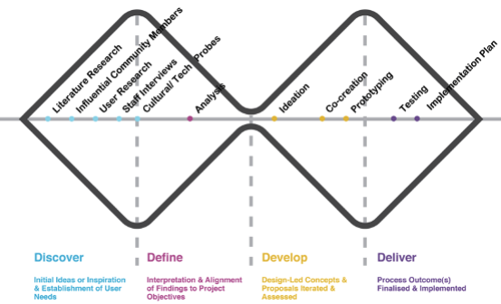
One Example
To illustrate, here is one example of a design process that fits the structure of Double Diamond…
This is one possible example, there are many other approaches that could be taken that fit the structure

Slide 21
The Gist of the Double Diamond
“Start with an idea, and through the initial design research, expand the thinking to explore the fundamental issues. Only then is it time to converge upon the real, underlying problem. Similarly, use design research tools to explore a wide variety of solutions before converging upon one. (Slightly modified from the work of the British Design Council, 2005.)”
Norman, the Design of Everyday Things, 2013

Slide 22
The Double Diamond design process model
Discuss end point
“Start with an idea, and through the initial design research, expand the thinking to explore the fundamental issues. Only then is it time to converge upon the real, underlying problem.”
“Similarly, use design research tools to explore a wide variety of solutions before converging upon one.”

Slide 23
The Four Phases
“The double diamond is formed from four distinct phases. These are Discover, Define, Develop and Deliver. The shape is generic throughout projects but stretched and morphed depending on the project’s characteristics such as the type of product or service, whether there are external suppliers involved, or if it is a completely new product or the development of an existing one. Each of the phases consists of a series of iterative loops where exploration and testing of ideas can happen.”
emphasis added

Slide 24
Core Activities
“Each of the phases consists of a series of iterative loops where exploration and testing of ideas can happen”
…. the activities within the iterative loops will consist of the following core activities* (Norman, 2013):
Research (Observing/Establishing requirements)
Generating Ideas/Designing alternatives
Prototyping
Evaluating/Testing
*assuming a human-centered design process, not technology-centered design process

Slide 25
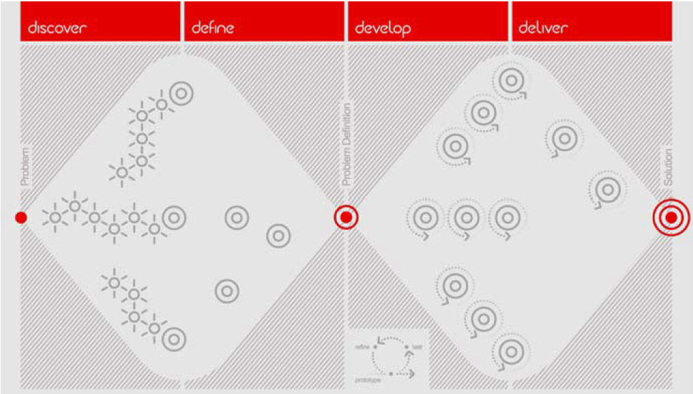
The Double Diamond design process model
successive iterations of core activities

Slide 26
Convergence vs Divergence
the Double Diamond model provisions for two phases of divergence and two phases of convergence
….

Slide 27
Divergence
the purpose is to generate variants/options
success criteria: number and quality of different variants/options generated
having a large slate of options is crucial to the subsequent convergence phase
examples:
generate a large set of ideas about design problems/opportunities
generate a large set of design concepts
generate a large set of interface variants
generate a large set of user scenarios
generate a large set of storyboards, prototypes, design element variants, possible layouts,
etc…

Slide 28
Convergence
the purpose is to refine and narrowing down
success criteria: quality of the choice made among all the many possible variants/options
examples:
of a large set of different prototypes, select one for further development
of a large set of personas, select one to be the primary
of a large set of design problems/opportunities, select one to be the focus of a design response
etc….

Slide 29
Two Diamonds
Diamond #1: Discover/Define
Diamond #2: Develop/Deliver
both diamonds make use of iterations of the core activities, but the core activities will look different
in the Discover/Define diamond, the iterations are most legible

Slide 30
Diamond #1: Discover/Define
Discover is a phase of divergent thought
Discover pivots into Define
Define is a phase of convergent thought
The result of Discover/Define will be an artefact
project brief
problem statement
statement of requirements
design concept
… other possible names for this artefact
basically, the artefact spells out what the second diamond is responding to…

Slide 31
Discover Phase
a divergent phase; the fuzzy front end (FFE); the phase during which ideas form
is critical to the (eventual) definition of the nature of the problem that is being addressed through design (Rhea 2003)
unstructured, can make use of different methods
e.g., market research; qualitative user research methods (focus groups, interviews, probes), ethnography; use of team approaches; brainstorming; target user visioning, rapid sketching
often covers a significant amount of design activity that goes on within an organization, which may not be actively acknowledged as being design (Gorb and Dumas, 1987)

Slide 32
Define Phase
a filtering phase
a convergent phase
various tools and methods used to accomplish the convergence – techniques for analysis and synthesis:
e.g., visual thematic analysis, motivation/obstacle analyses, customer journey maps
results in a design brief or the concept
the design brief contains actionable tasks
analogous to a statement of requirements or problem statement

Slide 33
Result of Diamond #1: Discover/Define
an artefact
project brief
problem statement
statement of requirements
design concept
… other possible names for this artefact
basically, the artefact spells out what the second diamond is responding to…
design materials (research materials, ideation materials, etc)

Slide 34
The Transition Point
this will look different depending on the design contexts
in some design contexts, there will not be a formal sign-off
in organizational/corporate contexts, the design process does not move to the second diamond until there is sign-off and/or ‘concept approval’
sign-off is not given until:
the design brief and the overall corporate objectives have been be aligned
outcome measurements have been agreed
potential bottlenecks, opportunities and no-go areas are defined

Slide 35
Diamond #2: Develop/Deliver
again, a sequence of diverge/converge

Slide 36
Develop Phase
a divergent phase
often employs multidisciplinary teams with diverse viewpoints
employs successive iterations of core activities
use of visual techniques for the team to see iterations of sketches, prototypes, and other design work on the product or service concept
multiple variants, repeated iterations of core activities:
Research (Observing/Establishing requirements) and Generating Ideas/Designing alternatives
e.g., scenario and persona development, storyboards, Plus/Minus scenarios
Prototyping
e.g., lo-fidelity techniques, prototyping software, etc
Evaluating/Testing
e.g., observational studies, walkthroughs, Wizard of Oz simulations, usability testing

Slide 37
Deliver Phase
a convergent phase
employs successive iterations of core activities
’final’ testing, planning for launch into ‘production’ environment
decisions about targets and in-use evaluation measures
provisioning for feedback from production environment, information needs to flow back into organization

Slide 38
In Sum
What is the best practice for design? this is a trick question. There is no single best practice.
Effective practice will consist of certain core activities, undertaken in phases (4-5 phases)
Each project will have its own specific characteristics, which will be a product of various constraints and drivers
now-popular Double Diamond Model – this is not ’the’ best practice, but an overarching model of many successful practices

Slide 39
In Sum
the Double Diamond model is explanatory/descriptive model of the design process; it explains the purpose of and the methods that are potentially used within each phase
an explanatory/descriptive model is not the same thing as a design methodology
the Double Diamond model can provide a basis or framework for a methodology
a design methodology can be based on the systematization of the phases of the Double Diamond model (with the addition of components that implement constraints and drivers, and build

Slide 40
3. When in the design process does prototyping take place?

Slide 41
Prototyping in Human Centered Design
before talking about prototyping, it is important to clarify that we will be discussing prototyping in a Human Centered Design (HCD) process

Slide 42
Technology Centered Design (TCD)
Technology Centered Design (TCD) puts the technology as the central focus
SW design puts SW as the central focus
Premises:
requirements gathering is a key activity (alternatively: requirements elicitation, requirements gathering, automatic requirements analysis, etc)
the design process then responds to the requirements
the user’s role is via their participation in the development of requirements
Collorary
the statement of requirements mediates the user’s involvement in the process
Illustrative scenario (exaggerated to make a point):
user: you built this system for me, but I don't like how it behaves
developer: but you said you wanted X when we collected requirements and the system does X

Slide 43
Human Centered Design (HCD)
In HCD
the focus is not on the technology
the focus is on the users, their tasks, and their environments

Slide 44
Human Centered Design (HCD)
There are three core principles in HCD:
these principles are discussed in Sharp et al, 2019, sec 2.2.4, although I'm presenting them in a different order
employ an iterative approach
the focus on users must come in the early, not late, iterations
decisions should be made empirically

Slide 45
HCD Principle: Employ an iterative approach
there are four core activities, undertake these in sequence and iteratively

Slide 46
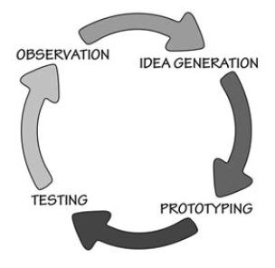
Four Core Activities
the output of one activity generally feeds into the next activity
Research (Observing/Establishing requirements)
Generating Ideas/Designing alternatives
Evaluating/Testing
Prototyping

Slide 47
Four Core Activities
Textbook:
Establish requirements
Designing alternatives
Prototyping
Evaluating
Norman, DOET:
Observing (research)
Generating Ideas
Prototyping
Testing

Slide 48
Establish Requirements
Design Alternatives
Evaluating
Prototyping
Sharp et al (2019), Ch 2
Donald A. Norman, The Design of Everyday Things, New York : Basic Books, 2013.

Slide 49
HCD Principle: Early Focus on Users
the focus on users comes in the early, not late, iterations
the persona technique is often used as a was to characterize users (via the creation of archetypes)
in characterizing users, many different frameworks:
cognitive, behavioral, attitudinal, affective, social
there should be a focus on users engaged in activities in their environments (situated action)
there are many different approaches to capturing this data: scientific observation, anthropological, sociological
there should be a focus on involving users in the design process (e.g., during idea generation)

Slide 50
HCD Principle: Empirical Decisions
before discussing empirical decision making, we first need to discuss prototyping

Slide 51
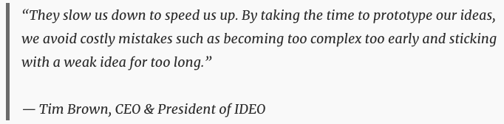
Prototyping
https://www.interaction-design.org/literature/topics/prototyping
Prototyping is an experimental process where design teams implement ideas into tangible forms from paper to digital.
Teams build prototypes of varying degrees of fidelity to capture design concepts and test on users.
With prototypes, you can refine and validate your designs.

Slide 52
Video, Alan Dix
embedded in https://www.interaction-design.org/literature/topics/prototyping

Slide 53
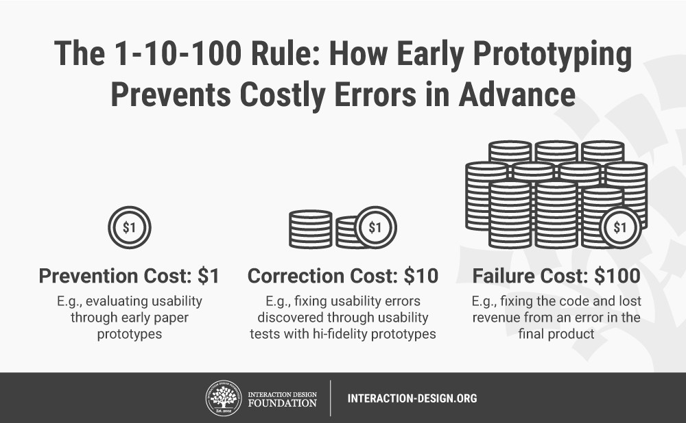

Slide 54
Motivations for Prototyping, I
to establish a foundation from which to ideate towards improvements
to employ a concrete form for ideas, provides a basis for communication
to provide a sense of ownership to all concerned stakeholders—therefore fostering emotional investment in the product’s ultimate success.
to provide a basis for discussion with stakeholders – provides a picture of the potential benefits, risks and costs associated with where a prototype might lead
to provision for adaptability – can make changes early (avoiding commitment to a single, falsely-ideal version, getting stuck on initial idea)
to improve time-to-deployment, by minimizing the number of errors to correct

Slide 55
Motivations for Prototyping, II
to have something to show users, so they can give you their feedback to help pinpoint which elements/variants work best and whether an overhaul is required
to have something that provides a basis for experimentation (can observe the prototype in use, gain insights and gather feedback data, can spot unforeseen issues concerning accessibility and usability)

Slide 56
Wireframe
a wireframe is a schematic or blueprint of something
at one time, wireframe implied web design, but now used more generally for a schematic representation
the schematic representation consists of the components and the layout

Slide 57
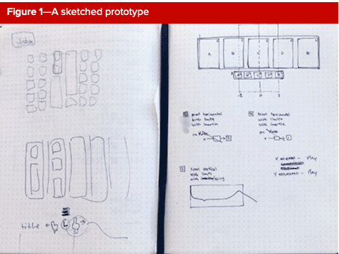
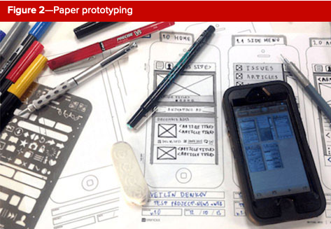
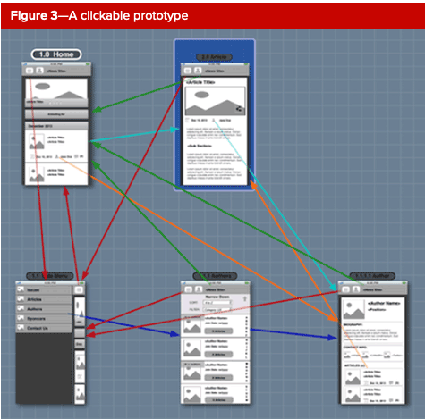
Low-Fidelity Prototypes
quick and simple, outlines the interactive system’s flow
not visually refined (as compared to high-fidelity prototypes)
Examples:
sketches (pen and pencil drawings)
paper prototypes (using office or craft supplies)
click-through prototypes (e.g., Sprint 07 activity)
the prototype is not “natively” responsive
Notes:
https://www.uxmatters.com/mt/archives/2019/01/prototyping-user-experience.php

Slide 58
High-Fidelity Prototypes
more advanced than their low-fidelity counterparts
aesthetically elaborated
their function is closer to that of the final product
Examples:
interactive prototypes
flows are more elaborated, but visual elements are still medium-fidelity
digital prototypes
aesthetically rich, typography, colour palette
animations and other effects may be included
coded prototypes
coded in html/css, natively responsive

Slide 59
HCD Principle: Empirical Decisions
during the design process, design concepts can be expressed via one or more prototypes
a prototype establishes a foundation from which to ideate towards improvements (several possible routes may be possible)
different prototypes express design concept variants (need to choose among them)
thus, prototypes represent decision to be made
these decisions will depend upon users
their preferences, their ability to perform tasks and accomplish goals, aspects of their user experience, reactions, etc
what is the source of information for these decisions?
the design team could presume to know, to guess, or to anticipate the user's performance
the design team could create occasions to collect the relevant data (user provides feedback or user’s behaviour is observed)
the idea is to base decisions on 'authentic' information rather than presupposed information

Slide 60
HCD Principle: Empirical Decisions
notice this principle contrasts very strongly with Saffer's (2010) identification of "Genius Design" [Box 2.1]
"…genius design …relies largely on the experience and creative flair of a designer. Jim Leftwich, an experienced interaction designer interviewed by Dan Saffer (2010, pp. 44–45), prefers the term rapid expert design. In this approach, the users' role is to validate ideas generated by the designer, and users are not involved during the design process itself. Dan Saffer points out that this is not necessarily by choice, but it may be because of limited or no resources for user involvement."

Slide 61
Connect to Module 04 activity
the module activity will be used to establish these key concepts in prototyping
frame
components
flows, actions

