Slide 1
R-Design-VI Personas
© Melanie Baljko

Slide 2
Intellectual Property Notice
This presentation is protected by Canadian and international copyright laws. Reproduction and distribution of the presentation without the written permission of the copyright holder is prohibited.
These course materials are designed for use as part of the EECS3461 course at York University and are the intellectual property of the instructor unless otherwise stated. Third party copyrighted materials (such as book chapters, journal articles, music, videos, etc) have either been licensed for use in this course or fall under an exception or limitation in Canadian Copyright law.
Copying this material for distribution (e.g., uploading material to a commercial third-party website) may lead to a charge of misconduct under York’s Code of Student Rights and Responsibilities and the Senate Policy on Academic Honesty and/or legal consequences for violation of copyright law if copyright law has been violated.
© Melanie Baljko, 2021

Slide 3
Dependencies
This resource pack assumes that you are already familiar with:
R-Humans-II (and all previous)
R-Design-V (and all previous)
R-Interaction-II (and all previous)

Slide 4
Key Questions
Purpose of the persona, scenario, and journey mapping representations?
What is the persona representation?
What is a persona hypothesis?
Steps in persona construction?

Slide 5
1. Purpose of the persona, scenario, and journey mapping representations?

Slide 6
Personas, Scenarios, Journey Maps
personas, scenarios, and journey maps are UX design representations
they are abstractions used in the design process
each of personas, scenarios, and journey maps has their own form and process
purposes:
representation (of research results)
communication (among team members, between team members and others)
empathy

Slide 7
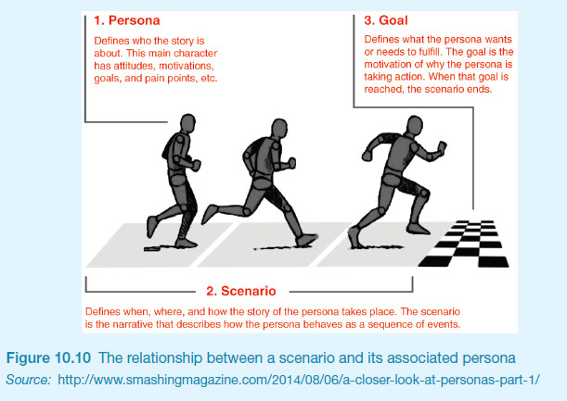

Slide 8
2. What is the persona representation?

Slide 9
Relevant Concepts: Recap
Before discussing the construct of a persona, let’s recap:
we have already discussed the issue that user is a discursive construct
user as an object of scientific object of study
user as a constituency in need of empowerment

Slide 10
Personas are abstractions
personas are abstractions
these abstractions are used to represent users
they are a “middle layer” type of abstraction
mediates between low-level data and high-level “the user”
low-level: specific data about specific humans
“the user” is the most general abstraction
middle layer -> a smallish number of ‘types’ of users
personas are mostly accepted as a design technique, but there is debate and criticism of the technique

Slide 11

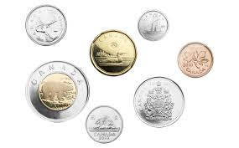
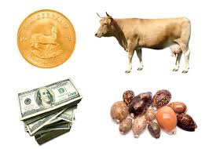
Levels of Abstraction
the specific coins that are in my pocket
these coins are the different type of coins that are in circulation in Canada
the coin as a type of currency

Slide 12


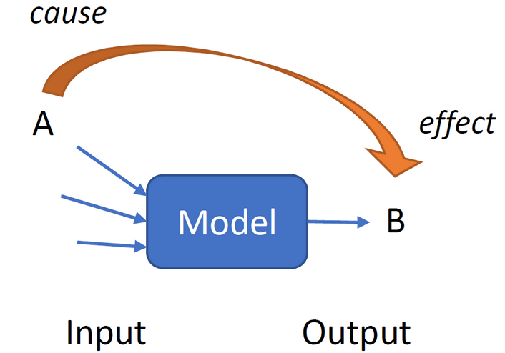
Levels of Abstraction
the users that are “within reach” (constitute a certain market, live in a certain place, etc)
these persona are the archetypes of the users that relevant to the design domain
the persona as a type of user model

Slide 13
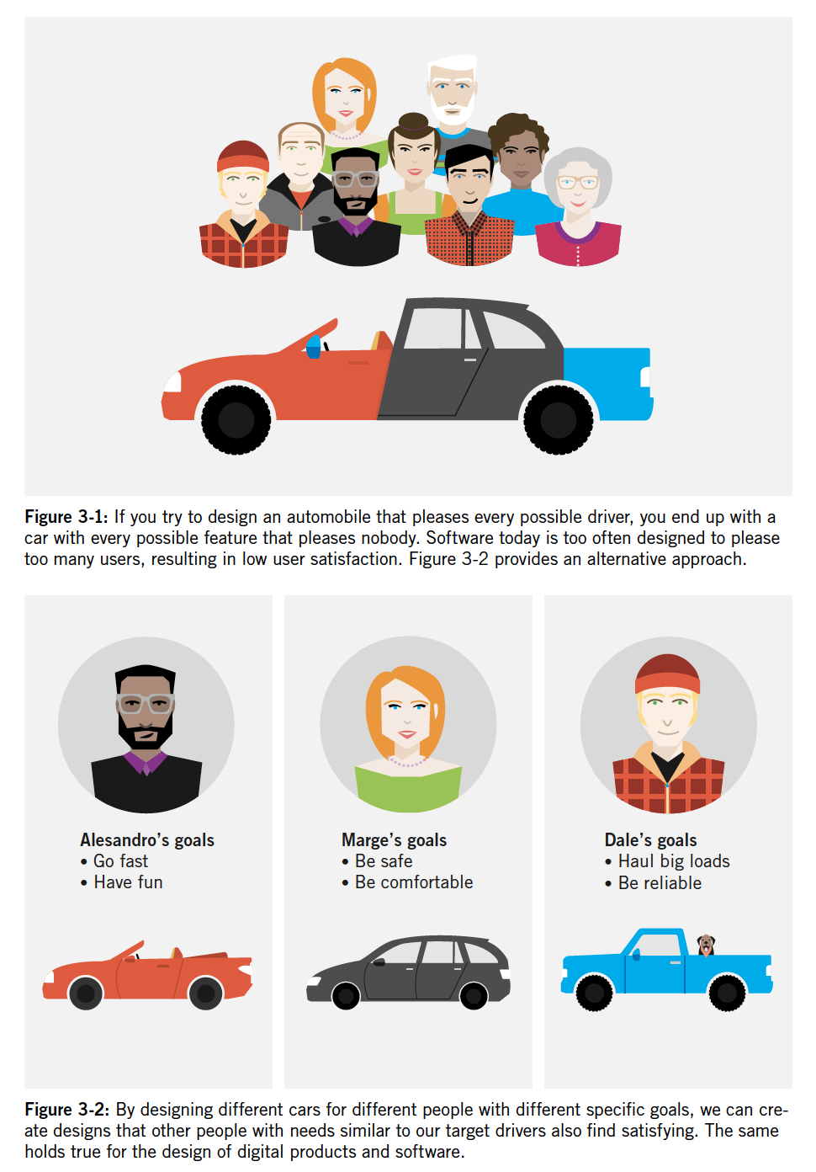
p 63, Cooper et al (2014) illustration of diversity of goals
and argues for the need to model goals
…good thing the figure doesn’t reinforce stereotypes (ugh)

Slide 14
What is a Persona?
a persona is text-and-graphics-based representation of an archetypical user
it is a fictional, yet realistic, description of a typical or target user
personas are developed from data; they are based in evidence
the evidence can be derived from various data collection methods (e.g., interviews, surveys, demographic data)
personas are developed via a process of pattern detection from the data set

Slide 15
Example Persona
Developed using Xtensio Templates

Slide 16
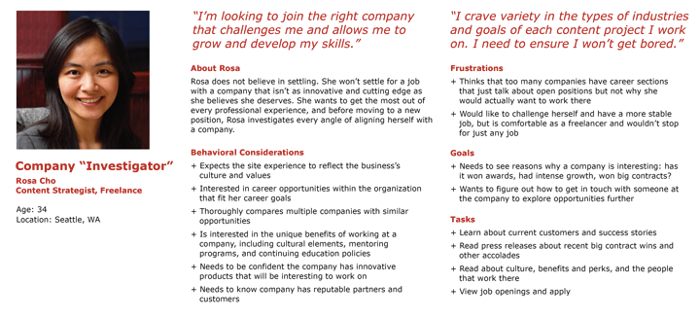
Example Persona
https://s3.amazonaws.com/media.nngroup.com/media/editor/2015/01/19/examplepersona.png

Slide 17
Typical Persona Elements
https://www.nngroup.com/articles/persona/
Name, age, and a photo (gender complications)
Tag line
Characterization of experience level in the domain relevant to the design domain
Characterization of context for their interaction in the design domain (e.g., choice or required? frequency and pattern, typical platform and posture)
Goals and concerns when they perform tasks relevant to the design domain (e.g., speed, accuracy, thoroughness, safety, comfort, other needs that may factor into their usage)
Quotes to sum up the persona’s attitude

Slide 18
Why do we use personas?
to tackle complexity in the design process:
to represent constituencies in the design process
to better engage the empathy of designers
to communicate user needs to product team members
to tackle complexity in post hoc evaluation
to focus the scope of evaluation

Slide 19
Why are personas represented using this format?
the fictional name, the composite demographic information, and the narrative storytelling are used to:
better engage the empathy of designers
to communicate user needs to product team members

Slide 20
Persona Types
A design process will usually make use of a small set of personas.
Primary persona: the main target of the design; will be satisfied by the interface design
Secondary persona: a secondary target of design with specific additional needs; will be mostly satisfied with the primary persona’s interface and the specific additional needs that can be accommodated without upsetting the product’s ability to serve the primary persona. Only sometimes employed
Supplemental personas: represent stakeholders; needs are captured by primary or secondary personas
Negative/anti-personas: an explicit articulation of who the design is not meant for

Slide 21
What is an Anti-Persona
An anti-persona is also a user model just like a persona, but represents who the design is not being built to serve
Their use is purely rhetorical: to help communicate to other members of the team that a persona should definitely not be a design target.
“Good candidates for negative personas are often technology-savvy early-adopter personas for consumer products, criminals, less-harmful pranksters and “trolls,” and IT specialists for business-user enterprise products.” (Cooper et al, 2014)

Slide 22
Brief History of the Persona Design Representation
the concept of personas was first introduced in 1995, following the efforts of Alan Cooper and Wayne Greenwood, in response to the need for a tool to communicate design decisions to clients and to convey the user needs (Goodwin, 2009)
Prior to this, starting in 1983, Cooper used a similar method known as proto-persona (e.g., an explanation of why he, as a user, would perform a certain task, what he would know in the beginning of the task, and what he would find out as he goes on) (Goodwin, 2009; Pruitt & Adlin, 2006).
In the meantime, much analysis of the role, function, and impacts of the persona representation
The concept of the individual persona has been elaborated to the concept of a group persona (e.g, Matthews et al, 2011)

Slide 23
How not to create personas
This is a way to create “something” that will look like a persona:
come up with a fictional name and a stock photo
write down the persona characteristics based on the designer’s own personal imaginings or envisioned version of the user and/or anecdotes
add in some demographic or market segment data
add in a narrative constructed by the designer that is not based on any specific data
You can create something that will look like a persona, but the resulting output is not likely to be useful

Slide 24
How do we construct personas?
there is much discussion and debate about best practices for persona construction
in this resource pack, we’ll draw on:
Chapter 11, Sharp et al (2019)
Chapter 3, Cooper et al (2014)
but even these two sources differ
We’ll adopt a two-step process:
persona hypothesis formulation
persona construction

Slide 25
Best Practices
develop persona hypothesis and formulate interview plan
persona construction
conduct interviews (qualitative research)
organize and analyze qualitative data, identify significant variables (dimensions)
the variables (dimensions) combine to create a ‘map’ or ‘space of possibilities’
identify emergent clusters in the map; for each cluster, synthesize characteristics and identify goals; verify and validate
designate and develop personas (for the clusters)

Slide 26
Formulating an interview plan
interviews will be conducted to verify or refute the persona hypothesis
each kind of user postulated in the persona hypothesis phase will require a certain number of interviews
according to Cooper et al (2014)
for “enterprise or professional products”, 4-6 interviews will suffice
for “consumer products”, “a good rule of thumb is to double the numbers just discussed: 8 to 12 interviews for each user type postulated in the persona hypothesis”
the interview participants should be relevant informants, meaning they should be representative of the user type that is being investigated
the interview plan consists of:
identifying the number of interviews to be conducted per each kind of user postulated in the persona hypothesis
obtaining access to the interview participants
can plan to conduct early, middle, or late interviews

Slide 27
3. What is a persona hypothesis?

Slide 28
Persona Hypothesis
Cooper et al (pp. 46-47, 2014)
the persona hypothesis is “a first try at defining the different kinds of users (and sometimes customers) for a product”
the persona hypothesis helps to shape the subsequent data collection phase
the data collection phase (typically interviews) which will generate data, which when analyzed, can provide evidence for (or refute) the initial hypothesis

Slide 29
Persona Hypothesis
The persona hypothesis attempts to address, at a high level, these three questions:
What different sorts of people might use this product?
How might their needs and behaviors vary?
What range of cultural/environmental factors relating to organizational/community context need to be explored?
the process may start (as a default) with the idea that there is a single kind of user
via exploration of the three questions above, the hypothesis may expand to include several kinds of users

Slide 30
Hypothesis Formulation, Component #1
How to address the question “What different sorts of people might use this product?”
a common way to identify ‘sorts’ of people is via social roles
in business or organizational contexts, roles can map onto job descriptions
in other contexts, roles can be based on:
attitudes and aptitudes
lifestyle choices
stage of life
action: articulate the roles that are hypothesized as a further elaboration of the initial characterization of the target users from the design brief

Slide 31
Hypothesis Formulation, Component #2
How to address the question “How might user needs and behaviors vary?”
can be tricky to identify variables in advance of data collection, since the target behaviours will depend on the design domain
demographic factors may possibly be relevant: age, location, gender, and socioeconomic status
factors relating to expertise may possibly be relevant:
degree of digital literacy,
degree of domain knowledge,
prior relevant experience
action: articulate the factors relating to needs and behaviours that are hypothesized as a further elaboration of the initial characterization of the target users from the design brief

Slide 32
Hypothesis Formulation, Component #3
How to address the question “What range of cultural/environmental factors need to be explored?”
environmental and/or cultural factors relating to the organization/community context can have an impact on user needs and behaviours
can be tricky to identify variables in advance of data collection; factors relating to cultural/environmental context may possibly be relevant:
size of organization/community;
geographic locale of organization/community;
type of organization/community;
prior tech penetration into the organization/community;
security and privacy concerns and issues within the organization/community
action: articulate the factors relating to culture/environment of the organization/community that are hypothesized as a further elaboration of the the design brief

Slide 33
Outcomes of Persona Hypothesis Formulation
at the end of the persona hypothesis formulation, one or more kinds of users will get postulated

Slide 34
4. Steps in persona construction?

Slide 35
Best Practices
develop persona hypothesis and formulate interview plan
persona construction
conduct interviews (qualitative research)
organize and analyze qualitative data, identify significant variables (dimensions)
the variables (dimensions) combine to create a ‘map’ or ‘space of possibilities’
identify emergent clusters in the map; for each cluster, synthesize characteristics and identify goals; verify and validate
designate and develop personas (for the clusters)

Slide 36
Formulating an interview plan
interviews will be conducted to verify or refute the persona hypothesis
each kind of user postulated in the persona hypothesis phase will require a certain number of interviews
according to Cooper et al (2014)
for “enterprise or professional products”, 4-6 interviews will suffice
for “consumer products”, “a good rule of thumb is to double the numbers just discussed: 8 to 12 interviews for each user type postulated in the persona hypothesis”
the interview participants should be relevant informants, meaning they should be representative of the user type that is being investigated
the interview plan consists of:
identifying the number of interviews to be conducted per each kind of user postulated in the persona hypothesis
obtaining access to the interview participants
can plan to conduct early, middle, or late interviews

Slide 37
Types of Interviews
early interviews:
broad, open-ended questions about the design domain from the user’s point of view;
designed to identify the design domain’s basic rules, structures, and vocabularies
middle interviews:
open-ended and clarifying questions, designed to flesh out information on emerging patterns of use; questions are more focused on specifics building upon the basic information from early interviews
late interviews:
confirmation-style and closed-ended questions, further clarification questions about user roles and behaviors, refinement to assumptions about user tasks, processes, and needs

Slide 38
Conducting Interviews
can use a two- or three-person set-up
two person set-up: an interviewer and a interviewee
three person set-up (Cooper et al, 2014): two designers per interview, one who is a moderator and the other is the facilitator
the moderator drives the interview and takes light notes
the facilitator takes detailed notes and looks for any holes in the questioning
adopt a position of humility:
don’t position yourself as an expert, adopt a nonjudgmental stance; don’t be afraid to ask naïve questions, be a sympathetic and receptive listener

Slide 39
General categories of interview questions
goal-oriented questions:
about goals and objectives
about opportunities (good use of time, waste of time)
about priorities (most important, not important)
about information and decision-making
flow-oriented:
process (what do you do and when)
occurrence and recurrence (how often, routine vs not routine)
what is usual vs an exception
attitude-oriented:
aspiration (near term, long term)
avoidance (prefer not to do, procrastinate/last to do)
motivation (most enjoyable, first to do)

Slide 40
Interview questions
open-ended questions typically questions begin with “why,” “how,” “what”, “describe…”
closed-ended questions ask the the interviewee to chose from among an explicit or implicit set of alternatives
leading questions are based on presuppositions and will result in biased answers
examples of leading questions from Cooper et al (2014):
Would feature X help you?
You like X, don’t you?
Do you think you’d use feature X if it were available?
Does X seem like a good idea to you?

Slide 41
Interviews
a “conversation with a purpose” (Kahn and Cannell, 1957).
Four main types of interviews (Fontana and Frey, 2005):
open-ended or unstructured
structured,
semi-structured, and
group interviews (focus groups)

Slide 42
Interviews
open-ended or unstructured
interviewer has an agenda (a general plan of topics to be covered), but is flexible
interviewer has the questions planned out in advance, but can modify and/or revise on the fly
e.g., ask for follow-up (probing), pursue new angles, etc
interviewer questions are open, can be answered as fully or briefly as desired
interviews will not be consistent across participants

Slide 43
Interviews
structured
interviewer has an agenda (a plan of topics to be covered in a particular sequence) and is not flexible
interviewer has the questions planned out in advance, does not modify and/or revise on the fly
interviewer questions are short and clearly worded, typically closed
interviews will be consistent across participants

Slide 44
Interviews
semi-structured
interviewer has an agenda (a plan of topics to be covered in a particular sequence) and is somewhat flexible
interviewer has the questions planned out in advance, only modifies and probes until there is no new relevant information forthcoming from the interviewee
interviewer questions are closed
interviews will be mostly consistent across participants

Slide 45
Interviews
group interviews (focus groups)
instead of conducting several interviews, bring all participants together into a common conversation
facilitator (interviewer) has an agenda (a general plan of topics to be covered), but is flexible
facilitator has the questions planned out in advance, but can modify and/or revise on the fly
e.g., ask for follow-up (probing), pursue new angles, etc
guides discussion
manages the group dynamic (encourages quiet people to participate, intervenes when someone starts to dominate)
conversational format has cultural dependencies

Slide 46
Analysis of Qualitative Data
interview methods will produce large amounts of qualitative data
typically, thematic coding methods are used
recall Mod01: Dark Pattern Analysis Activity, which used thematic coding

Slide 47
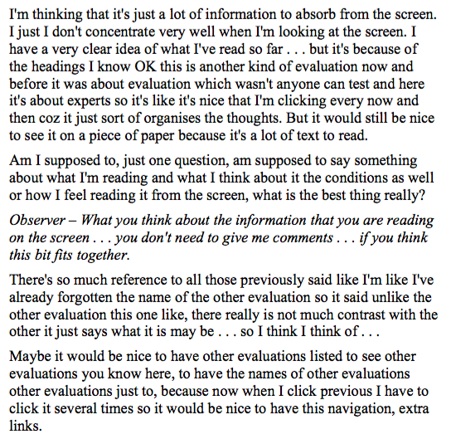
excerpt of a sample of a transcription of interview data
in this example, this is an interview to gather feedback from a prototype (as opposed to persona development)
the transcript needs to include what the interviewer is asking (show in italics in the example, below labelled ‘observer’)
the transcript can include disfluencies (um, like), pauses are shown as …

