Slide 1
R-Design-VII Scenarios and Journey Maps
© Melanie Baljko

Slide 2
Intellectual Property Notice
This presentation is protected by Canadian and international copyright laws. Reproduction and distribution of the presentation without the written permission of the copyright holder is prohibited.
These course materials are designed for use as part of the EECS3461 course at York University and are the intellectual property of the instructor unless otherwise stated. Third party copyrighted materials (such as book chapters, journal articles, music, videos, etc) have either been licensed for use in this course or fall under an exception or limitation in Canadian Copyright law.
Copying this material for distribution (e.g., uploading material to a commercial third-party website) may lead to a charge of misconduct under York’s Code of Student Rights and Responsibilities and the Senate Policy on Academic Honesty and/or legal consequences for violation of copyright law if copyright law has been violated.
© Melanie Baljko, 2021

Slide 3
Dependencies
This resource pack assumes that you are already familiar with:
R-Humans-II (and all previous)
R-Design-VI (and all previous)
R-Interaction-II (and all previous)

Slide 4
Key Questions
Purpose of the persona, scenario, and journey mapping representations?
What is a scenario?
What is the journey map representation?

Slide 5
1. Purpose of the persona, scenario, and journey mapping representations?

Slide 6
Personas, Scenarios, Journey Maps
personas, scenarios, and journey maps are UX design representations
they are abstractions used in the design process
each of personas, scenarios, and journey maps has their own form and process
purposes:
representation (of research results)
communication (among team members, between team members and others), building shared understanding
empathy (build capacity to view domain from other perspectives)

Slide 7
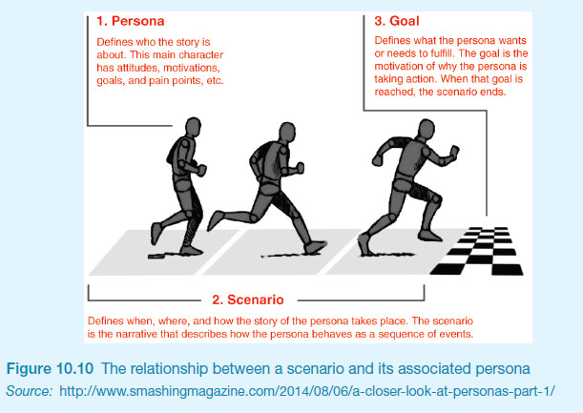

Slide 8
2. What is a scenario?

Slide 9
Scenario
11.5.2 Scenarios
A scenario is an “informal narrative description” (Carroll, 2000)
describes human activities or tasks in a story that allows exploration and discussion of contexts, needs, and requirements
might not necessarily describe the use of software or other technological support used to achieve a goal
the focus of such stories is … about what the users are trying to achieve (their goals)
Understanding why people do things as they do and what they are trying to achieve in the process focuses the study on human activity rather than interaction with technology

Slide 10
"Telling stories is a natural way for people to explain what they are doing or how to achieve something. It is therefore something that stakeholders can easily relate to. The focus of such stories is also naturally likely to be about what the users are trying to achieve, i.e. their goals. Understanding why people do things as they do and what they are trying to achieve in the process allows us to concentrate on the human activity rather than interaction with technology." (10.6, Preece)

Slide 11
Scenarios
"Telling stories is a natural way for people to explain what they are doing or how to achieve something. It is therefore something that stakeholders can easily relate to. The focus of such stories is also naturally likely to be about what the users are trying to achieve, i.e. their goals. Understanding why people do things as they do and what they are trying to achieve in the process allows us to concentrate on the human activity rather than interaction with technology."
user stories are able what 'is', what has happened, what the user would like to happen given the 'now'

Slide 12
Scenarios
allows exploration and discussion of contexts, needs, and requirements.
can be understood by the stakeholders (depending on vocabulary and phrasing), allowing opportunity for participation
scenarios play in role in developing design briefs

Slide 13
Scenarios
what about creating opportunity, a future that does not yet exist?
do we know who the potential users are? can we talk to them? what would potential users say? what is within their imaginary?
about designers:
(perhaps) generate different possibilities

Slide 14
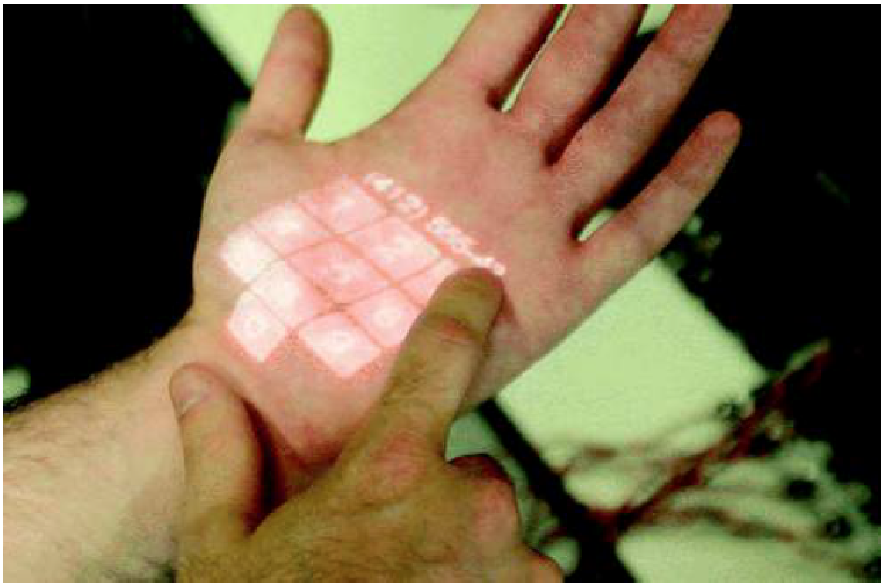
p. 302
"Bramat has just finished his daily 4 mile run. He likes listening to music while he exercises, and has b een playing his favorite pieces. This new skinput technology is great as he can focus on the running while scrolling through the available tracks, skipping through them with a simple tap of his fingers. He comes in exhausted and flops down on his favorite seat. With a flick of his fingers he turns off his music player and opens the palm of his hand to reveal the television remote control panel, graphically projected on his skin. He taps on a button to choose the station for the program he wants, adjusts the volume with a few more taps, and sits back to watch. Feeling hungry, he walks to his kitchen, opens his palm once again and sees a list of recipes possible given the items in his fridge. With another hand gesture, his palm turns into a telephone keypad, from where he can invite a friend over for dinner."

Slide 15
this scenario was developed to illustrate an envisioned situation in the future
was this part of the design brief or a response to it?

Slide 16
Scenarios
Scenarios can be used to model existing work situations, but they are more commonly used for expressing proposed or imagined situations to help in conceptual design. (11.5, p.332)

Slide 17
Scenarios
Four roles for scenarios (Bødker, 2000, p. 63):
As a basis for the overall design.
For technical implementation.
As a means of cooperation within design teams.
As a means of cooperation across professional boundaries, i.e. as a basis of communication in a multidisciplinary team.
scenarios have been used:
as scripts for user evaluation of prototypes
as the basis of storyboard creation
to build a shared understanding among team members
to sell ideas to users, managers, and potential customers

Slide 18
Plus/Minus Scenarios (Bodker, 2000)
see §11.5, pp. 332-333
given a design proposal, write two short stories
one to capture the most positive consequences of the proposed design solution
the other to capture the most negative consequences of the proposed design solution
this technique is employed by designers
helps develop a more comprehensive view of the proposal
provides reflection on imagined benefits, consequences, and ramifications

Slide 19
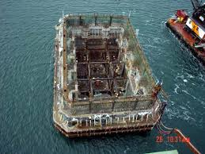
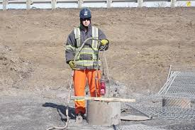
Example #1: a hypermedia system to be used by inspectors of caissons
A caisson is a large watertight chamber, open at the bottom, from which the water is kept out by air pressure and in which construction work may be carried out under water
"Kurt"

Slide 20
Example: Plus Scenario (p. 333)
The setting is the Lindholm construction site sometime in the future. Kurt has access to a portable PC. The portables are hooked up to the computer at the site office via a wireless modem connection, through which the supervisors run the hypermedia application.
Action: During inspection of one of the caissons Kurt takes his portable PC, switches it on and places the cursor on the required information. He clicks the mouse button and gets the master file index together with an overview of links. He chooses the links of relevance for the caisson he is inspecting.
Kurt is pleased that he no longer needs to plan his inspections in advance. This is a great help because due to the ‘event-driven’ nature of inspection, constructors never know where and when an inspection is taking place. Moreover, it has become much easier to keep track of personal notes, reports etc. because they can be entered directly on the spot.
The access via the construction site interface does not force him to deal with complicated keywords either. Instead, he can access the relevant information right away, literally from where he is standing.
A positive side-effect concerns his reachability. As long as he has logged in on the computer, he is within reach of the secretaries and can be contacted when guests arrive or when he is needed somewhere else on the site. Moreover, he can see at a glance where his colleagues are working and get in touch with them when he needs their help or advice.
All in all, Kurt feels that the new computer application has put him more in control of things.
Notes:
Caissons are Used in building to hold water back during construction.

Slide 21
Example: Minus Scenario (p. 333)
The setting is the Lindholm construction site sometime in the future.
Kurt has access to a portable PC. The portables are hooked up to the computer at the site office via a wireless modem connection, through which the supervisors run the hypermedia application.
Action: During inspecting one of the caissons Kurt starts talking to one of the builders about some reinforcement problem. They argue about the recent lab tests, and he takes out his portable PC in order to provide some data which justify his arguments. It takes quite a while before he finds a spot where he can place the PC: either there is too much light, or there is no level surface at a suitable height.
Finally, he puts the laptop on a big box and switches it on. He positions the cursor on the caisson he is currently inspecting and clicks the mouse to get into the master file. The table of contents pops up and from the overview of links he chooses those of relevance – but no lab test appears on the screen. Obviously, the file has not been updated as planned.
Kurt is rather upset. This loss of prestige in front of a contractor engineer would not have happened if he had planned his inspection as he had in the old days.
Sometimes. he feels like a hunted fox especially in situations where he is drifting around thinking about what kind of action to take in a particular case. If he has forgotten to log out, he suddenly has a secretary on the phone: “I see you are right at caisson 39, so could you not just drop by and take a message?”
All in all Kurt feels that the new computer application has put him under control.
Notes:
Caissons are Used in building to hold water back during construction.

Slide 22
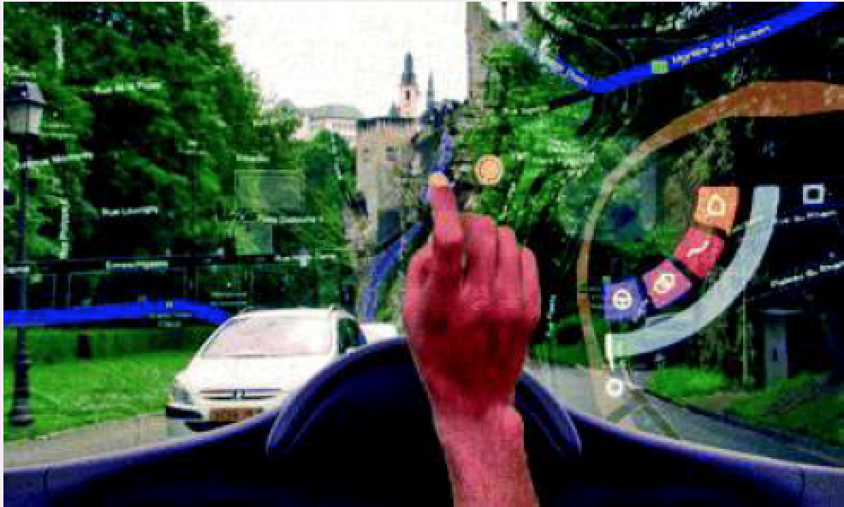
example #2
an augmented reality in-car navigation system

Slide 23
Plus Scenario
Beth is on her way to her friend's new house. She hasn't been there before so she's following the directions from her new in-car navigation system. While waiting in a traffic light queue she brings up the overview map of her route and projects it on the windscreen. From this view she sees that there is a traffic jam on the original recommended route and tells the system to recalculate the route in order to avoid the jam. The display automatically reverts to normal driving mode.
Once through the traffic lights, there is quite a complicated set of road changes and intersections. By projecting arrows and route boundaries directly on her windscreen, the navigation system guides her through the road junction. Beth is surprised at how easy it is to follow the system's directions, and as she avoids the traffic jams she arrives at her friend's house on time.

Slide 24
Minus Scenario
Beth is on her way to her friend's new house. She hasn't been there before so she's following the directions from her new in-car navigation system. It was quite difficult to set up the route she wants to take because although the system can tell her about traffic jams, she has to manually agree every section of her route and this took a long time because she doesn't know the roads. Finally, she chose to have an ‘overview’ map of her route displayed as well as local directions for the next turn and other landmarks. At last she set out in the right direction.
Despite being in the bottom corner of her windscreen, the overview map is very distracting as it is constantly changing and flashing information. Her directions are also displayed on her windscreen but are quite difficult to interpret. Suddenly a large arrow appears right in her line of sight highlighting an upcoming speed camera. This makes her jump and she swerves, narrowly missing the car in front. Feeling quite flustered and nervous, Beth turns off the system and telephones her friend for directions.

Slide 25
Stakeholders
Stakeholders are “people or organizations who will be affected by the system and who have a direct or indirect influence on the system requirements” (Kotonya and Sommerville, 1998).
It will frequently be the case that the formal ‘client’ who orders the system falls very low on the list of those affected…. (Dix et al, 2004)
…the group of stakeholders includes the development team itself as well as its managers, the direct users and their managers, recipients of the product's output, people who may lose their jobs because of the introduction of the new product, and so on (Sharp et al, 1999)

Slide 26
3. What is the journey map representation?

Slide 27
What is a Journey Map?
v1. A journey map is a visualization of the process that a person goes through in order to accomplish a goal
v2. A journey map is a visualization of a scenario that a persona goes through in order to accomplish a goal
Nuance between two versions:
person, process => actual human actor, actual experience; direct empirical basis for knowledge
persona, scenarios => archetypes, abstracted model of a human actor and types of experience, archetypes are representative

Slide 28
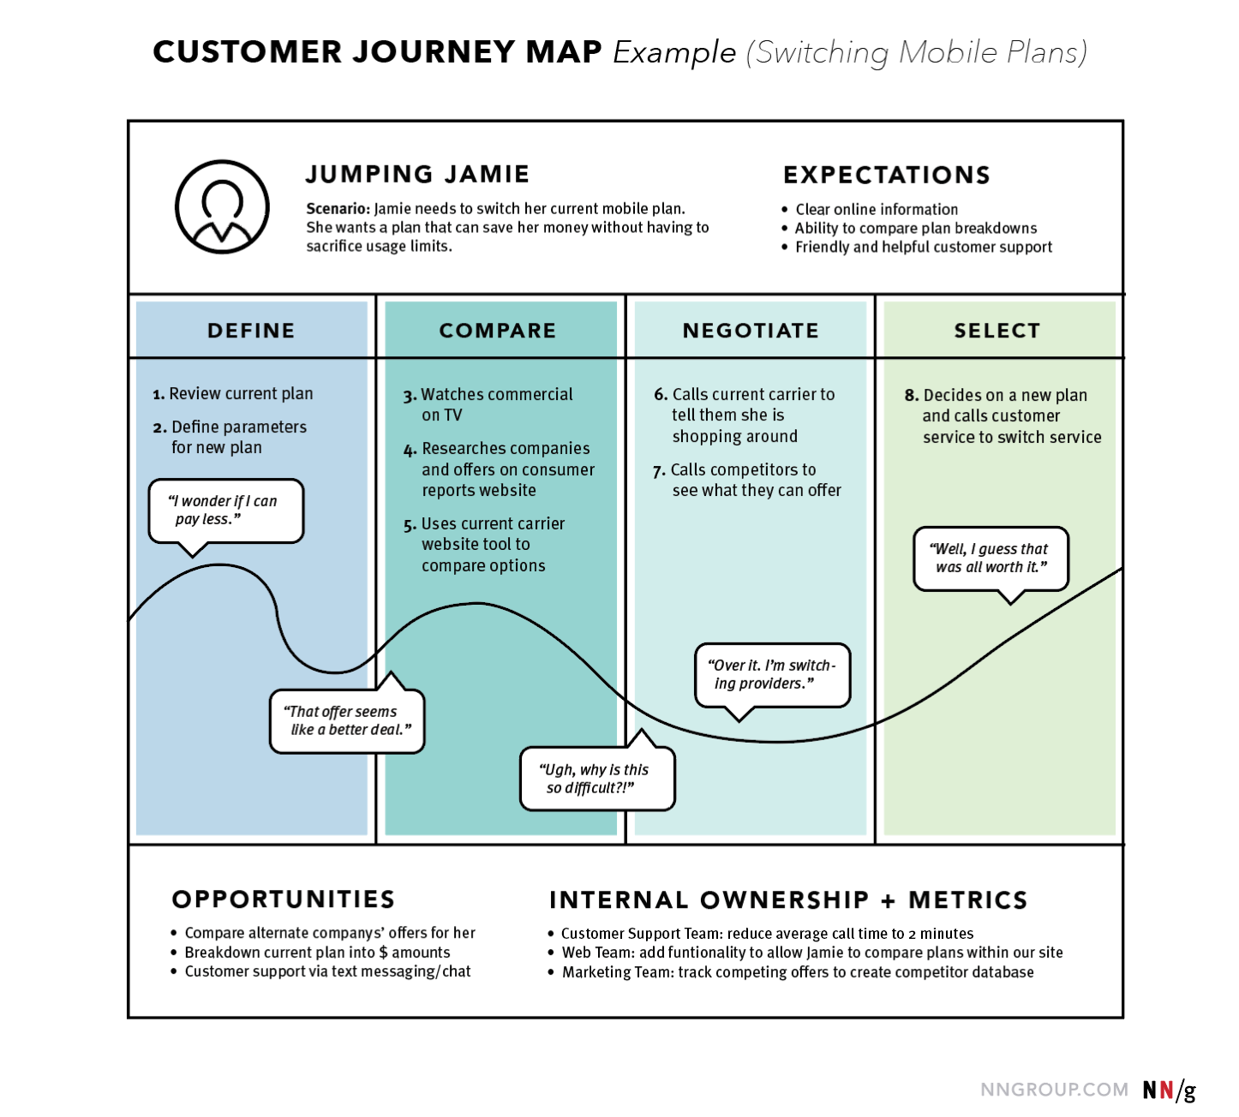
Examples
https://www.nngroup.com/articles/journey-mapping-101/

Slide 29
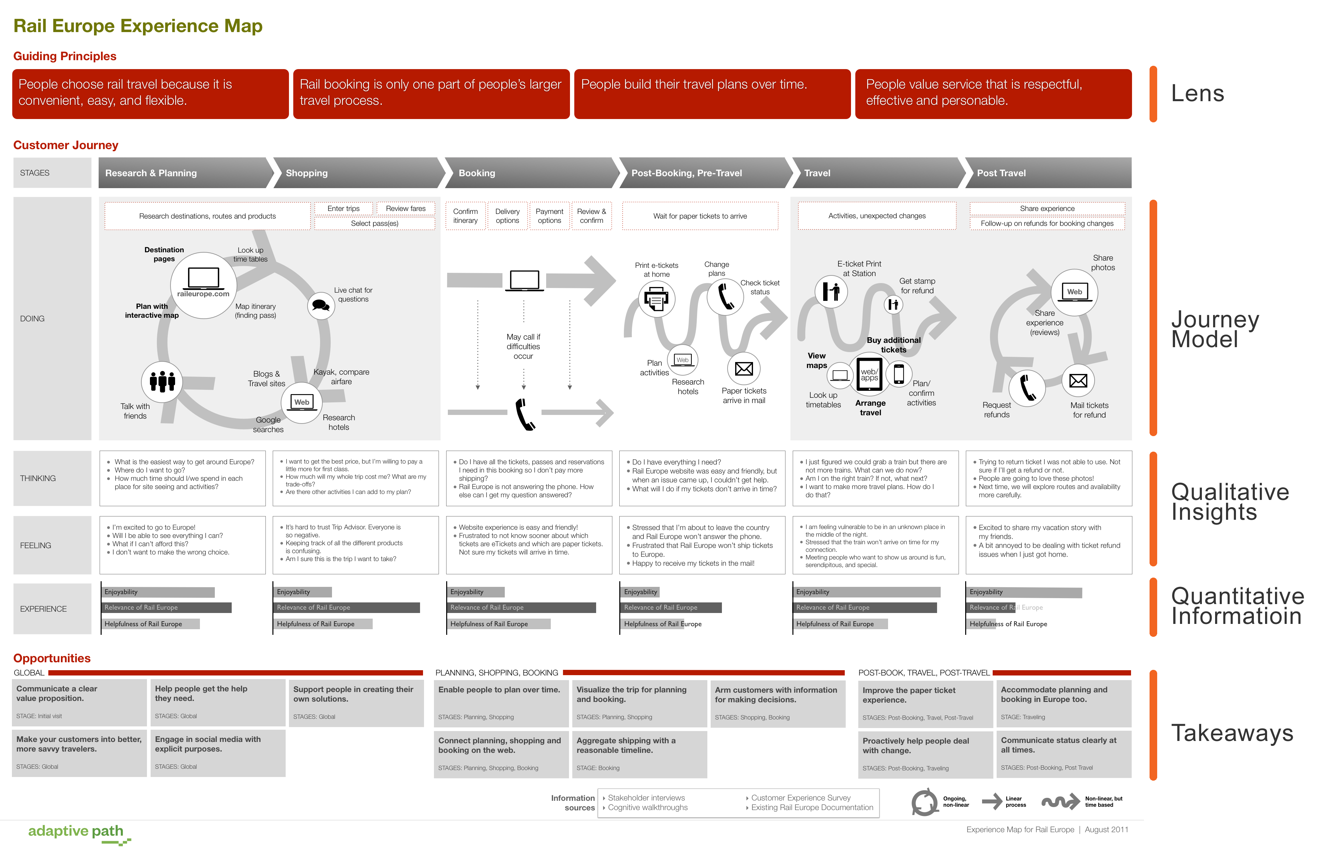
http://uxmastery.com/ux-marks-the-spot-mapping-the-user-experience/

Slide 30
General Observations
the journey map is a dense representation, consisting of text and graphics
the format of the journey map representation can and does vary
the journey map representation is intended to support discovery and understanding (big picture)
other similar representations
experience map – generalized version of journey map (generalized across multiple experiences within a domain)
story map – journey broken into smaller pieces, focus on planning and implementation

Slide 31
Specific and/or Abstracted
the journey map format is used to represent either:
the specific (specific actor, specific experience) and/or
the abstracted (persona, scenario)
whether we are representing a specific experience or a scenario – these are generalized to the ”journey”
this representation is best for scenarios that involve a sequence of events (such as shopping or taking a trip) or describe a process (thus involve a set of transitions over time), or might involve multiple modes of interaction (between the actor and system(s) being modelled)
much UX research is embedded in a market-based economic context, so the actor/persona is often referred to as the ”customer”
BUT in many domains of human activity, the human actor is not really inhabiting a “customer” role and instead adopts a different social role (e.g., education -> student, common—based peer production -> contributor)

Slide 32
Journey Map: Common Components
identification of the actor/persona
articulation of the experience/scenario (journey); articulation of the actor’s motivations, goals, expectations in this context
high-level breakdown of the experience/scenario into phases (journey phases)
articulation of actor/persona’s actions within each phase; articulation of actor/persona’s emotions (and other mindsets) within each phase
articulation of insights gains from the mapping

Slide 33
Journey Map: Component 1
identification of the actor/persona
depending on the type of journey map, can refer to specific actor or persona (archetype)
can be a name, or more often, uses the ‘tagline’ from a persona building activity
identifies the point of view, the perspective from which the experience/scenario is being portrayed
since the map has one point of view, the maps provides a strong, clear narrative
a given experience/scenario often will have multiple participants, thus there can be multiple maps, one for each of the different perspectives

Slide 34
Examples
Component 1
https://www.nngroup.com/articles/journey-mapping-101/

Slide 35
Journey Map: Component 1, continued
articulation of the actor’s motivations, goals, expectations in the experience/scenario context
this description is provided as text phases/bullet points
if an actor, this will be summarizing empirical evidence (qualitative)
if a persona, this will be a summarizing of a model; the model can be retrospective (what already exists) or prospective (thinking about users of products and services that do not yet exist)
the articulation is provided at a summary level of detail
the level of detail needs to align with the purpose of the mapping activity, which is:
discovery and understanding of the ‘big picture’
build common understanding within a team
provide a basis for communication (team can refer to the representation)

Slide 36
Examples
Component 1, continued
https://www.nngroup.com/articles/journey-mapping-101/

Slide 37
Journey Map: Component 2
articulation of the experience/scenario (journey)
these description is provided as text phases/bullet points
if an experience, this text will be summarizing empirical evidence (qualitative)
if a scenario, this text will be summarizing of a model; the model can be retrospective (what already exists) or prospective (for existing products and services that are anticipated and do not yet exist)
the articulation is provided at a summary level of detail
the level of detail needs to align with the purpose of the mapping activity, which is:
discovery and understanding of the ‘big picture’
build common understanding within a team
provide a basis for communication (team can refer to the representation)

Slide 38
Examples
Component 2
https://www.nngroup.com/articles/journey-mapping-101/

Slide 39
Journey Map: Component 3
high-level breakdown of the experience/scenario into phases (journey phases)
this breakdown aims for a high-level summary into a small number of phases (say, like 3-8 phases)
the breakdown into phases provided organization for the rest of the information in the journey map (actions, thoughts, and emotions).
the phases will vary from scenario to scenario
examples of phases
example 1: discover, try, buy, use, seek support
example 2: engagement, education, research, evaluation, justification
example 3: purchase, adoption, retention, expansion, advocacy

Slide 40
Examples
Component 3
https://www.nngroup.com/articles/journey-mapping-101/

Slide 41
Journey Map: Component 4
articulation of actor/persona’s actions within each phase; articulation of actor/persona’s emotions (and other mindsets) within each phase
actions are the actual behaviors and steps taken in each phases, provided in narrative form
emotions and other mindsets
emotions are identified, primarily according to valence (the positive/negative association), the valence is often represented as a single line that arcs across the phases
other mindsets can refer to thoughts, questions, motivations, and information needs at the different phases in the journey
these are ideally represented using data extracted from qualitative research (quotes)

Slide 42
Examples
Component 4
https://www.nngroup.com/articles/journey-mapping-101/

Slide 43
Journey Map: Component 5
articulation of insights gains from the mapping
different types of insights can be gained
‘ownership’: who ‘owns’ what change? if changes were to be made, which entities would be involved
metrics: identification of the metrics that are relevant to the actor/persona and the experience/scenario
this will have a connection to the first component, which was identification of the actor/persona, and in particular motivations, goals, expectations in the experience/scenario context
answers the question “How are we going to measure improvements we implement?”
opportunities: insights about how the user experience could be improved

Slide 44
Examples
Component 5
https://www.nngroup.com/articles/journey-mapping-101/

Slide 45
Journey Map: Summary
Journey mapping is a process that provides a high-level representation of a human experience (or persona in a scenario)
The representation representation builds shared understanding within a team; provides a concrete artefact that is useful in communication, and builds empathy (build capacity to view domain from other perspectives)
If done well, the representation can reveals opportunities for improvement through design intervention

