Slide 1
Resource Pack: Humans (Users) III Cognition, Attention, Perception
© Melanie Baljko

Slide 2
Intellectual Property Notice
This presentation is protected by Canadian and international copyright laws. Reproduction and distribution of the presentation without the written permission of the copyright holder is prohibited.
These course materials are designed for use as part of the EECS3461 course at York University and are the intellectual property of the instructor unless otherwise stated. Third party copyrighted materials (such as book chapters, journal articles, music, videos, etc) have either been licensed for use in this course or fall under an exception or limitation in Canadian Copyright law.
Copying this material for distribution (e.g., uploading material to a commercial third-party website) may lead to a charge of misconduct under York’s Code of Student Rights and Responsibilities and the Senate Policy on Academic Honesty and/or legal consequences for violation of copyright law if copyright law has been violated.
© Melanie Baljko, 2021

Slide 3
Dependencies
This resource pack assumes that you are already familiar with:
R-Humans-II
R-Design-VIII (and all previous)
R-Interaction-III (and all previous)

Slide 4
Key Questions
What is cognition? (0. Cognitivist model of users?)
What is attention?
What is perception? segue to R-Design-VII
How are Gestalt principles applied to visual perception in UX design?
What is inattentional blindness and change blindness? And why are these relevant to UX design?
Why is attention and perception relevant to UX design?

Slide 5
0. Cognitivist models of users?

Slide 6
First Paradigm [Harrison, 2007]
The early days of computing (e.g., 1965-1980, prior to personal computing) saw interaction as a form of man-machine coupling
an amalgam of engineering and human factors, inspired by industrial engineering and ergonomics
questions to be answered: what are the problems in the coupling? how can we developing pragmatic solutions to them?
goal of design:
optimize the fit between humans and machines, deal with the concrete problems that arise in interaction and that cause disruption

Slide 7
Second Paradigm [Harrison, 2012]
Next comes a revolution that that human minds are like information processors, and that interaction can be modeled as information exchange between humans and computers
the paradigm places “rationality and rational analysis [as] the most important mode of operation for human activity” (Flyvbjerg, 2001, p. 23)
questions to be answered:
‘how does information get in’, ‘what transformations does it undergo’, ‘how does it go out again,’ ‘how can it be communicated efficiently’
premise:
human information processing is deeply analogous to computational signal processing
the primary interaction task is enabling communication between the machine and the person

Slide 8
Model Human Processor (Card et al, 1983)
One of the first HCI models to be used; based on information processing model
Models the information processes of a user interacting with a computer
Predicts which cognitive processes are involved when a user interacts with a computer
Enables calculations to be made of how long a user will take to carry out a task

Slide 9
Second Paradigm [Harrison, 2012]
premise and starting assumptions:
human information processing is deeply analogous to computational signal processing
the primary interaction task is enabling communication between the machine and the person
operations performed by one in pursuit of a goal affect the state of the other
If we modeling the state of the person as well as of the computer, then we can predict and optimize the relationship.

Slide 10
Human as an Information Processor
a framework that explains how people think/do
it uses metaphor of an (digital) information processor for the brain (and thus for cognition)
the metaphor abstracts away the human body, the interactant is reduced to a brain

Slide 11
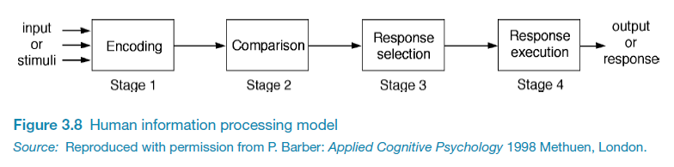
Information processing
Conceptualizes human performance in metaphorical terms of information processing stages
Notes:
11
A number of comparisons have been made, including conceptualizing the mind as a reservoir, a telephone network, and a digital computer. One prevalent metaphor from cognitive psychology is the idea that the mind is an information processor. Information is thought to enter and exit the mind through a series of ordered processing stages. Within these stages, various processes are assumed to act upon mental representations. Processes include comparing and matching. Mental representations are assumed to comprise images, mental models, rules, and other forms of knowledge.

Slide 12
What happens in the middle?
In this model of the user:
there is an input stage
there is an output stage
In between receiving the input and producing the output, something is happening in the mind of the user
what is happening? this middle part is the cognitive processing

Slide 13
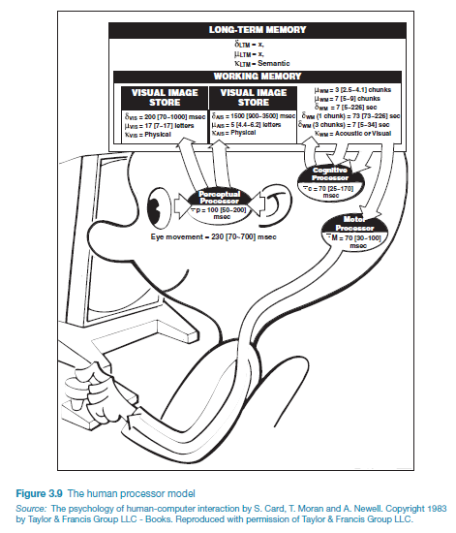
Notes:
13

Slide 14
Mental Models
a framework that posits that people use mental models generally in cognition, for:
reasoning, making decisions
generating their next actions
generating explanations about what they observed
… many more
There are two key points
a mental model is an internal construction
a mental model can be "run"
There is plenty of evidence that people have mental models

Slide 15
Mental models: How do they work?
Craik (1943) described mental models as:
internal constructions of some aspect of the external world
constructions that are manipulated somehow (processing)
this result of the processing is that predictions and inferences can be made
Johnson-Laird (1983) and others
the process involves unconscious and conscious processes
the process involves 'fleshing out' the mental model
the process involves 'running' the mental model
the process involves activation of images and analogies

Slide 16
Deep vs Shallow Mental models
Mental models can be formed in a deep or a shallow way
Example of a deep model:
a model of how a car operates to the extent that you can trouble-shoot
how the combustion engine turns over, alternator, etc
how fuel lines/carberator/etc work
how braking systems operate
how steering systems operate
Example of a shallow model:
a model of how a car operates to the extent that you can drive it
how to start the car
how to accelerate
how to brake
how to turn
to drive, a shallow model suffices; to trouble-shoot malfunction, need a deeper model

Slide 17
How Do Mental Models Develop?
Users develop an understanding of a system through learning about and using it
Knowledge is sometimes described as a mental model:
How to use the system (what to do next)
What to do with unfamiliar systems or unexpected situations (how the system works)
People make inferences using mental models of how to carry out tasks
they may start with incorrect assumptions
they may use inappropriate analogies
they may bring superstition into the process
they may use evidence to revise their mental models (towards or away from the correct model)

Slide 18
Shallow and Incorrect Mental Models
there is plenty of evidence that the mental models are frequently erroneous
Examples: thermostats, household plumbing, tailgating, elevator and crosswalk buttons, etc etc

Slide 19
0b. Norman’s gulfs of execution and evaluation

Slide 20
Gulf Bridging
not really a separate framework from mental models; rather an further component to explain how people behave
the framework supposes there are two gulfs:
a gulf of execution
a gulf of evaluation

Slide 21
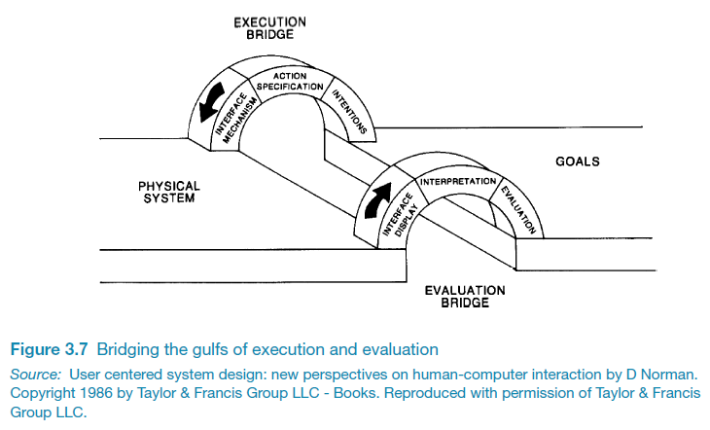
Bridging the gulfs

Slide 22
Gulf of Execution
the gulf of execution is the difference between the following two things:
the user’s model of what system is (and what the possible next actions are)
what is actually possible with the system
each user will have their own version of this gulf

Slide 23
Gulf of Evaluation
the gulf of evaluation is the difference between the following two things:
the user’s model of the system state (what just happened, given action I just did?)
the system’s actual state
each user will have their own version of this gulf

Slide 24
Application of the Gulfs
Norman’s model of the gulfs of evaluation and execution have been applied to the design process (which we will cover in R-Design-II)

Slide 25
1. What is cognition?

Slide 26
Course Textbook Reference
this resource pack draws upon sections 4.1, 4.2, and 4.3 of the course textbook

Slide 27
What is the Mind?
cognition a term that has come to be associated with a scientific approach to the human mind
the mind is understood as a set of “faculties” that includes:
cognition
other aspects generally considered non-cognitive, such as emotion, personality, motivation, sensory-perception, etc
characterizing and understanding the human mind has been a focus of human activity for thousands of years
the study of the mind has been a focus of many other fields and disciplines: e.g., philosophy, religion, science, medicine, among many others
the history of the study of the mind is hugely complex
each of these fields and disciplines organize themselves around different paradigms, and the paradigms themselves have evolved over time (we will cover paradigms in R-Knowledge Practice-III)
Notes:
“the ‘mind’ is simply a name for processes in the head that control complex behavior, and that it is both necessary and possible to infer those processes from behavior” [Hebb, 1958]

Slide 28
What is the Mind?
key questions have been and continue to be:
do non-humans have minds? what does it mean to have a mind?
what is the relationship between the body and the mind? (implies a Western tradition of mind-body dualism)
what is the relationship between cognition and the brain?
does cognition reside solely in the brain?

Slide 29
Theory of Mind
the ability or capacity to attribute mental states to oneself and others and to understand that others have desires, intentions, and perspectives that are different from one's own
mental states include: beliefs, desires, intentions, perspectives, knowledges, emotions
thought to be essential for empathy and understanding

Slide 30
What is cognition?
There are a range of meanings of cognition [Allen, 2017], but generally:
cognition is ”the mental action or process of acquiring knowledge and understanding through thought, experience, and the senses” [OED]
cognition is “the mental processes such as perception attention, memory, and so on, that are what the mind does” [Goldstein, 2011]
“Cognition refers to processes such as memory, attention, language, problem solving and planning” [Pessoa, 2008]
“Should cognitive scientists be any more embarrassed about their lack of a discipline-fixing definition of cognition than biologists are about their inability to define “life”? [Allen, 2017]

Slide 31
Non-human cognition
cognition is prototypically human [Allen, 2017]
animal cognition emerged as a field of study in the 1960’s, as researchers started to apply the emerging methods of cognitive science to non-human animals
mammals, primates, sea otters, dogs, etc
birds, corvids especially
fish
cetaceans, octopods
‘the cognitive capacities of collectives (insect swarms, human group)” have been “assumed to be too different from prototypical human cognition” [p. 4234, Allen, 2017]
“bacterial cognition, slime mold intelligence, and plant cognition, raise boundary questions about the scope of cognitive science” [p. 4237, Allen, 2017]
see biosemiotics

Slide 32
What is considered cognition?
memory
reasoning
planning
problem solving
learning
language, writing, reading
perception
there is a debate about whether perception is separate from cognition [Firestone and Scholl, 2015]

Slide 33
What is not considered to be cognition?
“Non-cognitive skills are defined as the “patterns of thought, feelings and behaviours” (Borghans et al., 2008) that are socially determined and can be developed throughout the lifetime to produce value. Non-cognitive skills comprise personal traits, attitudes and motivations” (Zhou, 2016)
traditionally, emotion has not been thought of as a cognitive process [Pessoa, 2008]
social interaction:
cognitive: social cognition focuses on the how people process, store, and apply information about other people and social situations using cognitive processes
non-cognitive: empathy and social emotions are considered non-cognitive

Slide 34
Metacognition
Metacognition: one's awareness of one's own strategies and methods of cognition

Slide 35
Cognition as the basis
We will use this characterization of cognition as the basis for engaged with the topics of attention and perception

Slide 36
2. What is attention?

Slide 37
Attention is a cognitive mechanism
The human mind is bombarded with millions of stimuli.
The human mind is constrained; it can process only a fraction of this incoming information.
The human mind must have a way of deciding which of this information to process.
Attention is a cognitive mechanism
it implements processes whereby this selection process is performed
“a general term for selectivity in perception” [Int’l Encyclopedia of the Social & Behavioural Sciences]
also described as the ‘allocation of limited cognitive processing resources’ (Anderson, 2004)

Slide 38
Visual, Auditory, other Stimuli
The human mind is bombarded with millions of stimuli, with respect to each of the sensory pathways
Attention works differently for each of these pathways

Slide 39
Elaboration: auditory bombardment
the auditory system can be bombarded with acoustic signals from multiple sources, and each ear can receive either slightly or completely different information
why slightly different information?
because the ears are spatially distinct, thus the incoming signals will be subtly different
why completely different information?
because dichotic listening scenarios can and do happen
dichotic listening: when each ear receives its own auditory stimuli (e.g., a person can be presented with two different auditory stimuli simultaneously)

Slide 40
The ‘cocktail party’ phenomenon
“when person is selectively listening to one message among many yet hears his or her name or some other distinctive message such as “Fire!” that is not being attended” [Goldstein, 2011]
e.g., You are in a crowded room with many people talking all at once. You are engaged in conversation talking to one person, paying close attention. Yet if someone is another conversation that is within earshot mentions your name, you immediately perk up and notice.

Slide 41
Elaboration: visual bombardment
the visual system receives information from the entire visual field but only a subset can be processed
“Visual selection is also dramatic, since the raw data transduced by the retinal photoreceptors (Kelly, 1962) come at a rate of many megabytes per second. Note that several megabytes is more than that is needed to encode the text in a typical long novel. The data rate has to be reduced by more than 99% to about 102 bits per second (Sziklai, 1956), the capacity of the human attentional bottleneck.” [Zhaoping, 2014]

Slide 42
The Visual Scene is an Illusion
One has impression of perceiving entire visual scene in finely-grained detail all at once.
This is an illusion created by the brain

Slide 43
ADDENDUM – VISION BASICS /start

Slide 44
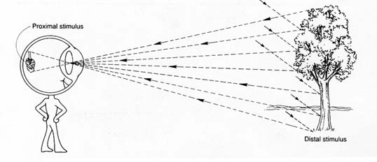
Vision Basics

Slide 45
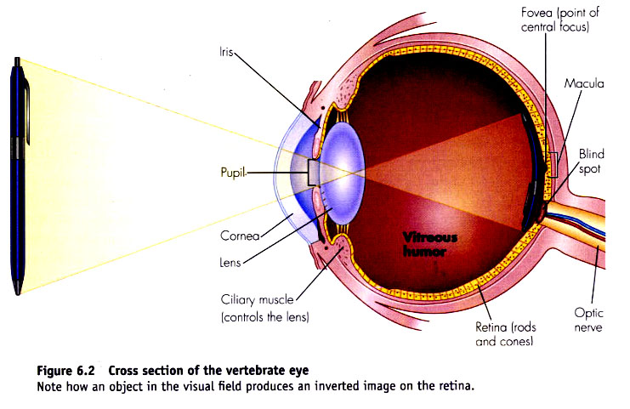

Slide 46
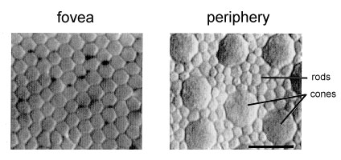
Areas of the Retina
photoreceptors are situated on the retina
two types: rods and cones
when light enters eye, it passes through these layers of cells before it hits the photoreceptors
fovea: tight packing of receptors (cones, no rods)
in center of retina, specialized for acute detailed vision
periphery of retina: proportion of rods to cones increase toward edge of retina

Slide 47
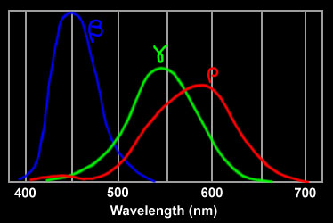
Colour Vision
Cones: three types of cones: short-, medium-, and long-wavelength
Hue is what we normally think of as colour
e.g., red vs. orange vs. yellow vs. green etc.
Red – perceived by long-wavelength cones
Green – perceived by medium-wavelength cones
Blue – perceived by short-wavelength cones

Slide 48
Colour Vision
Rods: rods are more sensitive to light than cones
are not specialized to particular wavelengths, instead attuned to a broad spectrum of light
Intensity, also called luminance or brightness
how much light/dark
The ratio of cones to rods in human retina is 1:10
what does this mean for relative sensitivity to variations in hue vs. intensity?

Slide 49
Colour Vision: Colour Blindness
Dyschromatopsia
A condition in which the ability to perceive colours is not fully normal
5-8% of males, 0.5% of women
red-green colour blindness most prevalent

Slide 50
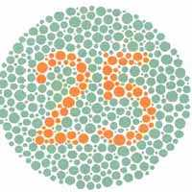
Testing Colour Blindness
“Ishihara plates” are used

Slide 51
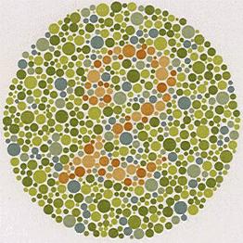
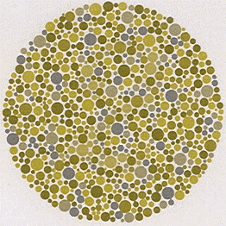
Simulation of Colour Blindness
stimulus image perceived image

Slide 52
The Visual Scene is an Illusion
The brain performs successive sampling of only small subsets of the visual scene via the fovea via various fixations
these eye movements are called saccades: rapid, ballistic movements of the eyes that abruptly change the point of fixation
The brain makes use of specialized neurological processing to knit together all of these samples
this creates the illusion of the entire visual scene being seen in finely-grained detail all at once

Slide 53
ADDENDUM – VISION BASICS /end

Slide 54
Endogenous and Exogenous Attention
From Goldstein, 2011:
exogenous attention refers to the automatic attraction of attention by a sudden visual or auditory stimulus
e.g., something moves off to the side and, without thinking, you automatically look toward it. A car backfires, and you turn your head to determine where the sound came from.
endogenous attention refers to consciously determined attention
e.g., you consciously decide to scan the environment, perhaps to find a specific stimulus or just to keep track of what is going on.

Slide 55
Vision and attention; overt and covert attention
there is a heavy focus on vision and attention, although attention is not specific to visual stimuli
[Goldstein, 2011]:
overt attention refers to shifts of attention that are accompanied by eye movement
the movements of the eyes provide observable signals of how attention is changing over time
covert attention refers to shifts of attention which occurs when attention is shifted without moving the eyes
commonly referred to as seeing something “out of the corner of the eye” (as you might do while trying to check someone out without looking directly at him or her)

Slide 56
Selective and Divided Attention
attention is most often associated with selective attention—the focusing of attention on one specific location, object, or message
divided attention refers to attending to two or more things at once

Slide 57
Selective Attentional Processes
The first modern theory of selective attention was the filter theory of Broadbent (1958) (also called ‘early selection model’, ‘bottleneck model’)
In this theory:
information flows from the senses through many parallel input channels and along the line there is a a selective filter which acts as an all-or-none switch that selects information from just one of the parallel input channels at a time
“Broadbent’s model provided testable predictions about selective attention, some of which turned out not to be correct” [Goldstein, 2011]
The field of cognitive psychology then generated other models: attenuation-based and late selection models of attention

Slide 58
Inattentional Blindness
[Goldstein, 2011]:
we may fail to perceive things that are clearly visible in our field of view
experiments demonstrate that when observers are attending to one sequence of events, they can fail to notice another event, even when it is right in front of them

Slide 59
Activity
You will watch a video
You will see two teams of three players each.
Count the number of times the players wearing white pass
the basketball.
Ready?
Watch the video for the “selective attention test” on the course website
https://www.youtube.com/watch?v=vJG698U2Mvo

Slide 60
What does this activity demonstrate?
Did you notice the gorilla?
In the experiment, nearly half—46 percent—of the observers failed to report having seen the event, even though it was clearly visible
This demonstrates inattentional blindness

Slide 61
Change Blindness
change blindness is an inability or difficulty in detecting changes in scenes
Viewing Activity:
Change blindness demonstration
https://www.youtube.com/watch?v=bh_9XFzbWV8

Slide 62
Ambient Displays and Attention
Ambient displays are defined as those that are "minimally attended" (e.g. just salient enough for conscious perception)
Alerting displays are "maximally divided" (e.g. slightly less salient than focal tasks)
Matthews et al (2004) categorize human attention (i.e., intent and expectation towards a stimulus) into three types:
inattention: stimulus is not directly available for conscious awareness but may still affect behavior (e.g., memory recall)
divided attention: distributing attention over several stimulus
focused attention: using all attentional resources to focus on one stimulus

Slide 63
Multitasking
There has been much research on the effects of multitasking on memory and attention (Burgess, 2015).
The general findings are
the ability to multitask depends on the nature of the tasks and how much attention each demands
the ability to multitask depends on the individual, and degree to which a person is distractable

Slide 64
Divided Attention
divided attention refers to the distribution of attention among two or more tasks
automatic processing is a type of task processing that occurs without intention and at a cost of only some of a person’s cognitive resources
controlled processing is the type of task processing that requires close attention

Slide 65
Q: when we perform multiple tasks, what is the impact, if any on the task outcomes?
In other words, are you better off doing one thing at a time in sequence or doing multiple things in parallel?
e.g.
task 1: read a passage, task 2: have a text message conversation with a friend
sequential mode: task 1 takes 10 min, task 2 takes 3 min
parallel mode: task 1 and task 2 together takes… [will the time be > 13 min?]

Slide 66
Can divided attention be practiced?
if many trials of practice can result in automatic processing, then divided attention can be achieved with practice
if the task is difficult and controlled processing is required, then divided attention becomes very difficult

Slide 67
Are some people more distractable than others?
[Sharp et al, 2019]:
a series of experiments comparing heavy with light multitaskers
the results showed that heavy media multitaskers were more prone to being distracted by the multiple streams of media they are viewing than those who infrequently multitask
Infrequent multitaskers were found to be better at allocating their attention when faced with competing distractions (Ophir et al, 2009)

Slide 68
Being good vs bad at multitasking?
A study of completion rates of coursework found that students who were involved in instant messaging took up to 50 percent longer to read a passage from a textbook compared with those who did not instant message while reading (Bowman et al., 2010).
Multitasking can also result in people losing their train of thought, making errors, and needing to start over.

Slide 69
if you are interested in this topic, a suggested reading is:
Hayles, N. Katherine. “Hyper and Deep Attention: The Generational Divide in Cognitive Modes.” Profession, 2007, pp. 187–199. JSTOR, www.jstor.org/stable/25595866

Slide 70
3. What is perception?

Slide 71
Sensation vs Perception
Sensation and perception refer to an interleaved set of processes
Sensation:
refers to the parts that involve the detection of a stimulus by the sensory receptors, which is initiated by an energy change in the environment (transduction)
Perception:
refers to the parts that involve the selection, organization, and interpretation of sensory information that give an object or event its meaning

Slide 72
The Human Sensory System
The human sensory system consists of a number of different systems:
auditory
visual
somatosensory: informs us about objects in our external environment through touch (i.e., physical contact with skin) and about the position and movement of our body parts (proprioception) through the stimulation of muscle and joints.
viscerosensory: sensitive to mechanical, thermal and chemical stimulation of the viscera (i.e., internal body organs such as the heart and gastrointestinal tract)
olfactory and gustatory: chemical senses of smell and taste
vestibular: tells us about the orientation of the body with respect to gravity and the orientation of the body with respect to self generated movements

Slide 73
Sensory Pathways
A sensory pathway carries peripheral sensations from a sensory organ to the brain. [2]
A sensory pathways consist of the chain of neurons, from receptor organ to cerebral cortex, that are responsible for the perception of sensations. [1]
Sensory pathways are called ascending pathways
in contrast with descending pathways, which carry motor output from the brain to control the musculature through motor neurons)
The various sensory modalities each follow specific pathways through the central nervous system.

Slide 74
Senses
Don’t confuse a human sense with a human sensory pathway, which is only part of the sense.
Example
the human sense of vision is active (not only ’input processing’). The visual system also involves action. For instance, the brain causes action of the eyes in order to scan the visual field in response to visual stimuli.
for the visual sense, there is a ‘feedback loop’ between the sensory ‘input’ and motor ‘output’
the visual pathway begins with the retina and the photoreceptors, which are in synaptic relationship with the second neurons of the visual pathway.
in the pathway, when light hits the eye, the photoreceptors produce a response that travels along neural pathways and results in brain activity.

Slide 75
Key Questions
how is information acquired from the environment via the different sense organs organs?
how is this information transformed into experiences of objects, events, sounds, and tastes?

Slide 76
Perceptual Processing
[pp. 50-52, Goldstein, 2011]:
bottom-up processing is the first step in perception, the stimulation of receptors by stimuli from the environment
perception involves more than bottom-up processing
We are able to recognize different objects based on perceptual building blocks, and to give these objects names like “pail” or “cup,” because of knowledge we bring to the situation.
processing that begins with a person’s prior knowledge or expectations is called top-down processing
the knowledge that a person brings to the situation can influence perception
attention has an impact on perceptual processing

Slide 77
Object Perception
[pp. 50-52, Goldstein, 2011]:
how do we perceive objects? two approaches to explain:
Helmoltz’s theory of unconscious inference
Gestalt processing

Slide 78
Helmholtz’s Theory of Unconscious Inference
[pp. 57-52, Goldstein, 2011]:
Helmholtz proposed a principle called the theory of unconscious inference, which states that some of our perceptions are the result of unconscious assumptions that we make about the environment
The theory of unconscious inference includes the likelihood principle, which states that we perceive the object that is most likely to have caused the pattern of stimuli we have received.

Slide 79
Gestalt Principles of Form Perception
Gestalt principles explain certain perceptual phenomena
Law of Similarity
elements will be grouped perceptually if they are similar to each other; people perceive groupings on the basis of similarity
Law of Proximity
when we perceive a collection of objects, we will see objects close to each other as forming a group
Law of Prägnanz (figure-ground)
in perceiving a visual field, some objects take a prominent role (the figures) while others recede into the background (the ground)
Law of Symmetry
when we perceive objects, we tend to perceive them as symmetrical shapes that form around their centre
Law of Closure
we perceptually “close up” (i.e., complete) objects that are not, in fact, complete
people perceive single objects even when part of the object is obscured

Slide 80
4. How are Gestalt principles applied to visual perception in UX design? 5. What is inattentional blindness and change blindness? And why are these relevant to UX design? 6. Why is attention and perception relevant to UX design?
segue to R-Design-VII

