Slide 1
Resource Pack: Interaction III Evaluation and Testing
© Melanie Baljko

Slide 2
Intellectual Property Notice
This presentation is protected by Canadian and international copyright laws. Reproduction and distribution of the presentation without the written permission of the copyright holder is prohibited.
These course materials are designed for use as part of the EECS3461 course at York University and are the intellectual property of the instructor unless otherwise stated. Third party copyrighted materials (such as book chapters, journal articles, music, videos, etc) have either been licensed for use in this course or fall under an exception or limitation in Canadian Copyright law.
Copying this material for distribution (e.g., uploading material to a commercial third-party website) may lead to a charge of misconduct under York’s Code of Student Rights and Responsibilities and the Senate Policy on Academic Honesty and/or legal consequences for violation of copyright law if copyright law has been violated.
© Melanie Baljko, 2021

Slide 3
Dependencies
This resource pack assumes that you are already familiar with:
R-Humans-I
R-Design-V (and all previous)
R-Interaction-II

Slide 4
Inquiry
Break down this resource pack into smaller pieces
1. Is user experience is different than usability?
2. What are the design principles of visibility, constraints, consistency, feedback
3. What are Shneiderman’s 'eight golden rules’ and Nielsen and Molich’s 10 User Interface design guidelines?

Slide 5
1. Is user experience is different than usability?

Slide 6
Humans are Sense-Makers
Recall Q3 from R-Design-III:
as humans, we are all about making sense of our experiences
sensations, emotions, and meaning are all part of this sense making
sense-making is omnipresent
sense-making can be nebulous
the experience of sense-making can be difficult to capture
sense making is ‘interior’
sense-making takes place in the body and the mind of the sense maker
sense-making is not directly observable

Slide 7
User Experience
is about how people feel about using a interactive system
is about their subjective experiences in using it, all aspects (e.g., looking, holding, opening or closing it, smelling it, etc) (e.g., pleasure, satisfaction, frustration, etc)
is about both overall impression and the effect of small details (e.g., how smoothly a switch rotates, the sound of a click, the touch of a button when pressing it)

Slide 8
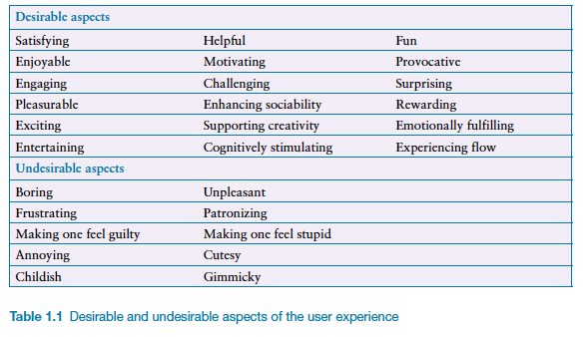
Subjective Qualities

Slide 9
Design User Experience?
It is important to point out that one cannot design a user experience, only design for a user experience.
e.g., “In particular, one cannot design a sensual experience, but only create the design features that can evoke it.” [Sharp et al, p. 13-14, 2019]

Slide 10
Usability
usability is operationalized in terms of different attributes, such as:
effectiveness, efficiency, safety, utility, learnability, memorability
usability is assessed via observable behaviours, which are then measured and interpreted

Slide 11

User Experience $≠$ Usability
thus, user experience is different than usability
user experience is connected to sense making
sense-making takes place in the body and the mind of the sense maker
sense-making is not directly observable, is ‘interior’
usability is operationalized in order to be measurable
usability is assessed via observable behaviours wrt effectiveness, efficiency, safety, utility, learnability, memorability
thus, usability is about observability and measurability, it is exterior

Slide 12
2. What are the design principles of visibility, constraints, consistency, feedback?

Slide 13
Assigned Reading for Design Principles
Preece et al, 2019, Chapter 2: The Process of Interaction Design (23 pp.)

Slide 14
Design Principles
Design principles are used by interaction designers to aid their thinking when designing for the user experience
Design principles are generally followed, but there may be occasions when the choice may be made to violate the principle (rationales can and do exist for this)
In implementing each principle, there is the potential to make assumptions about the user that may be incorrect

Slide 15
Design Principle: Constraints
Ensure non-applicable functionality is not selectable
constrain the user’s possible actions so that invalid or incoherent operations cannot be performed
at a given juncture, of all the possible actions, some may not be applicable
they should not be selectable to prevent incorrect user actions
they should possibly remain visible
the information that the option exists may still serve a function even if the option itself is not selectable
assumptions: the designer may make assumptions about how the user perceives and makes sense of information

Slide 16
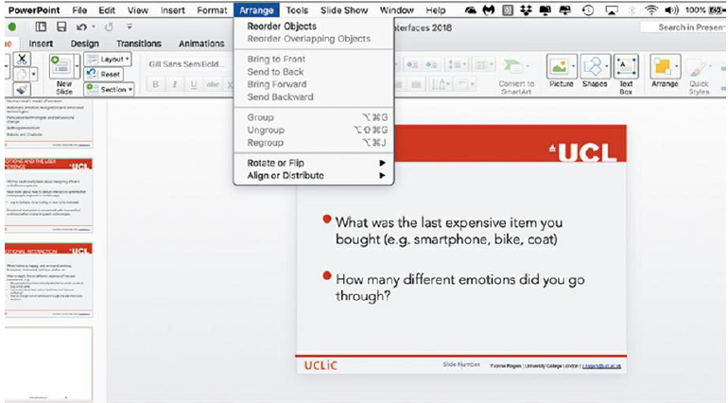
Example of a Constraint
these menu choices cannot be used since groupable items have not been selected,
thus these choices are not available for selection
but it is still useful to show that these options exist (supports learning) and to keep the menu consistent across all possible states

Slide 17
Design Principle: Visibility
For the given junction, ensure key functionality is visible
Ensure there is an answer the user's question "What actions are possible at this juncture?"
At a given juncture, of all the afforded actions, some may be applicable and others not
of those that are applicable → are they signified to the user in a way that is understandable?
of those that are not applicable → why might we want it to be visible (but not selectable?)
this principle serves to bridge the gulf of execution
assumptions: designer may make assumptions about how the user perceives and makes sense of information

Slide 18
Design Principle: Feedback
Provide feedback to signal what action has been done and what this action has accomplished
Answer the user's question "What was the result of the action that I just performed? "
this principle serves to bridge the gulf of evaluation
assumptions: designer may make assumptions about how the user perceives and makes sense of information

Slide 19
Design Principle: Consistency
Be consistent
have similar operations and use similar elements for achieving similar tasks
Why be consistent?
a consistent interface employs rules, and rules can be learned and absorbed by the user
thus, consistency in an interface can support learning
but sometimes consistency can be enforced in ways that are not actually helpful

Slide 20
Consistency Should be Based on Meaningful Principles
It is possible to be consistent on the basis of different principles (as the next example will demonstrate)
Although enforcing consistency according to one principle may be logical to the designer, it may not be meaningful or useful to the user
When we think of consistency, we should think "consistency with respect to what underlying principle and will this principle be helpful to the user?"

Slide 21
Grudin's Knife Analogy (1989) [p.24]
Scenario #1: There are different knives, including butter knives, steak knives, table knives, and fish knives.
Principle #1: These knives are all used in the kitchen, let's use the following principle:
Put things in the location where they are likely to be needed or used.
Thus, put the knives in the top drawer by the sink
Put all of the knives in that location, this is consistent
The principle makes it easy for everyone to find the knives, if it is followed consistently
….When all we have are kitchen knives, this is easy.

Slide 22
Grudin's Knife Analogy (1989) [p.24]
Scenario #2: There are different knives, including butter knives, steak knives, table knives, and fish knives. Some of these are really sharp. Some of these are special occasion knives or oversize knives. And there are putty knives and paint-scraping knives and jack-knives.
Principle #1: Put things in the location where they are likely to be needed or used.
Kitchen knives go in the kitchen. Tools go in the garage. Jack-knives go in the pocket or backpack.
But since this is a complicated domain, this consistency rule begins to break down
We might employ additional principles:
When convenient "real estate" is limited, prioritize prime real estate for frequently used items; put infrequently used items in less convenient locations
Knives that are special purpose are put in the cabinet in another room
When items are special cases, build a special provision for them
Knives that don't fit or are too sharp to put in the drawer, then placed special safe places (e.g., in a wooden block).

Slide 23
What does this Knife Analogy tell us?
The knife example demonstrates when we think of consistency, we should be thinking “consistent according to which principle(s)?”
By analogy, the concept applies to interfaces, in terms of aspects such as:
organization (of tools, functions, information); visual presentation; mode of interaction, etc
it might not make sense to be consistent to a particular principle at the expense of another principle
the complexity of the domain may require the use of multiple principles

Slide 24
In Sum
The design principle of constraints says to ensure non-applicable functionality is not selectable (and that non selectable does not mean not visible)
The design principle of visibility says to ensure that the user’s (tacit) question "What actions are possible at this juncture?” is always answered by the interface
The design principle of feedback says to ensure that the user’s (tacit) question "What was the result of the action that I just performed? ” is always answered by the interface
The design principle of consistency says to have similar operations and use similar elements for achieving similar tasks, but ‘similar’ needs to be based on principles that are meaningful for the user (and not the designer)

Slide 25
3. What are Shneiderman’s 'eight golden rules’ and Nielsen and Molich’s 10 User Interface design guidelines?

Slide 26
Shneiderman’s 'eight golden rules’
Ben Shneiderman is a computer scientist who conducted fundamental research in Human-Computer Interaction
In the mid-1980s, he proposed design guidelines, and these guidelines often get turned into heuristics for evaluation
design guidelines → to be applied prospectively
evaluation heuristics → to be applied retrospectively

Slide 27
Shneiderman’s 'eight golden rules’
1. Strive for consistency.
Consistent sequences of actions should be required in similar situations; identical terminology should be used in prompts, menus, and help screens; and consistent color, layout, capitalization, fonts, and so on, should be employed throughout.
Exceptions, such as required confirmation of the delete command or no echoing of passwords, should be comprehensible and limited in number
2. Seek universal usability.
Recognize the needs of diverse users and design for plasticity, facilitating transformation of content.
Novice to expert differences, age ranges, disabilities, international variations, and technological diversity each enrich the spectrum of requirements that guides design.
Adding features for novices, such as explanations, and features for experts, such as shortcuts and faster pacing, enriches the interface design and improves perceived quality.
http://www.cs.umd.edu/~ben/goldenrules.html

Slide 28
Shneiderman’s 'eight golden rules’
3. Offer informative feedback.
For every user action, there should be an interface feedback.
For frequent and minor actions, the response can be modest, whereas for infrequent and major actions, the response should be more substantial.
Visual presentation of the objects of interest provides a convenient environment for showing changes explicitly
4. Design dialogs to yield closure.
Sequences of actions should be organized into groups with a beginning, middle, and end.
Informative feedback at the completion of a group of actions gives users the satisfaction of accomplishment, a sense of relief, a signal to drop contingency plans from their minds, and an indicator to prepare for the next group of actions.
http://www.cs.umd.edu/~ben/goldenrules.html

Slide 29
Shneiderman’s 'eight golden rules’
5. Prevent errors.
As much as possible, design the interface so that users cannot make serious errors
If users make an error, the interface should offer simple, constructive, and specific instructions for recovery.
Erroneous actions should leave the interface state unchanged, or the interface should give instructions about restoring the state.
6. Permit easy reversal of actions.
As much as possible, actions should be reversible.
This feature relieves anxiety, since users know that errors can be undone, and encourages exploration of unfamiliar options.
The units of reversibility may be a single action, a data-entry task, or a complete group of actions, such as entry of a name-address block.
http://www.cs.umd.edu/~ben/goldenrules.html

Slide 30
Shneiderman’s 'eight golden rules’
7. Keep users in control.
Experienced users don’t want surprises or changes in familiar behavior.
Experienced users are annoyed by tedious data-entry sequences, difficulty in obtaining necessary information, and inability to produce their desired result.
8. Reduce short-term memory load
Humans’ limited capacity for information processing in short-term memory requires that designers avoid interfaces in which users must remember information from one display and then use that information on another display
http://www.cs.umd.edu/~ben/goldenrules.html

Slide 31
Nielsen and Molich's 10 User Interface Design Guidelines
About 4 years later, two usability experts (Jakob Nielsen and Rolf Molich) published a list of ten user interface design guidelines
these guidelines further iterate upon Shneiderman’s eight golden rules
can you spot the overlap/differences?

Slide 32
Nielsen and Molich's 10 User Interface Design Guidelines
1. Visibility of system status.
Users should always be informed of system operations with easy to understand and highly visible status displayed on the screen within a reasonable amount of time.
2. Match between system and the real world.
the language and concepts in the interface should mirror what the users would find in the real world
piggybacking on user’s expectations derived from their real-world experiences
3. User control and freedom.
Allow ‘backward’ steps, such as undoing and redoing previous actions.
https://www.interaction-design.org/literature/article/user-interface-design-guidelines-10-rules-of-thumb

Slide 33
Nielsen and Molich's 10 User Interface Design Guidelines
4. Consistency and standards.
ensure that both the graphic elements and terminology are maintained
5. Error prevention.
Whenever possible, design systems so that potential errors are kept to a minimum; eliminate or flag actions that may result in errors
do not require users to detect and remedy problems
https://www.interaction-design.org/literature/article/user-interface-design-guidelines-10-rules-of-thumb

Slide 34
Nielsen and Molich's 10 User Interface Design Guidelines
6. Recognition rather than recall.
maintaining task-relevant information within the display while users explore the interface (don’t require users to remember things)
ensure users can employ recognition instead of recall as they use the interface (Recognition is always easier than recall because recognition provides the use of cues)
7. Flexibility and efficiency of use.
allow frequent actions to be achieved through faster means (e.g., abbreviations, function keys, hidden commands and macro facilities)
allow users to customize or tailor the interface to suit their needs
https://www.interaction-design.org/literature/article/user-interface-design-guidelines-10-rules-of-thumb

Slide 35
Nielsen and Molich's 10 User Interface Design Guidelines
8. Aesthetic and minimalist design.
Keep clutter to a minimum. Do not allow unnecessary information to competes for the user's limited attentional resources (which could inhibit user’s memory retrieval of relevant information).
9. Help users recognize, diagnose and recover from errors.
provide error messages in plain language; do not assume users are unable to understand technical terminology
10. Help and documentation.
if possible, design the system so that the user does not need to consult documentation.
if this is not possible, ensure the documentation is easily located, specific to the task at hand and worded in a way that will guide them through the necessary steps towards a solution to the issue they are facing
https://www.interaction-design.org/literature/article/user-interface-design-guidelines-10-rules-of-thumb

Slide 36
In Sum
Schneiderman, Nielsen and Molich are all experts who developed lists of rules and principles for ‘good’ design
Schneiderman’s list came first, then Nielson and Molich (as well as other after them)
the 4 design principles discussed earlier are abstractions of these items

