Slide 1
R-Interaction-V Third Paradigm HCI
© Melanie Baljko

Slide 2
Intellectual Property Notice
This presentation is protected by Canadian and international copyright laws. Reproduction and distribution of the presentation without the written permission of the copyright holder is prohibited.
These course materials are designed for use as part of the EECS3461 course at York University and are the intellectual property of the instructor unless otherwise stated. Third party copyrighted materials (such as book chapters, journal articles, music, videos, etc) have either been licensed for use in this course or fall under an exception or limitation in Canadian Copyright law.
Copying this material for distribution (e.g., uploading material to a commercial third-party website) may lead to a charge of misconduct under York’s Code of Student Rights and Responsibilities and the Senate Policy on Academic Honesty and/or legal consequences for violation of copyright law if copyright law has been violated.
© Melanie Baljko, 2021

Slide 3
Dependencies
This resource pack assumes that you are already familiar with:
R-Humans-II (and all previous)
R-Design-VI (and all previous)
R-Interaction-II (and all previous)

Slide 4
Key Questions
design contexts?
What is a market vs a commons?
What is a proprietary vs a non-proprietary interactive system?
The StoryGraph vs Goodreads case study
How do ideas spread? How do technologies get adopted?

Slide 5
Topics
In this module, we will explore types of interactive systems where the ‘interface’ seems to melt away
What is ‘Dangling String’ and why is it relevant?
What is the idea of the disappearing interface?
What are the design dimensions of ambient systems?

Slide 6
1.

Slide 7
First Paradigm [Harrison, 2007]
The early days of computing (e.g., 1965-1980, prior to personal computing) saw interaction as a form of man-machine coupling
an amalgam of engineering and human factors, inspired by industrial engineering and ergonomics
questions to be answered: what are the problems in the coupling? how can we developing pragmatic solutions to them?
goal of design:
optimize the fit between humans and machines, deal with the concrete problems that arise in interaction and that cause disruption

Slide 8
Second Paradigm [Harrison, 2012]
Next comes a revolution that that human minds are like information processors, and that interaction can be modeled as information exchange between humans and computers
the paradigm places “rationality and rational analysis [as] the most important mode of operation for human activity” (Flyvbjerg, 2001, p. 23)
questions to be answered:
‘how does information get in’, ‘what transformations does it undergo’, ‘how does it go out again,’ ‘how can it be communicated efficiently’
premise:
human information processing is deeply analogous to computational signal processing
the primary interaction task is enabling communication between the machine and the person

Slide 9
User Interfaces, Interaction Design
recall our earlier class material, when we discussed the primary fields upon which User Interfaces and Interaction Design are based: Design and HCI
also recall that HCI had its start in the 1980’s, with a foundation in cognitive psychology
cognitive psychology is a field strongly associated with the scientific method

Slide 10
Historical Reflection
human as an 'information processor' was a dominant metaphor
dominant metaphors evolve and change over time
the 'person as an information processor' is just one of many different metaphors which have been used historically
Other metaphors?

Slide 11
Historical Reflection
history shows that we use metaphors for conceptualizing human performance, for explaining how people think/do
Prior metaphors include
hydraulic metaphors
the 4 humors (Hippocratic medicine), keeping balance, reservoirs
mechanical metaphors
e.g., clocks, steam engines
electricity, circuitry
e.g., chemical processes generate action potential, arose once galvanometers measured electrical current in biological specimens
telegraphic/telephone
nerves as a telephone network
many others

Slide 12
Analysis of the Metaphor
we will now discuss some of the content of the following paper:
Harrison, Steve & Sengers, Phoebe & Tatar, Deborah. (2011). Making epistemological trouble: Third-paradigm HCI as successor science. Interacting with Computers. 23. 385-392. 10.1016/j.intcom.2011.03.005.
the paper investigates some of the shortcomings of the metaphor of users as information processors

Slide 13
Harrison et al (2011)
Harrison, Steve & Sengers, Phoebe & Tatar, Deborah. (2011). Making epistemological trouble: Third-paradigm HCI as successor science. Interacting with Computers. 23. 385-392. 10.1016/j.intcom.2011.03.005.
theoretical/critical analyses paper
Steve Harrison Department of Computer Science and (by courtesy) Art and Art History, Virginia Tech
Phoebe Sengers Information Science and Science & Technology Studies, Cornell University
Deborah Tatar Department of Computer Science and (by courtesy) Psychology, Virginia Tech

Slide 14
1.

Slide 15
New challenging areas
workplace studies
ubiquitous and pervasive computing
non-task-oriented computing, such as ambient interfaces and experience-centered design
works that seeks to de-marginalize emotion

Slide 16
Workplace Studies
Area #1 of 4
workplace studies are intended to inform system design in computer supported cooperative work settings
these studies take into account the complex actions and interactions in workplace settings (including both formal and informal work practices)
ACM hosts a yearly conference called Computer-Supported Collaborative Work (CSCW)

Slide 17
Workplace Studies
Area #1 of 4
workplace studies focus on the social situation of interaction and the implications for the design of interactive systems
workplace studies take as central that social, situated actions explain the meaning of interaction
this view is hard to reconcile with the views that arise from the information-processing metaphor, which holds:
social interaction can be formalized as the exchange of information
other social factors are not accounted for

Slide 18
Ubiquitous, Pervasive, Ambient Computing
Area #2 of 4
core concepts:
computing is made to appear anytime and everywhere
computing is ambient and environment-baed (the environment is sensitive and responsive to people)
computing that is not demanding of attention; interaction occurs in the periphery of attention; can be perceived at a glance
these interrelated concepts are taken up in the interrelated design domains of:
ubiquitous computing
pervasive computing
ambient computing
calm technology

Slide 19
Ubiquitous, Pervasive, Ambient Computing
Area #2 of 4
design approaches connected to these concepts are derived from disciplines such as ethnography, design, and the arts
the concepts are based on the idea that use context is, in the end, fundamentally unspecifiable and dynamic
these ideas are hard to reconcile with the views that arise from the information-processing metaphor, which holds that:
information flow between machine and context (including the user) can be identified and optimized
context can be modelled as yet another source of information, this information can be flowed to digital systems

Slide 20
Non-task-oriented computing
Area #3 of 4
non-task-oriented computing aims to create meaningful user experiences
ambient/ubiquitous/pervasive computing
traditional platforms – desktop, mobile, VR, AR
does not aim to support specific tasks or goals
the idea is that there is value in the experience itself
this idea is hard to reconcile with the views that arise from the information-processing metaphor, which holds that:
problems can be formalized in terms of motivations, goals, tasks, and operations
attributes such as effectiveness and efficiency are important

Slide 21
Affective Computing
Area #4 of 4
Affective computing is concerned recognizing, interpreting, processing, and simulating human affects
Affective computing includes both:
the study of phenomena of emotion and affect
the application of this knowledge towards the development of systems and devices that demonstrate emotional intelligence and/or afford experiences of empathy and other phenomena of emotion
there are two approaches:
i) emotion can be modelled as information flow,
ii) emotion is co-constructed in action and cannot be modelled as information flow
this latter approach is not compatible with the information-processing metaphor

Slide 22
New challenging areas
in these design domains, the following issues are important:
social factors in interaction
unspecifiable and dynamic use contexts
meaning in user experience
co-constructed emotion
these issues raise shortcomings of the information-processing metaphor
in task-based computing, these issues of were marginal
now the issues are now becoming central

Slide 23
1.

Slide 24
What to do?
come up with a new metaphor, one that is better than the human-as-information-processor metaphor?
something even more radical?

Slide 25
Centrality
what has been 'central' in the field of HCI?
Answer: usability
And… whatever is not central gets considered ‘on the margins’
we discussed previously how frameworks of user experience arose to address what usability was not addressing

Slide 26
Marginality
what was marginal in the field of HCI in the 1980's?
emotions and computing
social factors
context
colonialism in computing
gendering, racialization
who gets to participate in building systems and who gets excluded
computing for personal pleasure, for fun, for aesthetic
evaluation based on discussion, impressions, emotion

Slide 27
Improvement?
So here we have an argument that the information-processing metaphor works ok for central phenomena, but starts to "fray at the edges"
… and what was formerly "at the edges" is now becoming more and more central
It seems natural to ask:
So what metaphor should we use instead?
Which metaphor is the "better" version of the information-processing metaphor?

Slide 28
Harrison et al argue that there is no "better" metaphor without first examining the underpinnings of knowledge
let's go back to science and its particular epistemological framework

Slide 29
1.

Slide 30
Underpinnings of knowledge

Slide 31
Recap
recall back in R-Knowledge-I
beliefs are a starting point
beliefs remain beliefs until they pass a test to be legitimated as knowledge
“An epistemology is a theory of knowledge. It answers questions about who can be a "knower” […]; what tests beliefs must pass in order to be legitimated as knowledge? […], what kinds of things can be known (can "subjective truths" count as knowledge?), and so forth.” [Harding, 1987]

Slide 32
Scientific method
the scientific method is a body of techniques for acquiring new knowledge
science has a particular epistemological framework

Slide 33
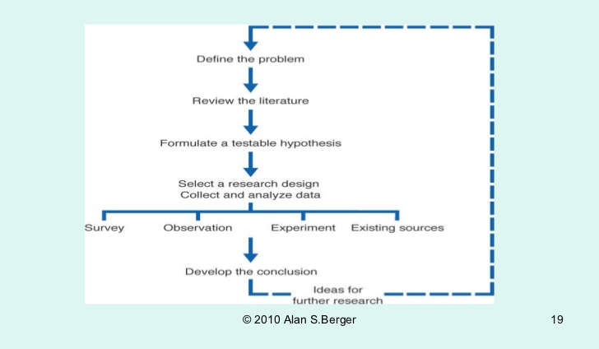
Scientific Approach
from slideshare

Slide 34
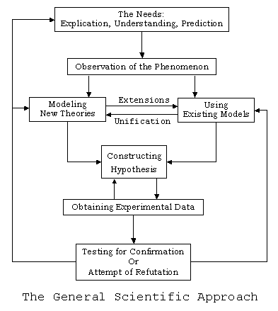
hypothesis construction: embedded within (prevalent, new) models and theories
*attribution for this diagram has not yet been located

Slide 35
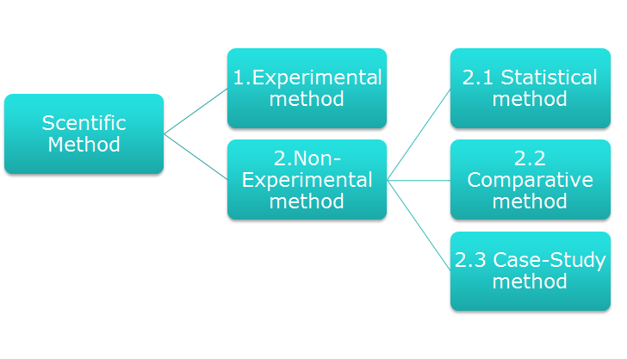
Scientific Research
Scientific research permits choice from a certain “tool box” of methods for investigation

Slide 36
The Science Stance
in science, there are specific tests for beliefs…
we start with a belief, and ”belief: the earth is flat”
then apply tests to the belief, and “use curvature test in an experiment”
if the belief passes the tests, then the belief gets legitimated as knowledge “belief does not pass test, earth must not be flat”
this is an oversimplification, but the point is that there is a specific test for whether the belief gets legitimated as knowledge
this knowledge is assumed to be objective

Slide 37
Generating Knowledge: Science Stance
knowledge generation consists of:
the development of a falsifiable hypothesis
the collection of data (using different methods), most often quantitative
methods such as: experiments, statistical methods, comparative methods, and case-study methods
the analysis of the data with respect to predictions generated by hypothesis; use statistical procedures to affirm or refute the hypothesis
assumes that the researcher is impartial and a disinterested outside observer
assumes that context should eliminated (via controls)
the findings are evaluated using standards such as reproducibility, reliability and validity

Slide 38
“Science-as-we-know-it” and Successor Science
philosophers of science identify two versions of science: "science-as-we-know-it” and successor science
Science ("science-as-we-know-it")
makes use of scientific method; has associated ideals and mechanisms
claims of universal objectivity

Slide 39
Successor Science
Successor science
a version of science with significant shifts in thinking about the nature of knowledge and about how we come have knowledge
deconstructs ‘universal’ claims to show how they actually embody specific gendered, class, or racial agendas
hold that bias is not simply the result of error or poor practice but is directly tied to the values and norms of the scientific method
not meant to be an 'unbiased' version of science-as-we-know-it, instead a variant of it
universal knowledge claims are suspect, since totalizing claims would imply taking one person’s point of view as more valuable or more central than others’, and therefore sidelining those in less powerful positions.
this perspective is formalized in the notion of ‘‘standpoint epistemology,’’ i.e. the idea that all knowledge arises from and is related to specific social, cultural, and historical circumstances

Slide 40
WTF? Is this saying that we should get rid of science?
No, this is not the point
Is it possible to engage in scientific practice without universal knowledge claims?
Yes, if you adopt a different metaphor…

Slide 41
Science & Metaphors for ‘Seeing’
metaphor #1:
science is based on a metaphor of transparent vision
assumes transparent access to 'natural reality'
truth consists of mental representations that are directly tied to and validated by natural reality

Slide 42
Science & Metaphors for ‘Seeing’
metaphor #2:
science is based on a metaphor of vision that is not transparent
the world is viewed through a particular lens that ‘colours’ what is seen
this is the metaphor for ‘situated knowledge’, which comes from particular points of view and is generated through particular mechanisms
‘truth’ is constructed of via interpretation
requires knowing not only what you can see in artefacts, but also knowing the mechanisms through which they are produced

Slide 43
Harraway (1988)
these ideas come from a remarkable and highly influential essay by feminist philosopher of science, Donna Haraway (Haraway, 1988).
The core idea was to rethink objectivity for successor science by changing the metaphor of vision which underlies it.

Slide 44
Standpoint Epistemology
any knowledge-maker has points of view that are situated (in their previous experiences, in the ideological framework, in their values, etc)
those who are 'scientific knowledge-makers' have points of view and those views are situated;
standpoint epistemology:
acknowledges the social dimension of scientific knowledge
acknowledges that knowledge arises from and is related to specific social, cultural, and historical circumstances
recognizes that there are claims of ‘universally-valid’, but the perspective of these claims is contingent on cultural and social factors

Slide 45
Harrison et al
taking situated knowledges seriously has two concrete implications for how we report HCI research

Slide 46
Harrison et al
Implication #1
research papers should articulate to the extent possible the intellectual and political commitments that the authors bring to a particular project, in order to allow readers to better evaluate the knowledge which it generates.

Slide 47
Harrison et al
Implication #2
since the mechanisms by which knowledge is produced are crucial for its evaluation, research papers should not only mention what methods were used but also articulate how and why methods are applied.
Practitioners in the field should not use ‘black-box’ methods (i.e., recipes that can be applied without understanding), since we need to know how knowledge was generated in order to be able to weigh it.

