Slide 1
R-Technosocial-I .
© Melanie Baljko

Slide 2
Intellectual Property Notice
This presentation is protected by Canadian and international copyright laws. Reproduction and distribution of the presentation without the written permission of the copyright holder is prohibited.
These course materials are designed for use as part of the EECS3461 course at York University and are the intellectual property of the instructor unless otherwise stated. Third party copyrighted materials (such as book chapters, journal articles, music, videos, etc) have either been licensed for use in this course or fall under an exception or limitation in Canadian Copyright law.
Copying this material for distribution (e.g., uploading material to a commercial third-party website) may lead to a charge of misconduct under York’s Code of Student Rights and Responsibilities and the Senate Policy on Academic Honesty and/or legal consequences for violation of copyright law if copyright law has been violated.
© Melanie Baljko, 2021

Slide 3
Dependencies
This resource pack assumes that you are already familiar with:
R-Humans-II (and all previous)
R-Design-VI (and all previous)
R-Interaction-II (and all previous)

Slide 4
Key Questions
design contexts?
What is a market vs a commons?
What is a proprietary vs a non-proprietary interactive system?
The StoryGraph vs Goodreads case study
How do ideas spread? How do technologies get adopted?

Slide 5
1. design contexts?

Slide 6
Situated Contexts
“On one level, design is a general human process that we use to understand and to shape our world. …we meet the challenges of design in specific challenges, addressing problems or ideas in a situated context. The challenges we face as designers today are as diverse as the problems clients bring to us. We are involved in design for economic anchors, economic continuity, and economic growth. We design for urban needs and rural needs and for social development and creative communities. We are involved with environmental sustainability and economic policy. agriculture competitive crafts for export, competitive products and brands for micro-enterprises, developing new products for bottom-of-pyramid markets and redeveloping old products for mature or wealthy markets.” ^{[1]}
[1] Friedman and Stolterman, series forward, Adversarial Design, Carl DiSalvo, 2012 emphasis added

Slide 7
Recap of Key Points…
Recall some of the key points from R-Design-III:
design is a basic human activity
UX design is an umbrella term for design practices that seek to (positively) intervene in user experience
user experience captures sense-making; it is about ‘inner’ experience
design is problem-solving (deficit thinking) and design is opportunity-generating (asset thinking)
the ideas that emerge from design have value
what is the shape and form of this value?

Slide 8
Design Contexts, Idea Valuation
Where do ideas go?
There are many different design contexts and we can distinguish among them in many different ways
Example (entity vs individual):
the context of an entity: to support business (for-profit) or other organizational (not-for-profit, public) function
personal contexts: personal problem solving, individual, grass-roots, entrepreneurial, creative practice

Slide 9
Design Contexts, Idea Valuation
“design for good”, ideas for positive social change
to be of service, to contribute positively
frameworks: societal benefit, human rights, UN Sustainable Development Goals (SDGs), design for socio-economic development (e.g., ICT4D)
to contribute to knowledge production:
e.g., for scholarly or research activities (e.g., design to support scholarship, to create experimental apparatii for data collection, to implement proof-of-concept);
for open science, citizen science, for open pedagogy

Slide 10
Design Contexts, Idea Valuation
for advocating change…
“critical design”
a form of research aimed at leveraging designs to make consumers more critical about their everyday lives
aims, in particular, to make consumers more critical about how their lives are mediated by assumptions, values, ideologies, and behavioral norms inscribed in designs
e.g., Bardzell and Bardzell, Dunne and Raby
aims to foreground the ethics of design practice
“speculative design”
the practice of addressing big societal issues with design processes and systems, looking towards the future and creating products and services for those scenarios
“adversarial design”
technology design that provokes and engages the political, activism
e.g., DiSalvo

Slide 11
2. What is a market vs a commons?

Slide 12
Starting Point
the design of interactive systems takes place in situated contexts
there are many situated contexts, only one of which is based in product development for consumer markets
another situated context is a commons; commons are different from consumer markets
the open source movement is an entry point
to get to the concept of the open source movement, we will first follow a sequence of introductory concepts

Slide 13
Digital ecosystem
“A digital ecosystem is a distributed, adaptive, open socio-technical system with properties of self-organisation, scalability and sustainability inspired from natural ecosystems.”[1][2]
we’ll use this concept to frame issues of production and consumption with respect to interactive systems
who is engaged in producing (designing, implementing, distributing) interactive systems? and why?
who is engaged in consuming (buying, adopting, using) interactive systems? and why?
[1] definition from Wikipedia [2] if Economics could be made a pre-requisite of this course, then we would draw more heavily on economic theory

Slide 14
Ecosystem
the concept of digital ecosystem derives from the more-basic concept of an ecosystem, which was first developed in the 1930’s in context of ecology
in ecology, an ecosystem is typically defined as:
“a community of living organisms in conjunction with the nonliving components of their environment, interacting as a system”[1]
[1] definition from Wikipedia, which cites: Tansley (1934); Molles (1999), p. 482; Chapin et al. (2002), p. 380; Schulze et al. (2005); p. 400; Gurevitch et al. (2006), p. 522; Smith & Smith 2012, p. G-5

Slide 15
Ecosystems as Dynamical Systems
ecosystems are dynamical systems that:
have a sense of balance (balance of population: producers and consumers)
a capacity to respond to perturbation
to resist disturbances and stay close to its equilibrium
to be perturbed but then to return to its equilibrium
gain a new state of equilibrium with a different composition of components
there is much more to the conceptualization of an ecosystem, but we’ll won’t delve into further detail here
the sustainability of an ecosystem refers to the ecosystem’s capacity to continue to exist
[1] definition from Wikipedia, which cites: Tansley (1934); Molles (1999), p. 482; Chapin et al. (2002), p. 380; Schulze et al. (2005); p. 400; Gurevitch et al. (2006), p. 522; Smith & Smith 2012, p. G-5

Slide 16
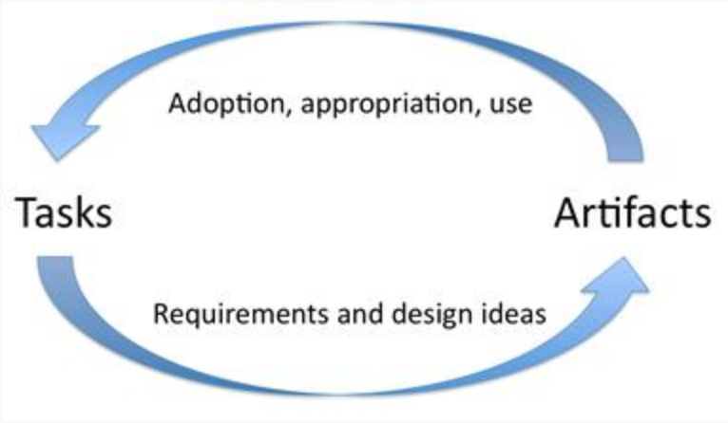
The “Task-Artifact Cycle”
“Human activities implicitly articulate needs, preferences and design visions. Artifacts are designed in response, but inevitably do more than merely respond. Through the course of their adoption and appropriation, new designs provide new possibilities for action and interaction. Ultimately, this activity articulates further human needs, preferences, and design visions.”
(Carroll, 2009)
Author/Copyright holder: Courtesy of John M. Carroll. Copyright terms and licence: CC-Att-SA-3 (Creative Commons Attribution-ShareAlike 3.0)

Slide 17
Commons
a commons is
a set of resources held in common, managed for individual and collective benefit, accessible to all members of a society
governed by social practice within its community of users, not by the state or a market

Slide 18
Types of Commons
environmental commons
common land for grazing, for hiking, etc
connected to the concept called the ‘tragedy of the commons’
cultural and intellectual commons
e.g., Wikipedia, literature, music
digital commons
e.g., github, sourceforge
information commons
e.g., the York library and other libraries, the WWW
knowledge commons
e.g., open educational resources (OERs), open-source research
*intellectual, digital, information, knowledge commons are overlapping, not distinguished very clearly

Slide 19
Tragedy of the Commons
a situation in which
individual users have open access to a resource
the individuals are unhampered by shared social structures or formal rules that govern access and use
the individuals act independently according to their own self-interest
through individual action, depletion of the resource is caused through their uncoordinated action
the acts of the individuals are contrary to the common good of all users
first coined in the 1800’s – grazing land in Great Britain is was called a ‘commons’ – if everyone grazes their livestock in an uncontrolled fashion, the grazing land is destroyed and becomes unusable for everyone
Ostrom (Nobel prize winner) found the tragedy of the commons is not as prevalent and not as difficult to solve some maintained

Slide 20
Commons-Based Peer Production
commons-based peer production (CBPP)
is a form of socio-economic production via collaborative work
often (but not always) the contributors are not financially compensated
different from economic production under traditional business models
e.g., thingiverse, fan fiction, open source software

Slide 21
Markets
a market is
a composition of systems, institutions, procedures, social relations or infrastructures whereby parties engage in exchange
markets have producers and consumers
consumer:
“a person or a group who intends to order, orders, or uses purchased goods, products, or services”
the exchange is typically in fungible goods (currency)
there also can be the ‘double coincidence of wants’ – each party holds an item that the other wants, exchange without monetary medium

Slide 22
Types of Markets
we can distinguish design contexts in terms of the ‘market’ within which the outcome will be deployed
consumer markets, business to consumer (B2C)
bottom-of-pyramid, mid-pyramid, top-of-pyramid markets refer to consumers grouped by socioeconomic status, from poorest to wealthiesr
consumer market is divided into different sectors: discretionary/non-discretionary or by industries (auto, leisure, household, apparel, etc)
planned obsolescence can be a business strategy
business to business (B2B)
designing products and services for business clients/customers
business to government (B2G)
design for government/public sector,
procurement processes can implement social policy
some educational institutions are public, others are private
“captive market”:
design done ‘in house’ within an organization for the organization

Slide 23
Market and Consumerism Effects
much of interactive system production is connected to consumer markets:
creating new competitive products and brands, for different markets (e.g., bottom-of-pyramid markets)
redeveloping extant products, for mature or wealthy markets (e.g., interactive refrigerators)
consumerism is:
encouragement of the acquisition of goods and services
a social and economic order
connected to capitalism
the gist of the idea: getting people to buy new stuff even if they don’t need it or want it, even if the production of the new stuff is harmful to the environment or exploits workers
however, the production and consumption of interactive systems does not only take place solely within the framework of consumer markets

Slide 24
Industrial Design and Mass Production
industrial design has its roots in mass production; it is a design process applied to products that are intended to be manufactured (as opposed to hand crafted)
thus, industrial design also has connections to consumer market

Slide 25
Assetization of Interactive Systems
Companies can and do make profit via the production and distribution of interactive systems, deployed via their own or other distribution platforms
Companies can assetize their interactive systems as products and services in different ways
We’ll next look at the distinction of proprietary vs non-proprietary software, which will illustrate:
the payware ⏤ freeware continuum
the closed-source ⏤ open-source continuum

Slide 26
3. What is a proprietary vs a non-proprietary interactive system?

Slide 27
Proprietary Software
has a publisher or owner
the publisher or owner retains intellectual property rights
the intellectual property rights typically are in the form of copyright of the source code or patent rights
intellectual property rights can be upheld legally
infringement of IP can result in damages, for which there is legal recourse
in addition to legal means, owners protect their intellectual property rights via controlling access (closed-source software, confidentiality, etc)
owners capitalize on their intellectual property rights in different ways:
license their technologies to others (for profit)
decline to license their technologies to others (to establish and maintain market position; to have a competitive edge)

Slide 28
Copyright
copyright is a legal instrument, put into force by the Copyright Act, a federal statute of Canada (1921, 1988, 1997, 2012)
other legal instruments: patents, trademarks, trade secrets
copyright is a type of intellectual property that gives its owner the exclusive right to make copies of a creative work
exclusive rights are usually not given in perpetuity, though
an interactive system (and its various facets, including its UI, techniques, algorithms) counts as a creative work
copyright attaches automatically upon the creation of the creative work
copyright does not need to be explicitly ‘claimed’
a copyright owner may decide what to do with the copyrighted work:
to monetize, but also may decide not to
to put their work into the public domain, uncopyrighted
But then others can take the work and convert it into proprietary software and then distribute it as a proprietary product.

Slide 29
Non-Proprietary Software
This is a complicated space
One dimension: do consumers need to pay?
upfront? after a while? never?
this is the payware ⏤ freeware continuum
Another dimension: can I take the software and riff on it?
yes without conditions? yes but subject to some conditions? yes but not legally? no not even if you wanted to and tried?
this is the closed-source ⏤ open-source continuum
Both dimensions are at play:
zero-price vs zero-restrictions (in the sense of freedom of use)
for example: Free and Open Source Software (FOSS) combines both dimensions – free and open-source

Slide 30
The Payware ⏤ Freeware continuum
Payware:
software that is sold (can be for profit or to cover costs)
the consumer needs to pay as a condition of use
a key issue is enforcement:
a provider can offer software for sale, but payment can be circumvented
e..g., cracked software
Freemium:
software is provided free initially, but payment is subsequently required (for ongoing use or for additional features)
Free:
do not have to pay; does not imply that the source code is available

Slide 31
The Closed-source⏤Open-source continuum
the payware ⏤ freeware continuum relates to pricing and distribution
the closed-source ⏤ open-source continuum relates to intellectual property rights
open-source may, at the outset, appear to be an issue of the availability of the source code
however, the issue does boils down to what one can do with the source code that has been made available

Slide 32
Copyleft
copyleft is set of practices
these practices make use of various legal instruments, but copyleft is not itself a legal instrument
e.g., there is no “Copyleft Act” federal statute in Canada (or in any other nation state, to my knowledge)
“Copyleft is a general method for making a program (or other work) free (in the sense of freedom, not “zero price”), and requiring all modified and extended versions of the program to be free as well.” [1]
there are different entities in the business of crafting suitable licenses for people to use:
the Creative Commons (a not-for-profit), provides CC-0 and other licenses
the Free Software Foundation (a not-for-profit), provides the Gnu General Public License (GPL)
[1] What is Copyleft?, https://www.gnu.org/copyleft/

Slide 33
Open Source
at one time referred to the open source software movement
open source now includes open content, open collaboration, and many practices connected with knowledge commons
open source stands in tension with privatization (and capitalism, market-economies)
‘stands in tension’ does not mean ‘is the opposite of’ or ‘contradicts’
e.g., some for-profit companies operate using open source products:
moodle is open source
eThink is a company that provides “implementation, integration, management. and cloud-hosting services for the open source LMS Moodle in the Higher Education” sector
the open source movement has opened up new spaces for production and consumption

Slide 34
4. The StoryGraph vs Goodreads case study

Slide 35
Case Study
Case Study: The StoryGraph vs Goodreads
”Why Goodreads is bad for books”, Sarah Manavis, newstatesman.com,
https://www.newstatesman.com/science-tech/social-media/2020/08/better-goodreads-possible-bad-for-books-storygraph-amazon
The article illustrates, via the lens of UI/UX design, some of the dynamics of proprietary software in establishing and holding market share

Slide 36
5. How do ideas spread? How do technologies get adopted?

Slide 37
Diffusion of innovations
The Diffusions of Innovations (DoI) is a theory that seeks to explain how, why, and at what rate new ideas and technology spread
DoI was first developed by Rogers (1st ed 1962… 5th ed 2003)
the theory has its basis in communication studies, and is now used widely in many different fields (knowledge mobilization, innovation studies, entrepreneurship, etc)

Slide 38
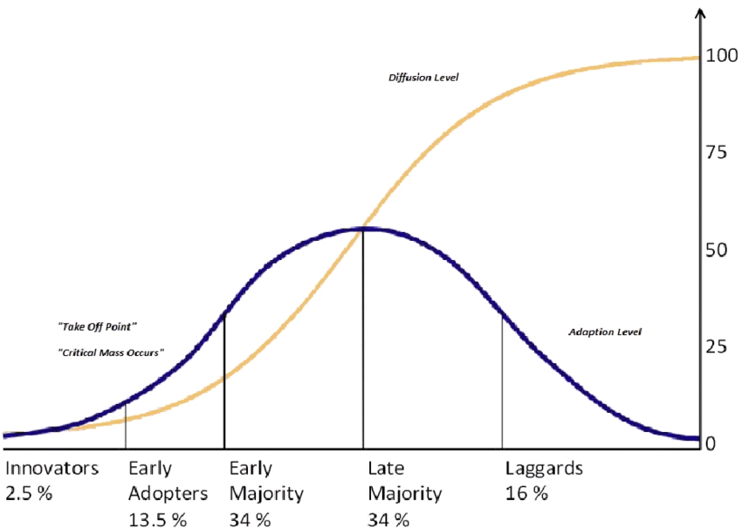
The ‘S’ Curve

Slide 39
Process of Technology Adoption
technology adoption occurs in stages
each stage occurs through a series of communication channels, over a period of time, among the members of a similar social system
exposure occurs via existing communication channels, many of which are established among the members of a similar social system

Slide 40
Exposure within Social Systems
the concepts of homophily and heterophily are used to explain the nature of social systems
homophily is the tendency of individuals to associate and bond with similar others
heterophily is the tendency of individuals to collect in diverse groups
most people have a combination of homophilous and heterophilous ties and behaviours
diffusion will be easily promoted among homophilous people, and within homophilous groupings
however, diffusion requires a certain degree of heterophily, for new ideas to be introduced outside of homophilous groupings

Slide 41
Process of Technology Adoption
awareness:
first exposure, lacking information, not yet been inspired to find out more
persuasion:
interest gained, actively seeking more info
decision: choice point
technology gets adopted or not?
implementation:
start using the technology, determining usefulness
adoption:
confirmation and continuation of use

Slide 42
The Decision Choice Point
Two factors play into the decision of whether a new technology is adopted
the degree of choice (the degree to which a decision can be made freely and implemented voluntarily)
who is making the decision

Slide 43
The Decision Choice Point: Types of Decisions
Optional:
made by an individual, who weighs the advantages/disadvantages and decides whether to adopt or reject the innovation
this may be a consumer decision (or not)
Collective
decision gets made made collectively by all participants.
Authority
decision gets made by individuals in positions of influence or power for the entire social system

Slide 44
Technology Acceptance, I
technology acceptance is an issue that is:
described primarily in organizational contexts (such as companies, which purchase or do in-house design of technologies for their employees to use)
primarily in discipline of Information Systems (IS)*

Slide 45
Technology Acceptance, II
technology acceptance is considered to be an issue
why? because “white collar performance” gets “often obstructed by users’ unwillingness to accept and use available systems” (Grudin, 2012)
“we bought this expensive system and now our employees refuse to use it”
The discipline of Information Systems is concerned with design questions such as these:
what factors can influence the acceptance of technologies in these organizational contexts?
we know that perceptions of the incoming technology is a key factor, so how can we influence the perceptions of users of technologies that are about to be deployed?

Slide 46
Technology Use vs Technology Acceptance
we can see that technology acceptance is a case of technology use and adoption, with characteristic communication channels, social structure, decision making
technology use is a broader phenomena

Slide 47
Case Study: technology as a service
Example:
think of rural telephone use, particularly in developing regions (e.g. Parikh and Lazowska 2006)
only one or a few people in a village might own a telephone
the relaying of telephone messages can become a service performed on behalf of others
does it make sense to refer to the person who sends and receives phone messages as a user of the telephone?
they are a user even if they do not press the buttons?

Slide 48
‘Displaced User’
The characteristic picture of the user is of a person sitting in front of a computer or within arm’s reach of a computer system (Carroll 2003).
What if a person has all the capacities of the interactive system available to them, albeit at second hand?
Would it make sense to also call this person a user?

Slide 49
Case Study: Types of Non-Use
Christine Satchell and Paul Dourish. 2009. Beyond the user: use and non-use in HCI. In Proceedings of the 21st Annual Conference of the Australian Computer-Human Interaction Special Interest Group: Design: Open 24/7 (OZCHI '09). Association for Computing Machinery, New York, NY, USA, 9–16. DOI:https://doi.org/10.1145/1738826.1738829
Satchell and Dourish (2009) identified several different types of non-use
active resistance
disenchantment
disenfranchisement
disinterest

