Slide 1
ISC Management System

Slide 2
Introduction
PRODUCT OWNER
Hà Thanh Liêm
SCRUM MASTER
Đinh Thanh Sơn
SCRUM TEAM
Lê Quang Bảo
Phạm Thị Thu Sương
Võ Minh Thư
Thạch Thị Kiều Linh
Nguyễn Thị Mai Trang
Phạm Nguyễn Quốc Việt
Vũ Quang Bình

Slide 3
Content
Technologies used
Database structure
Documents
Features & Assignments
Demo

Slide 4
Technologies used
1

Slide 5
Technologies used
Front-end:
AngularJS 1x
Bootstrap
Jquery
Ui grid
Back-end
Spring MVC
Maven
Hibernate
Tomcat
Springboot
Database management system
MySQL

Slide 6
Database structure
2

Slide 7
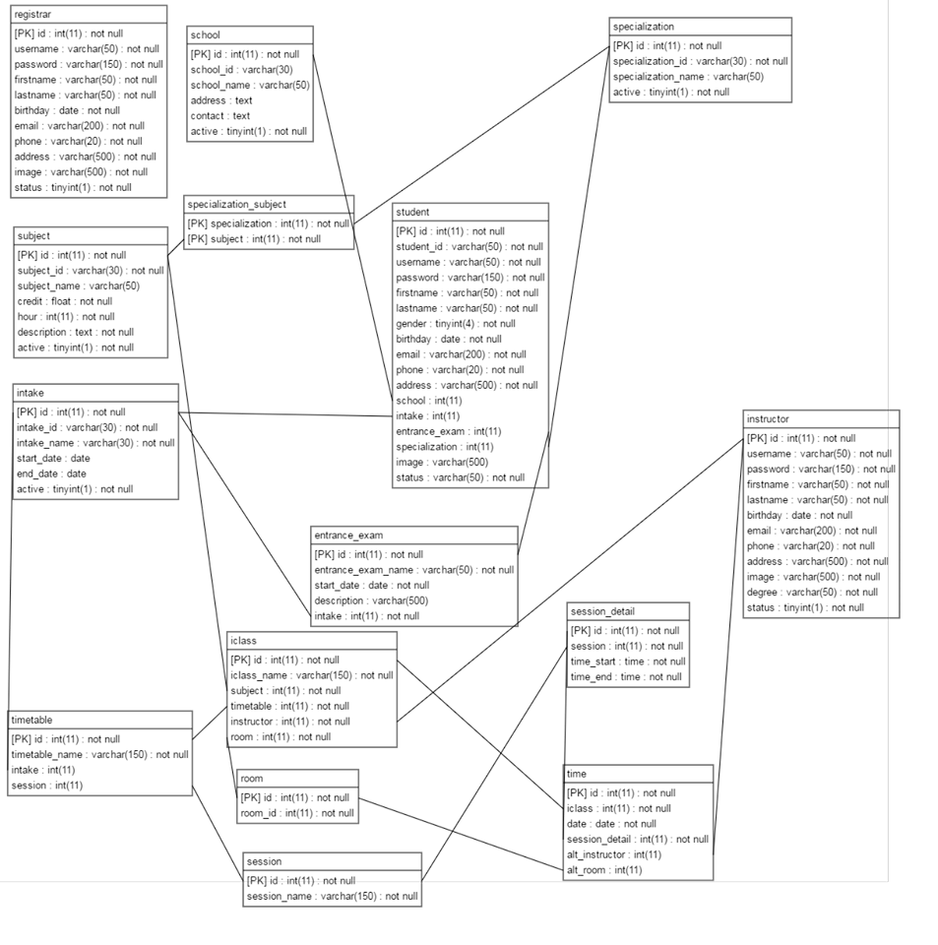
Database structure

Slide 8
Documents
3

Slide 9
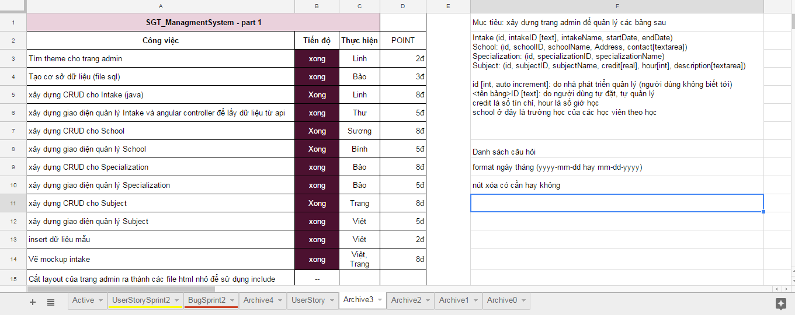
Documents
Tasks

Slide 10
Features & Assignments
4

Slide 11
Features & Assignments
Sprint 1 | Build admin website
Create database | Database for Intake, School, Course management
Intake management | CRUD Layout, controller for Intake. Layout includes filter, paging, validate
School management | CRUD Layout, controller for School Layout includes filter, paging, validate
Course management | CRUD Layout, controller for Course Layout includes filter, paging, validate
Specialization management | CRUD Layout, controller for Speciliazation Layout includes filter, paging, validate

Slide 12
Features & Assignments
Sprint 2 | Continue developing admin website’s feature
Create database | Database for Registrar, Instructor, Student, Entrance exam management
Registrar management | CRUD, reset password Layout, controller for Registrar. Layout includes filter, paging, validate, sort descending or ascending
Instructor management | CRUD, reset password Layout, controller for Instructor Layout includes filter, paging, validate, sort descending or ascending
Student management | CRUD, reset password Layout, controller for Student Layout includes filter, paging, validate, sort descending or ascending
Login form | Validate Username and Password
Fix bugs of Sprint 1 | Can not insert vietnamese word, can not validate duplicate ID
Add course for specilization | One course can be added into many specialiazation
Entrance exam | One intake can have many entrance exam
Data processing | Update all the information that was edited and bcrypt password in database

Slide 13
Features & Assignments
Sprint 3 | Continue developing admin website’s feature
Create database | Database for Time table, Room, Session, Class, subclass
Session management | CRUD Layout, controller for Session. Layout includes filter, paging, validate
Room management | CRUD Layout, controller for Room Layout includes filter, paging, validate
Timetable management | CRUD, reset password Layout, controller for Student Layout includes filter, paging, validate, build timetable for each intake, create new class base on course and instructor.
Export file excel | Apply for all the managements
Fix bugs of Sprint 2 | Some small bugs
Report | View report timetable by class or by instructor.

