Slide 1

PROJECT DEMO
Human Resource Management
Presenter: Le Qui Long
Mentor: Nguyen Trong Hoang
Nguyen Xuan Giang

Slide 2


Presentation agenda
Project
overview
Technologies
1
2
3
4
Project
structure
Features

Slide 3
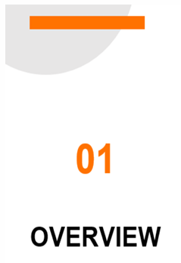
1. Project overview
Introduction: This project aims at creating a human resource
management application
Objectives:
Create a secured app with authentication and authorization
Allow many roles to serve different purposes
Allow user to view, change their info, create leave request, create salary raise request
Allow pm to give attendance to employees in their manage, accept or reject their leave request
Allow admin to manage projects; handle employee’s salary raise request
1
2
3
4

Slide 4












2. Applied technologies
1
2
3
4

Slide 5

3. Features
Login: through company account or email
User
Forgot password: token will be sent to their email
Account:
2
1
View, change their basic info
Upload avatar
View projects history
View attendance history
Create new, view leave request history
Create new, view salary raise history
3
4

Slide 6

3. Features
Features of user
PM
Give attendance: give attendance to all employees in their manage
1
2
Handle leave request: accept or reject leave requests created by employees in their manage
3
4

Slide 7

3. Features
Features of user
ADMIN
Manage projects:
Create, update projects
Assign employees to projects
Search employees by role, tech, effort, …
1
2
3
4
Handle salary raise request: accept or reject salary raise requests created by employees

Slide 8

3. Features
SCHEDULE
Everyday attendance notification
Weekly attendance report
1
2
Update employee’s leave days monthly
3
4

Slide 9
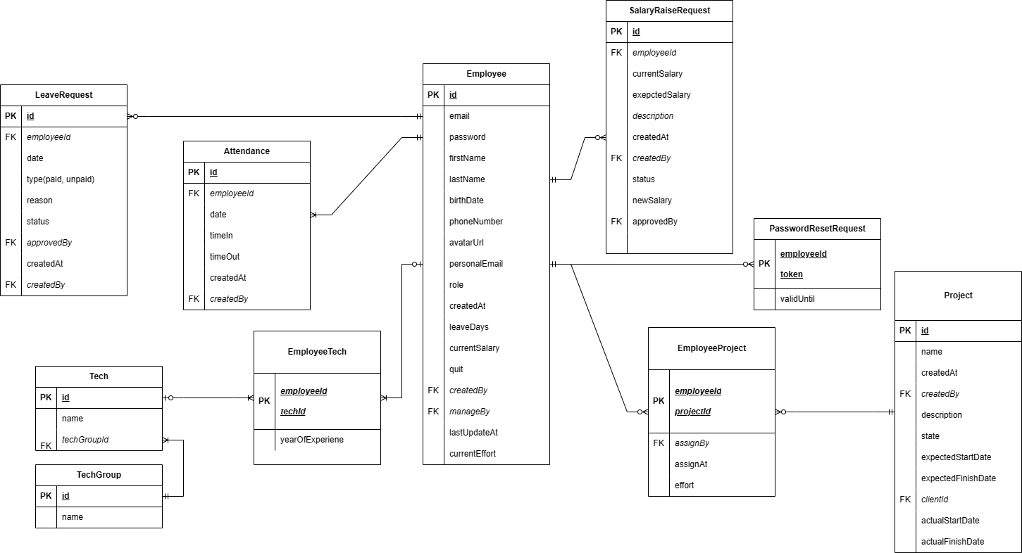
4. Structure
Database diagram
1
2
3
4

Slide 10
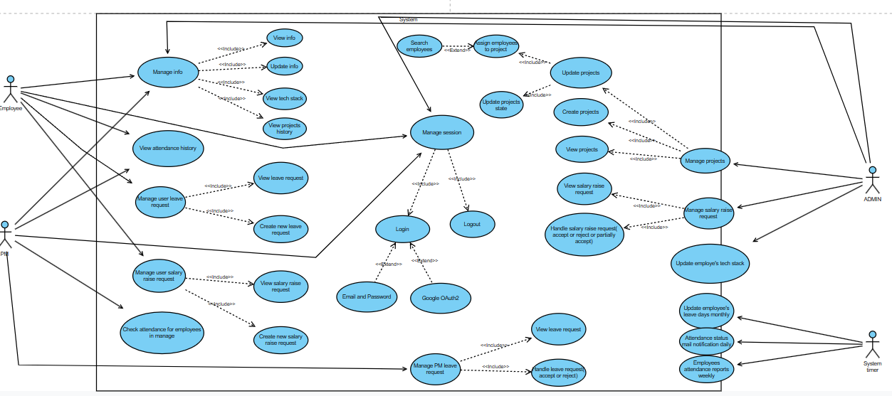
4. Structure
Use case diagram
1
2
3
4

Slide 11
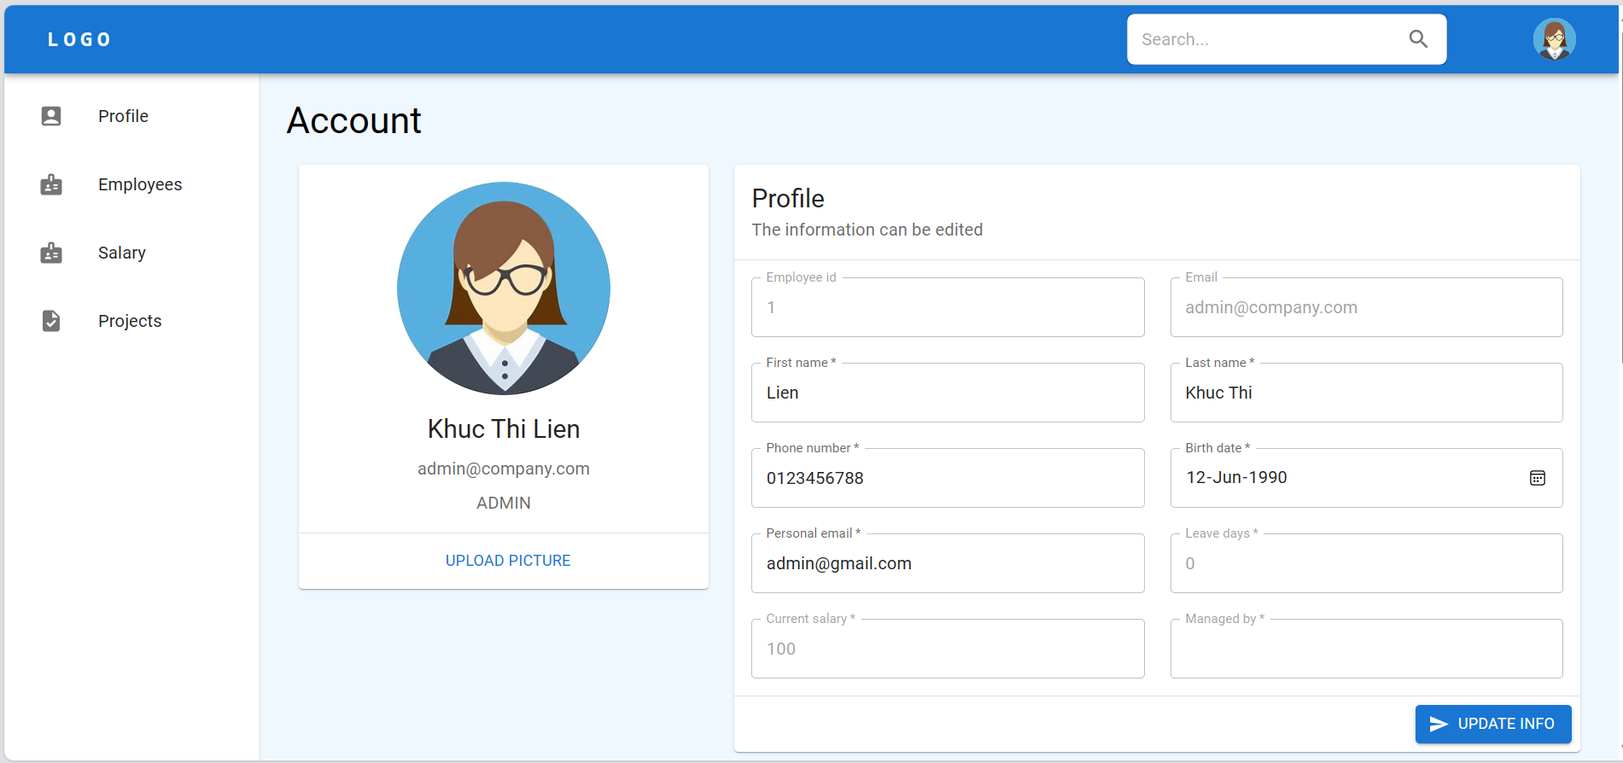
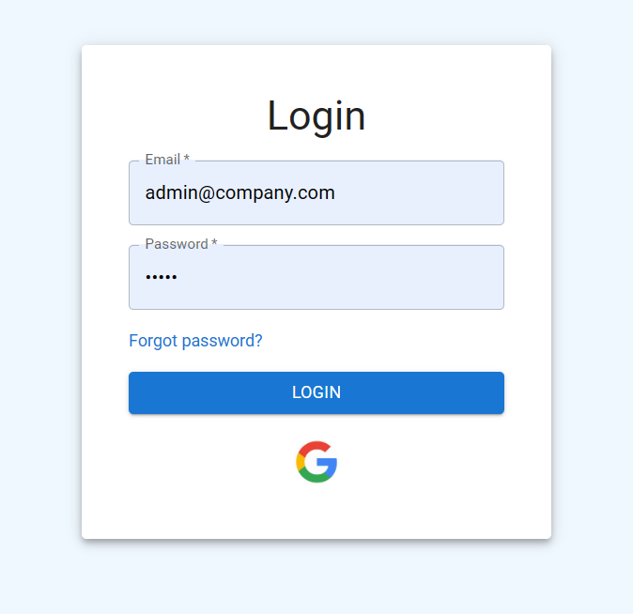
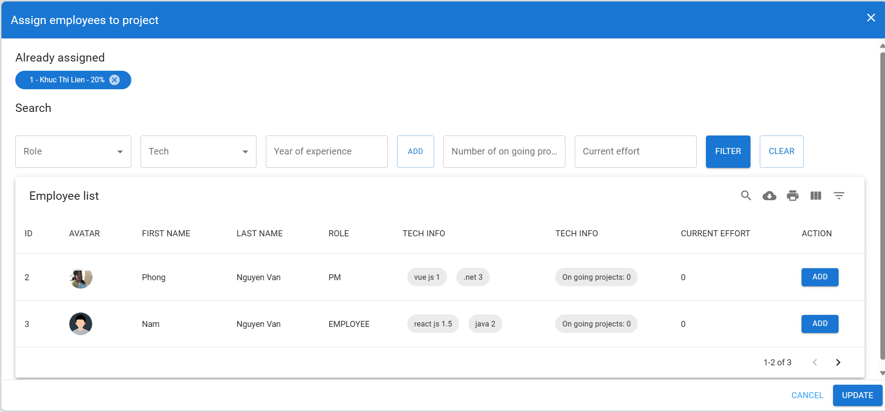
4. Structure
Mockup
1
2
3
4

Slide 12
Thanks for listening!
1
2
3
4

