Slide 1

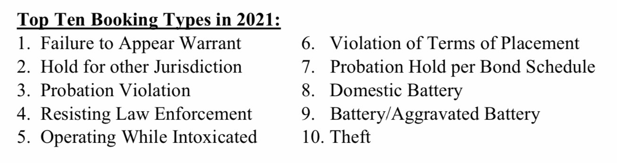
ComParing the top TEN bookings included in the Eve Hill Study. (from MCCC Annual report 2019) to current data
Operating While Intoxicated
Violation of Terms of Placement
Failure to Appear Warrant
Probation Violation
[not discussed]
[not discussed]
[not discussed]
Possession of Methamphetamine
Public Intoxication
Possession of Paraphernalia
Source: MCCC 2021 Annual Report
Research into the 2019 MCCC
Annual Report to identify 5,6,and 7
is ongoing.

Slide 2
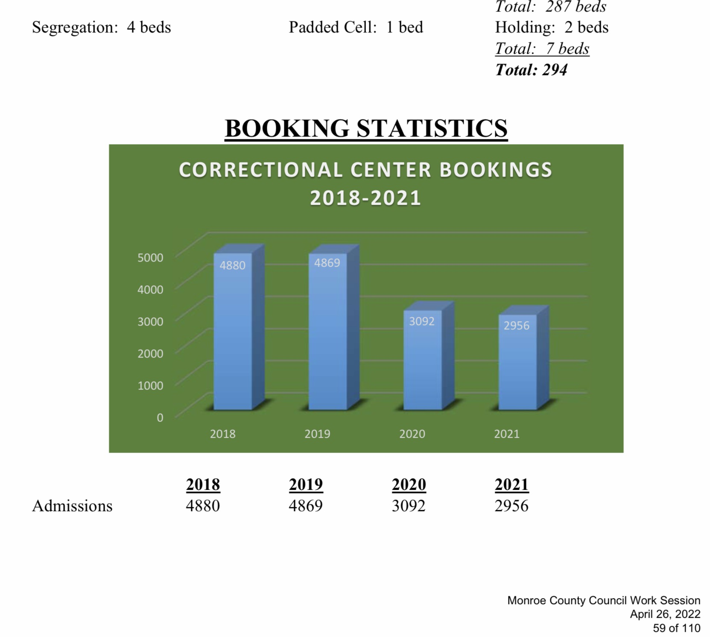
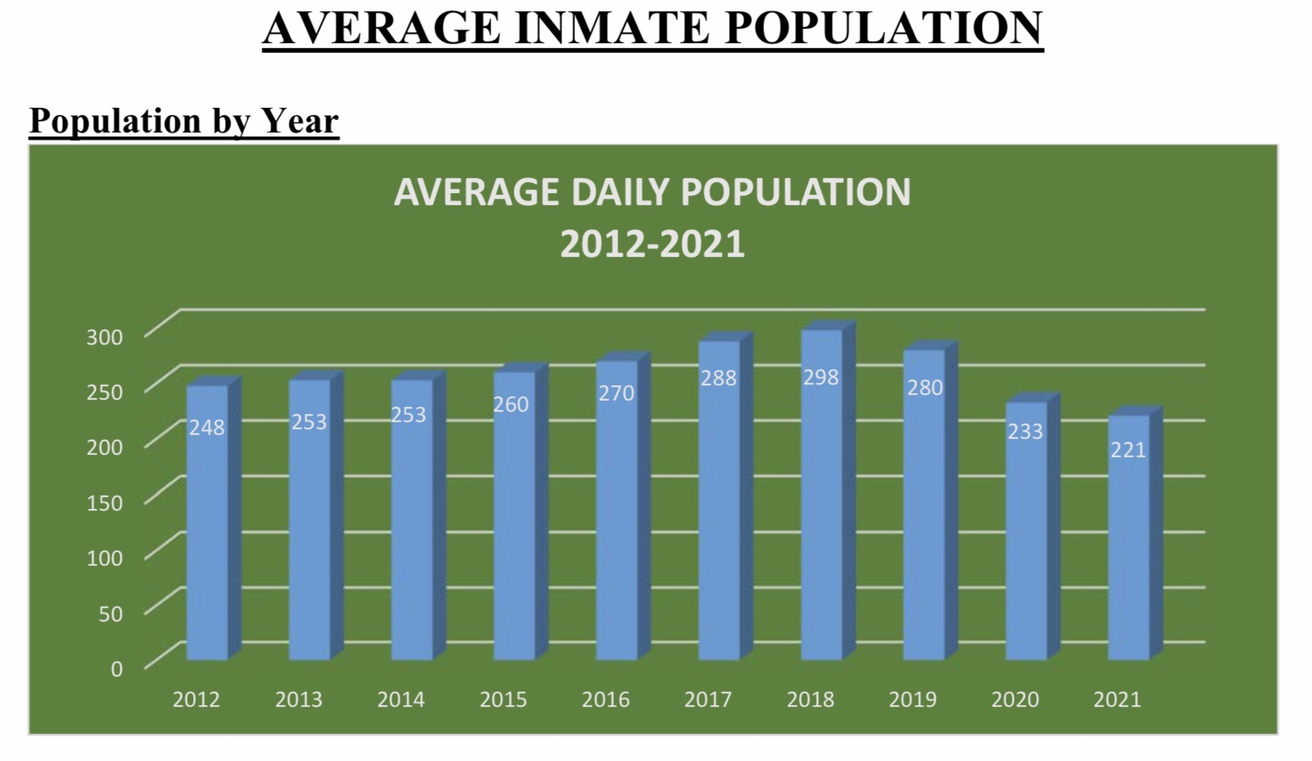
how Many and Why?
From MCCC 2021 Annual Report (online via the Monroe County website, material dated April 26, 2022).

Slide 3

how Many and Why?
From MCCC 2021 Annual Report (online via the Monroe County website, material dated April 26, 2022).

Slide 4
