Slide 1
Stratified Graph Spectra
Fanchao Meng
Biocomplexity Institute
mf3jh@Virginia.edu

Slide 2
Brief Plot
Background:
Graph Fourier Transform (GFT) is a fundamental tool in profiling spectral characteristics of real-valued graph signals.
Problem:
Most graph learning models (e.g. GCN) use vector-valued graph signals. And theoretically GFT is not applicable anymore.
Substitutes are wanted.
Our Solutions:
Five methods as substitutes for GFT on vector-valued graph signals.
Stratified graphs seeing the same graph from different levels of adjacency.

Slide 3
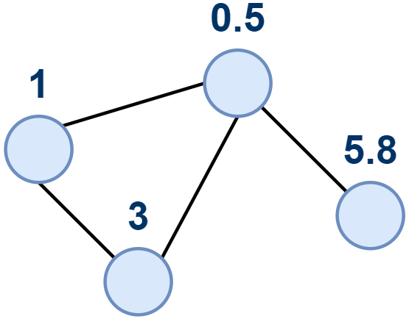
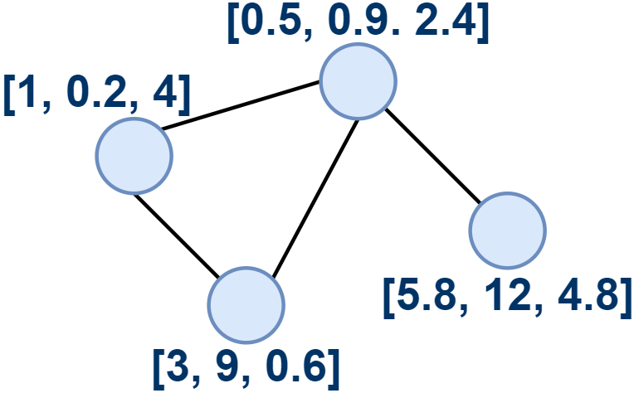
Real-Valued Signals vs Vector-Valued Signals
Real-Valued Graph Signal
Vector-Valued Graph Signal

Slide 4
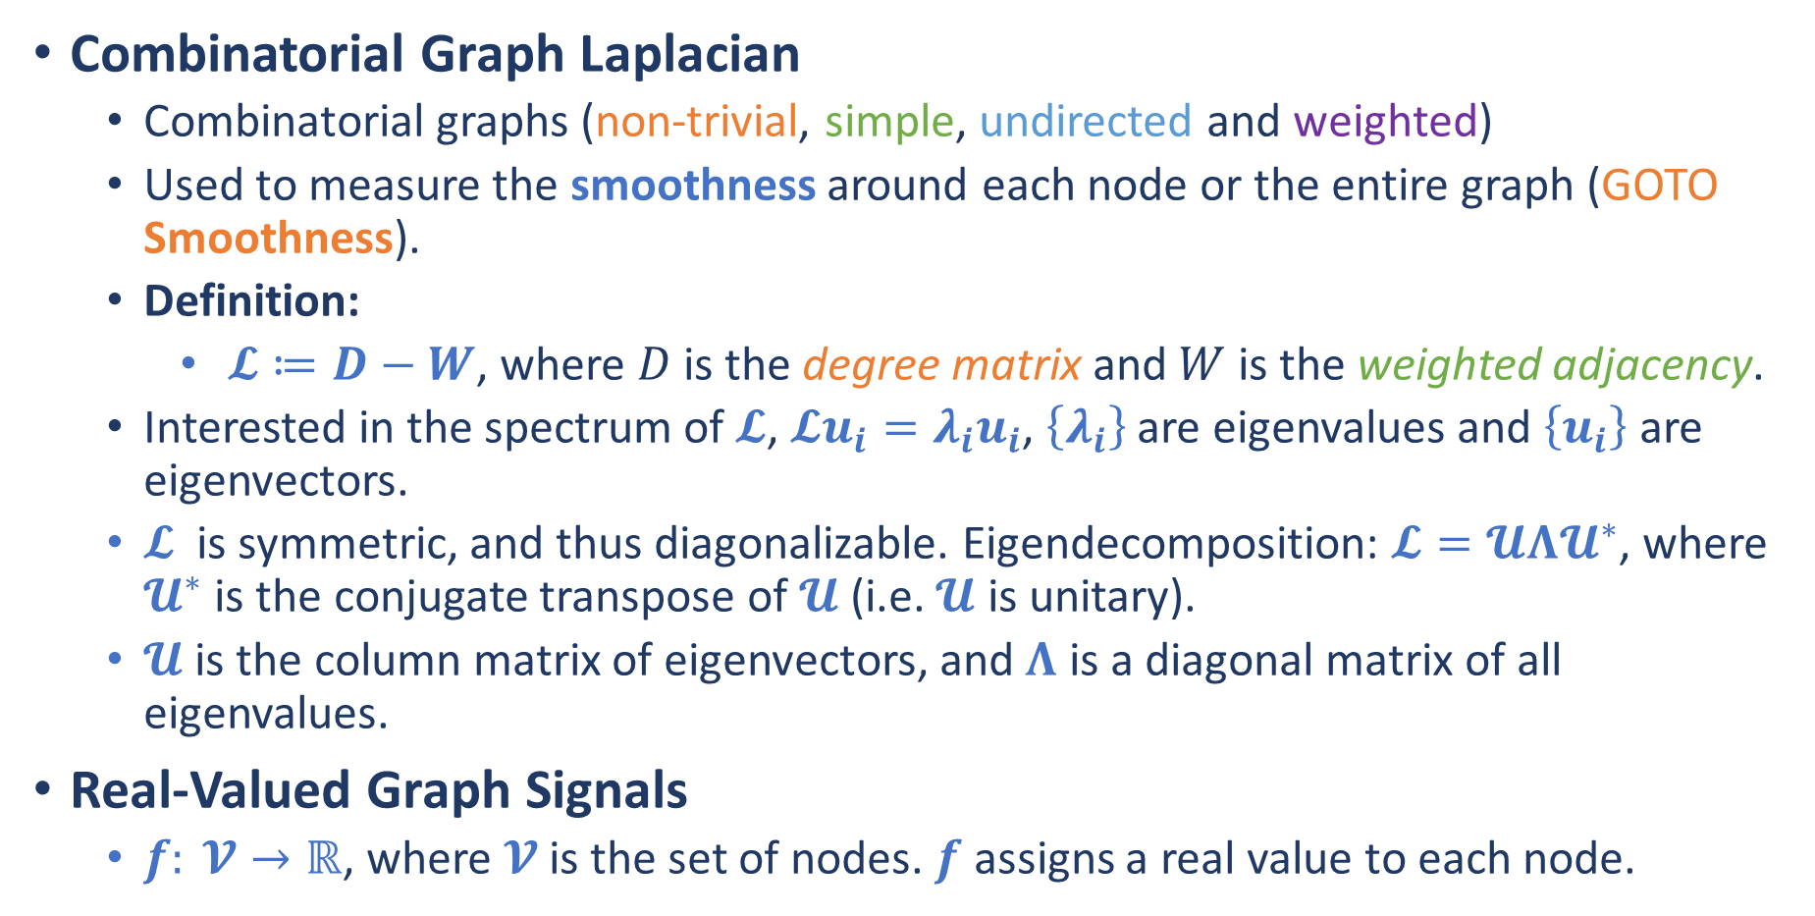
Graph Fourier Transform
Combinatorial Graph Laplacian
Combinatorial graphs (non-trivial, simple, undirected and weighted)
Used to measure the smoothness around each node or the entire graph (GOTO Smoothness).
Definition:
$𝓛≔D−W$, where $D$ is the degree matrix and $W$ is the weighted adjacency.
Interested in the spectrum of $𝓛$, $𝓛u_{i}=λ_{i}u_{i}$, $\left\{λ_{i}\right\}$ are eigenvalues and $\left\{u_{i}\right\}$ are eigenvectors.
$𝓛$ is symmetric, and thus diagonalizable. Eigendecomposition: $𝓛=𝓤Λ𝓤^{∗}$, where $𝓤^{∗}$ is the conjugate transpose of $𝓤$ (i.e. $𝓤$ is unitary).
$𝓤$ is the column matrix of eigenvectors, and $Λ$ is a diagonal matrix of all eigenvalues.
Real-Valued Graph Signals
$f: 𝓥→ℝ$, where $𝓥$ is the set of nodes. $f$ assigns a real value to each node.

Slide 5
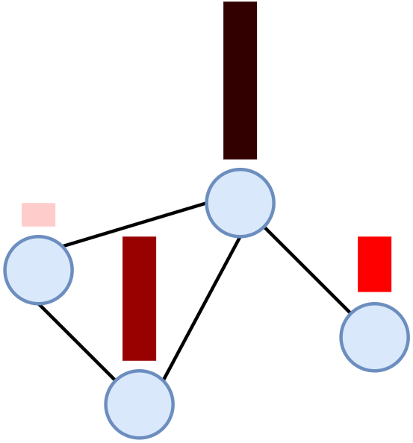
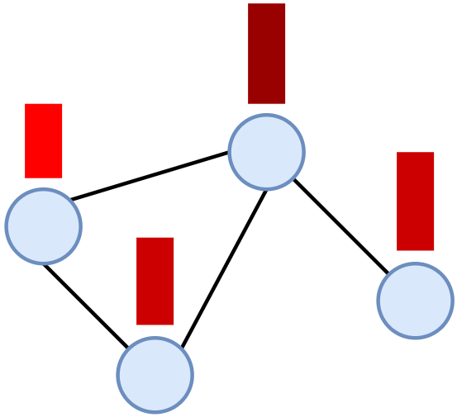
Smoothness
Smooth
Not Smooth
Adjacent nodes are similar.
Adjacent nodes are NOT similar.

Slide 6
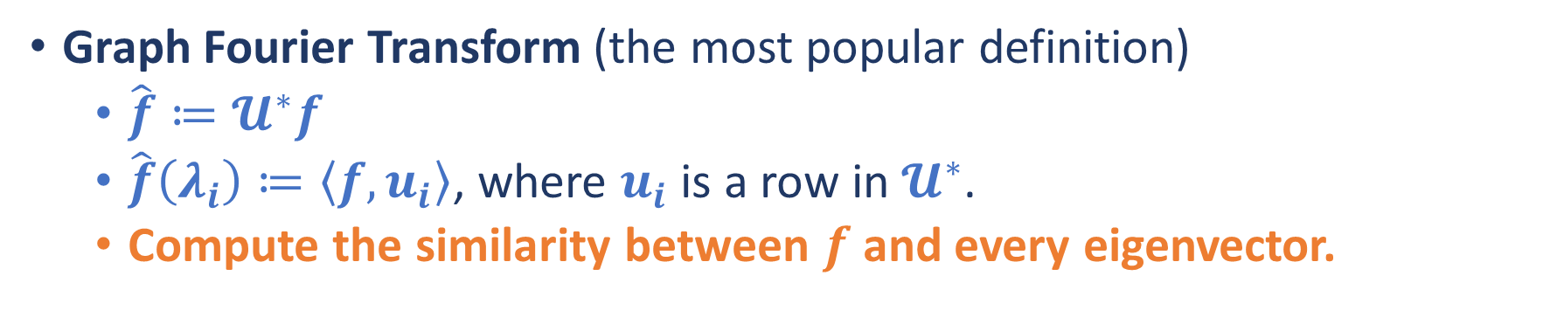
Graph Fourier Transform
Graph Fourier Transform (the most popular definition)
$\hat{f}≔𝓤^{∗}f$
$\hat{f}\left(λ_{i}\right)≔\left\langle f, u_{i}\right\rangle$, where $u_{i}$ is a row in $𝓤^{∗}$.
Compute the similarity between $f$ and every eigenvector.
The ESSENSE of GFT!!

Slide 7
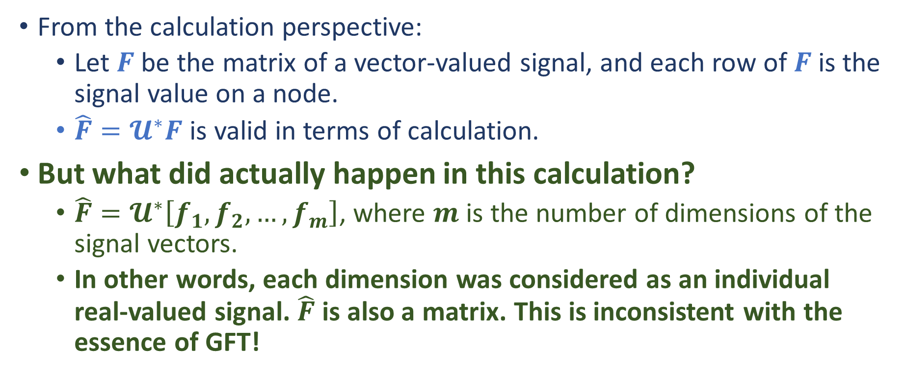
GFT on Vector-Valued Graph Signals?
From the calculation perspective:
Let $F$ be the matrix of a vector-valued signal, and each row of $F$ is the signal value on a node.
$\hat{F}=𝓤^{∗}F$ is valid in terms of calculation.
But what did actually happen in this calculation?
$\hat{F}=𝓤^{∗}\left[f_{1},f_{2},…,f_{m}\right]$, where $m$ is the number of dimensions of the signal vectors.
In other words, each dimension was considered as an individual real-valued signal. $\hat{F}$ is also a matrix. This is inconsistent with the essence of GFT!
Need something new!

Slide 8
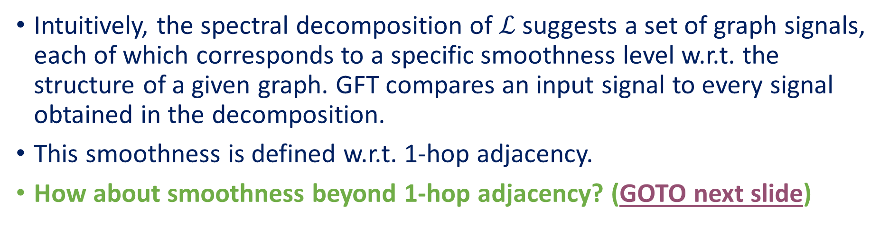
Resolutions of GFT
Intuitively, the spectral decomposition of $ℒ$ suggests a set of graph signals, each of which corresponds to a specific smoothness level w.r.t. the structure of a given graph. GFT compares an input signal to every signal obtained in the decomposition.
This smoothness is defined w.r.t. 1-hop adjacency.
How about smoothness beyond 1-hop adjacency? (GOTO next slide)
Should consider adjacency beyond 1-hop!

Slide 9
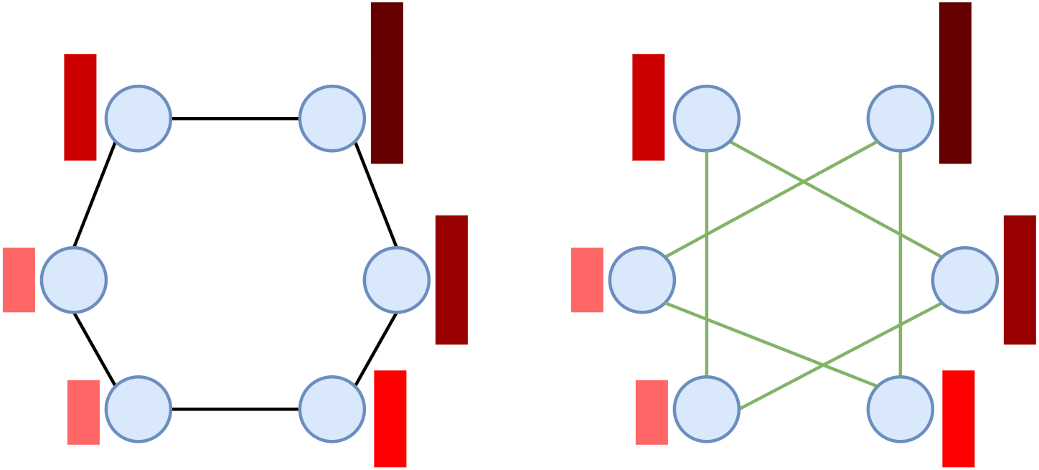
Resolutions of GFT
1-hop adjacency
2-hop adjacency

Slide 10
What We Proposed
Stratified Graphs (SGs)
Consider adjacency beyond 1-hop.
Stratified Graph Spectra (SGS) Methods
Substitutes for GFT.

Slide 11
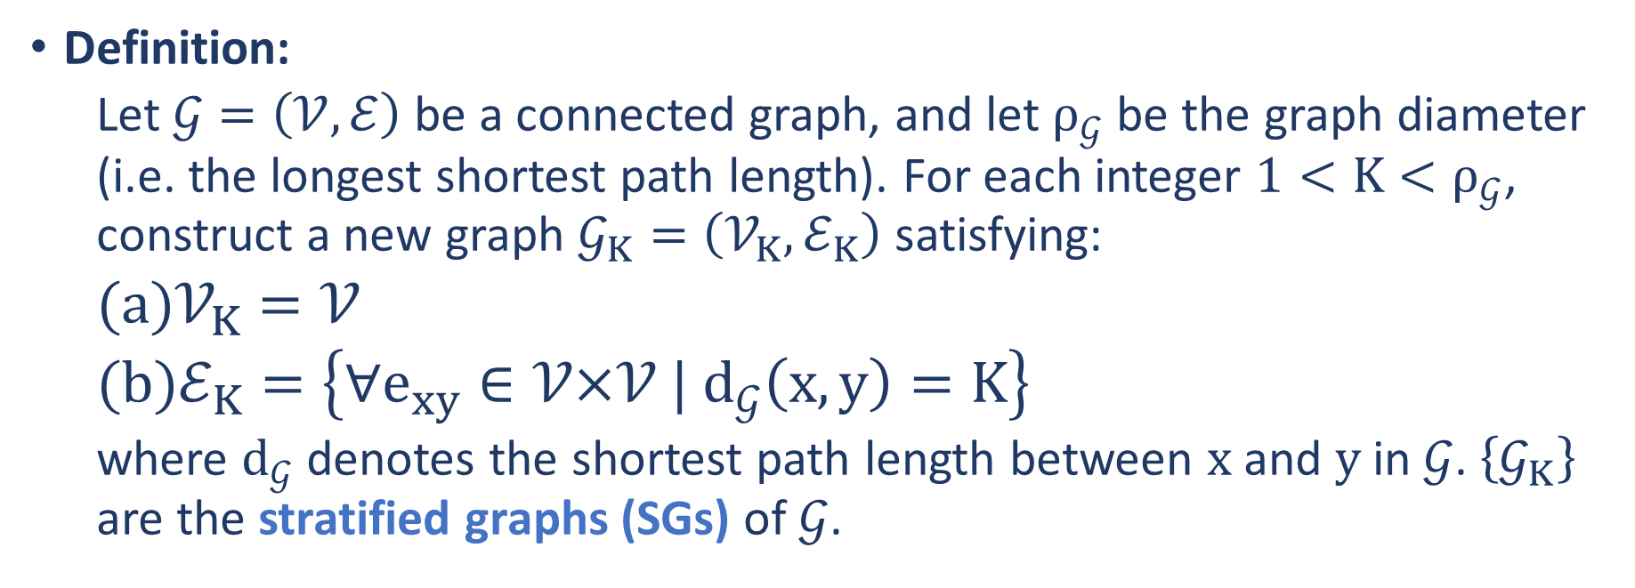
Stratified Graphs
Definition:
Let $𝒢=\left(𝒱,ℰ\right)$ be a connected graph, and let $ρ_{𝒢}$ be the graph diameter (i.e. the longest shortest path length). For each integer $1<K<ρ_{𝒢}$, construct a new graph $𝒢_{K}=\left(𝒱_{K},ℰ_{K}\right)$ satisfying:
$𝒱_{K}=𝒱$
$ℰ_{K}=\left\{∀e_{xy}∈𝒱\text{×}𝒱 | d_{𝒢}\left(x, y\right)=K\right\}$
where $d_{𝒢}$ denotes the shortest path length between $x$ and $y$ in $𝒢$. $\left\{𝒢_{K}\right\}$ are the stratified graphs (SGs) of $𝒢$.

Slide 12
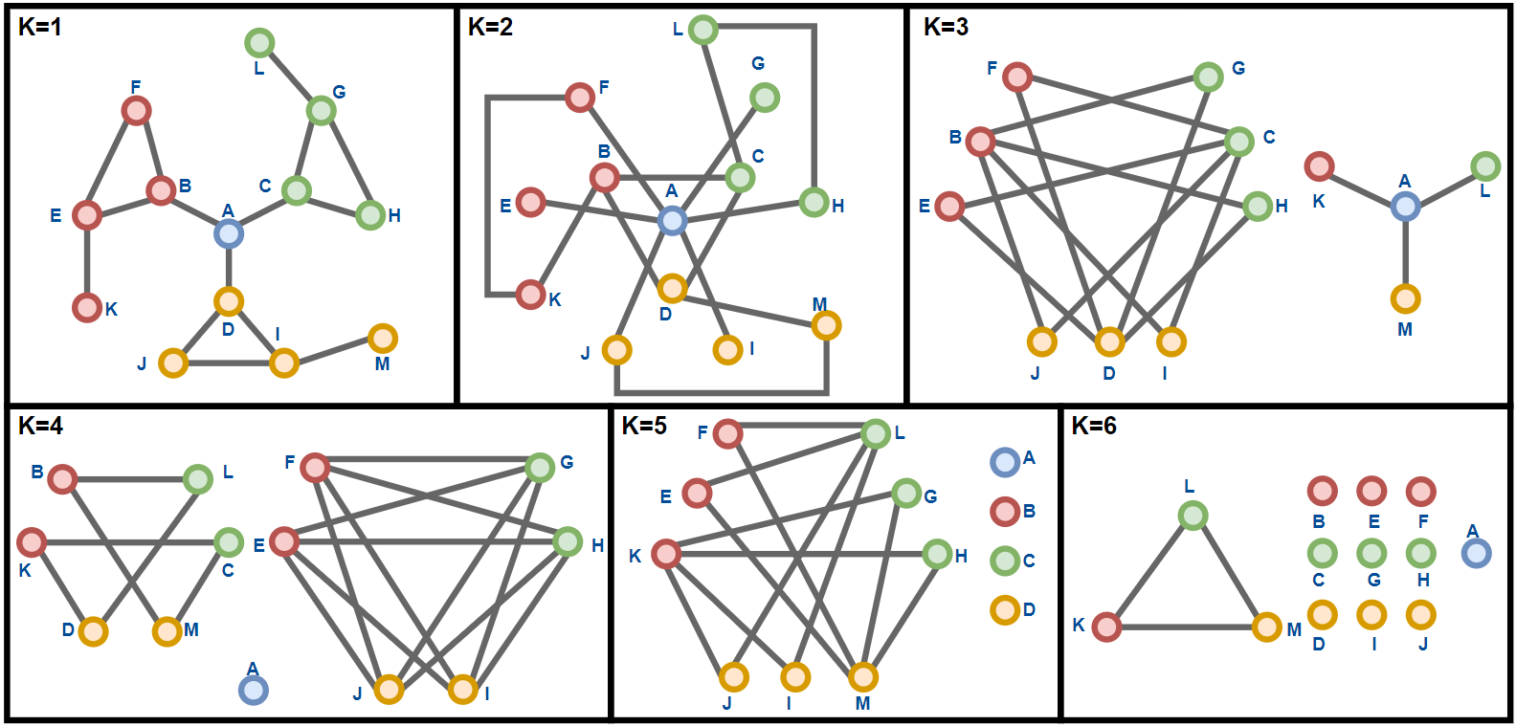
Stratified Graphs
A variant of the Caveman graph

Slide 13
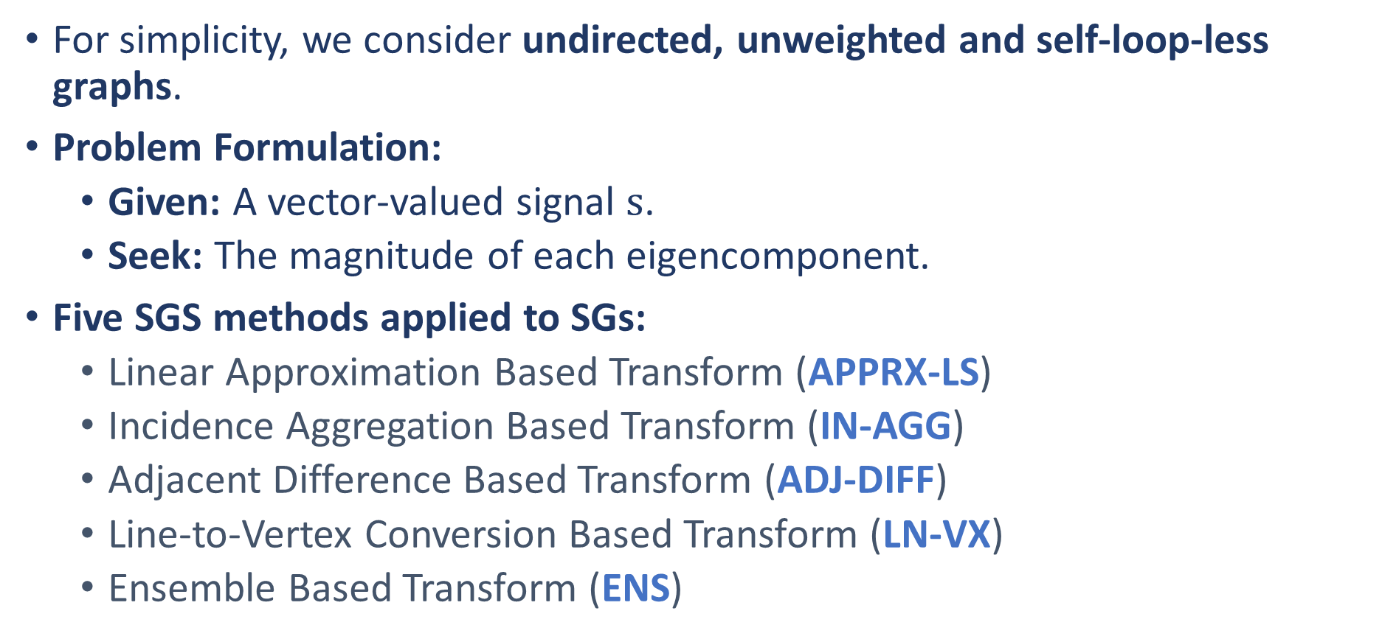
Stratified Graph Spectra Methods
For simplicity, we consider undirected, unweighted and self-loop-less graphs.
Problem Formulation:
Given: A vector-valued signal $s$.
Seek: The magnitude of each eigencomponent.
Five SGS methods applied to SGs:
Linear Approximation Based Transform (APPRX-LS)
Incidence Aggregation Based Transform (IN-AGG)
Adjacent Difference Based Transform (ADJ-DIFF)
Line-to-Vertex Conversion Based Transform (LN-VX)
Ensemble Based Transform (ENS)

Slide 14
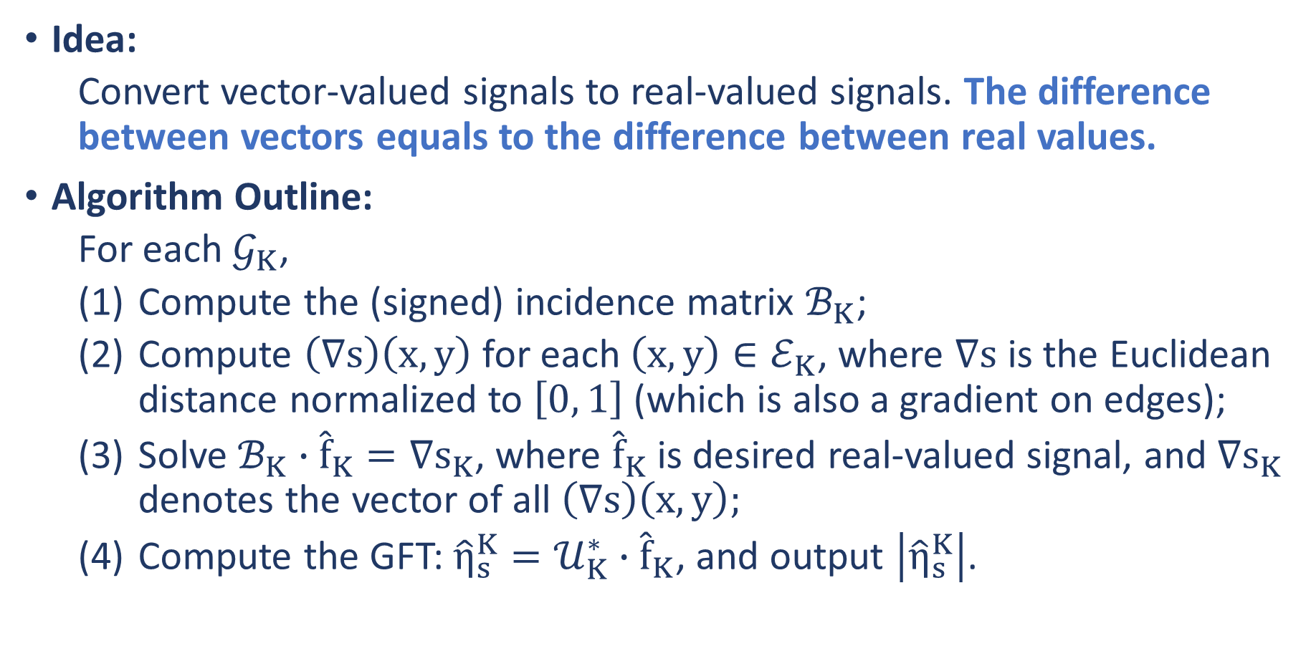
Linear Approximation Based Transform (APPRX-LS)
Idea:
Convert vector-valued signals to real-valued signals. The difference between vectors equals to the difference between real values.
Algorithm Outline:
For each $𝒢_{K}$,
Compute the (signed) incidence matrix $ℬ_{K}$;
Compute $\left(∇s\right)\left(x, y\right)$ for each $\left(x, y\right)∈ℰ_{K}$, where $∇s$ is the Euclidean distance normalized to $\left[0, 1\right]$ (which is also a gradient on edges);
Solve $ℬ_{K}∙{\hat{f}}_{K}=∇s_{K}$, where ${\hat{f}}_{K}$ is desired real-valued signal, and $∇s_{K}$ denotes the vector of all $\left(∇s\right)\left(x, y\right);$
Compute the GFT: ${\hat{η}}_{s}^{K}=𝒰_{K}^{∗}∙{\hat{f}}_{K}$, and output $\left|{\hat{η}}_{s}^{K}\right|$.

Slide 15
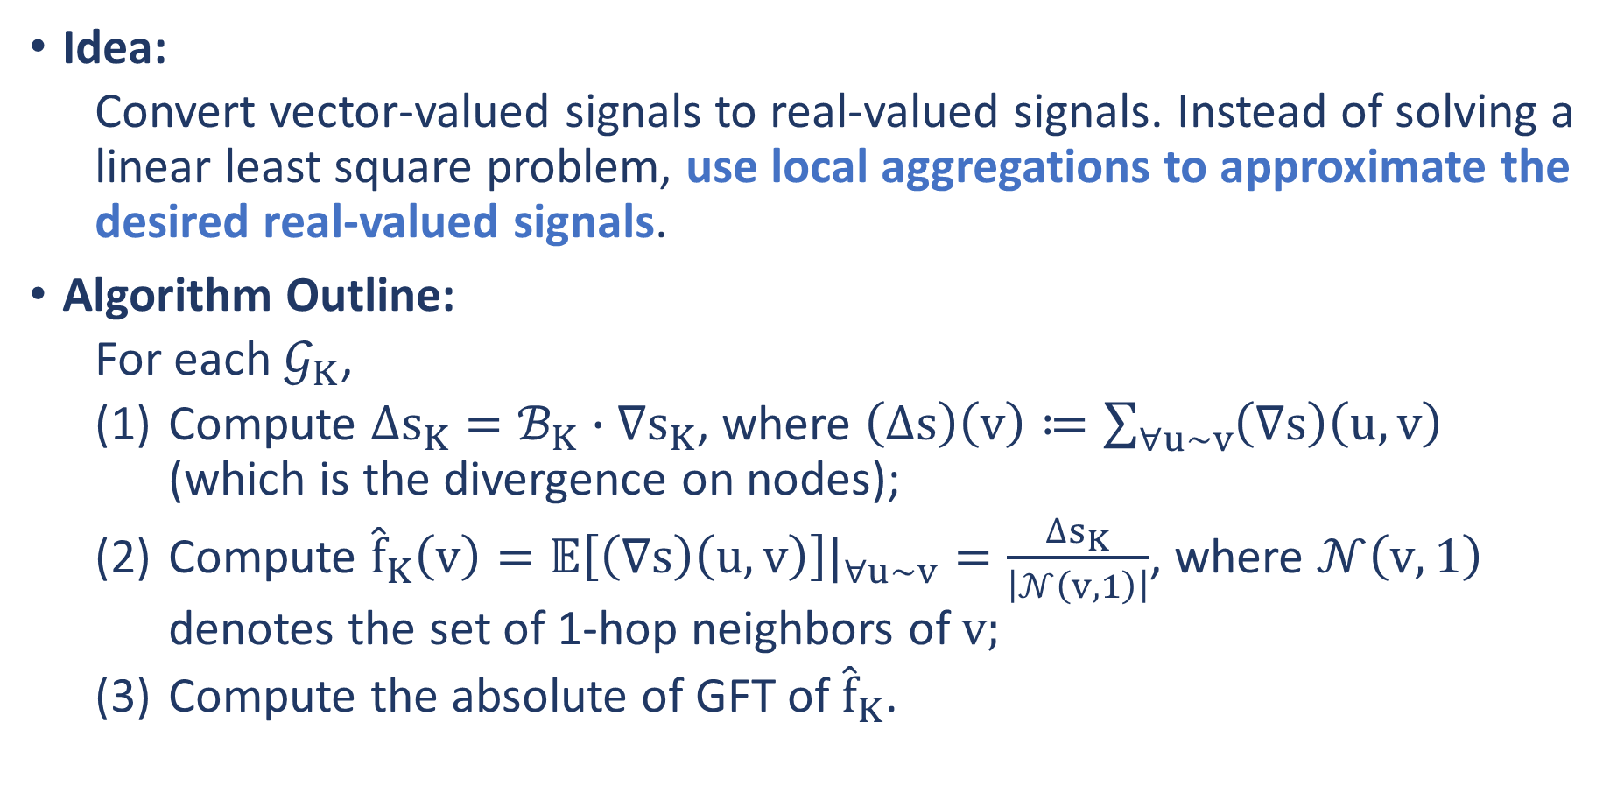
Incidence Aggregation Based Transform (IN-AGG)
Idea:
Convert vector-valued signals to real-valued signals. Instead of solving a linear least square problem, use local aggregations to approximate the desired real-valued signals.
Algorithm Outline:
For each $𝒢_{K}$,
Compute $∆s_{K}=ℬ_{K}∙∇s_{K}$, where $\left(∆s\right)\left(v\right)≔\sum_{∀u\sim v}{\left(∇s\right)\left(u,v\right)}$ (which is the divergence on nodes);
Compute ${\hat{f}}_{K}\left(v\right)=𝔼\left[\left(∇s\right)\left(u,v\right)\right]|_{∀u\sim v}=\frac{∆s_{K}}{\left|𝒩\left(v, 1\right)\right|}$, where $𝒩\left(v, 1\right)$ denotes the set of 1-hop neighbors of $v;$
Compute the absolute of GFT of ${\hat{f}}_{K}$.

Slide 16
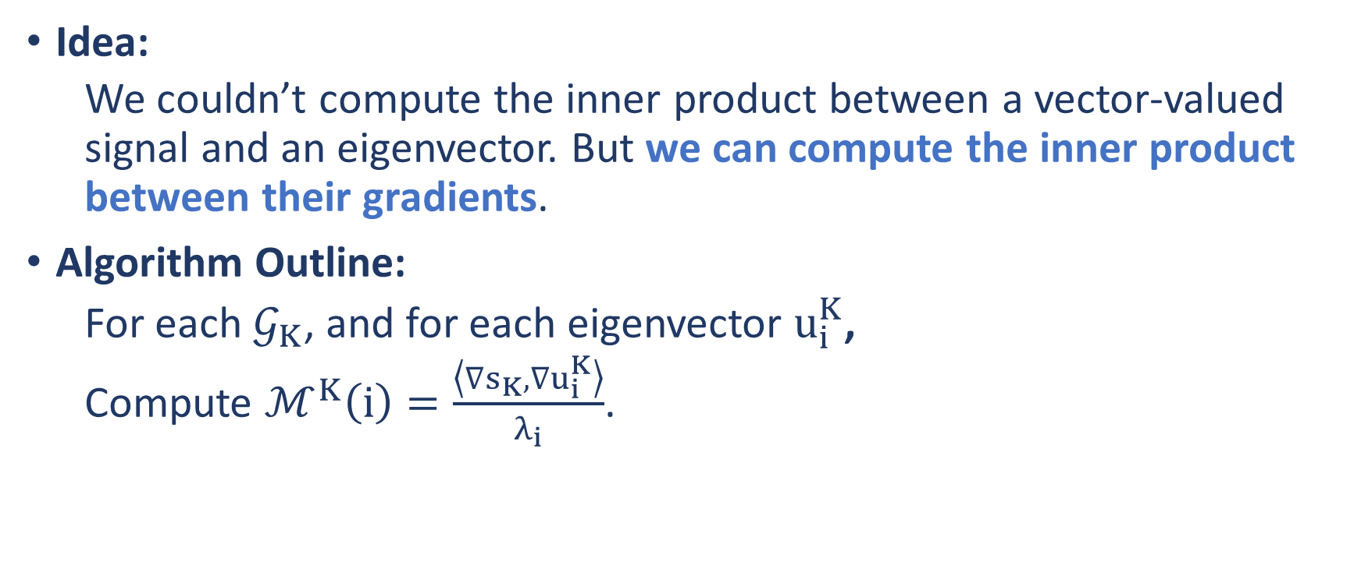
Adjacent Difference Based Transform (ADJ-DIFF)
Idea:
We couldn’t compute the inner product between a vector-valued signal and an eigenvector. But we can compute the inner product between their gradients.
Algorithm Outline:
For each $𝒢_{K}$, and for each eigenvector $u_{i}^{K}$,
Compute $ℳ^{K}\left(i\right)=\frac{\left\langle ∇s_{K},∇u_{i}^{K}\right\rangle }{λ_{i}}$.

Slide 17
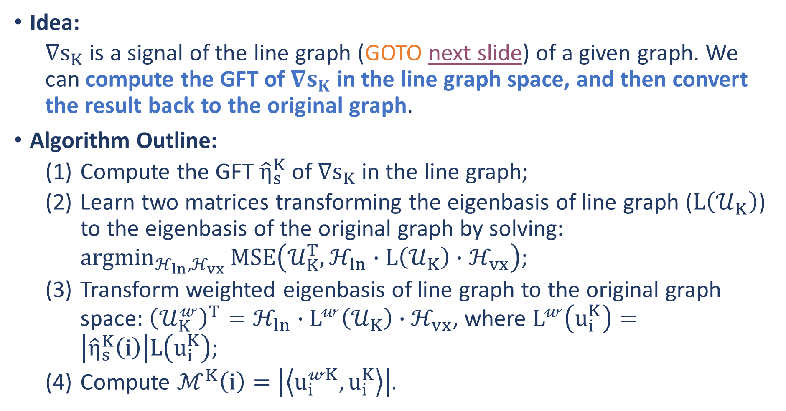
Line-to-Vertex Conversion Based Transform (LN-VX)
Idea:
$∇s_{K}$ is a signal of the line graph (GOTO next slide) of a given graph. We can compute the GFT of $∇s_{K}$ in the line graph space, and then convert the result back to the original graph.
Algorithm Outline:
Compute the GFT ${\hat{η}}_{s}^{K}$ of $∇s_{K}$ in the line graph;
Learn two matrices transforming the eigenbasis of line graph ($L\left(𝒰_{K}\right)$) to the eigenbasis of the original graph by solving: $\underset{ℋ_{ln},ℋ_{vx}}{argmin}{MSE\left(𝒰_{K}^{T},ℋ_{ln}∙L\left(𝒰_{K}\right)∙ℋ_{vx}\right)}$;
Transform weighted eigenbasis of line graph to the original graph space: ${\left(𝒰_{K}^{𝓌}\right)}^{T}=ℋ_{ln}∙L^{𝓌}\left(𝒰_{K}\right)∙ℋ_{vx}$, where $L^{𝓌}\left(u_{i}^{K}\right)=\left|{\hat{η}}_{s}^{K}\left(i\right)\right|L\left(u_{i}^{K}\right)$;
Compute $ℳ^{K}\left(i\right)=\left|\left\langle u_{i}^{𝓌K},u_{i}^{K}\right\rangle \right|.$

Slide 18
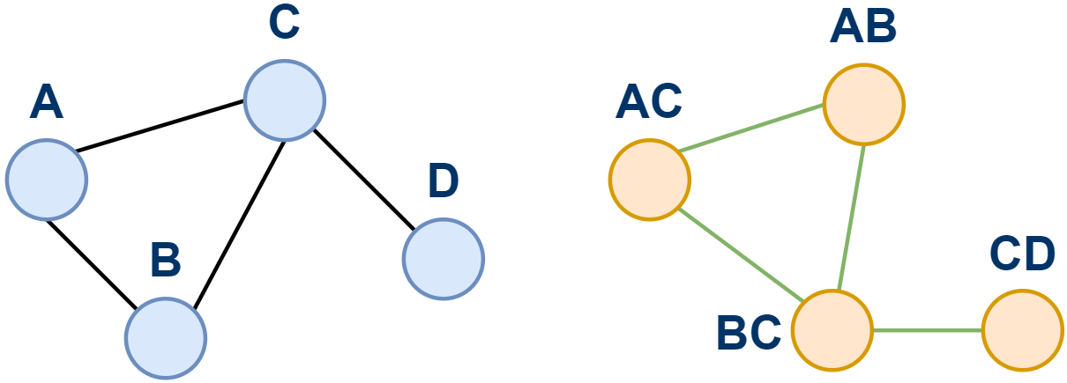
Line-to-Vertex Conversion Based Transform (LN-VX)

Slide 19
Ensemble Based Transform (ENS)
Idea:
Weighted sum of APPRX-LS, IN-AGG, ADJ-DIFF and LN-VX

Slide 20
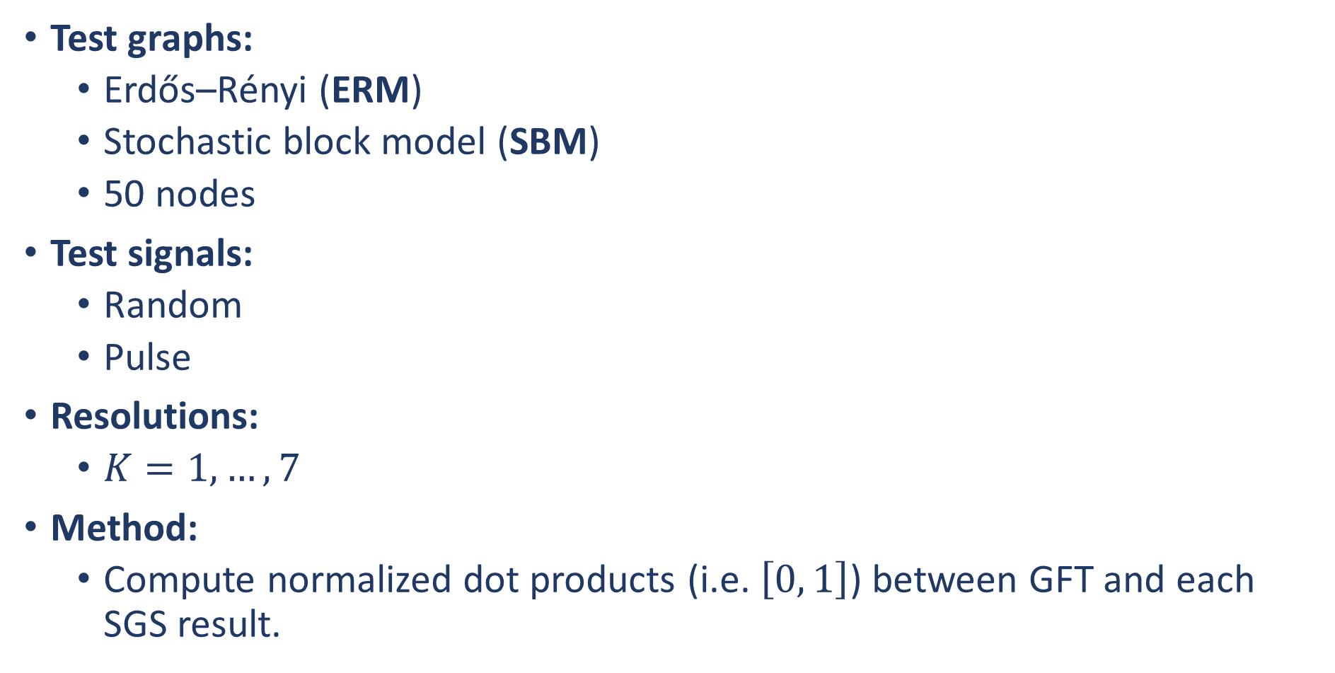
Task 1: SGS vs GFT on Real-Valued Graph Signals
Test graphs:
Erdős–Rényi (ERM)
Stochastic block model (SBM)
50 nodes
Test signals:
Random
Pulse
Resolutions:
$K=1, …, 7$
Method:
Compute normalized dot products (i.e. $\left[0, 1\right]$) between GFT and each SGS result.

Slide 21
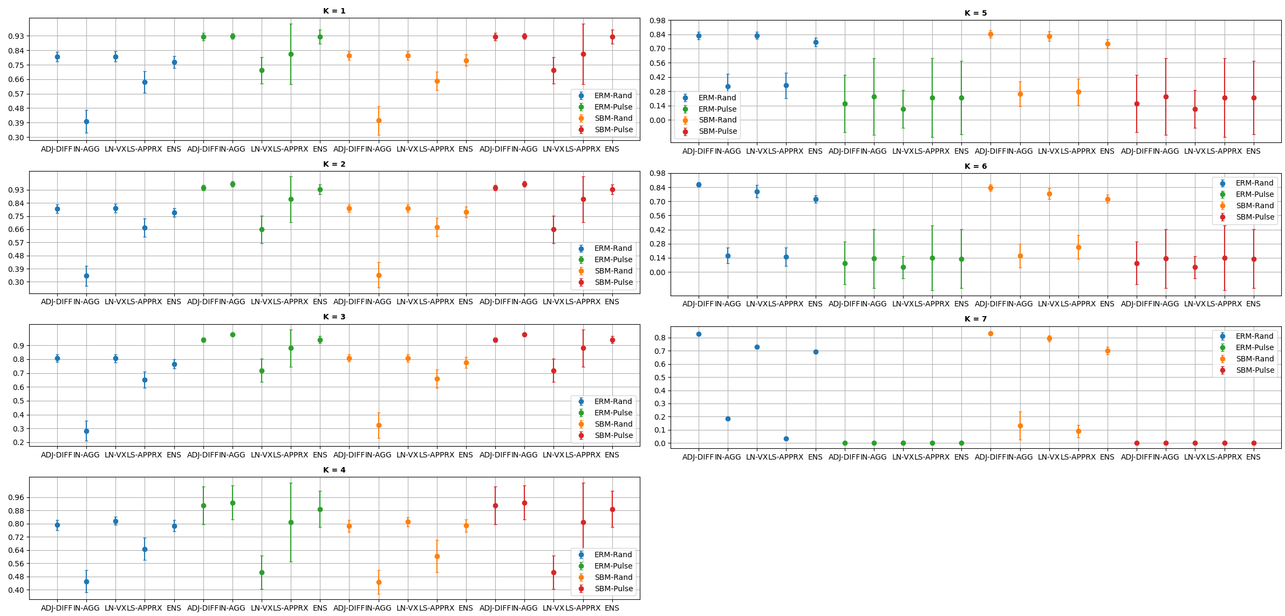
Task 1: SGS vs GFT on Real-Valued Graph Signals

Slide 22
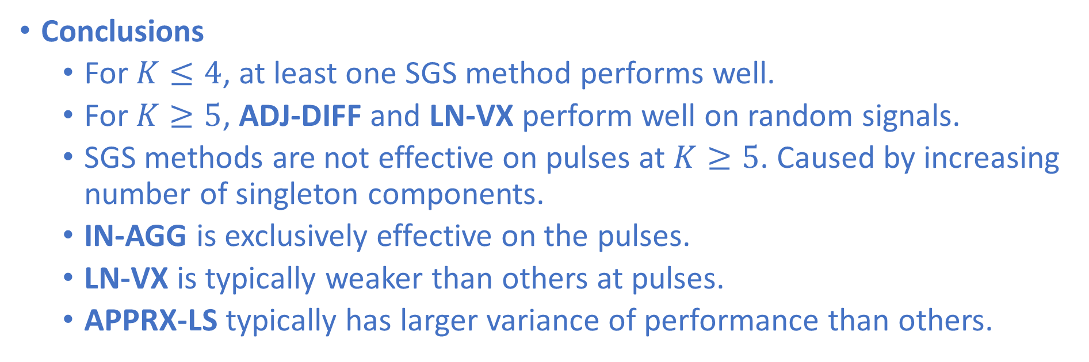
Task 1: SGS vs GFT on Real-Valued Graph Signals
Conclusions
For $K≤4$, at least one SGS method performs well.
For $K≥5$, ADJ-DIFF and LN-VX perform well on random signals.
SGS methods are not effective on pulses at $K≥5$. Caused by increasing number of singleton components.
IN-AGG is exclusively effective on the pulses.
LN-VX is typically weaker than others at pulses.
APPRX-LS typically has larger variance of performance than others.

Slide 23
Task 2: Agreement Between SGS Methods
Settings are the same at Task 1.
Compute normalized dot product between SGS results.
Abbreviations:
AD = ADJ-DIFF
AP = APPRX-LS
IN = IN-AGG
LN = LN-VX

Slide 24
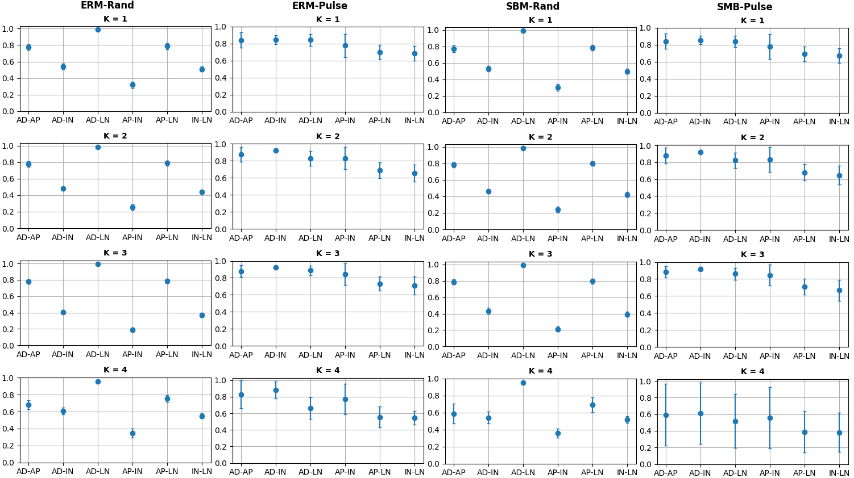
Task 2: Agreement Between SGS Methods

Slide 25
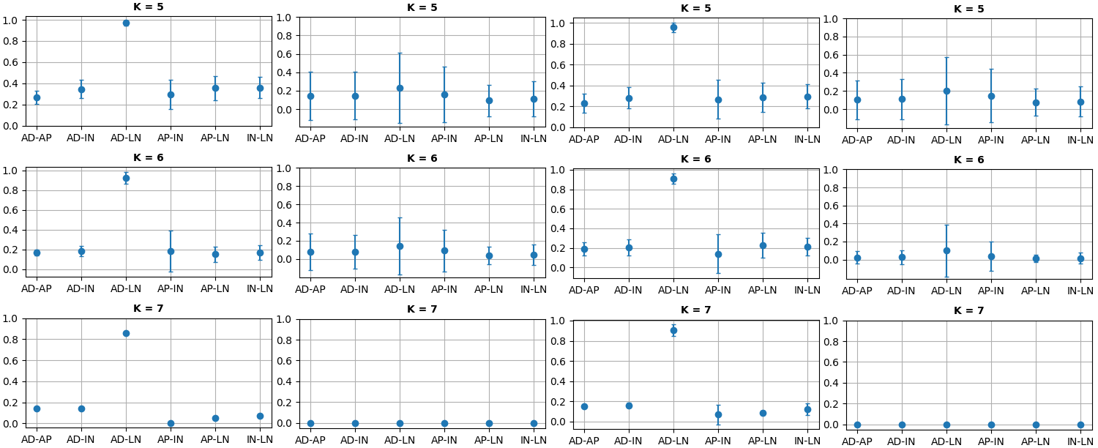
Task 2: Agreement Between SGS Methods

Slide 26
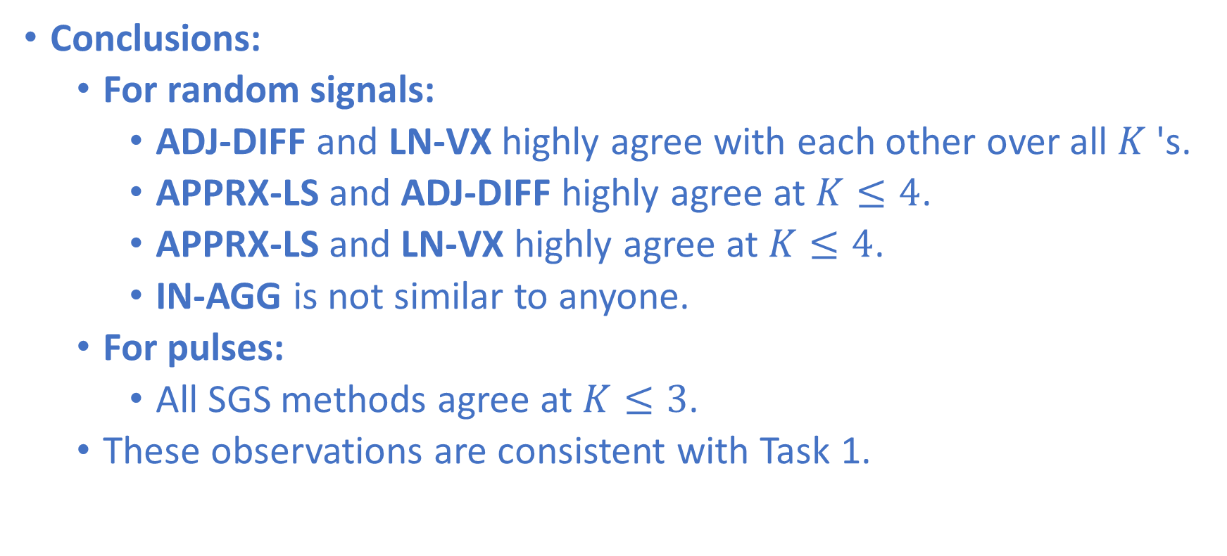
Task 2: Agreement Between SGS Methods
Conclusions:
For random signals:
ADJ-DIFF and LN-VX highly agree with each other over all $K$'s.
APPRX-LS and ADJ-DIFF highly agree at $K≤4$.
APPRX-LS and LN-VX highly agree at $K≤4$.
IN-AGG is not similar to anyone.
For pulses:
All SGS methods agree at $K≤3$.
These observations are consistent with Task 1.

Slide 27
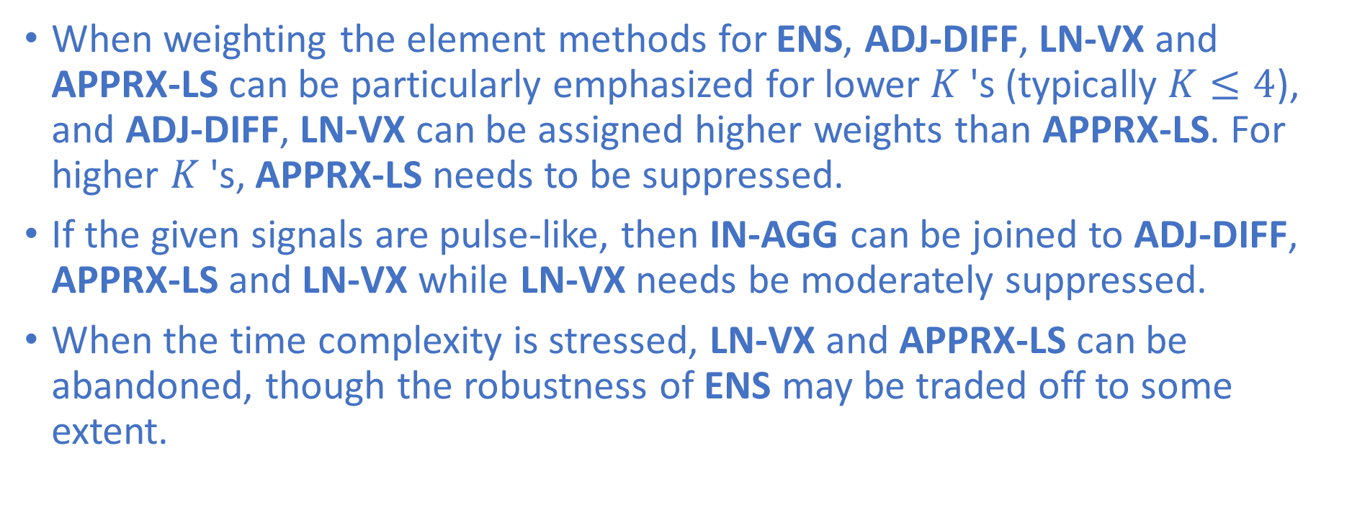
Practical Suggestion: Weight SGS Methods for ENS
When weighting the element methods for ENS, ADJ-DIFF, LN-VX and APPRX-LS can be particularly emphasized for lower $K$'s (typically $K≤4$), and ADJ-DIFF, LN-VX can be assigned higher weights than APPRX-LS. For higher $K$'s, APPRX-LS needs to be suppressed.
If the given signals are pulse-like, then IN-AGG can be joined to ADJ-DIFF, APPRX-LS and LN-VX while LN-VX needs be moderately suppressed.
When the time complexity is stressed, LN-VX and APPRX-LS can be abandoned, though the robustness of ENS may be traded off to some extent.

Slide 28
For More Details…
A Low-Pass Filtering Case Study
A Regularized Low-Pass Filtering Case Study
https://arxiv.org/abs/2201.03696
https://github.com/LeSaRDe/stratified_graph_spectra

Slide 29
Questions

