Slide 1
Stratified Graph Spectra
Fanchao Meng
Biocomplexity Institute
mf3jh@Virginia.edu

Slide 2
Brief Plot
Background:
Graph Fourier Transform (GFT) is a fundamental tool in profiling spectral characteristics of real-valued graph signals.
Problem:
Most graph learning models (e.g. GCN) use vector-valued graph signals. And theoretically GFT is not applicable anymore.
Substitutes are wanted.
Our Solutions:
Five methods as substitutes for GFT on vector-valued graph signals.
Stratified graphs seeing the same graph from different levels of adjacency.

Slide 3
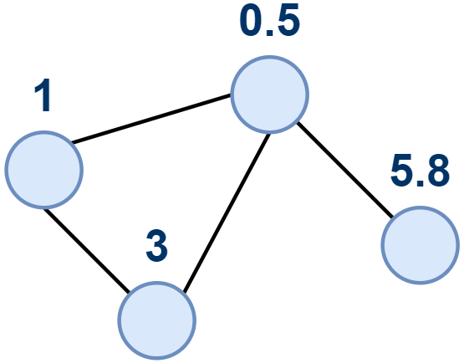
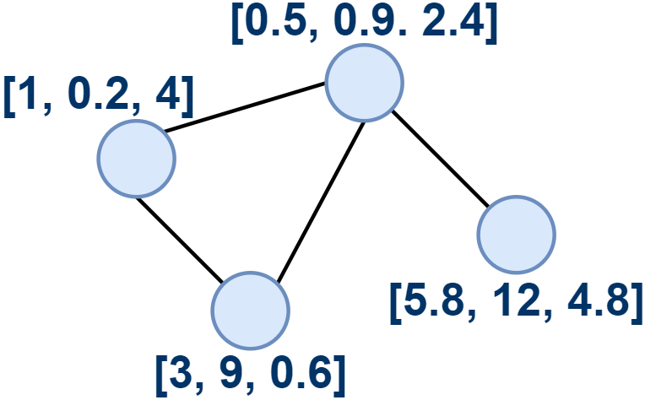
Real-Valued Signals vs Vector-Valued Signals
Real-Valued Graph Signal
Vector-Valued Graph Signal

Slide 4
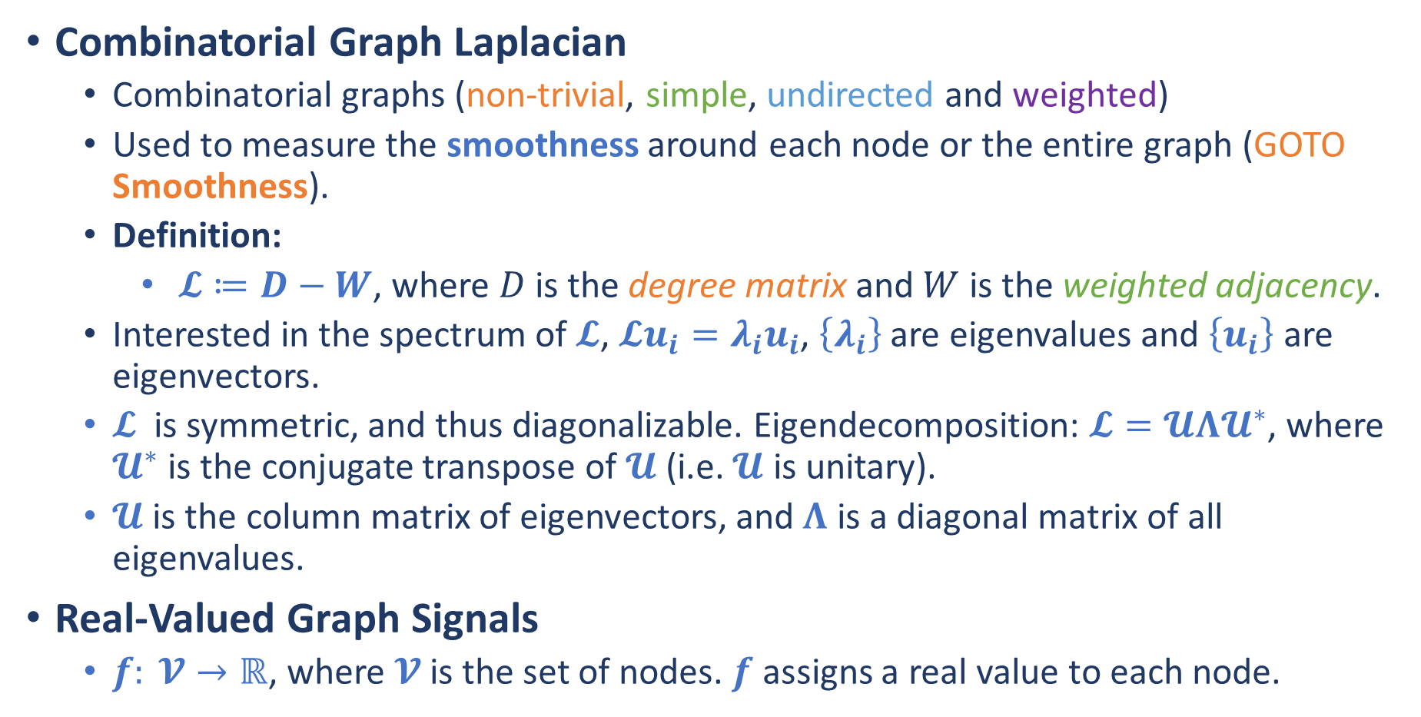
Graph Fourier Transform
Combinatorial Graph Laplacian
Combinatorial graphs (non-trivial, simple, undirected and weighted)
Used to measure the smoothness around each node or the entire graph (GOTO Smoothness).
Definition:
$𝓛≔D−W$, where $D$ is the degree matrix and $W$ is the weighted adjacency.
Interested in the spectrum of $𝓛$, $𝓛u_{i}=λ_{i}u_{i}$, $\left\{λ_{i}\right\}$ are eigenvalues and $\left\{u_{i}\right\}$ are eigenvectors.
$𝓛$ is symmetric, and thus diagonalizable. Eigendecomposition: $𝓛=𝓤Λ𝓤^{∗}$, where $𝓤^{∗}$ is the conjugate transpose of $𝓤$ (i.e. $𝓤$ is unitary).
$𝓤$ is the column matrix of eigenvectors, and $Λ$ is a diagonal matrix of all eigenvalues.
Real-Valued Graph Signals
$f: 𝓥→ℝ$, where $𝓥$ is the set of nodes. $f$ assigns a real value to each node.

Slide 5
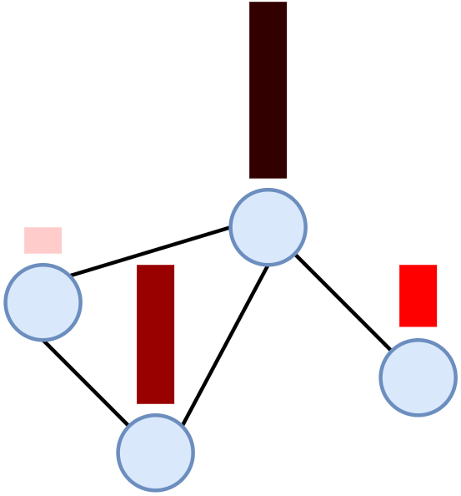
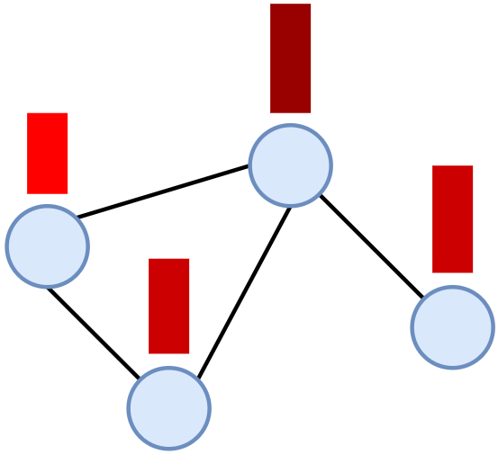
Smoothness
Smooth
Not Smooth
Adjacent nodes are similar.
Adjacent nodes are NOT similar.

Slide 6
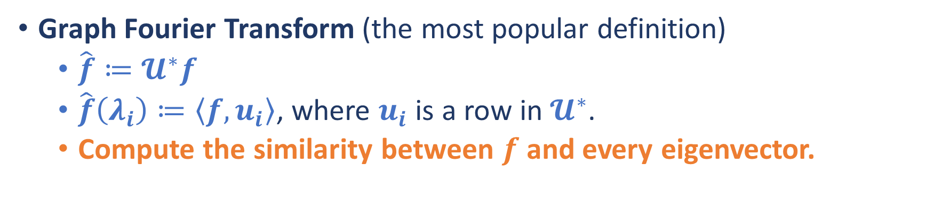
Graph Fourier Transform
Graph Fourier Transform (the most popular definition)
$\hat{f}≔𝓤^{∗}f$
$\hat{f}\left(λ_{i}\right)≔\left\langle f, u_{i}\right\rangle$, where $u_{i}$ is a row in $𝓤^{∗}$.
Compute the similarity between $f$ and every eigenvector.
The ESSENSE of GFT!!

Slide 7
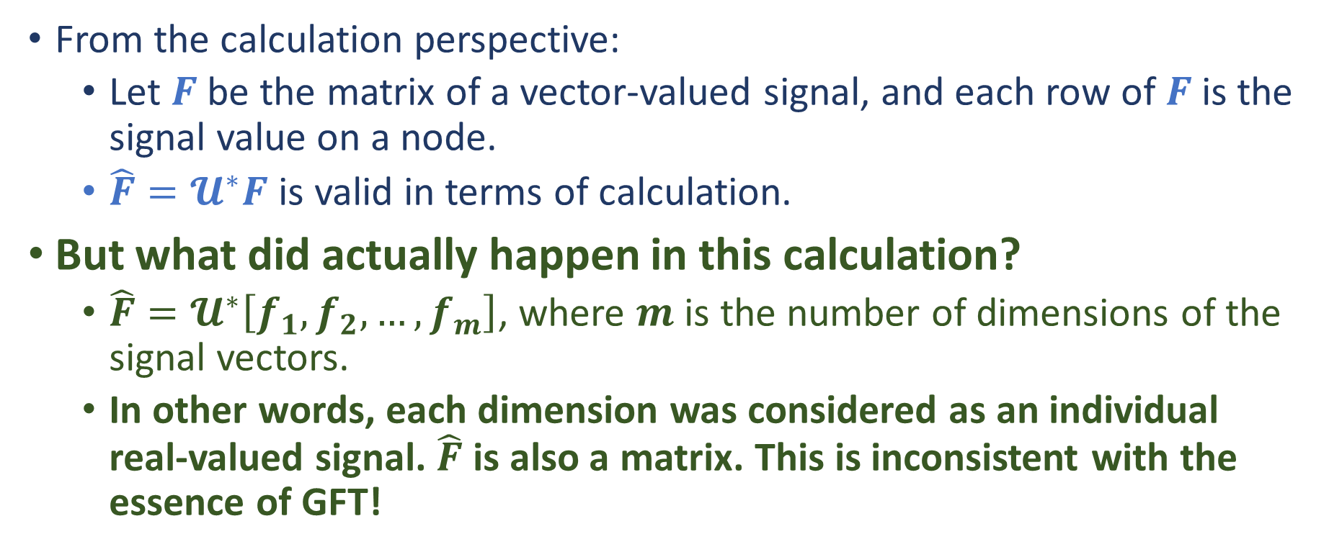
GFT on Vector-Valued Graph Signals?
From the calculation perspective:
Let $F$ be the matrix of a vector-valued signal, and each row of $F$ is the signal value on a node.
$\hat{F}=𝓤^{∗}F$ is valid in terms of calculation.
But what did actually happen in this calculation?
$\hat{F}=𝓤^{∗}\left[f_{1},f_{2},…,f_{m}\right]$, where $m$ is the number of dimensions of the signal vectors.
In other words, each dimension was considered as an individual real-valued signal. $\hat{F}$ is also a matrix. This is inconsistent with the essence of GFT!
Need something new!

Slide 8
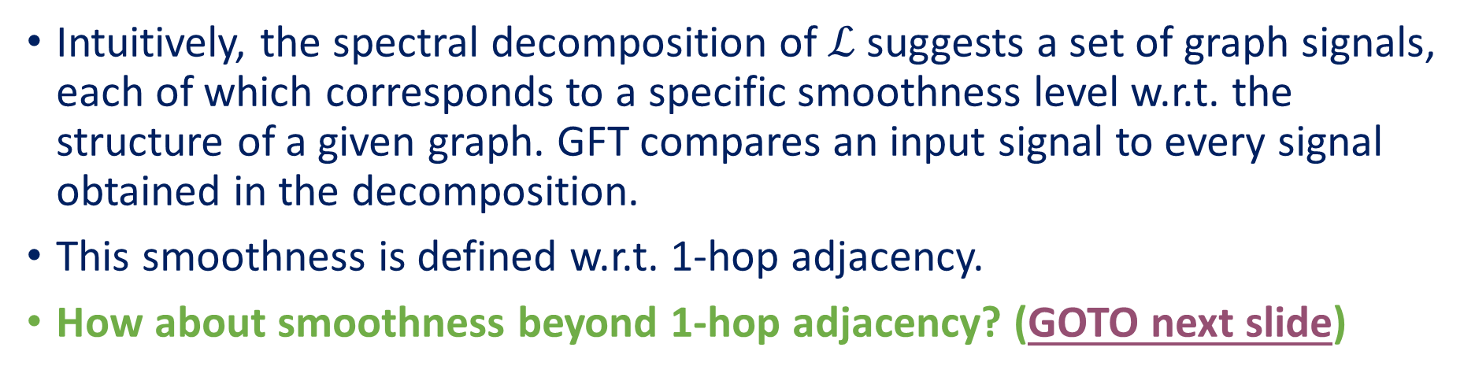
Resolutions of GFT
Intuitively, the spectral decomposition of $ℒ$ suggests a set of graph signals, each of which corresponds to a specific smoothness level w.r.t. the structure of a given graph. GFT compares an input signal to every signal obtained in the decomposition.
This smoothness is defined w.r.t. 1-hop adjacency.
How about smoothness beyond 1-hop adjacency? (GOTO next slide)
Should consider adjacency beyond 1-hop!

Slide 9
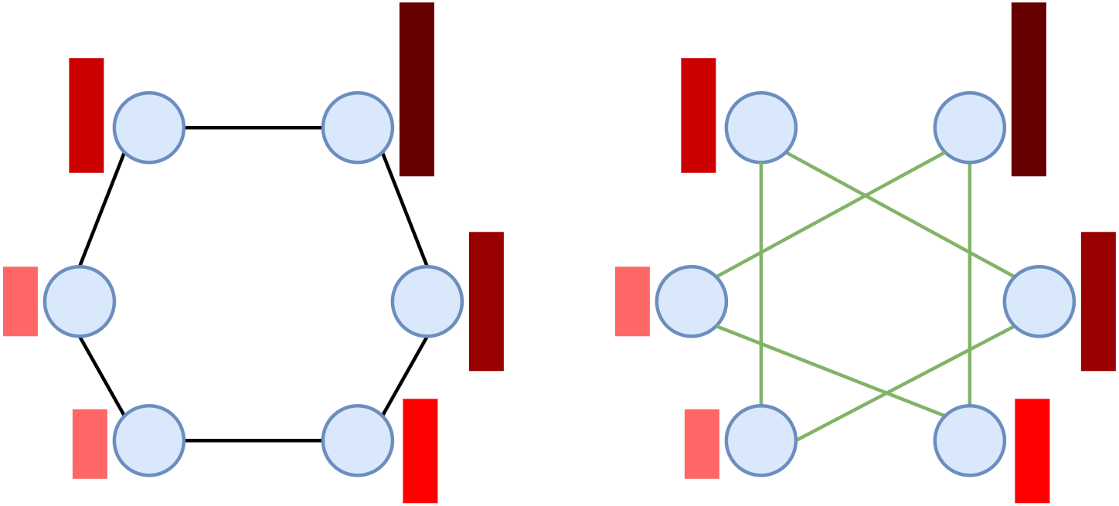
Resolutions of GFT
1-hop adjacency
2-hop adjacency

Slide 10
What We Proposed
Stratified Graphs (SGs)
Consider adjacency beyond 1-hop.
Stratified Graph Spectra (SGS) Methods
Substitutes for GFT.

Slide 11
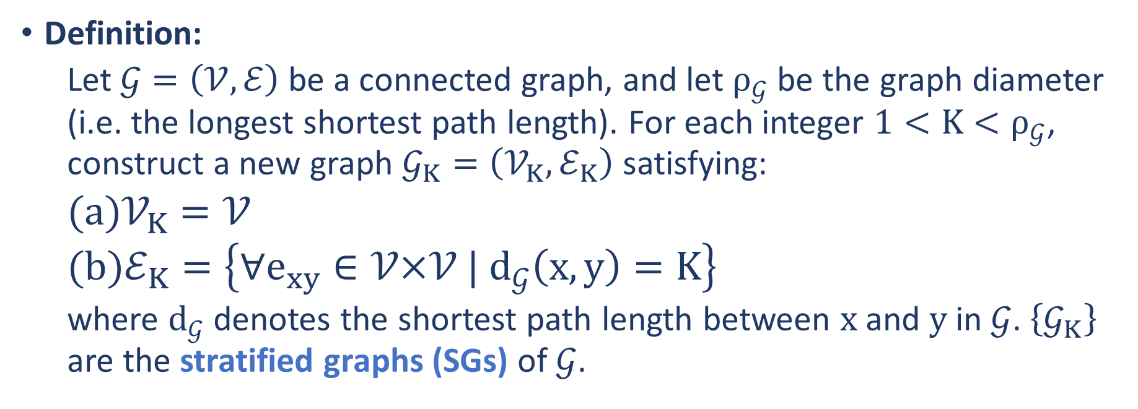
Stratified Graphs
Definition:
Let $𝒢=\left(𝒱,ℰ\right)$ be a connected graph, and let $ρ_{𝒢}$ be the graph diameter (i.e. the longest shortest path length). For each integer $1<K<ρ_{𝒢}$, construct a new graph $𝒢_{K}=\left(𝒱_{K},ℰ_{K}\right)$ satisfying:
$𝒱_{K}=𝒱$
$ℰ_{K}=\left\{∀e_{xy}∈𝒱\text{×}𝒱 | d_{𝒢}\left(x, y\right)=K\right\}$
where $d_{𝒢}$ denotes the shortest path length between $x$ and $y$ in $𝒢$. $\left\{𝒢_{K}\right\}$ are the stratified graphs (SGs) of $𝒢$.

Slide 12
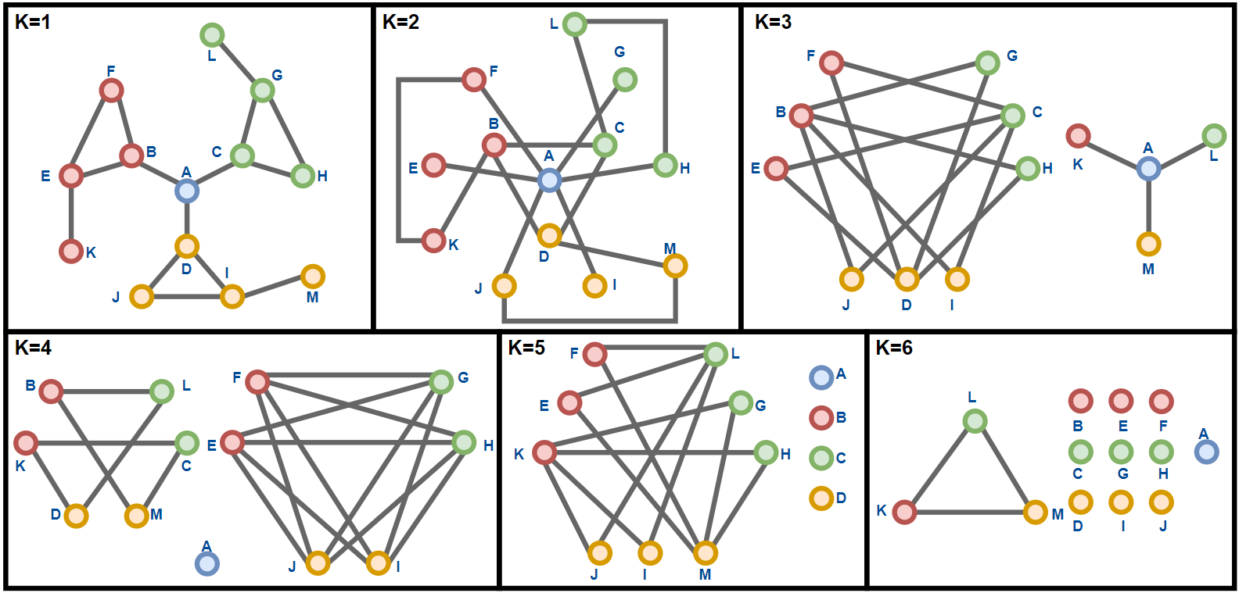
Stratified Graphs
A variant of the Caveman graph

Slide 13
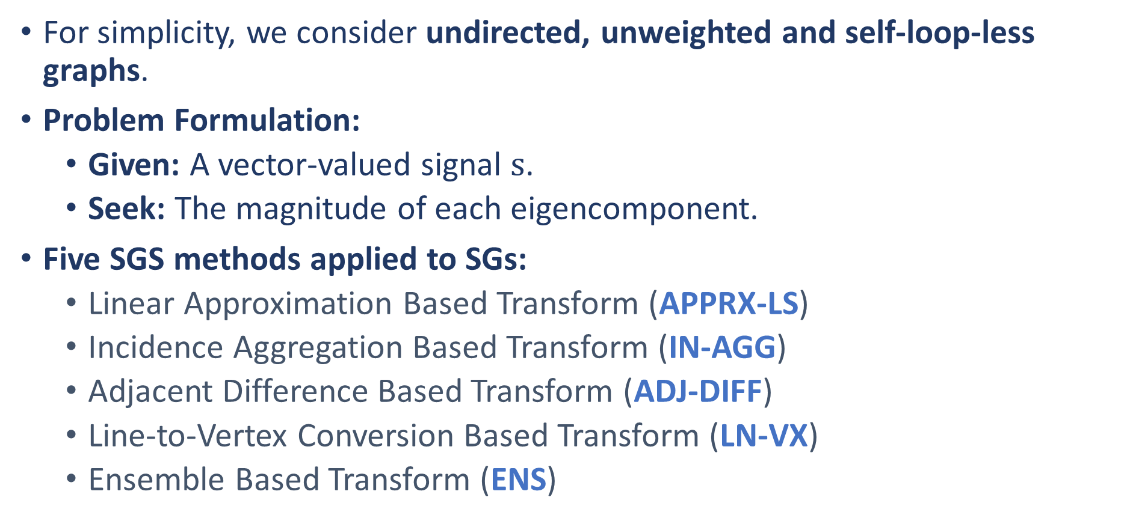
Stratified Graph Spectra Methods
For simplicity, we consider undirected, unweighted and self-loop-less graphs.
Problem Formulation:
Given: A vector-valued signal $s$.
Seek: The magnitude of each eigencomponent.
Five SGS methods applied to SGs:
Linear Approximation Based Transform (APPRX-LS)
Incidence Aggregation Based Transform (IN-AGG)
Adjacent Difference Based Transform (ADJ-DIFF)
Line-to-Vertex Conversion Based Transform (LN-VX)
Ensemble Based Transform (ENS)

Slide 14
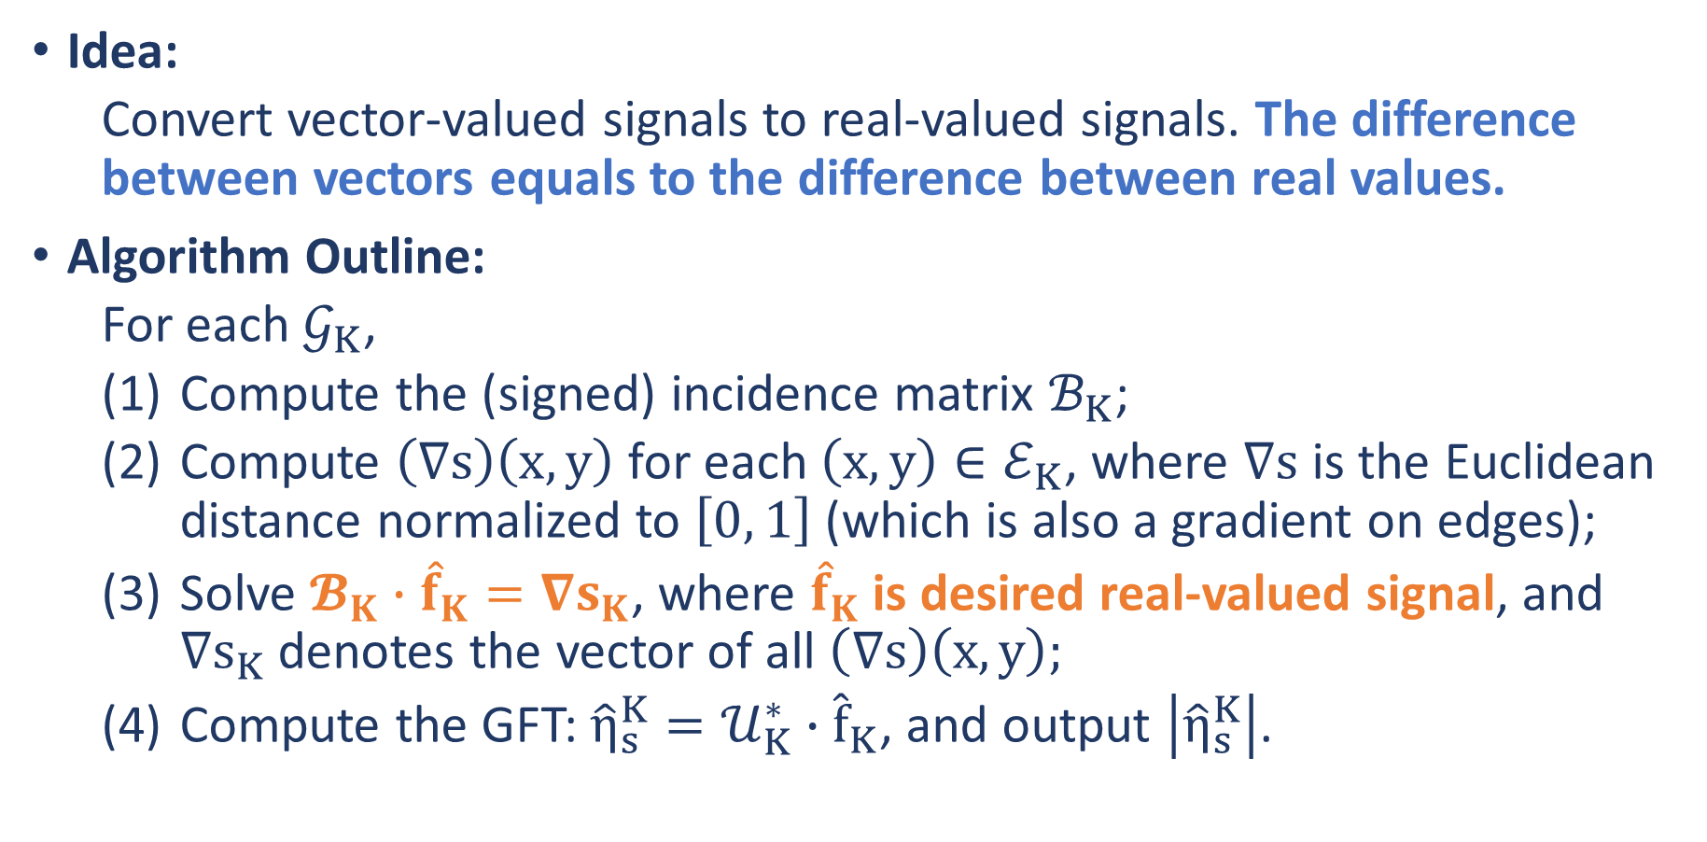
Linear Approximation Based Transform (APPRX-LS)
Idea:
Convert vector-valued signals to real-valued signals. The difference between vectors equals to the difference between real values.
Algorithm Outline:
For each $𝒢_{K}$,
Compute the (signed) incidence matrix $ℬ_{K}$;
Compute $\left(∇s\right)\left(x, y\right)$ for each $\left(x, y\right)∈ℰ_{K}$, where $∇s$ is the Euclidean distance normalized to $\left[0, 1\right]$ (which is also a gradient on edges);
Solve $𝓑_{K}∙{\hat{f}}_{K}=∇s_{K}$, where ${\hat{f}}_{K}$ is desired real-valued signal, and $∇s_{K}$ denotes the vector of all $\left(∇s\right)\left(x, y\right);$
Compute the GFT: ${\hat{η}}_{s}^{K}=𝒰_{K}^{∗}∙{\hat{f}}_{K}$, and output $\left|{\hat{η}}_{s}^{K}\right|$.

Slide 15
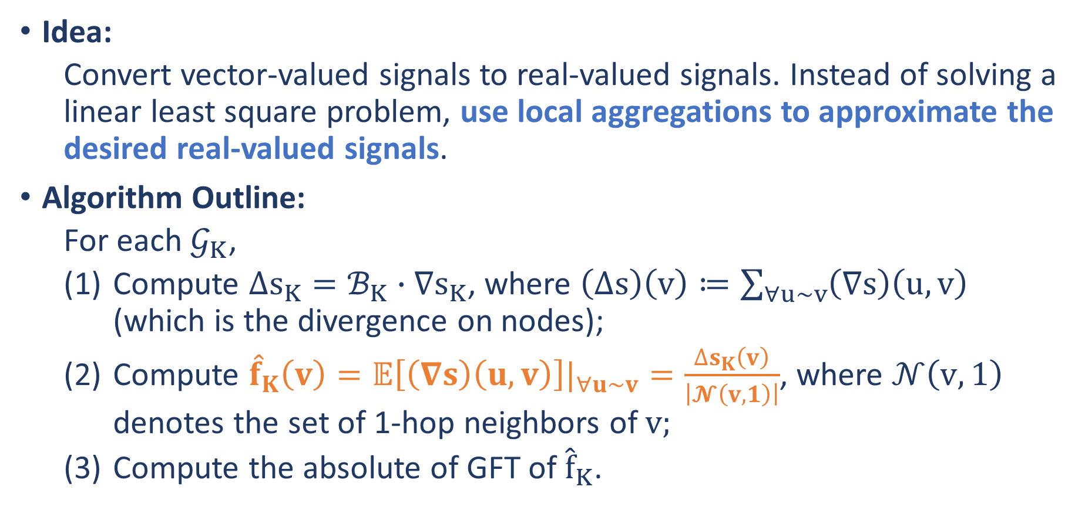
Incidence Aggregation Based Transform (IN-AGG)
Idea:
Convert vector-valued signals to real-valued signals. Instead of solving a linear least square problem, use local aggregations to approximate the desired real-valued signals.
Algorithm Outline:
For each $𝒢_{K}$,
Compute $∆s_{K}=ℬ_{K}∙∇s_{K}$, where $\left(∆s\right)\left(v\right)≔\sum_{∀u\sim v}{\left(∇s\right)\left(u,v\right)}$ (which is the divergence on nodes);
Compute ${\hat{f}}_{K}\left(v\right)=𝔼\left[\left(∇s\right)\left(u,v\right)\right]|_{∀u\sim v}=\frac{∆s_{K}\left(v\right)}{\left|𝓝\left(v, 1\right)\right|}$, where $𝒩\left(v, 1\right)$ denotes the set of 1-hop neighbors of $v;$
Compute the absolute of GFT of ${\hat{f}}_{K}$.

Slide 16
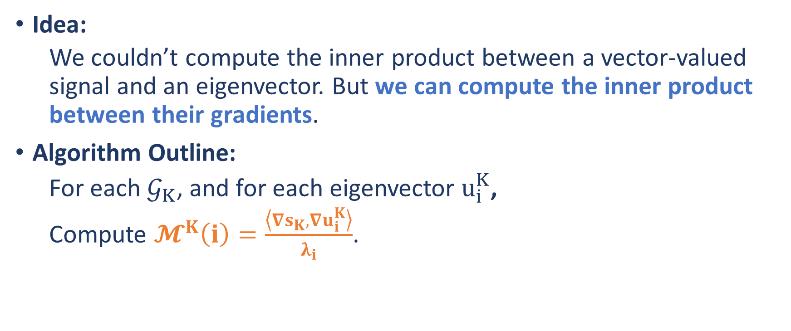
Adjacent Difference Based Transform (ADJ-DIFF)
Idea:
We couldn’t compute the inner product between a vector-valued signal and an eigenvector. But we can compute the inner product between their gradients.
Algorithm Outline:
For each $𝒢_{K}$, and for each eigenvector $u_{i}^{K}$,
Compute $𝓜^{K}\left(i\right)=\frac{\left\langle ∇s_{K},∇u_{i}^{K}\right\rangle }{λ_{i}}$.

Slide 17
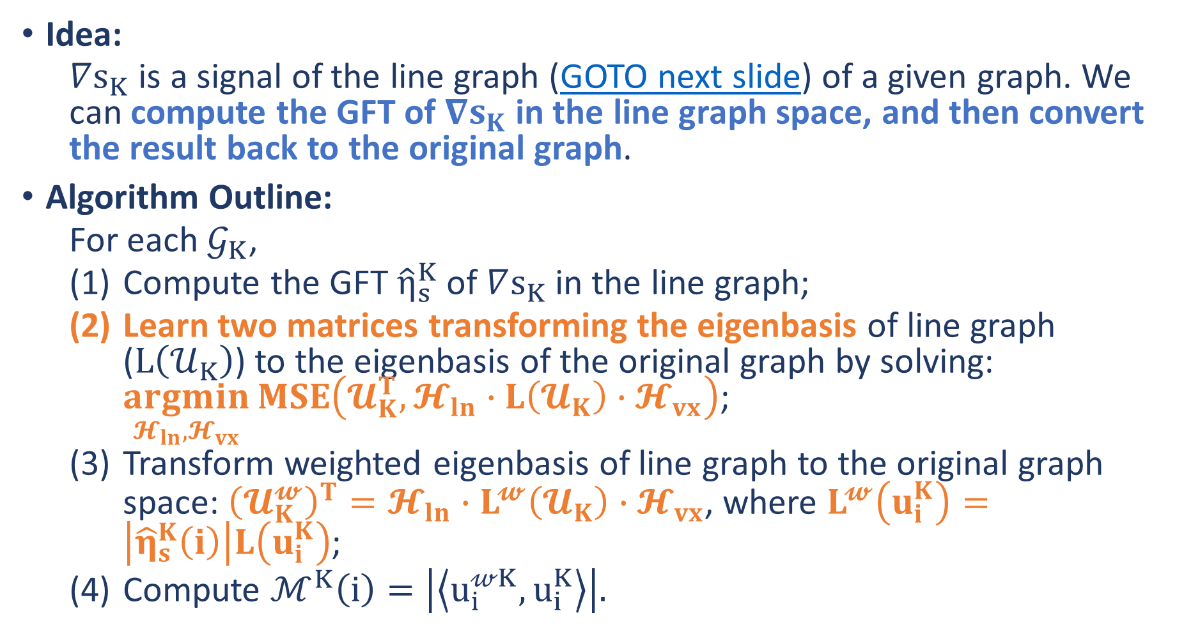
Line-to-Vertex Conversion Based Transform (LN-VX)
Idea:
$∇s_{K}$ is a signal of the line graph (GOTO next slide) of a given graph. We can compute the GFT of $∇s_{K}$ in the line graph space, and then convert the result back to the original graph.
Algorithm Outline:
For each $𝒢_{K}$,
Compute the GFT ${\hat{η}}_{s}^{K}$ of $∇s_{K}$ in the line graph;
Learn two matrices transforming the eigenbasis of line graph ($L\left(𝒰_{K}\right)$) to the eigenbasis of the original graph by solving: $\underset{𝓗_{ln},𝓗_{vx}}{argmin}{MSE\left(𝓤_{K}^{T},𝓗_{ln}∙L\left(𝓤_{K}\right)∙𝓗_{vx}\right)}$;
Transform weighted eigenbasis of line graph to the original graph space: ${\left(𝓤_{K}^{𝔀}\right)}^{T}=𝓗_{ln}∙L^{𝔀}\left(𝓤_{K}\right)∙𝓗_{vx}$, where $L^{𝔀}\left(u_{i}^{K}\right)=\left|{\hat{η}}_{s}^{K}\left(i\right)\right|L\left(u_{i}^{K}\right)$;
Compute $ℳ^{K}\left(i\right)=\left|\left\langle u_{i}^{𝓌K},u_{i}^{K}\right\rangle \right|.$

Slide 18
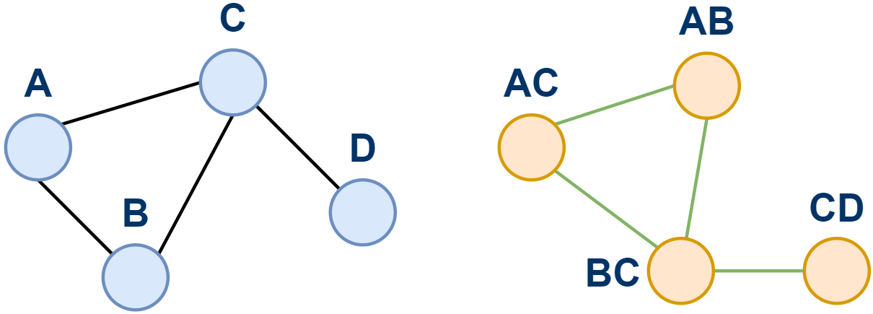
Line-to-Vertex Conversion Based Transform (LN-VX)

Slide 19
Ensemble Based Transform (ENS)
Idea:
Weighted sum of APPRX-LS, IN-AGG, ADJ-DIFF and LN-VX

Slide 20
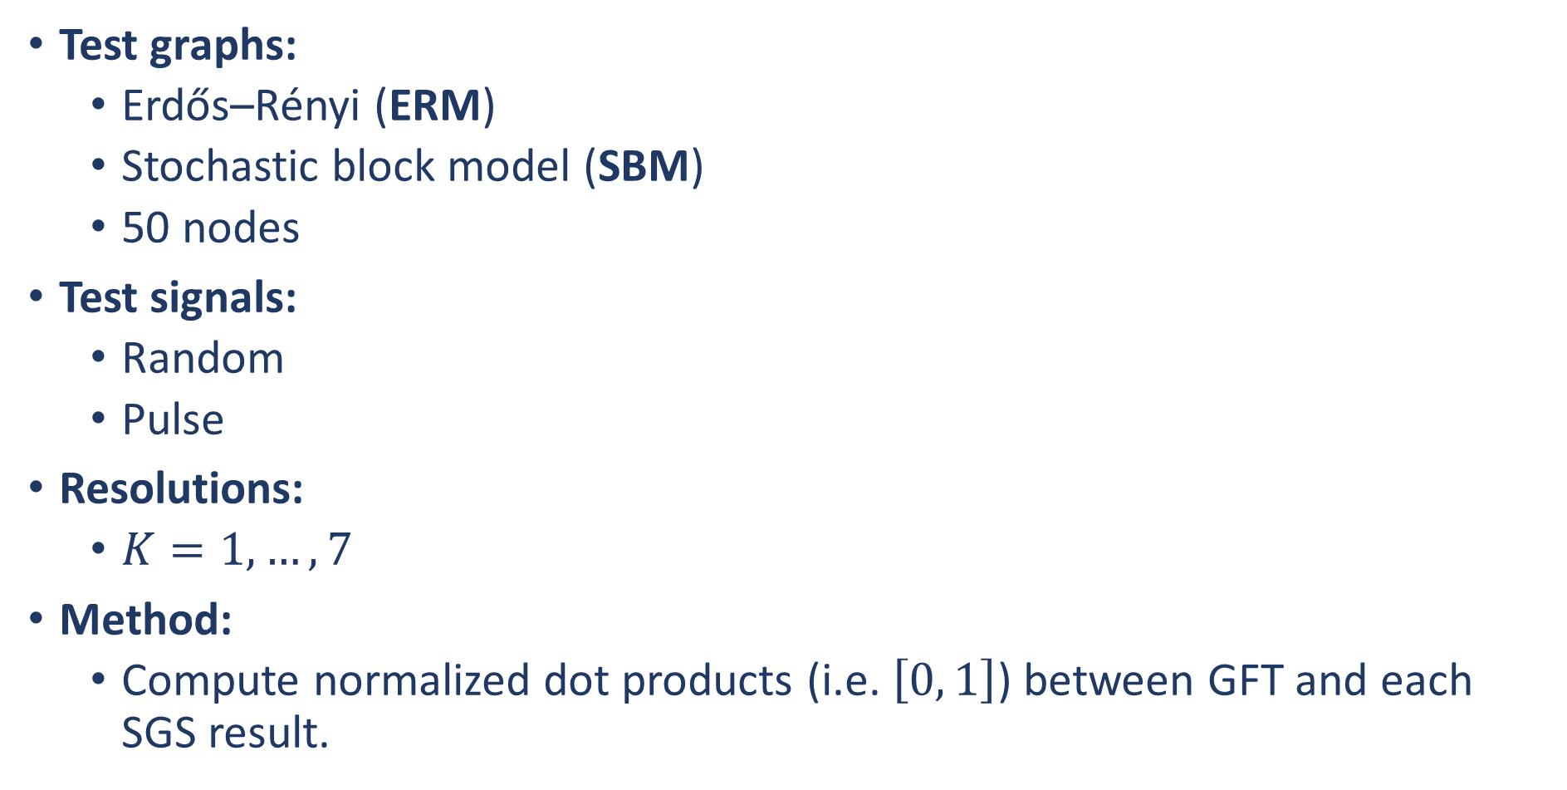
Task 1: SGS vs GFT on Real-Valued Graph Signals
Test graphs:
Erdős–Rényi (ERM)
Stochastic block model (SBM)
50 nodes
Test signals:
Random
Pulse
Resolutions:
$K=1, …, 7$
Method:
Compute normalized dot products (i.e. $\left[0, 1\right]$) between GFT and each SGS result.

Slide 21
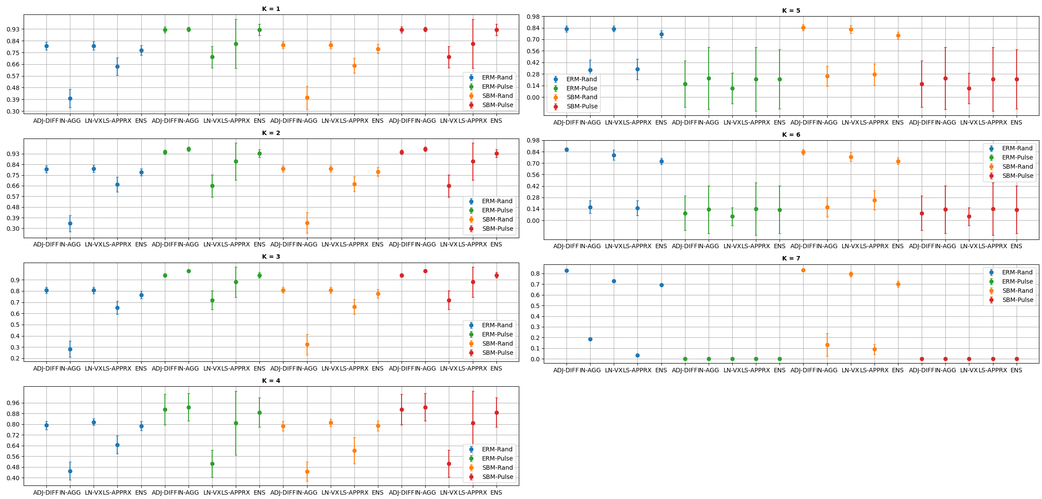
Task 1: SGS vs GFT on Real-Valued Graph Signals

Slide 22
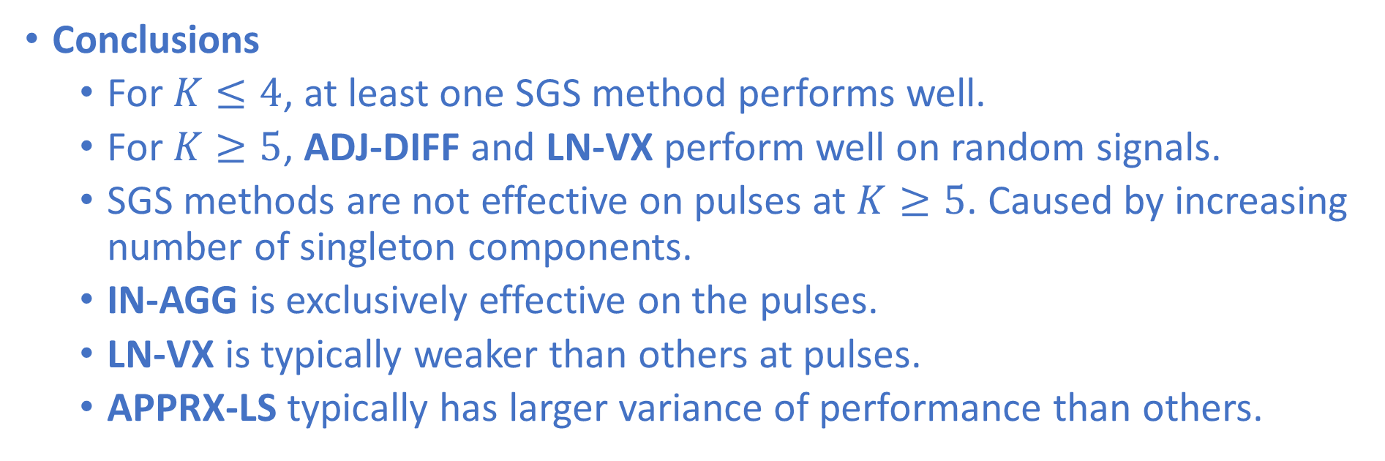
Task 1: SGS vs GFT on Real-Valued Graph Signals
Conclusions
For $K≤4$, at least one SGS method performs well.
For $K≥5$, ADJ-DIFF and LN-VX perform well on random signals.
SGS methods are not effective on pulses at $K≥5$. Caused by increasing number of singleton components.
IN-AGG is exclusively effective on the pulses.
LN-VX is typically weaker than others at pulses.
APPRX-LS typically has larger variance of performance than others.

Slide 23
Task 2: Agreement Between SGS Methods
Settings are the same as Task 1.
Compute normalized dot products between SGS results.
Abbreviations:
AD = ADJ-DIFF
AP = APPRX-LS
IN = IN-AGG
LN = LN-VX

Slide 24
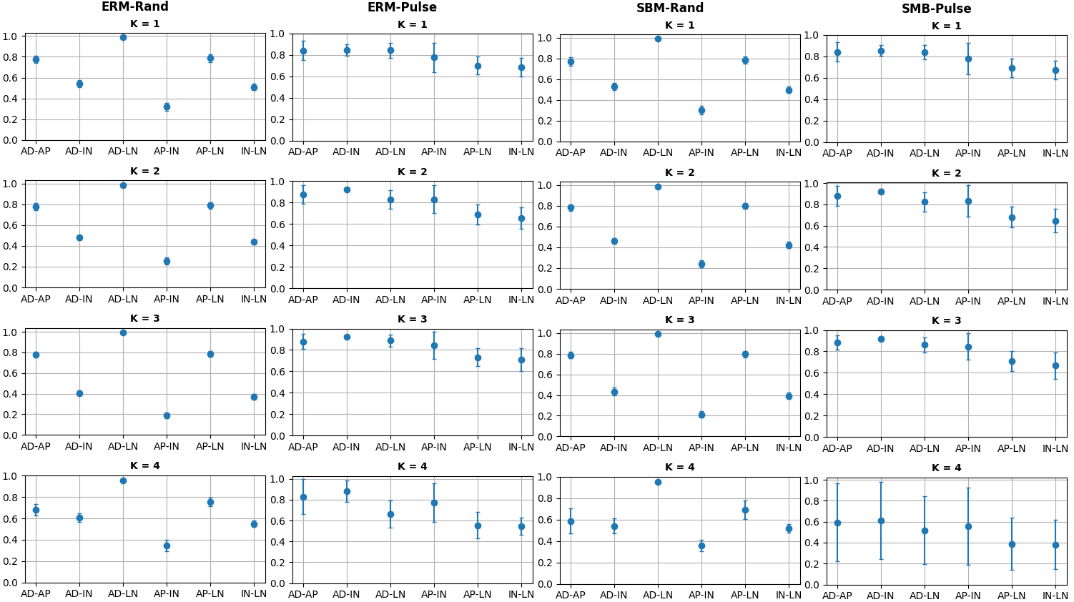
Task 2: Agreement Between SGS Methods

Slide 25
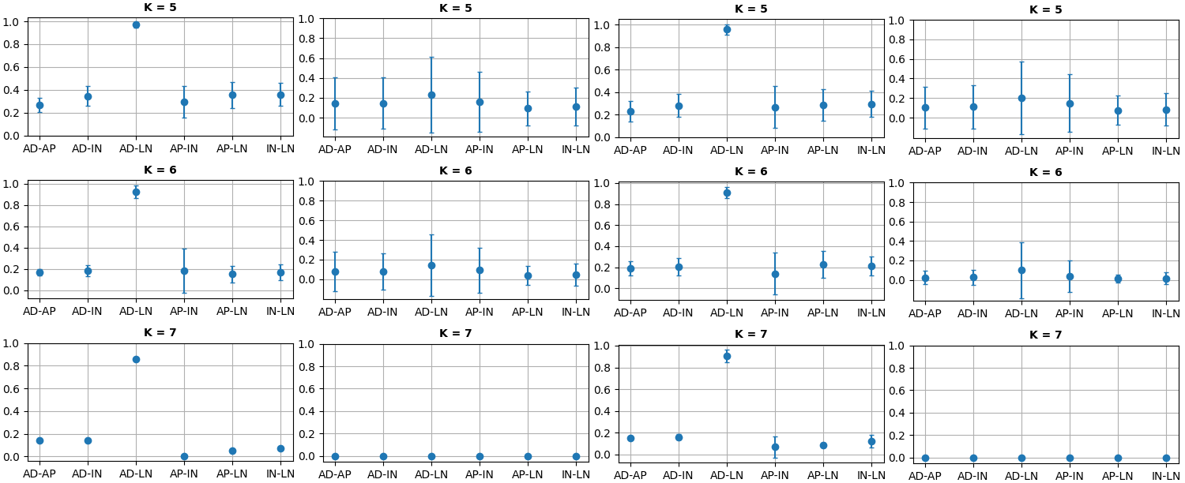
Task 2: Agreement Between SGS Methods

Slide 26
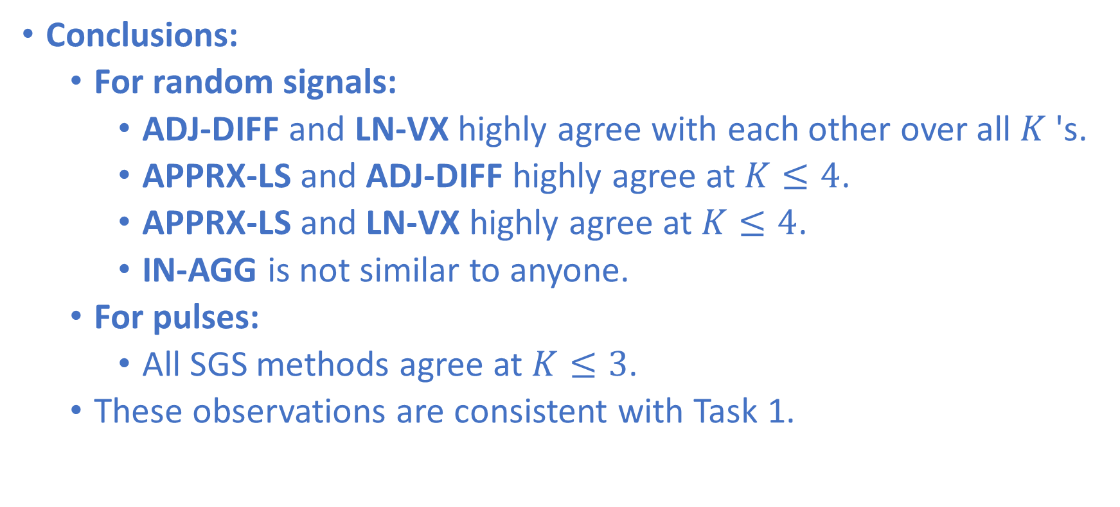
Task 2: Agreement Between SGS Methods
Conclusions:
For random signals:
ADJ-DIFF and LN-VX highly agree with each other over all $K$'s.
APPRX-LS and ADJ-DIFF highly agree at $K≤4$.
APPRX-LS and LN-VX highly agree at $K≤4$.
IN-AGG is not similar to anyone.
For pulses:
All SGS methods agree at $K≤3$.
These observations are consistent with Task 1.

Slide 27
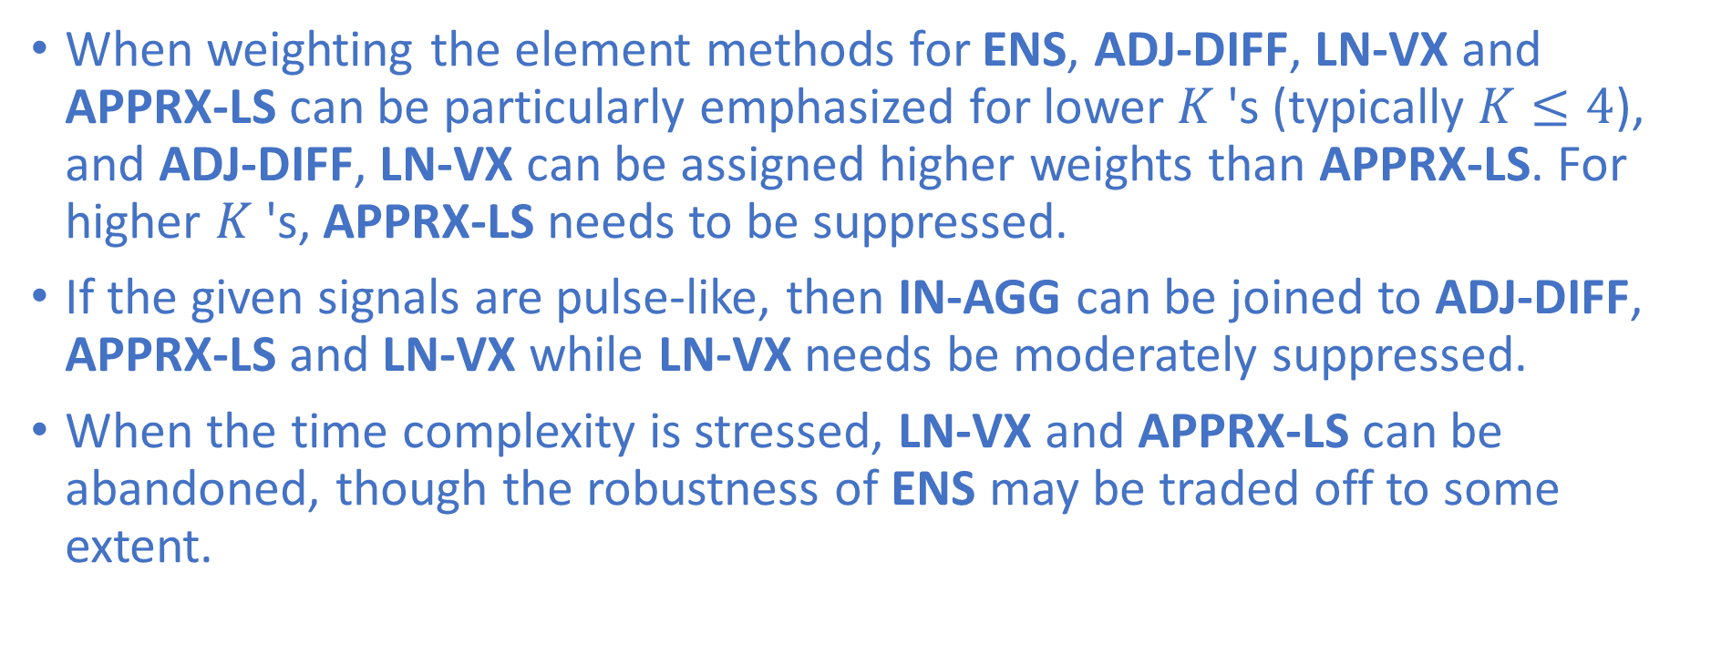
Practical Suggestion: Weight SGS Methods for ENS
When weighting the element methods for ENS, ADJ-DIFF, LN-VX and APPRX-LS can be particularly emphasized for lower $K$'s (typically $K≤4$), and ADJ-DIFF, LN-VX can be assigned higher weights than APPRX-LS. For higher $K$'s, APPRX-LS needs to be suppressed.
If the given signals are pulse-like, then IN-AGG can be joined to ADJ-DIFF, APPRX-LS and LN-VX while LN-VX needs be moderately suppressed.
When the time complexity is stressed, LN-VX and APPRX-LS can be abandoned, though the robustness of ENS may be traded off to some extent.

Slide 28
For More Details…
A Low-Pass Filtering Case Study
A Regularized Low-Pass Filtering Case Study
https://arxiv.org/abs/2201.03696
https://github.com/LeSaRDe/stratified_graph_spectra

Slide 29
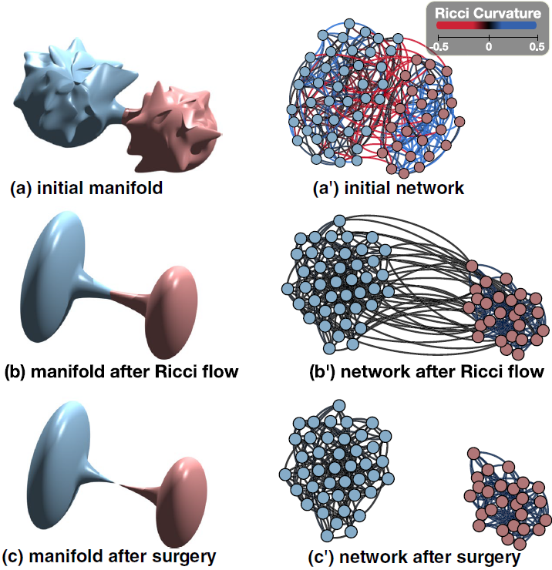
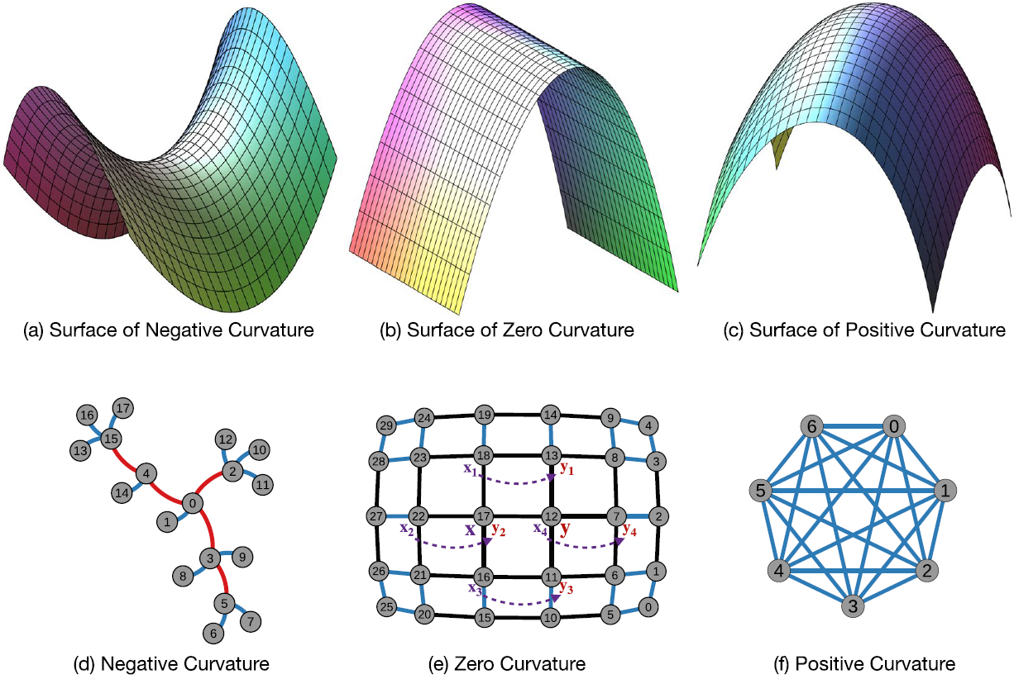
In-Progress Works
Applications of discrete Ricci curvatures (Ollivier & Forman) and Ricci flow
Community detection
Network role labeling
Dynamics of community structures and roles
Multimodal Ricci flow
Shapes of representation spaces of ML models
Ni, C. C., Lin, Y. Y., Luo, F., & Gao, J. (2019). Community detection on networks with Ricci flow. Scientific reports, 9(1), 1-12.

Slide 30
Questions

