Slide 1
Merge Sort and Divide & Conquer
Fanchao Meng
mf3jh@Virginia.edu

Slide 2
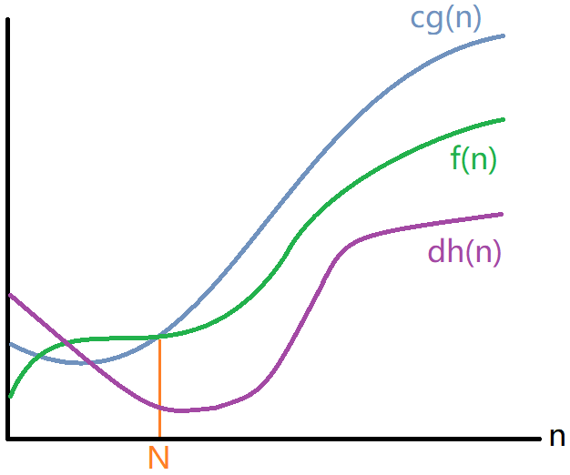
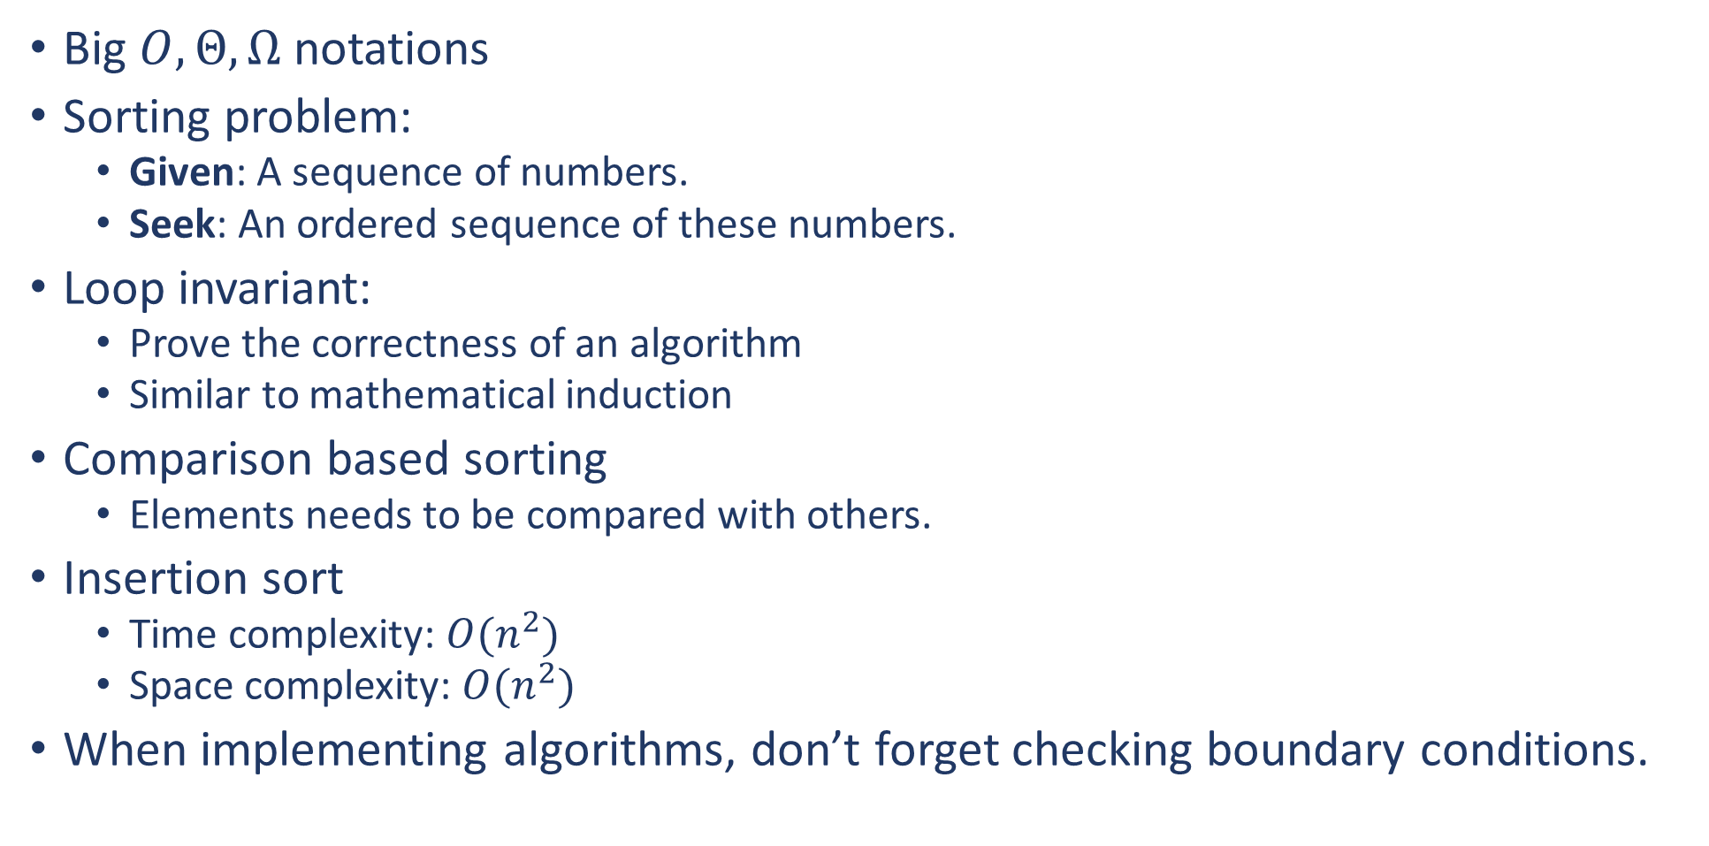



Recall
Big $O,Θ,Ω$notations
Sorting problem:
Given: A sequence of numbers.
Seek: An ordered sequence of these numbers.
Loop invariant:
Prove the correctness of an algorithm
Similar to mathematical induction
Comparison based sorting
Elements needs to be compared with others.
Insertion sort
Time complexity: $O(n^{2})$
Space complexity: $O(n^{2})$
When implementing algorithms, don’t forget checking boundary conditions.
$$f\left(n\right)=O(g(n))$$
$$f\left(n\right)=Ω(h(n))$$
$f\left(n\right)=Θ\left(g\left(n\right)\right),$ if $g\left(n\right)=h(n)$

Slide 3
The Plan of This Class
Advertise Merge Sort
Show you what is wrong with Insertion Sort
Introduce a super cool technique called “divide & conquer”
Introduce Merge Sort which utilizes the “divide & conquer” technique

Slide 4
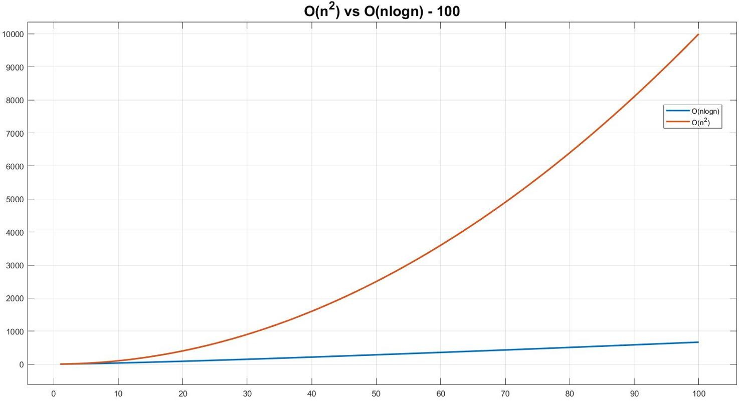
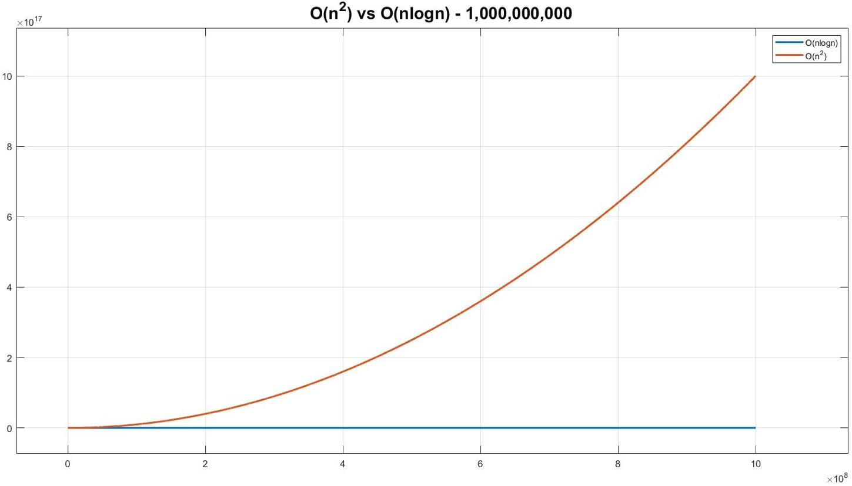
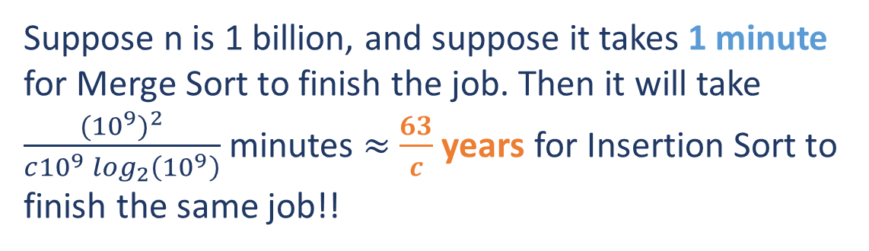



Why Merge Sort?
Suppose n is 1 billion, and suppose it takes 1 minute for Merge Sort to finish the job. Then it will take $\frac{{({10}^{9})}^{2}}{c{10}^{9}\log_{2}\left({10}^{9}\right)}$ minutes $≈$ $\frac{63}{c}$ years for Insertion Sort to finish the same job!!
Faster than $O(n^{2})$
How fast? $O\left(n\log_{2}n\right)$
$${10}^{17}$$
$${10}^{8}$$
100
1,000,000,000

Slide 5
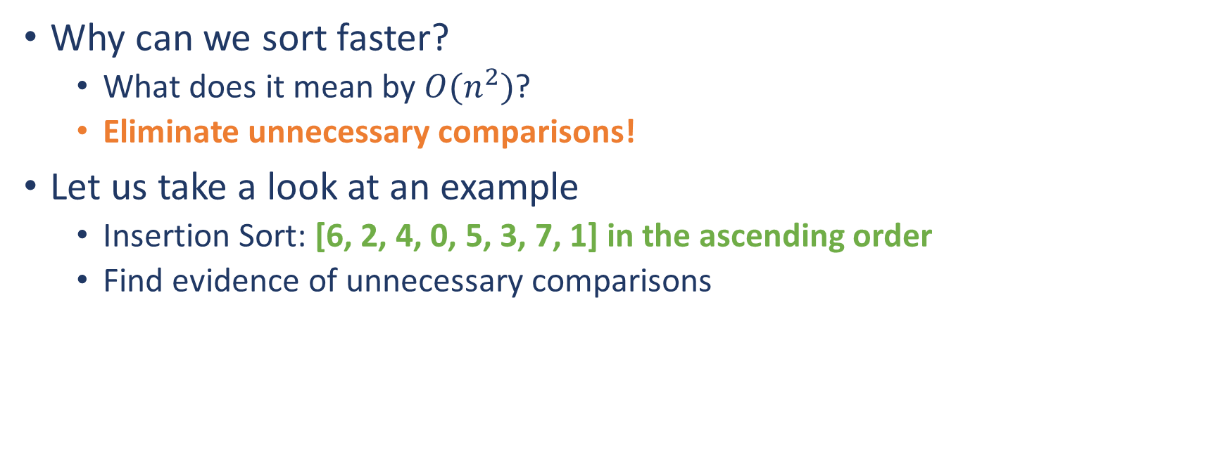
Motivation
Why can we sort faster?
What does it mean by $O(n^{2})$?
Eliminate unnecessary comparisons!
Let us take a look at an example
Insertion Sort: [6, 2, 4, 0, 5, 3, 7, 1] in the ascending order
Find evidence of unnecessary comparisons
Pairwise comparisons!

Slide 6
Motivation
Insertion Sort: Compare and Swap
6 | 2 | 4 | 0 | 5 | 3 | 7 | 1
Comparison occurs!
Number of Comparisons
6 | 2 | 4 | 0 | 5 | 3 | 7 | 1
1
Total number of comparisons is 22
2 | 6 | 4 | 0 | 5 | 3 | 7 | 1
2
2 | 4 | 6 | 0 | 5 | 3 | 7 | 1
3
0 | 2 | 4 | 6 | 5 | 3 | 7 | 1
4
To sort it more efficiently, we need a method using fewer comparisons.
0 | 2 | 4 | 5 | 6 | 3 | 7 | 1
4
0 | 2 | 3 | 4 | 5 | 6 | 7 | 1
1
0 | 2 | 3 | 4 | 5 | 6 | 7 | 1
7
0 | 1 | 2 | 3 | 4 | 5 | 6 | 7

Slide 7
Motivation
Find evidence of unnecessary comparisons
Up to this point, we have sorted 3 numbers, and we used 3 comparisons.
In the 1st step, 2 needs to be compared with 6.
6 | 2 | 4 | 0 | 5 | 3 | 7 | 1
The comparison results in: 2 < 6.
What is the LEAST number of comparisons needed for sorting 3 numbers in the worst case?
In the 2nd step, 4 needs to be compared with 6 and 2.
2 | 6 | 4 | 0 | 5 | 3 | 7 | 1
The comparisons result in: 2 < 4 < 6.
2 comparisons!
Thus, there must be 1 unnecessary comparison!
To eliminate unnecessary comparisons, we need to reorder the comparisons.
Which one?
2 vs 6
Evidence!
Let us introduce “Divide & Conquer”!

Slide 8
Homework #1
What is the least number of comparisons needed to sort [6, 2, 4, 0, 5, 3, 7, 1]?
Enumerate the comparisons.

Slide 9
Divide & Conquer - Intuition
“Divide & conquer” is an algorithm design paradigm. It is NOT a concrete algorithm but a “guideline” to design algorithms.
General idea:
Divide
Conquer
Combine
Small Problem
Small Solution
Big Problem
Big Solution
Small Problem
Small Solution
Small Problem
Small Solution

Slide 10
Divide & Conquer - Intuition
How could “divide & conquer” be applied in sorting?
6 | 2 | 4 | 0 | 5 | 3 | 7 | 1
Divide
6 | 2 | 4 | 0
5 | 3 | 7 | 1
If we can conquer each small problem…
0 | 2 | 4 | 6
1 | 3 | 5 | 7
If we can combine the small solutions…
0 | 1 | 2 | 3 | 4 | 5 | 6 | 7

Slide 11
“Combine” - Merge Two Sorted Sequences
Merging Problem:
Given: Two sorted sequences.
Seek: A merged and sorted sequence of the two input sequences.
The algorithm is straightforward. Let us take a look at an example.

Slide 12
“Combine” - Merge Two Sorted Sequences
0 | 2 | 4 | 6
1 | 3 | 5 | 7
 |  | 4 | 6
 |  | 5 | 7
0
0 | 1 | 2 | 3 | 4
 | 2 | 4 | 6
1 | 3 | 5 | 7
 |  |  | 6
 |  | 5 | 7
0 | 1
0 | 1 | 2 | 3 | 4 | 5
 | 2 | 4 | 6
 | 3 | 5 | 7
 |  |  | 6
 |  |  | 7
0 | 1 | 2
0 | 1 | 2 | 3 | 4 | 5 | 6 | 7
 |  | 4 | 6
 | 3 | 5 | 7
0 | 1 | 2 | 3

Slide 13
Homework #2
Implement this merging algorithm, MERGE(X, Y), where X is a sorted sequence, and Y is another sorted sequence.
What is the time complexity of this merging algorithm?

Slide 14

Divide & Conquer - Intuition
How could “divide & conquer” be applied in sorting?
6 | 2 | 4 | 0 | 5 | 3 | 7 | 1
Divide
6 | 2 | 4 | 0
5 | 3 | 7 | 1
If we can conquer each small problem…
0 | 2 | 4 | 6
1 | 3 | 5 | 7
If we can combine the small solutions…
0 | 1 | 2 | 3 | 4 | 5 | 6 | 7

Slide 15
“Conquer” - Solve Sub-problems
Why not we apply “divide & conquer” one more time?
If we do so, have we solved the problem? Or we are trapped into an “iteration”?
When should we stop the “iteration” and actually solve sub-problems?
6 | 2 | 4 | 0
6 | 2 | 4 | 0
6 | 2
4 | 0
6 | 2
4 | 0
The smallest sub-problems
6
2
4
0
2 | 6
0 | 4
Do we really need this layer of “divide”?
We stop the “iteration”, and actually solve the sub-problems!
NO!

Slide 16
“Conquer” - Solve Sub-problems
How do we know that we have reached the smallest sub-problems?
Totally customizable!
Nonetheless, the sizes of the smallest sub-problems can significantly affect the running time of your algorithm.
Think about this statement for a second. We will expand this a bit more later.

Slide 17
Divide & Conquer - Intuition
How could “divide & conquer” be applied in sorting?
6 | 2 | 4 | 0 | 5 | 3 | 7 | 1
Divide
6 | 2 | 4 | 0
5 | 3 | 7 | 1
If we can conquer each small problem…
0 | 2 | 4 | 6
1 | 3 | 5 | 7
If we can combine the small solutions…
0 | 1 | 2 | 3 | 4 | 5 | 6 | 7
Ready to introduce Merge Sort!

Slide 18
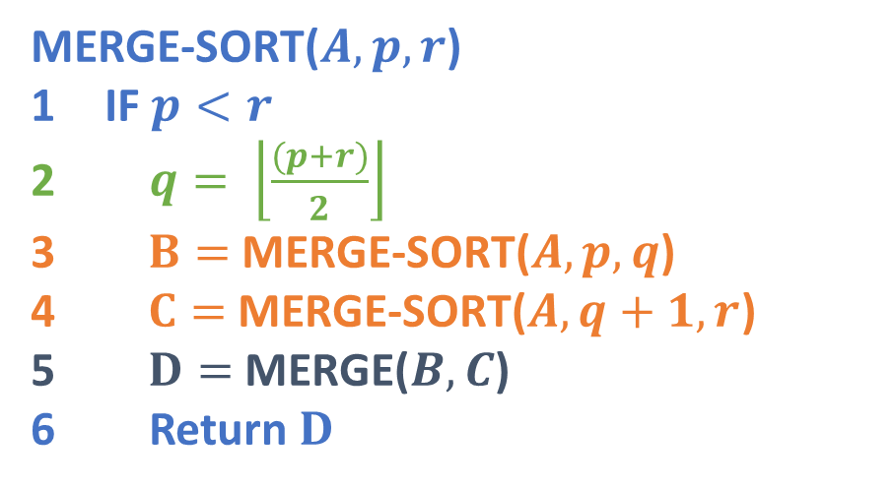
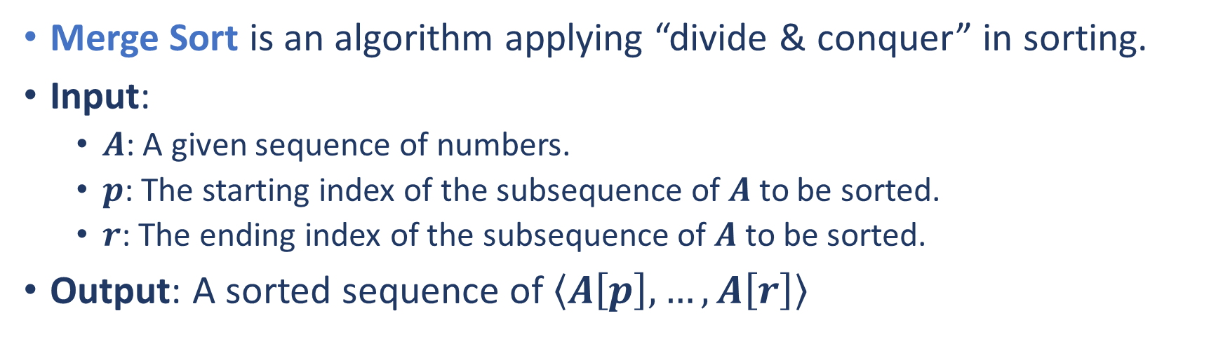
Merge Sort
Merge Sort is an algorithm applying “divide & conquer” in sorting.
Input:
$A$: A given sequence of numbers.
$p$: The starting index of the subsequence of $A$ to be sorted.
$r$: The ending index of the subsequence of $A$ to be sorted.
Output: A sorted sequence of $\left\langle A\left[p\right], …,A\left[r\right]\right\rangle$
MERGE-SORT($A, p, r$)
IF $p<r$
$q= \left\lfloor \frac{(p+r)}{2}\right\rfloor$
$B=$MERGE-SORT($A, p, q$)
$C=$MERGE-SORT($A, q+1, r$)
$D=$MERGE($B,C$)
Return $D$
Divide
Exercise:
Where did we solve the smallest sub-problems?
Conquer
Merge

Slide 19
Homework #3
Why does MERGE-SORT work? Can you prove it?
Hint: loop invariant

Slide 20
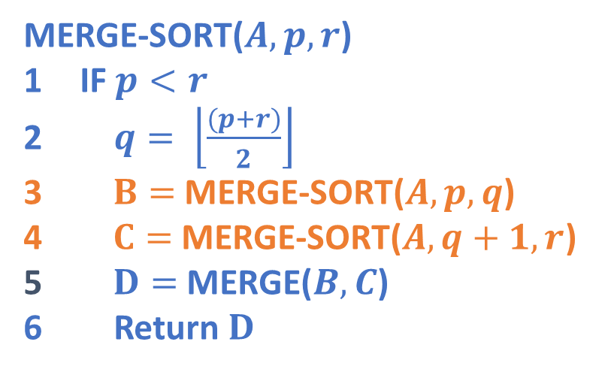
Time Complexity of Merge Sort
The difficulty of computing the time complexity of MERGE-SORT comes from the steps 3 and 4.
MERGE-SORT($A, p, r$)
IF $p<r$
$q= \left\lfloor \frac{(p+r)}{2}\right\rfloor$
$B=$MERGE-SORT($A, p, q$)
$C=$MERGE-SORT($A, q+1, r$)
$D=$MERGE($B,C$)
Return $D$
Recursion:
When defining a function, “recursion” is a construction method invoking the function itself, inside the function body, solving smaller instances of the same problem.
Recursion has a lot of stories. The following two materials are good starts.
[1] Graham, Ronald; Knuth, Donald; Patashnik, Oren (1990). “1: Recurrent Problems”. Concrete Mathematics: A Foundation for Computer Science. [2] Wirth, Niklaus (1976). “3: Recursive Algorithms”. Algorithms + Data Structures = Programs.

Slide 21



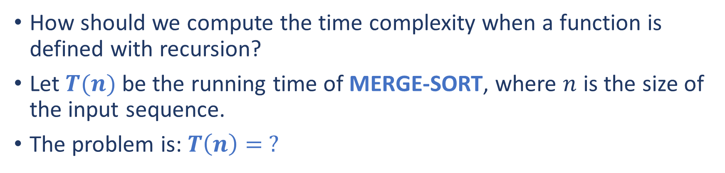



Time Complexity of Merge Sort
How should we compute the time complexity when a function is defined with recursion?
Let $T(n)$ be the running time of MERGE-SORT, where $n$ is the size of the input sequence.
The problem is: $T\left(n\right)= ?$
$$n=r−p+1$$
MERGE-SORT($A, p, r$)
IF $p<r$
$q= \left\lfloor \frac{(p+r)}{2}\right\rfloor$
$B=$MERGE-SORT($A, p, q$)
$C=$MERGE-SORT($A, q+1, r$)
$D=$MERGE($B,C$)
Return $D$
Running Time Per Line
$$O(1)$$
$$T(q−p+1)$$
$$T(r−q)$$
$$O(min⁡(q−p+1,r−q))$$

Slide 22
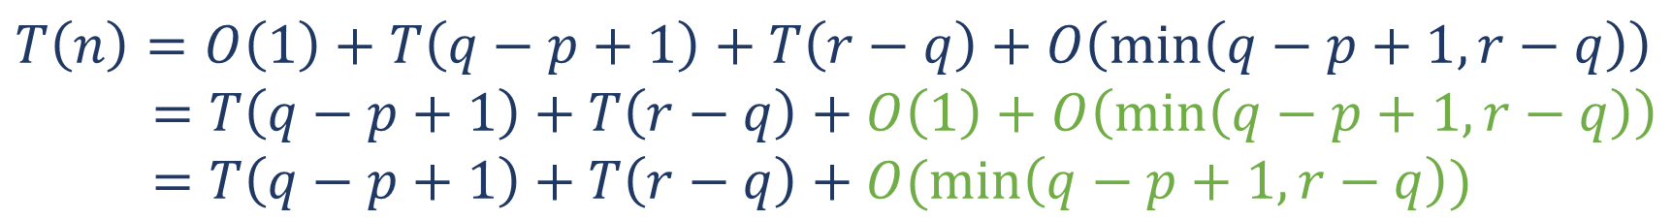






Time Complexity of Merge Sort
The problem is: $T\left(n\right)= ?$
$$n=r−p+1$$
MERGE-SORT($A, p, r$)
IF $p<r$
$q= \left\lfloor \frac{(p+r)}{2}\right\rfloor$
$B=$MERGE-SORT($A, p, q$)
$C=$MERGE-SORT($A, q+1, r$)
$D=$MERGE($B,C$)
Return $D$
Running Time Per Line
$$O(1)$$
$$T(q−p+1)$$
$$T(r−q)$$
$$O(min⁡(q−p+1,r−q))$$
$$T\left(n\right)=O\left(1\right)+T\left(q−p+1\right)+T\left(r−q\right)+O\left(\min\left(q−p+1,r−q\right)\right)$$
$$=T\left(q−p+1\right)+T\left(r−q\right)+O\left(1\right)+O\left(\min\left(q−p+1,r−q\right)\right)$$
$$=T\left(q−p+1\right)+T\left(r−q\right)+O(\min\left(q−p+1,r−q\right))$$
Exercise: Why?

Slide 23

Time Complexity of Merge Sort
$$n=r−p+1$$
The problem is: $T\left(n\right)= ?$
$$T\left(n\right)=T\left(q−p+1\right)+T\left(r−q\right)+O(\min\left(q−p+1,r−q\right))$$
Let $x=q−p+1$ and let $y=r−q$. Hence, $n=x+y$.
$$T\left(n\right)=T\left(x\right)+T\left(y\right)+O(\min\left(x,y\right))$$
Divide + Conquer
Combine

Slide 24



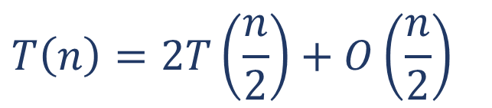
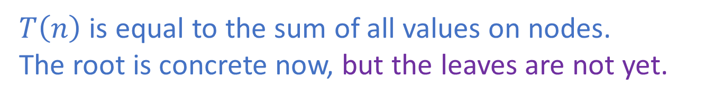


Time Complexity of Merge Sort
The problem is: $T\left(n\right)= ?$
$$T\left(n\right)=T\left(x\right)+T\left(y\right)+O(\min\left(x,y\right))$$
A special case: $x=y=\frac{n}{2}$
$$O\left(\frac{n}{2}\right)$$
$$T\left(n\right)=2T\left(\frac{n}{2}\right)+O\left(\frac{n}{2}\right)$$
$$T\left(n\right)$$
Let us express this equation in a graphical way.
$$T\left(\frac{n}{2}\right)$$
$$T\left(\frac{n}{2}\right)$$
$T\left(n\right)$ is equal to the sum of all values on nodes.
The root is concrete now, but the leaves are not yet.
What should we do next?

Slide 25
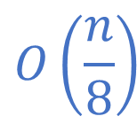


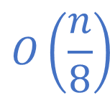




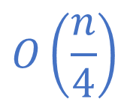


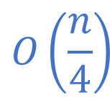
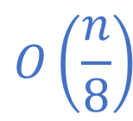

Time Complexity of Merge Sort
The problem is: $T\left(n\right)= ?$
We further expand the tree!
$$O\left(\frac{n}{2}\right)$$
$$O\left(\frac{n}{4}\right)$$
$$O\left(\frac{n}{4}\right)$$
How many layers?
$$(\log_{2}{n})−1$$
$$O\left(\frac{n}{8}\right)$$
$$O\left(\frac{n}{8}\right)$$
$$O\left(\frac{n}{8}\right)$$
$$O\left(\frac{n}{8}\right)$$
Exercise: Why?
$$…$$
$$…$$
$$…$$
$$…$$
$$T\left(2\right)$$
$$…$$
$$T\left(2\right)$$

Slide 26






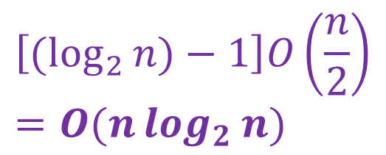
Time Complexity of Merge Sort
The problem is: $T\left(n\right)= ?$
We sum all values on nodes.
$$T\left(2\right)=?$$
$$O\left(1\right)$$
This is the time complexity of MERGE-SORT.
$$O\left(\frac{n}{2}\right)$$
$$O\left(\frac{n}{2}\right)$$
$$O\left(\frac{n}{4}\right)$$
$$O\left(\frac{n}{4}\right)$$
$$O\left(\frac{n}{2}\right)$$
$$\left[(\log_{2}{n})−1\right]O\left(\frac{n}{2}\right)=O(n\log_{2}{n})$$
$$O\left(\frac{n}{8}\right)$$
$$O\left(\frac{n}{8}\right)$$
$$O\left(\frac{n}{8}\right)$$
$$O\left(\frac{n}{8}\right)$$
$$O\left(\frac{n}{2}\right)$$
$$…$$
$$…$$
$$…$$
$$…$$
$$O\left(\frac{n}{2}\right)$$
$$T\left(2\right)$$
$$…$$
$$T\left(2\right)$$

Slide 27
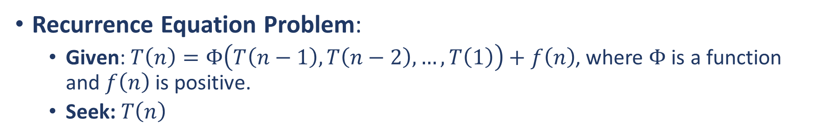
A Bit More on Recurrence Equations
Recurrence Equation Problem:
Given: $T\left(n\right)=Φ\left(T\left(n−1\right),T\left(n−2\right), …,T\left(1\right)\right)+f\left(n\right)$, where $Φ$is a function and $f\left(n\right)$ is positive.
Seek: $T\left(n\right)$
The recurrence equation for the time complexity of MERGE-SORT is a special case instance of this problem.
$$T\left(n\right)=T\left(x\right)+T\left(y\right)+O(\min\left(x,y\right))$$
How to solve?
Recursion tree (has been demonstrated)
Master method (a “cookbook” method)
Substitution method (CLRS 3rd Section 4.3)

Slide 28

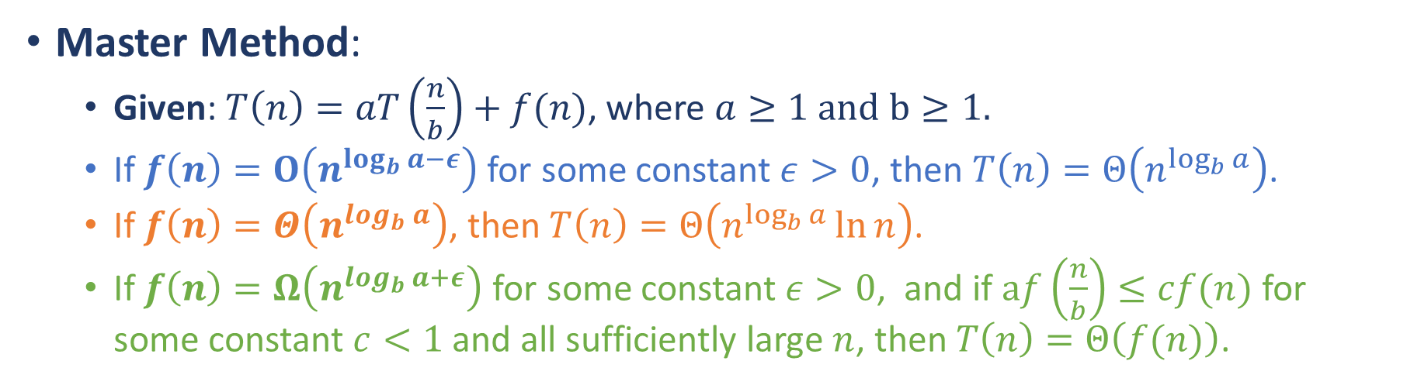
A Bit More on Recurrence Equations
Master Method:
Given: $T\left(n\right)=aT\left(\frac{n}{b}\right)+f(n)$, where $a≥1 and$ $b≥1.$
If $f\left(n\right)=O\left(n^{\log_{b}{a−ε}}\right)$ for some constant $ε>0$, then $T\left(n\right)=Θ\left(n^{\log_{b}{a}}\right)$.
If $f\left(n\right)=Θ\left(n^{\log_{b}{a}}\right)$, then $T\left(n\right)=Θ\left(n^{\log_{b}{a}}\ln{n}\right)$.
If $f\left(n\right)=Ω\left(n^{\log_{b}{a+ε}}\right)$ for some constant $ε>0$, and if $af\left(\frac{n}{b}\right)≤cf(n)$ for some constant $c<1$ and all sufficiently large $n$, then $T\left(n\right)=Θ\left(f(n)\right)$.
A key ingredient is $\log_{b}{a}$

