Slide 1
Solidarity Purchasing Group Sprint1
Team P04
MARINO Diego - CANNARELLA Alessandro - CAVALLO Simone - GOURLET Katell - LANFRANCO Dario - ACQUARO Claudio - LISCIANDRELLO Mattia

Slide 2


Slide 3
Stories implemented
Enter client order
As a shop employee
I want to enter product requests for a client
So her products are booked
1
Browse products
Filter by categories
Choose products quantities
Add to/remove from basket
Create order for the client

Slide 4
Stories implemented
Enter new client
As a shop employee
I want to enter new client data
So that she is registered in the system
2
Client registration form
Notes:
1=> complete
2=> almoth okay. Only one counter for now
3=> yes but for one counter

Slide 5
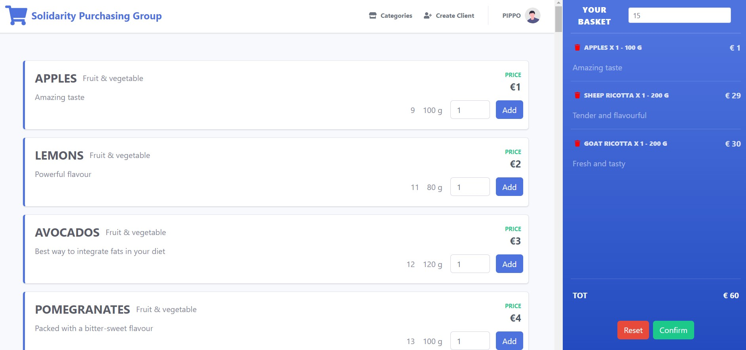
Demo
Shop employee’s view

Slide 6
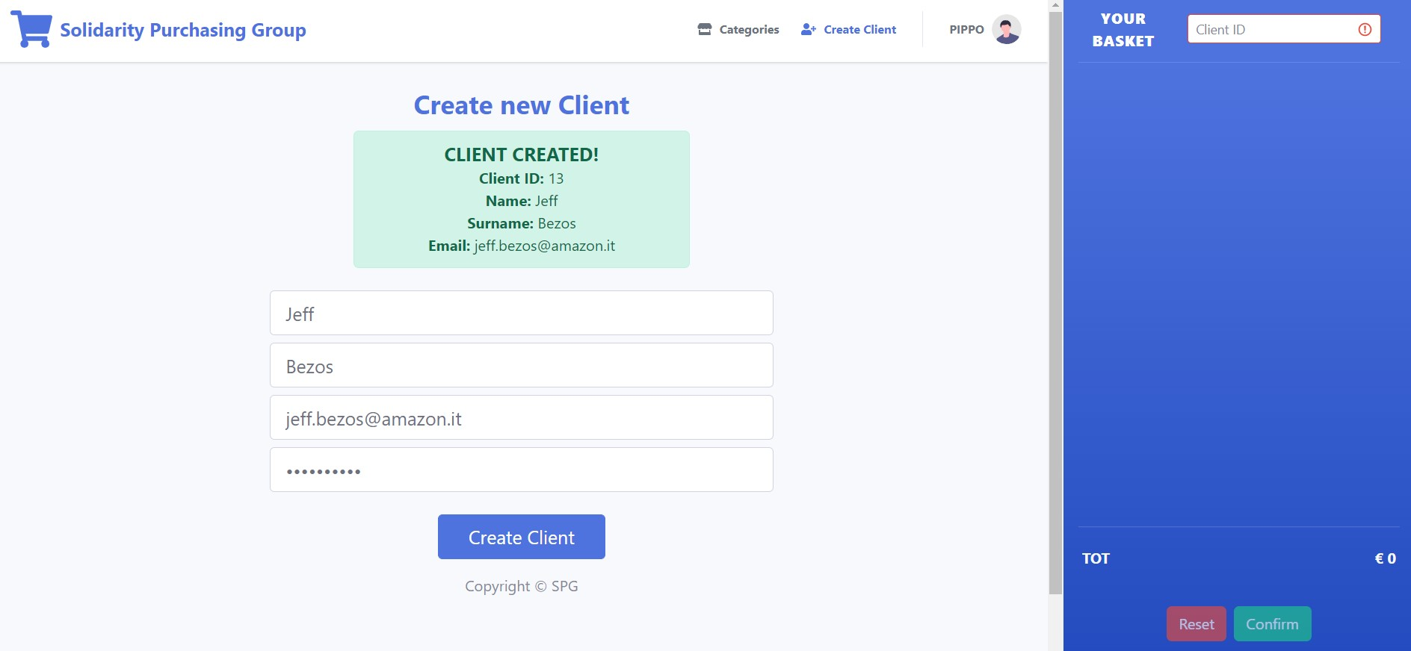
Demo
Shop employee’s view

Slide 7
Thanks for your attention!

