Slide 1
期末考试
时间：12月 28日（周二） 19: 00 ⎯ 21: 00
地点：
六教6C300
闭卷考试。请隔行隔列入座。
请带好学生证、笔、计算器。
草稿纸由答题纸自取，自带计零分。
请将其他物品（包括已静音的手机）放到教室前面。

Slide 2
期末考试范围
（按《量子物理》书中章节号列出，括号里的内容不要求）
第一章：1-11 (9.2, 9.3, 10.2)
第三章：1-2
第四章：1-6 (2.2, 2.4)

Slide 3
题型
分数
单选 30
填空 30
简答 8
解答 32
请将第一、二大题的答案直接写在试卷相应位置，其它题的解答写在答题纸上。草稿纸从答题纸中自取。

Slide 4
总成绩= 0.35a + 0.50b + c
a： 期中成绩，满分100
b： 期末成绩，满分100
c： 作业成绩，满分15
作业缺一次扣1.2分，
统计截止时间：12月27日22:00

Slide 5
等级制 | 百分制 | 绩点
A+、A | 100-95 | 4.0
A- | 94-90 | 4.0
B+ | 89-85 | 3.6
B | 84-80 | 3.3
B- | 79-77 | 3.0
C+ | 76-73 | 2.6
C | 72-70 | 2.3
C- | 69-67 | 2.0
D+ | 66-63 | 1.6
D | 62-60 | 1.3
F | ≤59 | 0

Slide 6
答疑
时间：12月27、28日下午1: 30 - 3: 00
地点：六教A413

Slide 7
查成绩
请大家在网络学堂“课程作业” 中“总成绩”一栏提交相关的信息，在作业说明框内注明班级、学号、姓名，这样就可知道绩点。有问题请在2022年1月12日前联系助教。

Slide 8
课件修改
1. 3-71
2. 4b-34
3. 4c-21
4. 4d-45

Slide 9
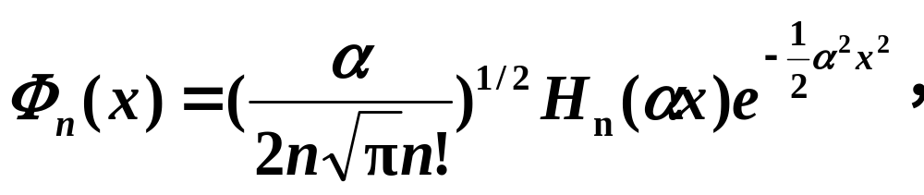
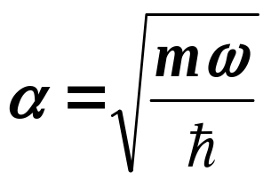

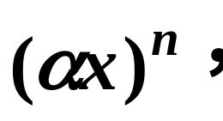
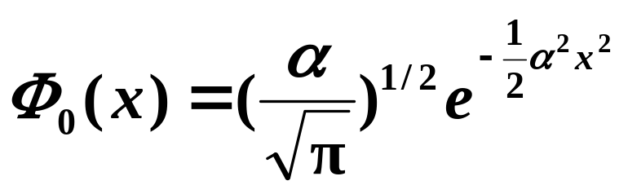
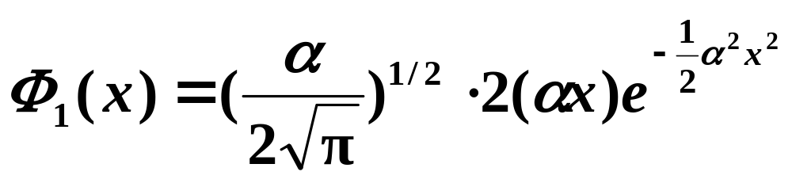
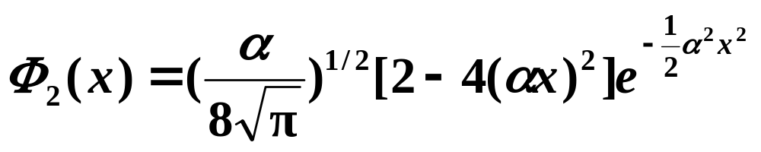
1. 3-71
2.2.3 谐振子的能量本征波函数
H_{n}是厄密（Hermite）多项式，
最高阶是



Slide 10





2. 4b-34
l j
n=3
2 5/2
n | l | j
1 | 0 | 1/2 | 1.461
2 | 0 1 1 | 1/2 1/2 3/2 | 0.456 0.091 0.162
3 | 0 1 1 2 2 | 1/2 1/2 3/2 3/2 5/2 | 0.162 0.054 0.018
2, 1 3/2
1, 0 1/2
n=2
1 3/2
1, 0 1/2
ν
选择定则：

Slide 11

3. 4c-21
 | 2 | 1 | 0 | -1 | -2
1 |  | (1⁺, 0⁺) | (1⁺, -1⁺) | (-1⁺, 0⁺)
0 | (1⁺, 1⁻) | (1⁺, 0⁻) (1⁻, 0⁺) | (1⁺, -1⁻) (0⁺, 0⁺) (1⁺, -1⁺) | (-1⁺, 0⁻) (-1⁻, 0⁺) | (-1⁺, -1⁻)
-1 |  | (1⁻, 0⁻) | (1⁻, -1⁻) | (-1⁻, 0⁻)
m
m_{s}
为求出允许存在的能级的l、s值，需要分两步：
(1) 求出两个电子体系的总磁量子数m、m_{s}
m = m₁+m₂, m_{s} = m_{s1}+m_{s2}
(2) 由可能出现的m、m_{s}值推出l、s

Slide 12
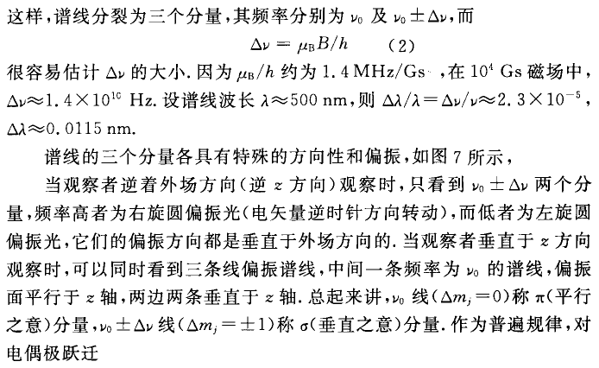
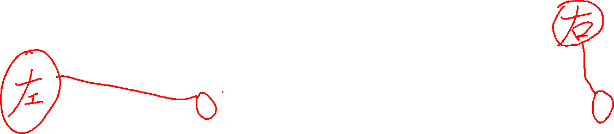
4. 4d-45

Slide 13
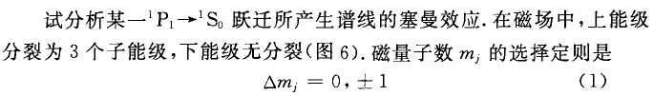
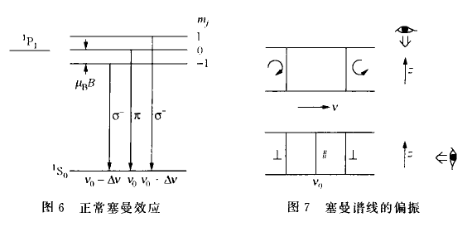

Slide 14
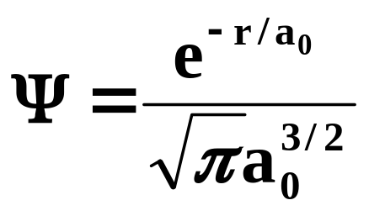
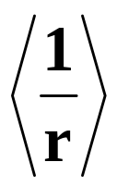
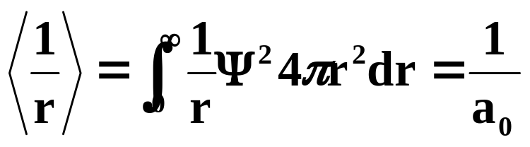
问题：
例4.4 The wave function for the lowest energy level of hydrogen is , where a₀ is Bohr radius.
The expectation value of reciprocal distance of the electron from the nucleus is
A. 1.5/a₀ B. 1/a₀ C. a₀ D. ∞ E. 2/a₀
解：
选B。

Slide 15
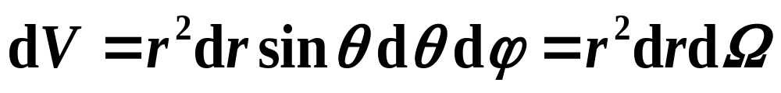
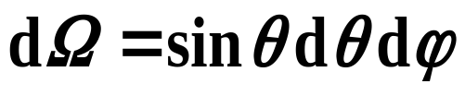
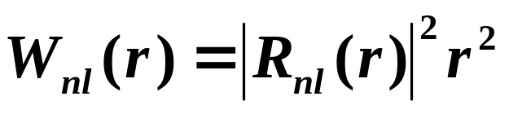
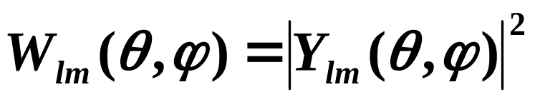
2.2 电子的概率分布
电子出现在体积元dV中的概率为：
：(θ ,ϕ )方向立体角元
电子沿径向的概率密度为
电子出现在(θ ,ϕ )方向附近单位立体角元中的概率为

Slide 16
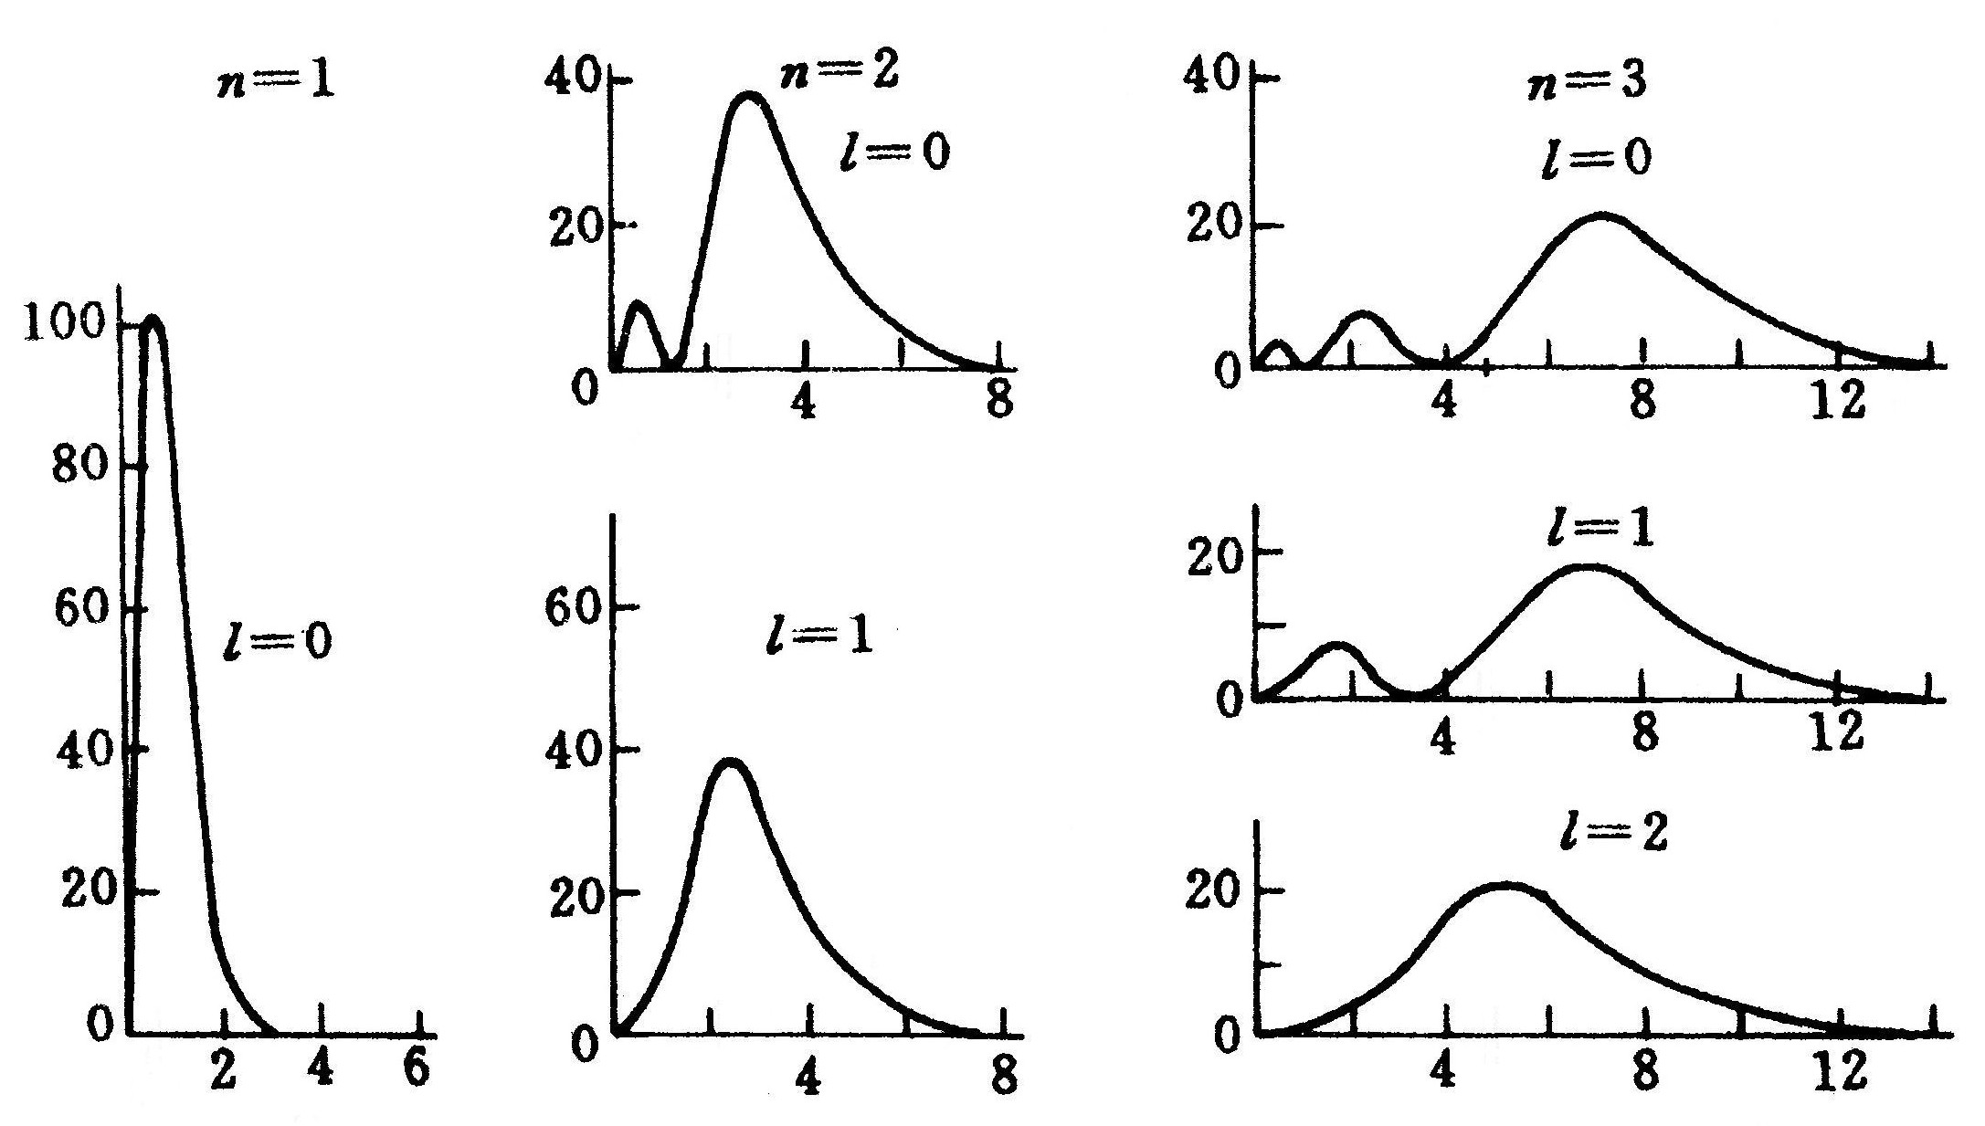

W_{nl}
基态
激发态
电子沿径向的概率密度W_{nl}(r)
“只在此山中，云深不知处。” ⎯ 贾岛《寻隐者不遇》

Slide 17
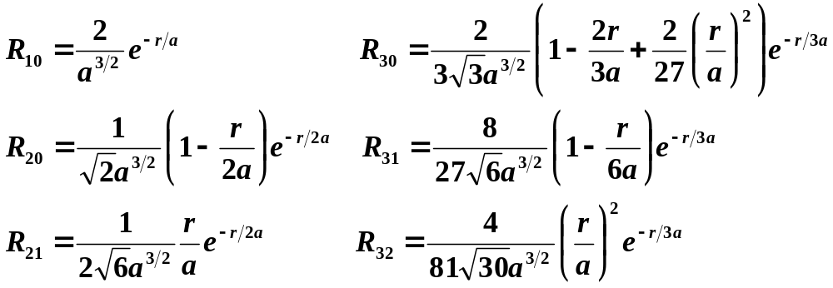
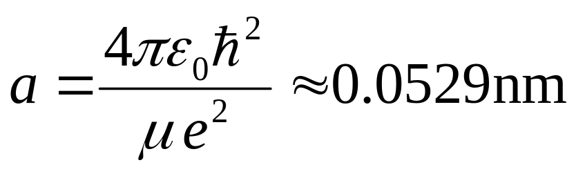
当n =1,2,3时的R_{nl} ：
其中
为玻尔半径。

Slide 18
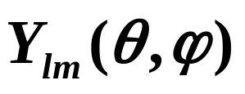

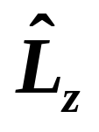
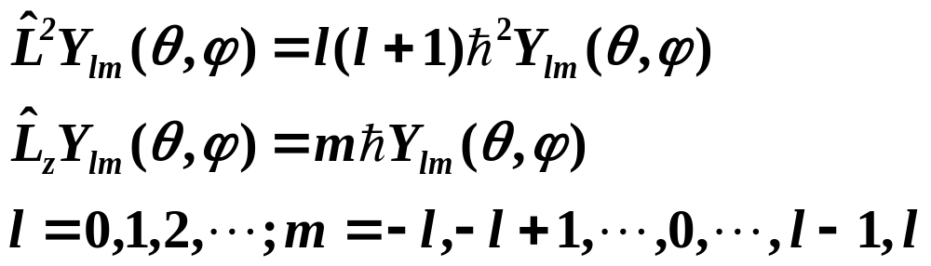
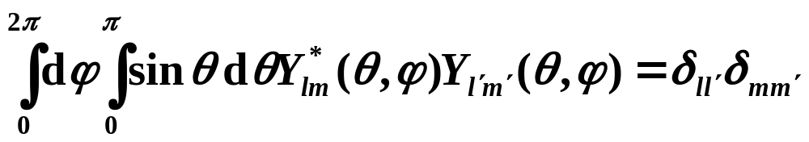
是 和 的共同本征波函数：
正交、归一化条件：

Slide 19
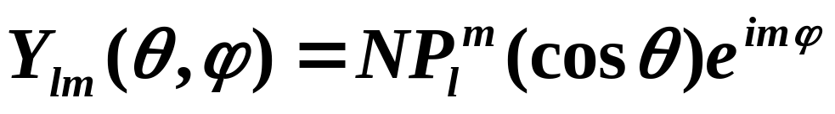
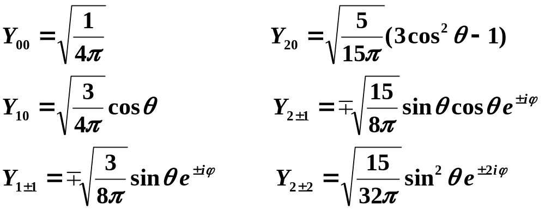
当l=0,1,2时的球谐函数：

Slide 20
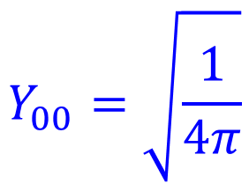
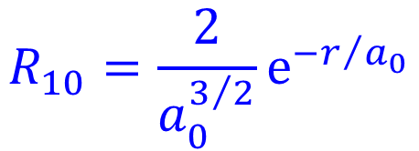


Slide 21
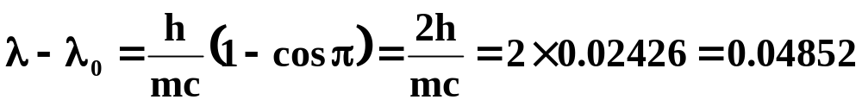
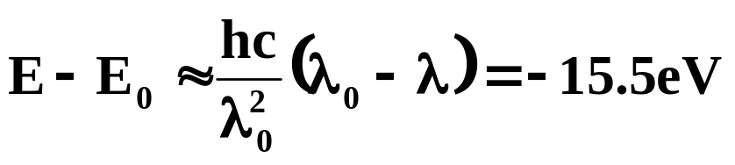
1. Electromagnetic radiation of wavelength 6.20 Å is incident on a substance and back – scattered at an angle of 180º. Determine the Compton energy shift of the EM waves.
2.0 keV B. 15.5 eV C. 30.0 eV
D. 3.0 keV E. 4.0 keV
[解]
(Å)
选B。

Slide 22
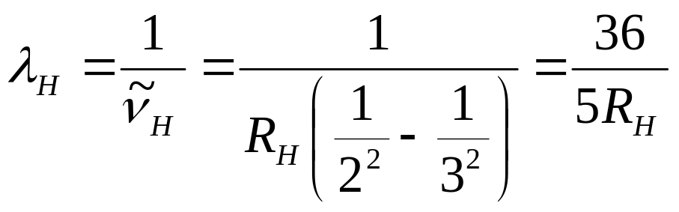
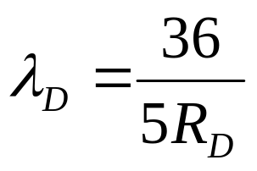
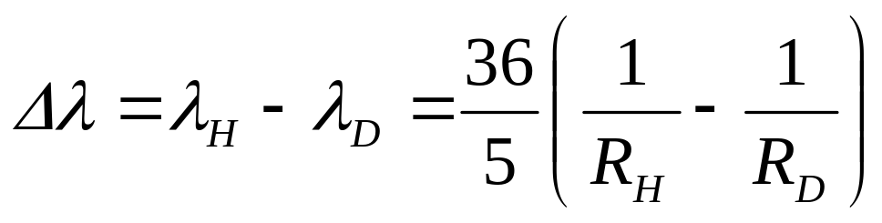
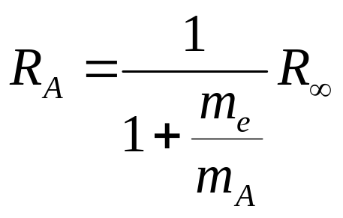
2. 在氢放电管中，混有少量同位素氘(²D)，求这两种原子巴耳末线系H_{α}光谱线的波长差Δλ。
解：
(1)

Slide 23
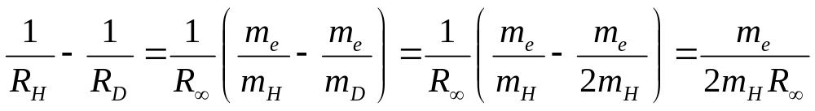
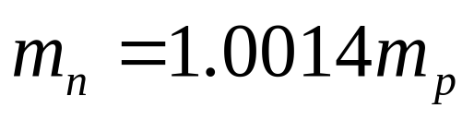
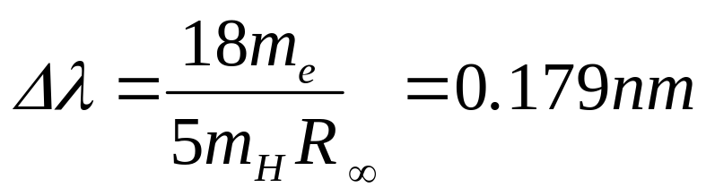
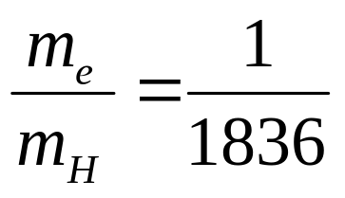
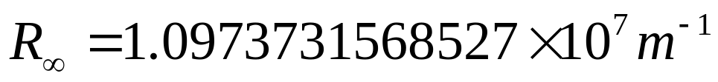
(2)
(1)
(2)代入(1) ，得

Slide 24
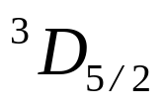
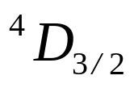
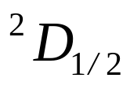

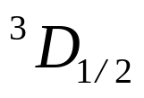

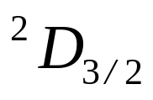
3. Which of the following states is possible for an atom with a closed core plus one d-electron (l=2)?
A.
B.
C.
D.
E.
解：原子态由最外层电子决定。本题中原子最外层只有一个d电子，所以l = 2，s = 1/2。
j = l+s, l+s−1, …, | l−s |，可取值为5/2，3/2。因此原子态可表示为
或
。选D。

Slide 25
4. Stern and Gerlach succeeded in deflecting a beam of silver atoms with an inhomogeneous magnetic field. Which of the following is a generally accepted inference from the results of their measurements?
A. The technique is useful for precise measurement of the magnetic field intensities.
B. The single deflection observed is principally due to an induced magnetic moment in the silver atom.
C. The two deflections observed are due to the two possible measured values of a component of the magnetic moment of the atom.
D. The three deflections observed are due to neutral atoms, negatively charged ions and positively charged ions.
E. The continuous range of values observed is due to random orientation of the magnetic moments of atoms.

Slide 26
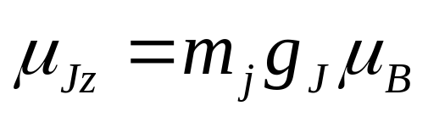
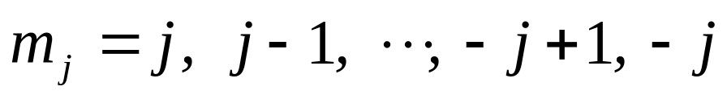
解：Stern-Gerlach实验：原子射线束射入不均匀的磁场区域，偏转后在屏上可观测到几条清晰可见的黑斑。这表明原子磁矩只取几个特定的方向，从而原子角动量的投影是量子化的。应用上没有反过来利用它求磁场的。选(C)。
斑纹条数 = 2j+1
例如，
Ag: (Kr)4d¹⁰5s¹, ²S_{1/2}
j =1/2, 2j+1 = 2，利用非均匀磁场可测到2条斑纹。

Slide 27
5. In the Stern-Gerlach effect, observed when a beam of atoms is passed through an inhomogeneous magnetic field, which of the following is true?
A. The atoms must be ionized first.
B. No deflection is observed for hydrogen atoms.
C. Only one deflection is observed for hydrogen atoms.
D. Two distinct deflections are observed for sodium (Z = 11) atoms.
E. Three distinct deflections are observed for magnesium (Z = 12) atoms.

Slide 28
解：在Stern - Gerlach实验中，原子射线束的分裂数为2j + 1，j是总角动量量子数。对于基态的Na原子，电子组态为1s²2s²2p⁶3s¹，原子态为¹S_{1/2}，j = 1/2，因此分裂成二条线。选D。
H: 1s¹, ²S_{1/2}
Mg: (Ne) 3s², ¹S₀

Slide 29
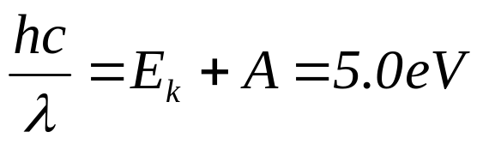
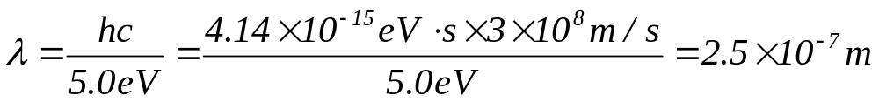
6. A photon impinges on the surface of a clean copper plate in a vacuum. A retarding potential of 1 volt is necessary to ensure that an emitted photoelectron is thought to rest. If the work function of the copper plate is 4.0 electron volts, the wavelength of the photon is most nearly
A. 12,000 Å B. 4000 Å C. 3000 Å D. 2500 Å
E. 600 Å
解：根据Einstein光电效应的理论
由此可知入射光子的波长λ ≈ 2500Å。选（D）。

Slide 30
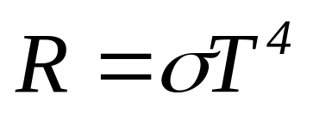
7. A blackbody at temperature T₁ radiates energy at a power level of 10 milliwatts (mW). The same blackbody, when at a temperature 2T₁, radiates energy at a power level of
A. 10 mW B. 20 mW C. 40 mW D. 80 mW
E. 160 mW
解：由斯特蕃 ⎯ 玻耳兹曼定律，黑体辐射的总辐射本领和它的绝对温度的四次方成正比
选（E）。

Slide 31
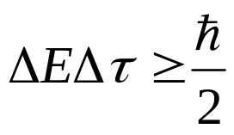

8. The natural line width of an atomic transition with a mean lifetime of 5 × 10⁻⁹ second is most nearly
A. 4.1 × 10⁻¹⁵ eV B. 1.3 × 10⁻¹¹ eV
C. 1.3 × 10⁻⁷ eV D. 4.1 × 10⁻² eV
E. 13.6 eV
解：
选（C）。

Slide 32


9. If an electron were confined to nuclear dimensions, the uncertainty in its momentum would be most nearly
A. 0.2 eV/c B. 200 eV/c C. 200 KeV/c
D. 200 MeV/c E. 200GeV/c
解：
选 (D)。

Slide 33
10. The hypothesis that an electron possesses spin is qualitatively significant for the explanation of all of the following topics EXCEPT the
A. structure of the periodic table
B. specific heat of metals
C. anomalous Zeeman effect
D. deflection of a moving electron by a uniform magnetic field
E. fine structure of atomic spectra
选D。

Slide 34






11. Eigenfunctions for a rigid dumbbell rotating about its center have a dependence of the form
where m is a constant. Which of the following values of A will properly normalize the eigenfunction?
A.
B.
2π
C. (2π)²
D.
E.
解：令
选(D)。

Slide 35

祝
同学们取得好成绩！

Slide 36


Slide 37

祝
假期愉快！

Slide 38


