Slide 1

Object Selection
_______________________
_______________________
Student:
Nguyen Van Khoi
Tran Hoang Nam
Supervisor:
MSc. Tu Trung Hieu

Slide 2
Introduction
Literature review
Problem statement
Interactive graph cut segmentation
Silent Lazy Snapping solution
Experimental results
Future direction
Question and answer

Slide 3
Introduction
Literature review
Problem statement
Interactive graph cut segmentation
Silent Lazy Snapping solution
Experimental results
Future direction
Question and answer

Slide 4
Graph cut for Interactive Segmentation

Slide 5
Lazy Snapping

Slide 6
Grabcut

Slide 7
Introduction
Literature review
Problem statement
Interactive graph cut segmentation
Silent Lazy Snapping solution
Experimental results
Future direction
Question and answer

Slide 8
Binary labelling problem

Slide 9
Min-cut Max-flow problem

Slide 10
Introduction
Literature review
Problem statement
Interactive graph cut segmentation
Silent Lazy Snapping solution
Experimental results
Future direction
Question and answer

Slide 11
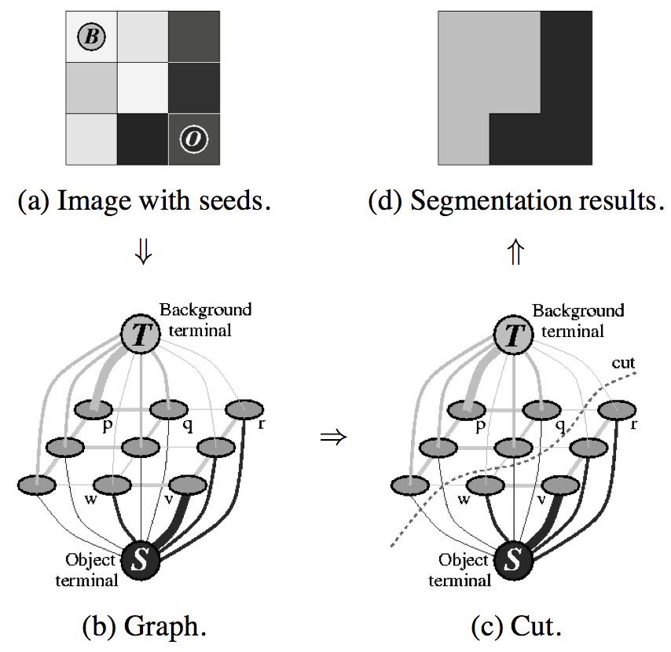
Graph cut construction
A simple segmentation example for a 3x3 image.

Slide 12
Energy function

Slide 13
Energy function (cont.)

Slide 14
Detailed implementation
Negative log-likelihood of intensity for regional term
Ad hoc function for boundary term
Max-flow algorithm provided by Boykov and Kolgomorov (2001)

Slide 15
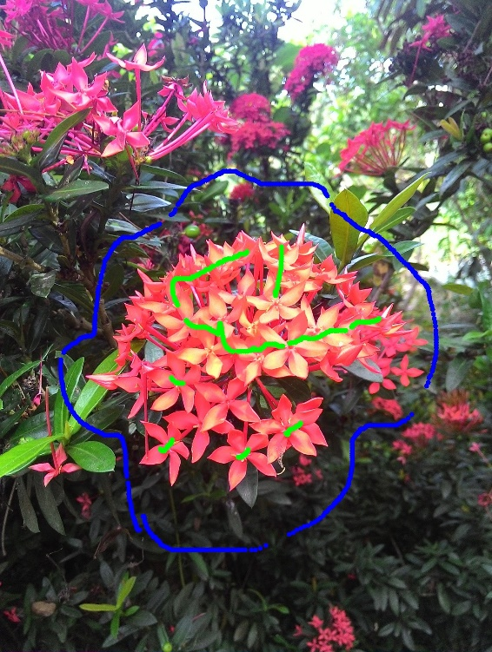

Sample result and comment

Slide 16
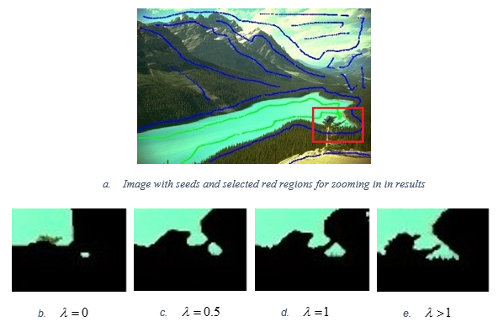
Sample result and comment (cont.)

Slide 17
Introduction
Literature review
Problem statement
Interactive graph cut segmentation
Silent Lazy Snapping solution
Experimental results
Future direction
Question and answer

Slide 18
Introduction
Literature review
Problem statement
Interactive graph cut segmentation
Silent Lazy Snapping solution
Experimental results
Future direction
Question and answer

Slide 19
Introduction
Literature review
Problem statement
Interactive graph cut segmentation
Silent Lazy Snapping solution
Experimental results
Future direction
Question and answer

Slide 20
Introduction
Literature review
Problem statement
Interactive graph cut segmentation
Silent Lazy Snapping solution
Experimental results
Future direction
Question and answer

