Slide 1
Automation Testing
Giảng viên ths.đinh thị mỹ cảnh

Slide 2
Hình thức đánh giá
Điểm quá trình: 40%
Chuyên cần + Một bài kiểm tra thực hành
Cuối kỳ: 60%
Thi thực hành

Slide 3
References
Arnon Axelrod, “Complete Guide to Test Automation: Techniques, Practices, and Patterns for Building and Maintaining Effevtive Software Project”, 2018, Apress.
Pallavi Sharma - Selenium with Java – A Beginner’s Guide_ Web Browser Automation for Testing using Selenium with Java (English Edition)-BPB Publications (2022)
https://www.tutorialspoint.com/selenium

Slide 4
Contents
Chương 1: Overview of Automation Testing
Chapter 2_Introduction to Selenium
Chapter 3_Preparing System and Application Under Test
Chapter 4_WebDriver, WebElement, and By
Chapter 5_Concept of Synchronization
Chapter 6_Working with WebElements-Form, Table, and Dropdown

Slide 5
Contents
Chapter 7_Working with WebElement – Alert, Frame, Iframe, and Window
Chapter 8_Extra Concepts-Actions, Screenshot, WebDriverManager
Chapter 9_What is TestNG
Chapter 10_Concept of Page Object Mdel
Chapter 11_Data Driving Test
Chapter 12_Introducing Maven

Slide 6
Chapter 1: Overview of Automation Testing

Slide 7
Contents
Why Do We Need Test Automation?
Differences Between Manual and Automated Tests
Automated testing tools
Reaching Full Coverage
Testing frameworks
The Test Automation Process
Test Execution
Test Metrics
Analyzing Results
Management Reporting
Notes:
Chapter 1, 2,4

Slide 8
1. Why Do We Need Test Automation?
To reduce the time it takes to test the software before release.
From Waterfall to Agile Software Development.
The Cost of Software Complexity
Refactoring
Continuous Improvement

Slide 9
2. Differences Between Manual and Automated Tests
Preciseness
Maintainability
Sensitivity to Change – Preciseness and Maintainability Put Together
Handling Failures
Length of a Test Case
Dependencies Between Tests
Logging and Evidence Collection
Trust

Slide 10
3. Automated testing tools
IDEs and Programming Language
Microsoft’s Coded UI only works with C# or VB.Net
Selenium supported by many different languages
(Unit) Testing Frameworks
JUnit and TestNG for Java; MSTest, NUnit, xUnit for .Net; for Python you have the built-in unittest framework and py.test; and for JavaScript the most popular ones are Jasmine and Mocha.

Slide 11
3. Automated testing tools
BDD-Style Frameworks
Cucumber
SUT Interaction Technologies
SoapUI
Postman
Record, Edit, Playback Tools vs. Code Libraries
Selenium
Appium
Microsoft Coded UI
Unified Functional Testing (UFT)

Slide 12
3. Automated testing tools
Test Management Suites
These tools typicall allow managing suites of tests, scheduling of tests, test result and provide reports, graphs and trends for management
Build Tools and CI/CD Pipelines
Other Considerations for Choosing Tools

Slide 13
4. Reaching Full Coverage
if we want to reach 100% coverage, how do we measure it? 100% of what?
The three most common metrics that attempt to answer this question are:
1. Percentage of manual test cases covered by automation
2. Percentage of covered feature
3. Percentage of code coverage

Slide 14
4. Reaching Full Coverage
Percentage of Manual Test Cases Covered by Automation
If you convert the manual tests to automated tests as is, then you may be able to say that you reached 100% when done.
Percentage of Covered Features
Suppose that you have a list of features that were developed (e.g., in TFS, Jira, Excel, or any other way) and a description of these features, and you also have a list of test cases that are related to these features (probably managed using the same tool)
Percentage of Code Coverage
Notes:
Percentage of Code Coverage: 3 độ đô C1, C2, C3 đã học

Slide 15
5. Testing frameworks
What is a testing framework
Why do we need a testing framework
Types of testing frameworks
Components of Automation Testing Framework
How to create a test automation framework

Slide 16
What is a testing framework
A testing framework is an execution environment for automated tests. It is the overall system in which the tests will be automated.
It is defined as the set of assumptions, concepts, and practices that constitute a work platform or support for automated testing.

Slide 17
What is a testing framework
The Testing framework is responsible for:
Defining the format in which to express expectations
Creating a mechanism to hook into or drive the application under test
Executing the tests
Reporting results

Slide 18
Why do we need a testing framework
Application independent and has the capability to expand.
Avoiding duplication of test cases automated.
Helps teams organize their test suites and in turn help improve the efficiency of testing.

Slide 19
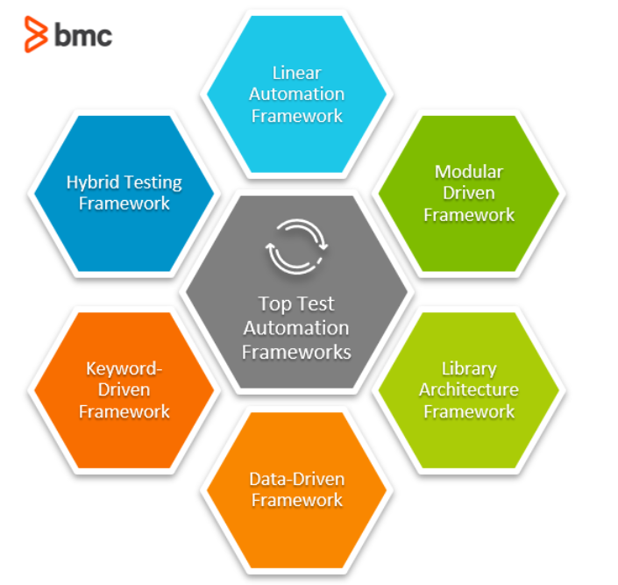
Types of testing frameworks

Slide 20
1-Linear scripting Framework
Linear scripting frameworks create test scripts for individual test cases or small snippets of code.
This is useful in testing smaller applications and can be employed to create test scripts in very little time.

Slide 21
Example
if the operation that you have to verify is the creation of a new account in Gmail, then the following will be the steps:
Open gmail.com
Click on “Create Account”
Enter the details
Verify the details
Create an account

Slide 22
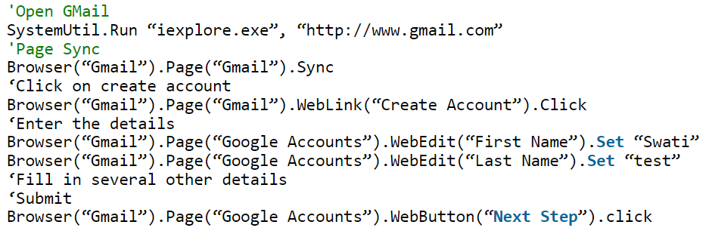
Example

Slide 23
Linear scripting Framework
Advantage: It is easily compatible with existing test automation tools since most of them already support the record and playback feature.
Disadvantage: Scripts developed using this network aren’t reusable and are hard to maintain.

Slide 24
2-Module Based Testing Framework
In a modular-driven test framework, testers disintegrate larger test cases into smaller modules for individual testing.
The individual test scripts can also be clubbed together to create master test scenarios. It also ensures the reusability of test scripts.

Slide 25
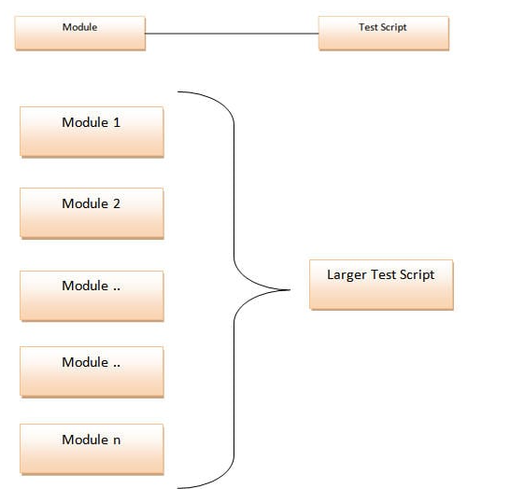
Module Based Testing Framework

Slide 26
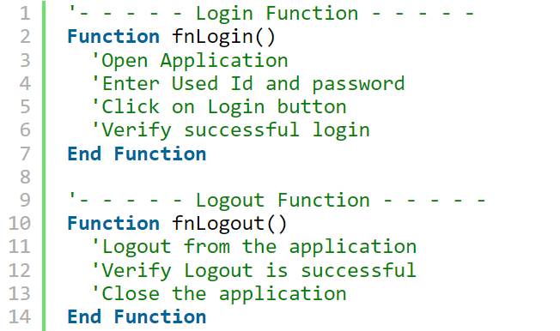
Example

Slide 27
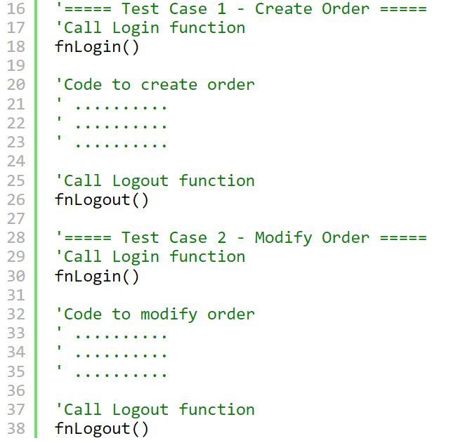
Example

Slide 28
Module Based Testing Framework
Advantages:
Modular division of scripts leads to easier maintenance and also the scalability of the automated test suites.
The functionality is available in easy to use test libraries so creating new driver scripts for different tests is easy and fast.
Disadvantages:
Test script have test data embedded in them. So when the test data needs to be updated we need to change the code of the script. This becomes a big problem when the test script is large.

Slide 29
3-Library Architecture Testing Framework
Segregate the application into functions or rather common functions can be used by the other parts of the application as well.
Thus we create a common library constituting of common functions for the application under test.

Slide 30
Library Architecture Testing Framework
Advantages:
This framework also introduces the high level of modularization which leads to easier and cost-efficient maintenance and scalability too.
Disadvantages:
The test data is lodged into the test scripts, thus any change in the test data would require changes in the test script as well.
With the introduction of libraries, the framework becomes a little complicated.

Slide 31
4-Data Driven Testing Framework
Data Driven Testing Framework helps the user segregate the test script logic and the test data from each other. It lets the user store the test data into an external database.
Typically the Data input can be anything:
MS Excel files
Database
Text files
XML files….etc.

Slide 32
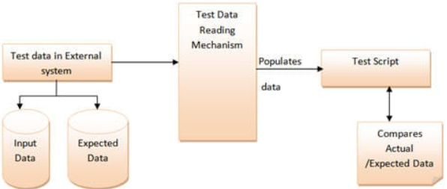
Data Driven Testing Framework
Note:
The test data stored in an external file can belong to the matrix of expected value as well as the matrix of input values.

Slide 33
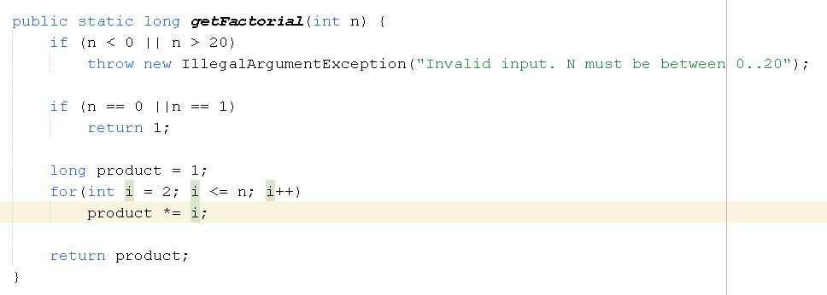
Example
Giả sử, ta có 1 chương trình yêu cầu tính giai thừa

Slide 34
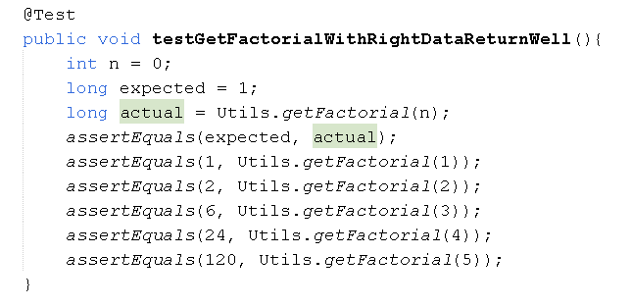
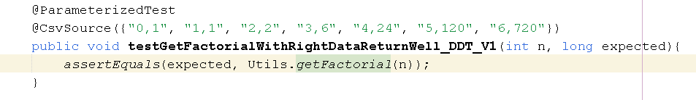
CSV file

Slide 35
Data Driven Testing Framework
Advantage
It is very time-efficient since tests can be framed using multiple data sets.
Disadvantage
Programming expertise is needed since multiple sources of data need to be verified before integration.

Slide 36
5-Keyword Driven Testing Framework
This particular testing framework uses action-based keywords such as click, login, verify link, etc.
The keyword-driven testing framework maps the keyword repository to test data and creates scripts based on the application requirements.

Slide 37
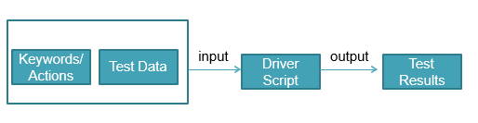
Keyword Driven Testing Framework
These directives are called keywords. The keyword based testing is an extension to the data driven testing.

Slide 38
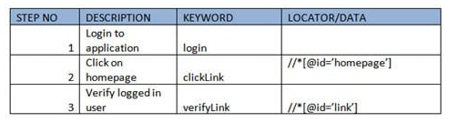
Example
Test case of Keyword Driven Test Framework

Slide 39
Keyword Driven Testing Framework
Advantage
Test scripts are reusable and can be developed independent of the application.
Disadvantage
It is not a very scalable framework since keywords need to be defined during the initial set up.

Slide 40
6-Hybrid Testing Framework
Hybrid testing framework is the combination of modular, data-driven and keyword driven testing frameworks.
This combination of frameworks helps the data driven scripts take advantage of the libraries which usually accompany the keyword driven testing.
Notes:
Cái tên nói tên tất cả, hybrid test framework là sự kết hợp giữa hai hoặc nhiều các loại framework trên.
Điểm cộng lớn ở đây chính là việc phát huy các ưu điểm của các framework mà nó kết hợp sử dụng.

Slide 41
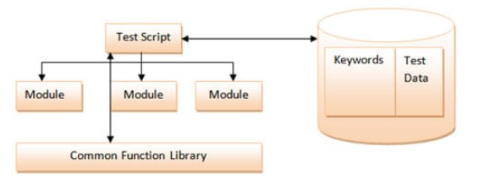
Hybrid Testing Framework

Slide 42
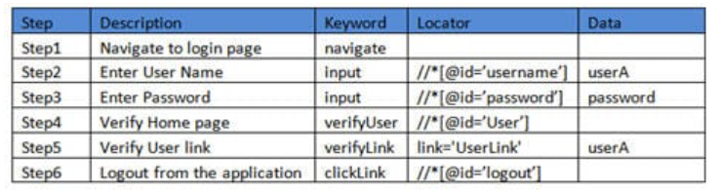
Example

Slide 43
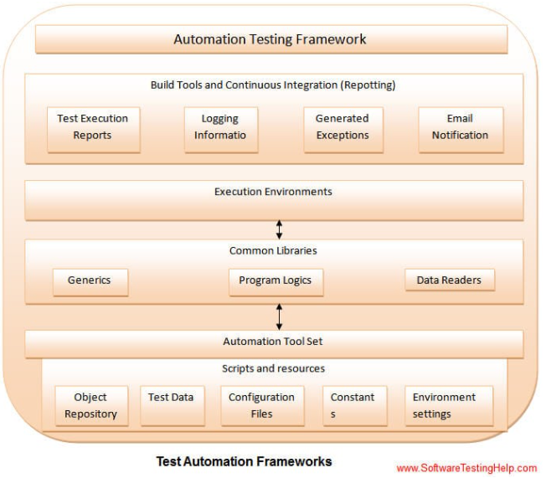
Components of Automation Testing Framework

Slide 44
Automation Framework: Selenium
What is Selenium Framework?
Data Driven Framework in Selenium
Keyword Driven Framework in Selenium
Hybrid Framework
Notes:
Selenium là công cụ kiểm thử tự động miễn phí (mã nguồn mở) dành cho các ứng dụng web trên các trình duyệt và nền tảng khác nhau.

Slide 45
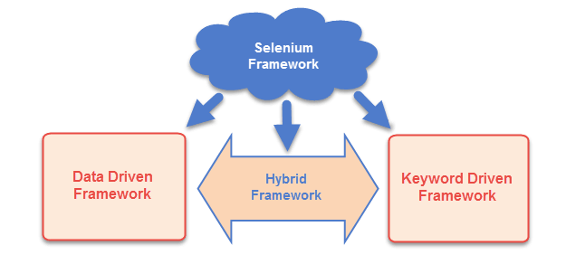
What is Selenium Framework?

Slide 46
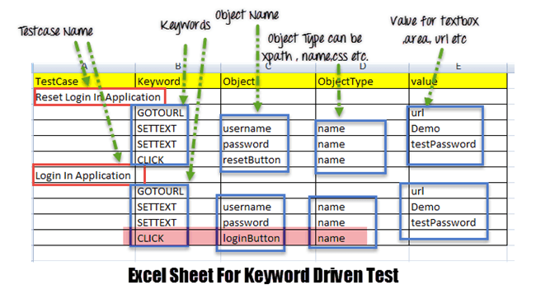
Keyword Driven Framework in Selenium
Notes:
Object Type: có thể là Xpath, name, CSS path, class name etc. dung để định vị các phần tử trên trang web hoặc UI

Slide 47
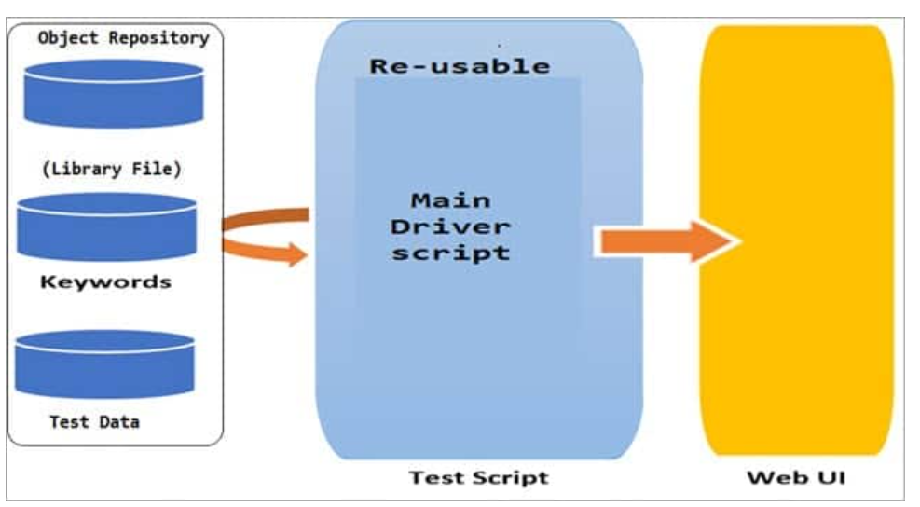
Components Of Hybrid Driven Framework
Function Library
Excel Sheet to store Keywords
Design Test Case Template
Object Repository for Elements/Locators
Test Scripts or Driver Script

Slide 48
How to create a test automation framework
Organizing your assets
Understanding your applications
Gathering relevant data
Creating smoke tests
Setting up error logging

Slide 49
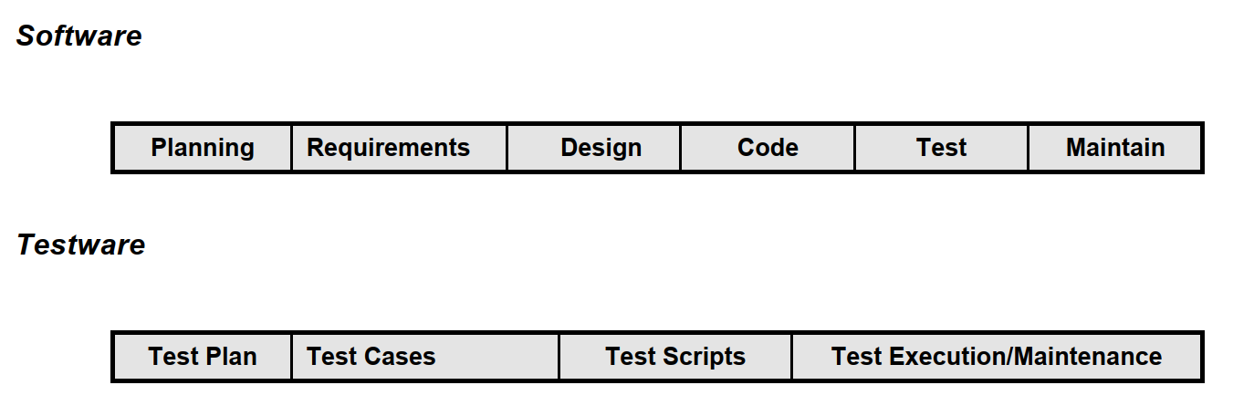
6) The Test Automation Process
In an ideal world, testing would parallel the systems development life cycle for the application. This cycle is generally depicted as:

Slide 50
The Test Automation Process
The Test Team
Test Automation Plan
Planning the Test Cycle
Test Suite Design
Test Cycle Design

Slide 51
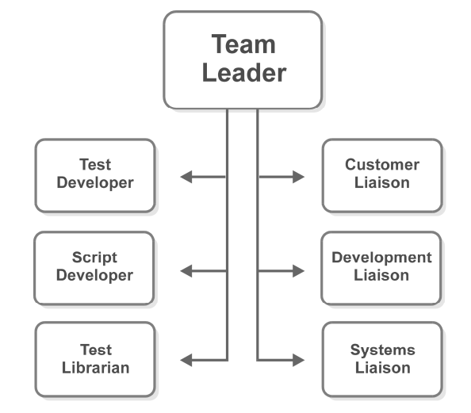
The Test Team

Slide 52
The Test Team
The Team Leader is responsible for developing the Test Plan and managing the team members according to it.
Test Developers are experts in the application functionality, responsible for developing the test cases, executing them, analyzing and reporting the results.
Script Developers are experts in the testing tool, ideally with technical programming experience.

Slide 53
The Test Team
The Test Librarian is responsible for managing the configuration, change and version control for all elements of the test library.
The Customer Liaison represents the user community of the application under test.
The Development Liaison represents the programmers.
The Systems Liaison represents the system or network support group and database administrator.

Slide 54
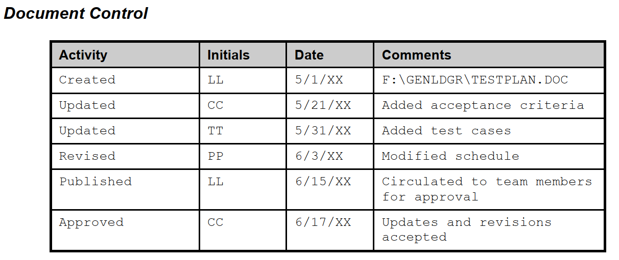
Test Automation Plan
A Test Automation Plan describes the steps needed to automate testing.
Example Plan:
This section is used to control additions and changes to the plan.

Slide 55
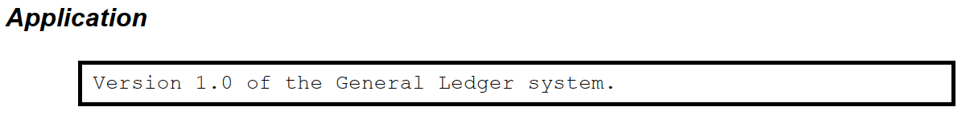
Test Automation Plan
Example Plan:
Describe the application under test in this section.

Slide 56
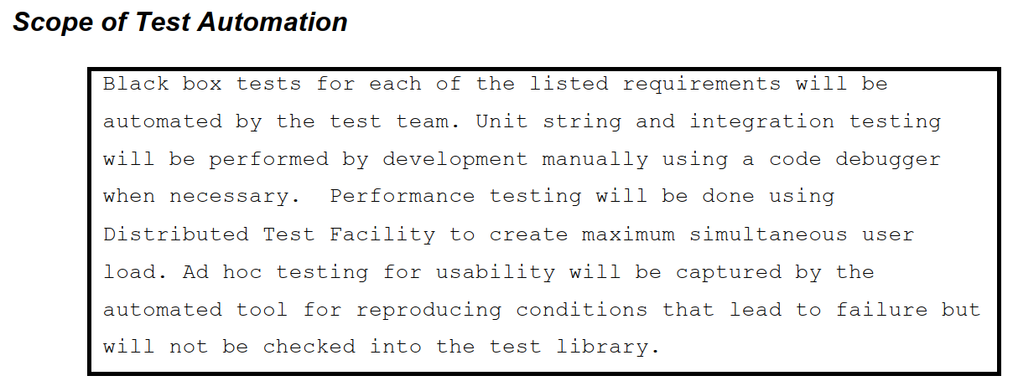
Test Automation Plan
Example Plan:
The statement of scope is as important to describe what will be tested as what will not be, as well as who will be responsible.

Slide 57
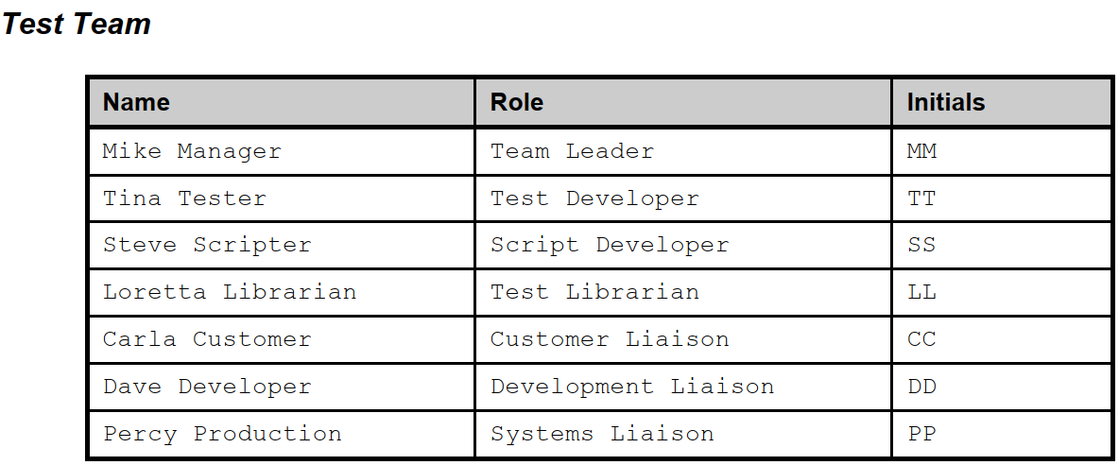
Test Automation Plan
Example Plan:
List the names and roles of the test team members, and cross-reference each of the steps to the responsible party(ies).

Slide 58
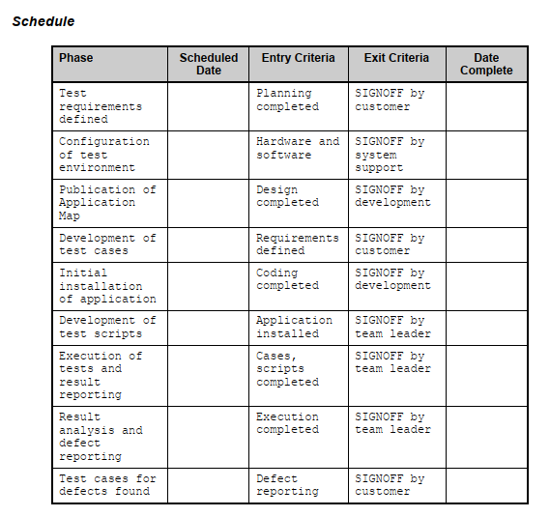

Slide 59
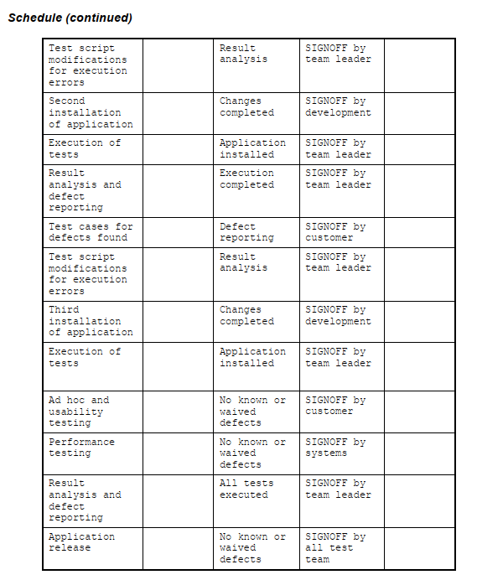

Slide 60
Planning the Test Cycle
The test cycle must be carefully planned to minimize the amount of supervision or interaction required.
Verifying the test environment
Executing test suites or individual tests in sequence
Producing test result reports
Performing final cleanup

Slide 61
Test Suite Design
A test suite is a set of tests which are related.
Related tests: A test suite usually contains tests that are related by the area of the application they exercise, but they may also be selected by their priority.
Context : All tests in a suite should share the same beginning and ending context, as well as the expected state of the database.
Documentation: Test suite documentation should include the set and sequence of individual tests, the beginning and ending context, as well as an data or sequence dependencies with other test suites

Slide 62
Test Cycle Design
The configuration of the test platform as well as initialization, setup and cleanup of the test environment.
Setup: the setup of the test environment, including verifying the configuration and all other variables that affect test execution .
Context: The beginning and ending context of a cycle should be the same point, usually the program manager or command prompt.
Schedule sequence: A test schedule is often comprised of a set of test cycles.
Cleanup: deleting work files, making file backups, assembling historical results, and any other housekeeping tasks.

Slide 63
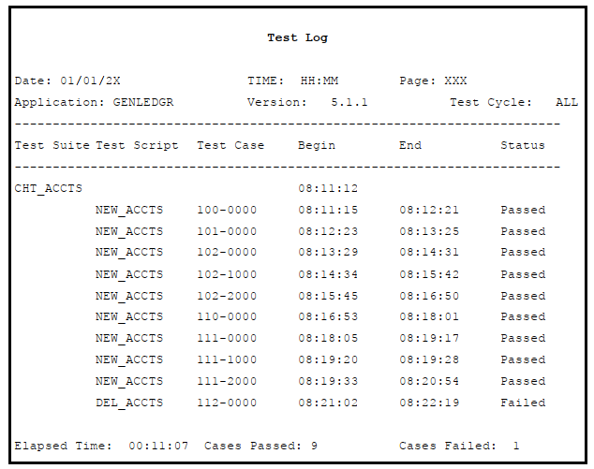
7) Test Execution
Test log: The test log reports the results of the test execution for each test case.

Slide 64
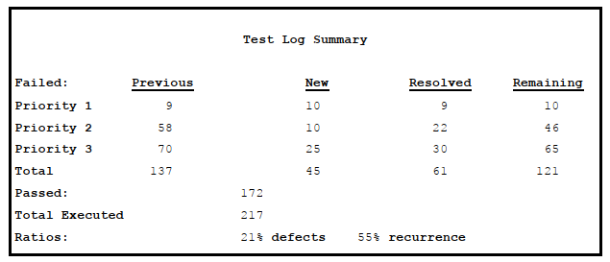

Slide 65
8) Analyzing Results
Inaccurate results: occur when the test results do not accurately reflect the state of the application.
False failure from test environment
False failure from application changes
False failure from test errors
Duplicate failure
False success from test defect
False success from missed error

Slide 66
Analyzing Results
Defect tracking: Once a test failure is determined to be in fact caused by an error in the application, it becomes a defect that must be reported to development for resolution.
Reported defect:
A unique identifier
Tracked as to the test case that revealed it.
The date it was logged as a defect
The developer it was assigned to, and when it was actually fixed.

Slide 67
9) Test Metrics
Metrics are simply measurements. Test metrics are those measurements from your test process that will help you determine where the application stands and when it will be ready for release.
Measure progress
Code coverage
Requirements coverage
Requirements satisfied
Priority Requirements.
Exit criteria

Slide 68
9) Test Metrics
Test case coverage
Predicting time to release
Defect Ratio
Fix rate
Recurrence ratio
Post-release defects
Defect prevention
Continuous improvement

Slide 69
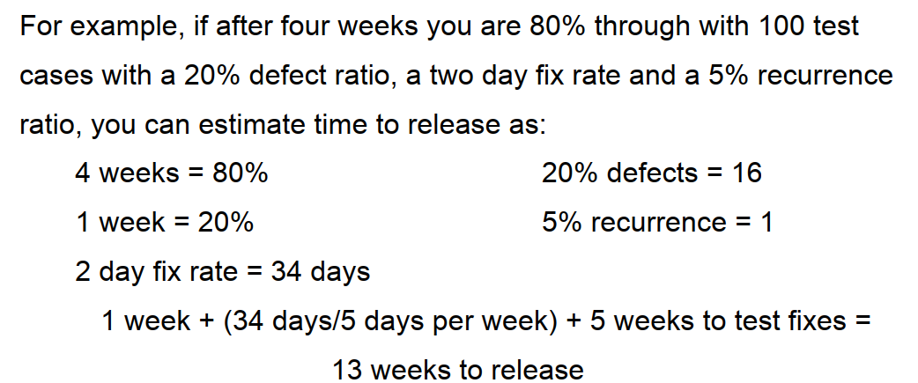
10) Management Reporting
Management is usually interested in something very simple: when will the application be ready?
Estimated time to release

Slide 70
Management Reporting
Saving money
Saving time
Higher quality
Better coverage

Slide 71
Management Reporting
Historical trends
The reason historical trends are important is that they highlight progress - or, perish the thought, regression.
Another reason to analyze historical trends is that you can analyze the impact of changes in the process.

Slide 72
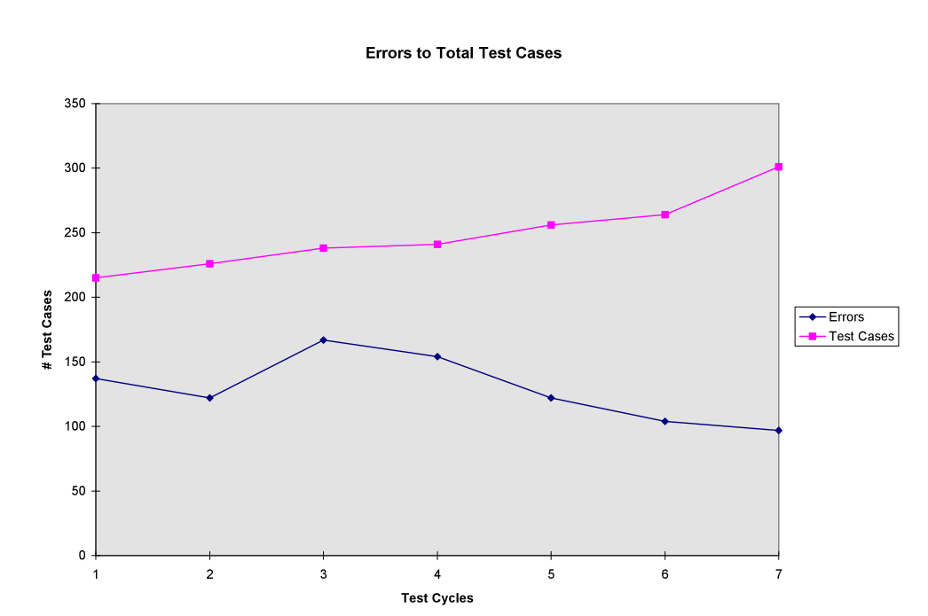

Slide 73
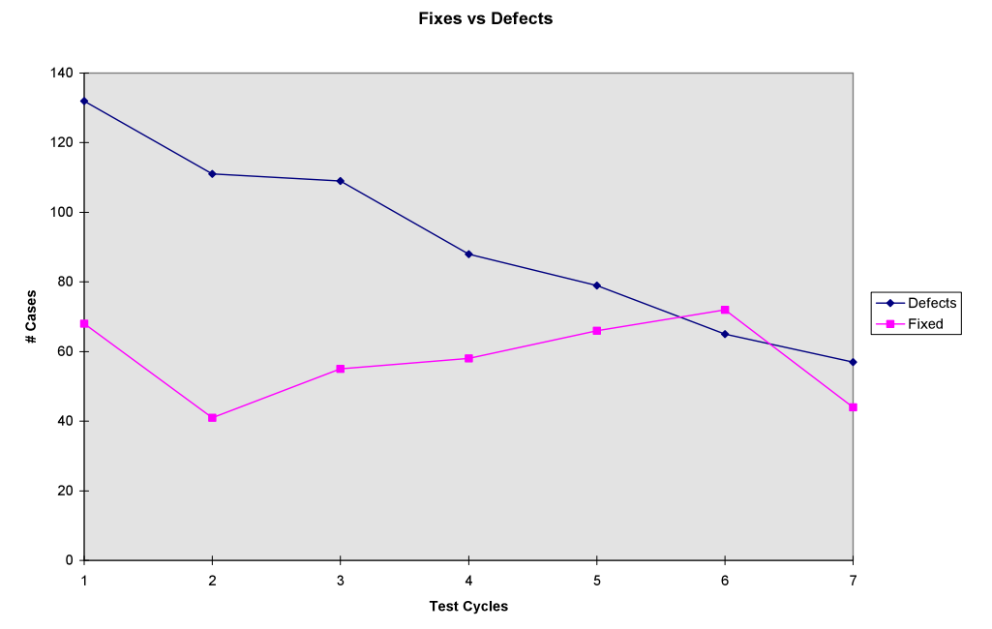

Slide 74
THANKS

