Slide 1
1. Core Lib (Base CURD) 2. CQRS – MediatR – DI – Domain Event 3. EF – Soft delete with Query filter 4. EF – POCO – Fluent Api 5. Fluent Validation 6. Action Filter 8. Swagger 9. Elmah 10. RabitMq 11. Multilanguage 12. Api Gate way 13. Globle Exception 14. Auto Mapper

Slide 2
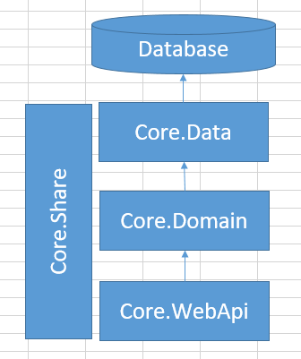

Slide 3
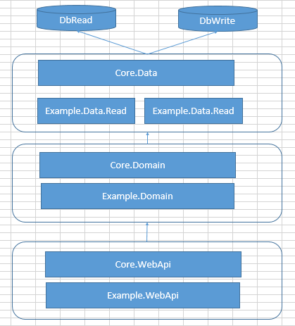

Slide 4
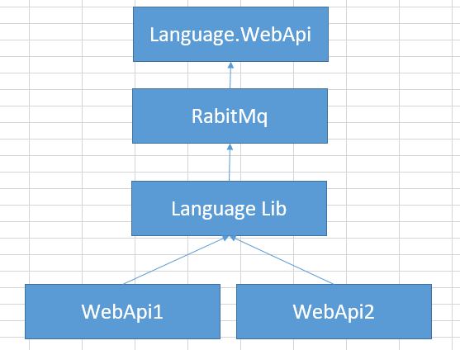

Slide 5
