Slide 1
Sprint 3
Java Collections Framework - Part 2
# | Version | Release date | Notes
1 | 1.0 | 19-07-2019 | (1) Architecture (2) Dependency injection (DI) (3) Invertion of control (IoC)
2 | 2.0 | 26-07-2019 | (1) Inversion of Control (IoC) (2) Dependency Inversion Principle (DIP) (3) Dependency Injection (DI) (4) IoC containers

Slide 2
Contents
(1) Inversion of Control (IoC)
(2) Dependency Inversion Principle (DIP)
(3) Dependency Injection (DI)
(4) IoC containers

Slide 3
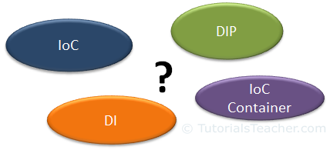
Contents

Slide 4
Main Keywords
Design Principle
Design Pattern

Slide 5
Sub Keywords
Loosely Coupled
Tightly Coupled
IoC
DIP
DI
IoC Container

Slide 6
Overview (1)
OOP
  Programming paradigm
  Objects
  Interact with one another
  Base idea
  => Best application
  Prices
  Securities
  Maintenance
  ...

Slide 7
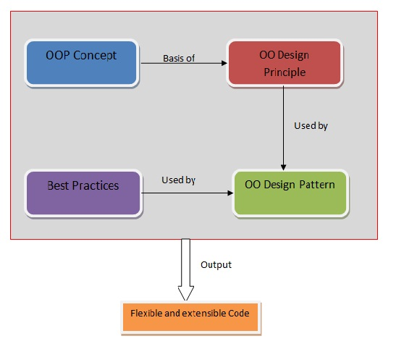
Overview (2)
2. Elements of OOP
Ref: https://techythought.wordpress.com/2013/01/21/design-principle-vs-ds-design-pattern-describing-oop-elements/
Order item

Slide 8
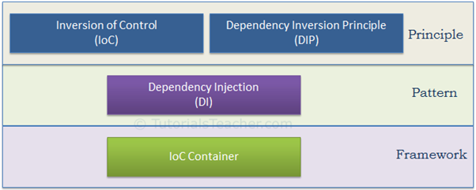
Overview (3)
2. Elements of OOP
Ref: https://www.tutorialsteacher.com/ioc/introduction
=> classify: item is on of ?

Slide 9
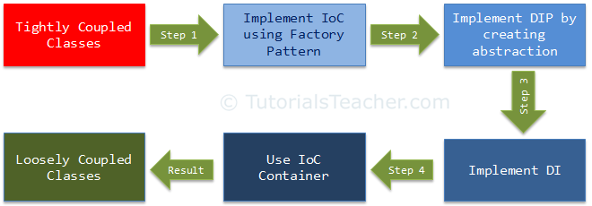
Overview (4)
3. Combined items

Slide 10
Overview (5)
4. Loosely coupled
object-oriented design
  classes should be designed in a loosely coupled way
  changes in one class should not force other classes to change
  whole application can become maintainable and extensible

Slide 11
Overview (6)
4. Design principle vs Design pattern
Design principle
Design pattern
=> To compare

Slide 12
Design Principle (1)
High level guidelines => to design better software applications
Do not provide implementation guidelines
Not bound to any programming language
One of the most popular sets of design principles: SOLID (SRP, OCP, LSP, ISP, DIP) principle

Slide 13
Design Principle (2)
Những nguyên lý thiết kế trong OOP => code dễ đọc, dễ test, rõ ràng hơn => maintainace code sẽ dễ hơn rất nhiều => SOLID là 1 trong số các nguyên lý giúp làm điều này.

Slide 14
Design Principle (3)
SOLID
6.1 Single responsibility principle
- Một class chỉ nên giữ 1 trách nhiệm duy nhất
Ví dụ: Error
public class ReportManager()
{
public void ReadDataFromDB();
public void ProcessData();
public void PrintReport();
}

Slide 15
Design Principle (4)
SOLID
6.2 Open/closed principle
- Có thể thoải mái mở rộng 1 class, nhưng không được sửa đổi bên trong class đó
- Theo nguyên lý này, mỗi khi ta muốn thêm chức năng,.. cho chương trình, chúng ta nên viết class mới mở rộng class cũ ( bằng cách kế thừa hoặc sở hữu class cũ) không nên sửa đổi class cũ.

Slide 16

Design Principle (5)
SOLID
6.3 Liskov Substitution Principle
- Trong một chương trình, các object của class con có thể thay thế class cha mà không làm thay đổi tính đúng đắn của chương trình
- List x = new ArrayList() (???)

Slide 17
Design Principle (6)
SOLID
6.4 Interface Segregation Principle
- Thay vì dùng 1 interface lớn, ta nên tách thành nhiều interface nhỏ, với nhiều mục đích cụ thể

Slide 18
Design Principle (7)
SOLID
6.5 Dependency inversion principle
- Các module cấp cao không nên phụ thuộc vào các modules cấp thấp. Cả 2 nên phụ thuộc vào abstraction.
- Interface (abstraction) không nên phụ thuộc vào chi tiết, mà ngược lại.( Các class giao tiếp với nhau thông qua interface,
không phải thông qua implementation.)

Slide 19
Design Principle (8)
High level guidelines => to design better software applications
Do not provide implementation guidelines
Not bound to any programming language
One of the most popular sets of design principles: SOLID (SRP, OCP, LSP, ISP, DIP) principle

Slide 20
Design Principle (9)
5. A high-level statement
+ we can keep in mind while designing or creating classes for our application
+ does not provide specific implementation steps

Slide 21
Design Pattern (1)
Provides low-level solutions related to implementation
Specific implementation for the specific object-oriented programming problem
a commonly occurring problem within a given context in software design
create a class that can only have one object => best way: Singleton design pattern
Design patterns are tested by others and are safe to follow

Slide 22
Design principle vs Design pattern
Hight-level
Low-level

Slide 23
clarifies whether they are principles or patterns

Slide 24
IoC & DIP
high level design principles
should be used while designing application classes
recommend certain best practices
do not provide any specific implementation details

Slide 25
DI & IoC container
DI: pattern
IoC caontainer
  Framework

Slide 26
Inversion of Control (1)
Design principle
inversion of different kinds of controls in object-oriented design
+ Nó được sử dụng để đảo ngược các loại điều khiển khác nhau trong thiết kế hướng đối tượng để đạt được khớp nối lỏng lẻo
3. to achieve loose coupling between application classes

Slide 27
Inversion of Control (2)
Ví dụ 1: Staffs vs Company
+ suppose you drive a car to your work place
+ This means you control the car
+ The IoC principle suggests to invert the control=> meaning that instead of driving the car yourself, you hire a cab, where another person will drive the car. Thus, this is called inversion of the control - from you to the cab driver.
+ You don't have to drive a car yourself and you can let the driver do the driving so that you can focus on your main work.
Ví dụ 2: You and your wife

Slide 28
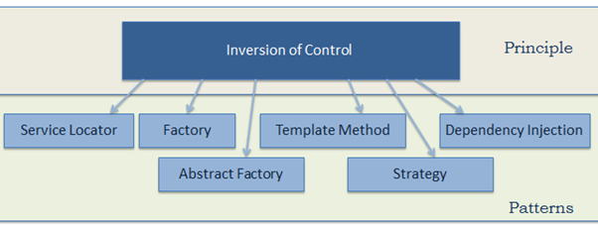
Inversion of Control (3)
The following pattern (but not limited) implements the IoC principle.

Slide 29
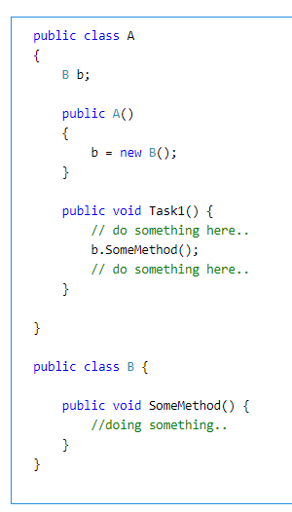
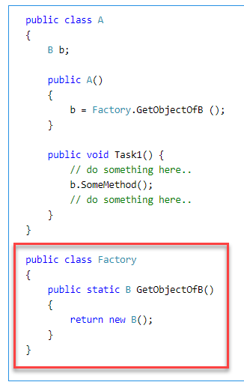
Inversion of Control (4)

Slide 30
Dependency Invertion Principle (1)
1. One of the SOLID principles
2. By Robert Martin
3. IoC => loosely couple
DIP =>more loosely coupled

Slide 31
Dependency Invertion Principle (2)
Helps in achieving loose coupling between classes.
+ Highly recommended to use DIP and IoC together in order to achieve loose coupling
High-level modules should not depend on low level modules. Both should depend on abstraction.
Abstractions should not depend on details. Details should depend on abstractions.

Slide 32
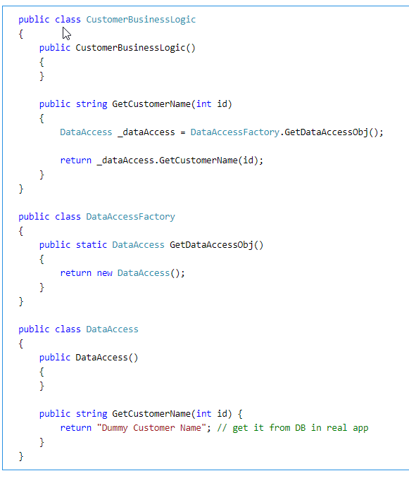
Dependency Invertion Principle (2)
Example
Ref: https://www.tutorialsteacher.com/ioc/dependency-inversion-principle

Slide 33
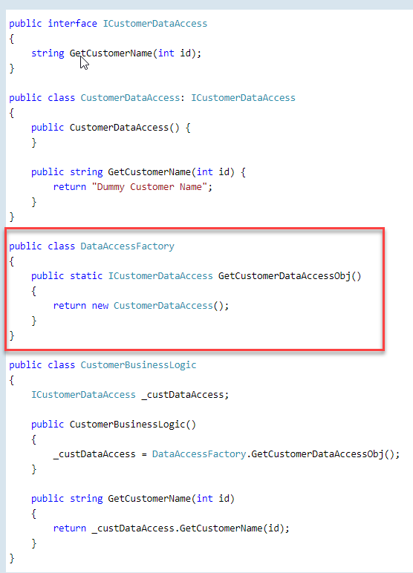

Slide 34
Dependency Injection (1)
1. Design pattern
2. Implements the IoC principle to invert the creation of dependent objects
3. so that we as programmers do not need to put more time and effort into it
4. Creation of dependent objects outside of a class

Slide 35
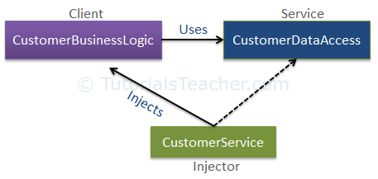
Dependency Injection (1)
Example
Ref: https://www.tutorialsteacher.com/ioc/dependency-injection

Slide 36
References
[1] Spring Framework Reference Documentation
v5.0.0
https://docs.spring.io/spring/docs/5.0.0.BUILD-SNAPSHOT/spring-framework-reference/htmlsingle/#overview-ivy-dependency-management
v5.1.7
https://docs.spring.io/spring/docs/5.1.7.RELEASE/spring-framework-reference/
[2] Java Design Patterns
https://www.journaldev.com/2394/java-dependency-injection-design-pattern-example-tutorial

