Slide 1


NORMIE
Review 1
AI Agent for Automated
Database Schema Design
and Normalization
Lavanay Sharma
(RA2311003010277)
Supervisor Name:
Dr. R. Sathya
27 September 2026
27 September 2026
1
Notes:
Review 1 deck. Source: Normie project implementation, local workspace, 27 September 2026.

Slide 2
Review 1 Progress
Normie now accepts either a plain-English domain description or a denormalized CREATE TABLE statement.
The prototype uses Groq to extract entities and functional dependencies, then runs deterministic Python algorithms for attribute closure, candidate-key detection, normal-form checks, and 3NF or BCNF decomposition.
The API returns normalized tables, CREATE TABLE SQL, a plain-language report, and Mermaid ERD text.
Current evidence: two end-to-end demo inputs, Swagger API endpoints, and four passing normalization tests.
27 September 2026
2
Notes:
Source: Normie implementation and local test result, 27 September 2026.

Slide 3
Problem and Design Principle
A denormalized schema repeats the same facts across rows, creating update, insertion, and deletion anomalies. Manual normalization requires understanding functional dependencies and candidate keys.
Normie uses an LLM only to interpret the business requirement or existing schema. The normalization engine itself is deterministic code.
This separation matters for the project: the AI proposes a schema hypothesis, while closure computation, candidate-key detection, 1NF, 2NF, 3NF, and BCNF checks remain explainable and repeatable.
Target users: students learning relational design and developers needing a first schema draft.
27 September 2026
3
Notes:
Source: project problem statement and implemented architecture.

Slide 4
Literature Review
S.No | Author's Name | Title | Methods | Merits | Demerits
1 | Agentic Schema Refinement authors (2026) | Agentic Schema Refinement | Multi-agent LLM (Analyst, Critic, Verifier) for semantic-layer construction | Improves downstream Text-to-SQL performance; handles wide, ambiguous tables | Tested only on commercial datasets; agent coordination overhead
2 | Miffie authors (2025) | Database Normalization via Dual-LLM Self-Refinement | Dual-LLM (generation + verification) self-refinement loop | High-accuracy anomaly detection; no human effort needed | Struggles with highly complex/specialized schemas; costly compute
3 | Divljan et al. (2025) | Towards an LLM-based Tool for Automated Database Design | LLM derives Conceptual Data Model from text spec, forward-engineers schema | Works across multiple natural languages; functional early prototype | Only implements CDM generation so far; early-stage tool
4 | Text2Schema authors (2025) | Text2Schema: Filling the Gap in Designing DB Table Structures | Multi-agent framework (six roles) with error detection/correction | First schema-generation benchmark (500 schemas); beats prompt-based baselines | Complex six-role pipeline; benchmark may not generalize
5 | Salem et al. (2024) | LLM + NLP Tool for ER-to-SQL Conversion | Combines LLMs with classical NLP to convert text/ER images to SQL | Automates the logical modeling stage | Lacks methodological clarity/internal detail
6 | MDPI authors (2025) | AI-Assisted Evaluation of ER/Schema Diagrams Using LLMs | LLM generates reference ER/schema in PlantUML, compares to submissions | Enables scalable automated assessment | Scoring methodology often unclear across notations
27 September 2026
4
Notes:
Literature review retained from the zeroth review deck.

Slide 5
Literature Review (contd.)
S.No | Author's Name | Title | Methods | Merits | Demerits
7 | SBBD authors (2024) | Database Modeling Automation from Natural Language Requirements | LLM + prompt engineering to auto-generate ER diagrams from text | Flexible across multiple LLMs; validated with real users | Struggles with cardinalities and nullable constraints
8 | United Techno (2025) | AI-Powered ERD Automation with LLM | LLM-driven table extraction, relationship discovery, ERD generation | Cuts modeling time from weeks to minutes; scales to 1000s of tables | Industry case study, not peer-reviewed; limited technical detail
9 | AutoG authors (2025) | AutoG: Automatic Graph Construction from Tabular Data | Guided generation with "chain-of-augmentation" for schema/graph construction | Solves multi-step relation-detection failures of naive generation | Requires careful prompt/action design; dataset-specific tuning
10 | Anonymous (2025) | Automated Feedback on Student UML/ER Diagrams Using LLMs | LLMs analyze PlantUML text representations of ER/UML diagrams | Text-based diagrams process more reliably than images for LLMs | Limited to text-representable diagrams; feedback quality varies
11 | KARMA authors (2025) | KARMA: Multi-Agent LLMs for Knowledge Graph Enrichment | 9 collaborative agents for entity discovery, relation extraction, schema alignment | Adheres to domain-specific schema; strong conflict resolution | High agent-orchestration complexity
27 September 2026
5
Notes:
Literature review retained from the zeroth review deck.

Slide 6
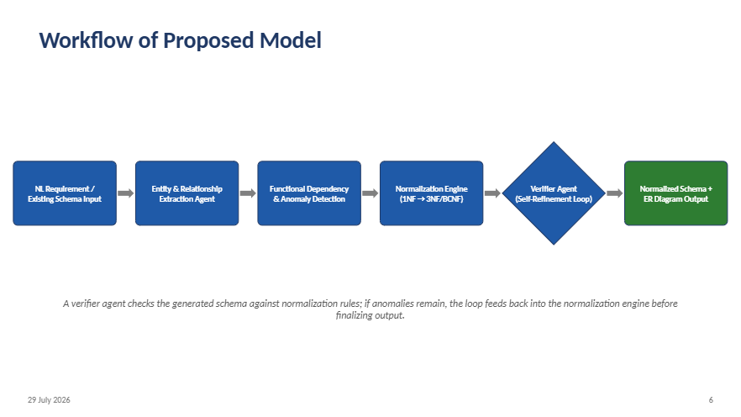

Implemented Workflow
Input
prose or DDL
Groq extraction
validated JSON
FDs and
anomaly checks
Deterministic
normalization
Optional semantic
verifier
SQL, report,
and ERD
NL Requirement /
Existing Schema Input
Entity & Relationship
Extraction Agent
Functional Dependency
& Anomaly Detection
Normalization Engine
(1NF → 3NF/BCNF)
LLM extraction is bounded by Pydantic validation. The mathematical normalization stage has no LLM dependency.
27 September 2026
6
Notes:
Source: implemented FastAPI pipeline. The verifier is an optional semantic pass in the current prototype.

Slide 7
Implementation Status
Input Layer
Implemented: regex distinguishes DDL from free text; sqlparse reads CREATE TABLE columns.
Extraction Agent
Implemented: Groq JSON mode, Pydantic validation, one repair retry, and demo fallback.
FD Detection
Implemented: structured FD list drives deterministic checks and decomposition.
Normalization
Implemented: closure, candidate keys, 1NF/2NF/3NF checks, 3NF synthesis, optional BCNF.
Verifier
Partial: optional Groq semantic review; bounded refinement remains future work.
Output
Implemented: tables, foreign keys, CREATE TABLE SQL, explanation report, Mermaid ERD.
27 September 2026
7
Notes:
Source: current implementation in app/input_layer.py, ddl_parser.py, extraction.py, normalization.py, verifier.py, output.py, and api.py.

Slide 8
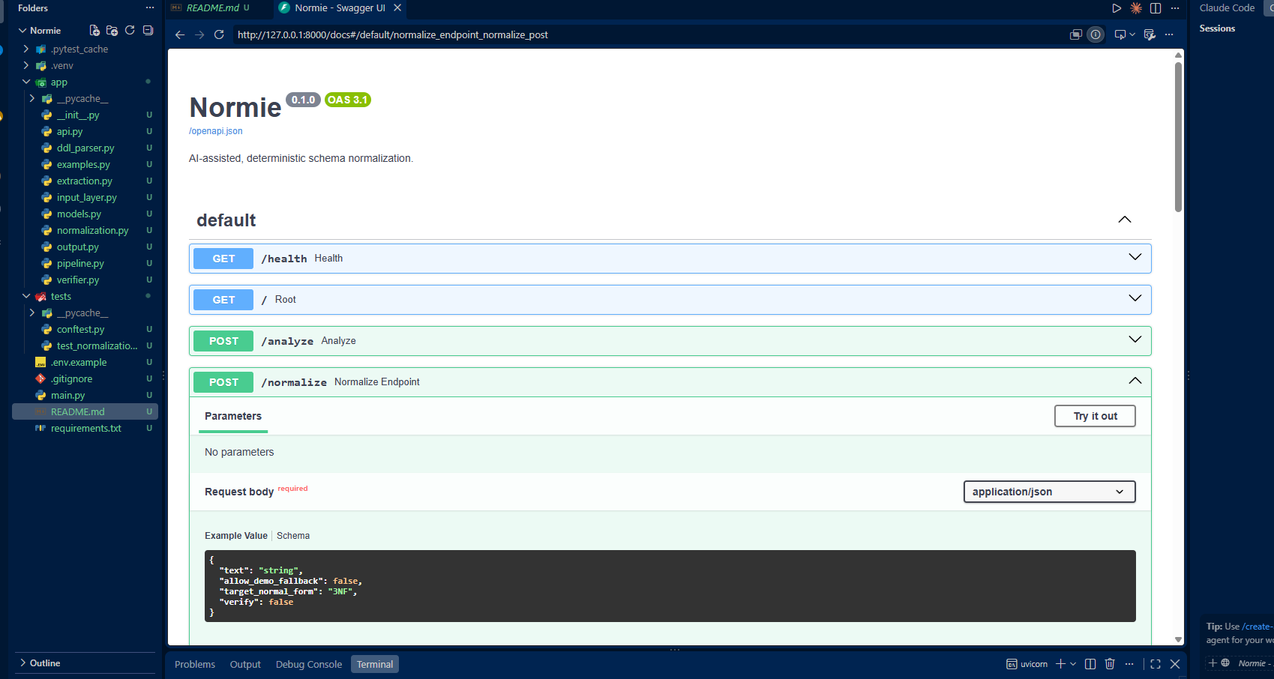
Working Prototype and Evidence
Demo inputs
• Plain-English student, course, instructor requirement
• Messy enrollment CREATE TABLE statement
Demo output
• Students, courses, instructors, and enrollment relations
• Foreign keys, CREATE TABLE SQL, report, and Mermaid ERD
Validation
• 4 automated normalization tests passed
• Swagger exposes /analyze, /normalize, and /report
Swagger API interface used to submit the normalization request
27 September 2026
8
Notes:
Evidence image: local Normie Swagger UI captured in the supplied project screenshots. Test result: 4 passed in local pytest run.

Slide 9
Review 1 Scope and Next Work
Completed in this review
• End-to-end FastAPI prototype with two input modes
• Deterministic 3NF synthesis and optional BCNF decomposition
• SQL DDL, report, Mermaid ERD, and automated tests
Current limitations
• Functional dependencies still depend on LLM interpretation or demo assumptions
• Verifier feedback is advisory, not yet an automatic schema-changing loop
• Evaluation currently uses curated examples rather than a benchmark dataset
Next milestone
• Add bounded verifier-feedback refinement
• Evaluate against expert-designed schemas
• Render the Mermaid ERD in a presentation-ready visual view
27 September 2026
9
Notes:
Source: current prototype scope and planned work. Claims are limited to the implemented features.

Slide 10
THANK YOU
Normie | Review 1 | 27 September 2026
10
Notes:
End slide.

