Slide 1
Video Action Localization 交流
4月19日

Slide 2
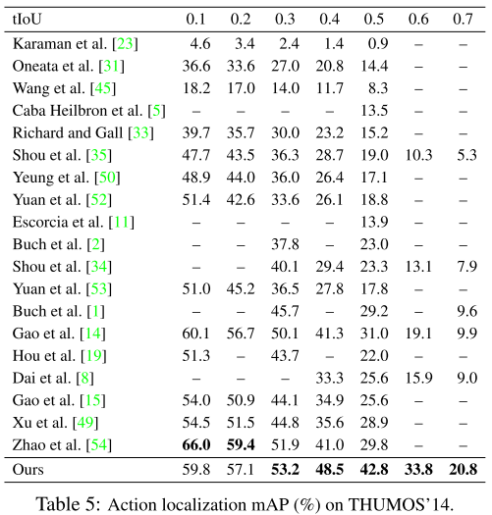
Rethinking the Faster R-CNN Architecture for Temporal Action Localization
--CVPR2018
Pipeline:
1. Generate proposals;
2. Classify proposals, regress
Faster RCNN
Domain shift challenge
Large variation in action duration
Temporal Context
Fuse multi-stream feature

Slide 3
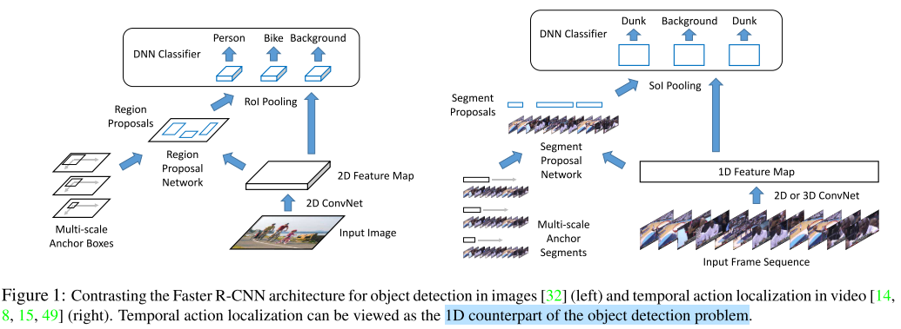
Rethinking the Faster R-CNN Architecture for Temporal Action Localization
--CVPR2018

Slide 4
已有方法 Proposal，Classification + Regression
R-C3D
TURN
CBR
TCN

Slide 5
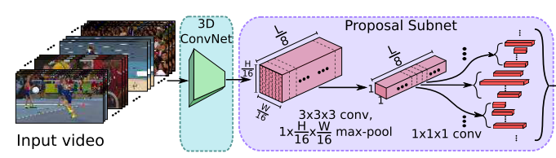
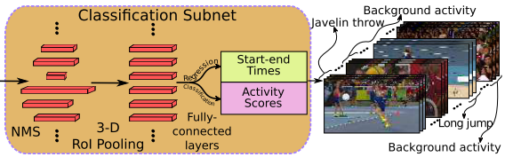
R-C3D: Region Convolutional 3D Network for Temporal Activity Detection
--ICCV 2017
Proposal
1. Feature:
2. Sliding window尺寸预先定义
每个位置k个
THUMOS’14
K=[2,4,5,6,8,9,10,12,14,16]
输入frame数量：768
3. 使用两个1x1x1的conv预测每个proposal的offset和score
所有anchor共享receptive field
未考虑context信息

Slide 6
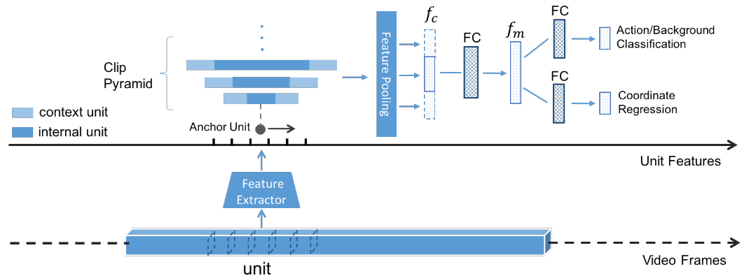
TURN TAP : Temporal Unit Regression Network for Temporal Action Proposals
--ICCV 2017
考虑（前/后）context信息
每一帧提feature，使用average pooling得到clip的feature

Slide 7
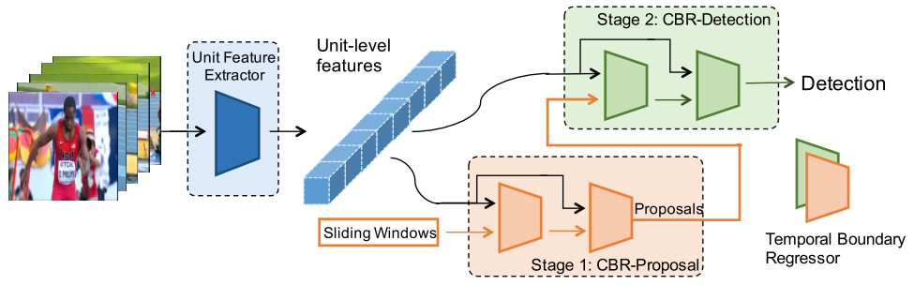
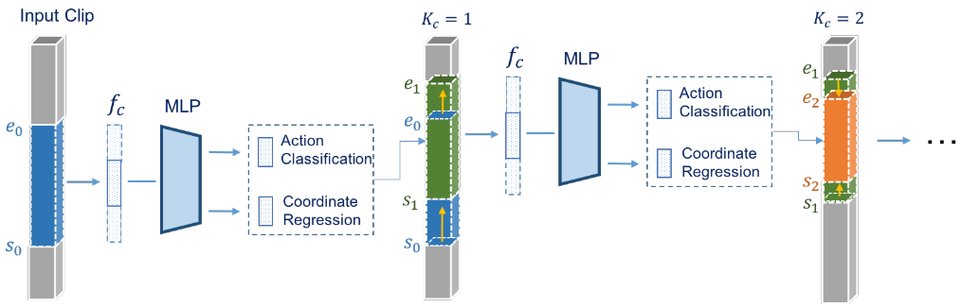
Cascaded Boundary Regression for Temporal Action Detection
--BMVC 2017
1. Stage 1 proposal，二分类
Stage 2 detection，多分类
2. 每个阶段以cascade的形式进行，k=2、3效果好
只做了early fusion

Slide 8
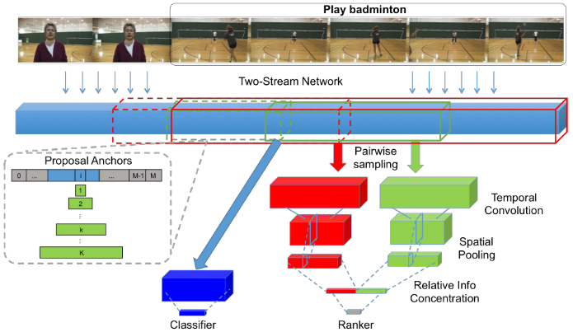
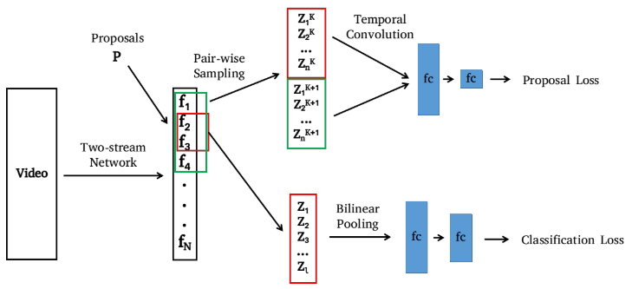
Temporal Context Network for Activity Localization in Videos
--ICCV 2017
1. 对于每个proposal，以不同尺度的sliding window提取context信息
2. 没有做regression
只做了early fusion

Slide 9
本文做法
Receptive Field Alignment
Context Feature Extraction
Late Feature Fusion

Slide 10
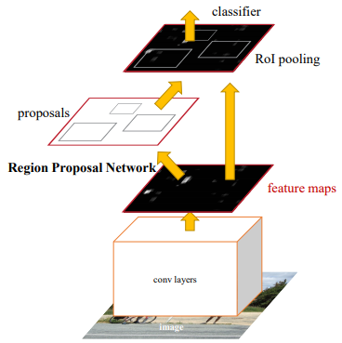
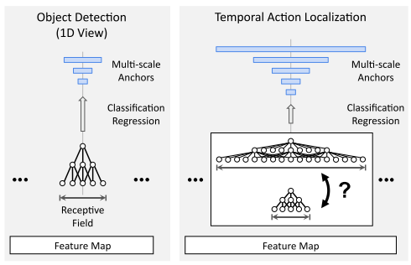
Receptive Field Alignment
Object detection
RPN网络使用1x1的conv预测每个anchor对应k个proposal包含物体的score，感受野相同
Temporal action localization
Action duration变化大，每个proposal需要与之匹配的感受野

Slide 11
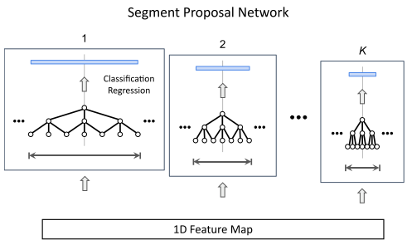
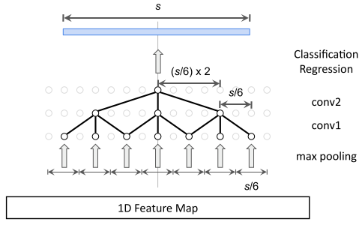
Receptive Field Alignment
Multi-tower network
对于K个proposal，使用k个ConvNet，保证感受野对应
Dilated Temporal Convolution
根据proposal的长度，调整max pooling的stride和conv的dilation

Slide 12
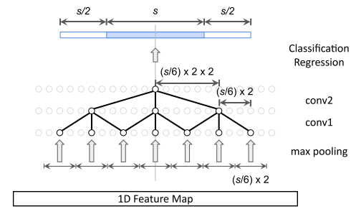
Context Feature Extraction
背景信息的作用：
accurate boundary localization 2. semantic cue
引入背景信息后，需相应调整max pooling的stride和conv的dilation

Slide 13
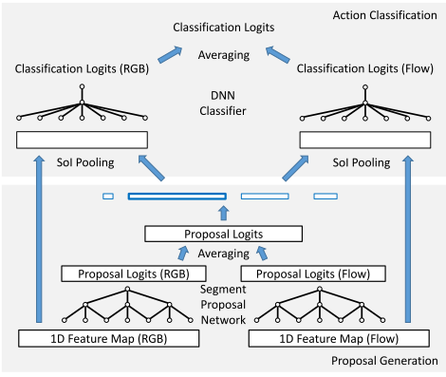
Late Feature Fusion
1.基于RGB和基于Flow的网络独立地计算
2. 在generate proposal和classification时，使用element-wise average融合

Slide 14
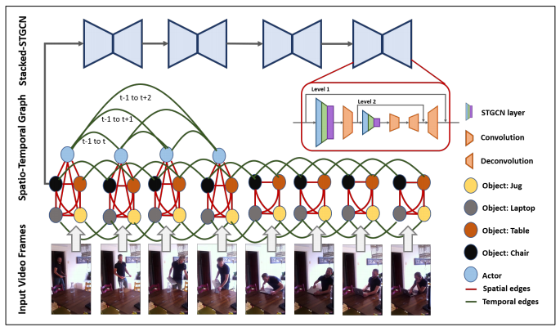
思考1：采用FPN结构做receptive field alignment， Encoder-Decoder
Stacked Spatio-Temporal Graph Convolutional Networks for Action Segmentation
arXiv 1811.10575
University of Maryland College Park, Pallabi Ghosh et.al.

Slide 15
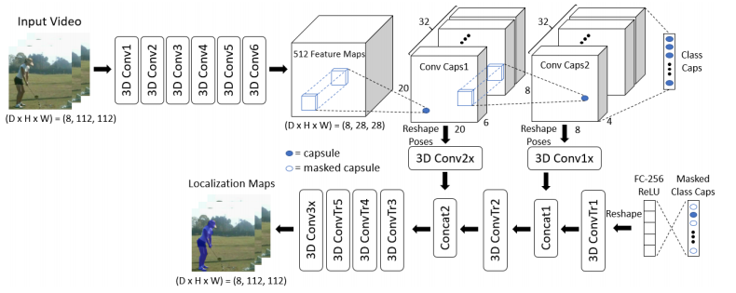
思考1：采用FPN结构做receptive field alignment， Encoder-Decoder
VideoCapsuleNet: A Simplified Network for Action Detection
NIPS 2018
University of Central Florida, Kevin Duarte et.al.

Slide 16
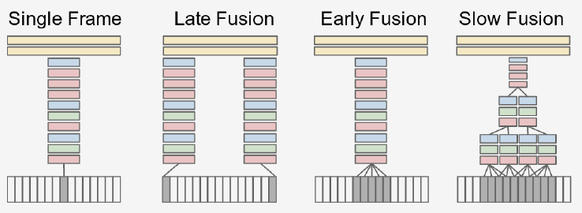
思考2：video信息融合方式的比较
CVPR 2014- Large-scale Video Classification with Convolutional Neural Networks
Slow fusion效果最优

Slide 17
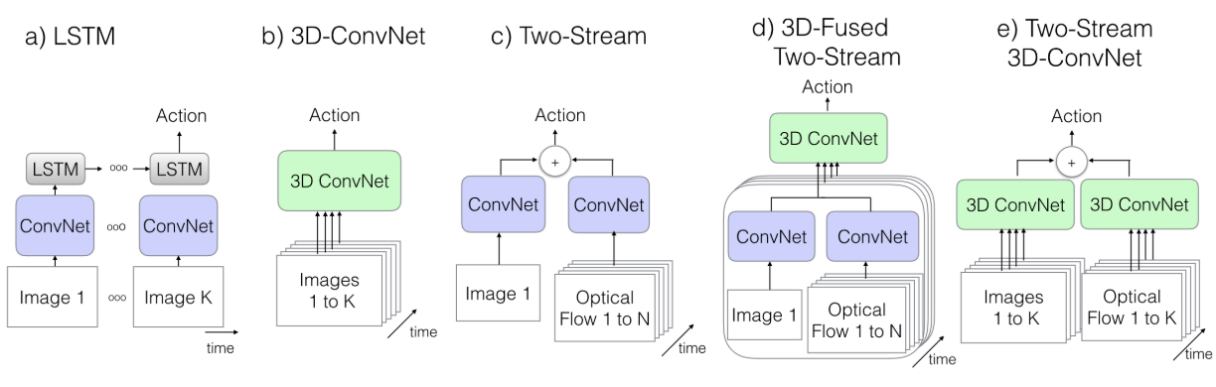
思考2：video信息融合方式的比较
CVPR 2017- Quo Vadis, Action Recognition? A New Model and the Kinetics Dataset
Two-Stream 3D-ConvNet效果最优

