Slide 1
Fixation of uncertain points
Le Yang Apr. 21

Slide 2
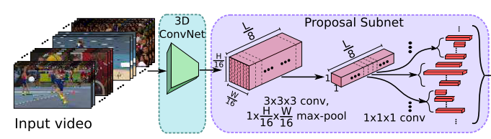
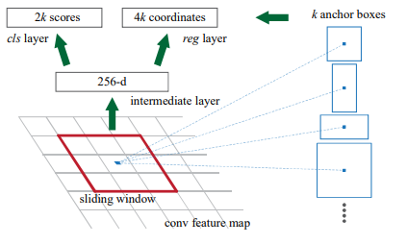
R-C3D: Region Convolutional 3D Network for Temporal Activity Detection --ICCV 2017
Huijuan Xu, Abir Das, Kate Saenko Boston University
Anchor based temporal proposal
Question: As for feature map , K=[2,4,5,6,8,9,10,12,14,16], when predict action/background score, how to handle various temporal length?
Answer: For each anchor, the used feature is , using two 1x1x1 convolution layers, predict action/background score as well as the relative offset. (Similar with faster R-CNN)

Slide 3
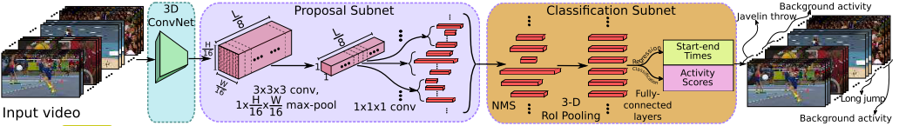
R-C3D: Region Convolutional 3D Network for Temporal Activity Detection --ICCV 2017
Huijuan Xu, Abir Das, Kate Saenko Boston University
Question: How to do NMS? How to calculate feature?
Answer: (1) Set threshold as 0.7, do greedy Non-Maximum Suppression.
(2) 3D RoI Pooling. After 3D ConvNet, the feature would be , divide the feature into sub-volume (e.g., 1x4x4), do max-pooling. The feature after 3D RoI Pooling would be .
Two fully connected layers are used to do classification and regression.

Slide 4
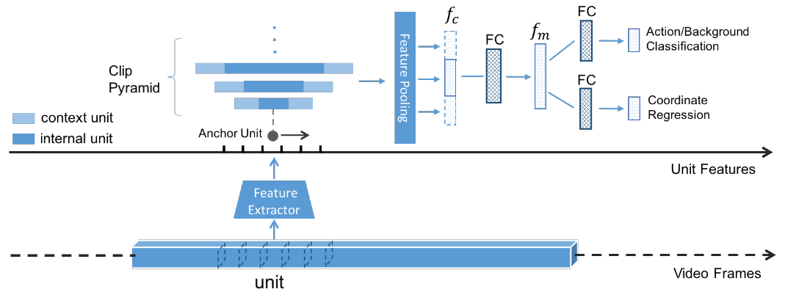
TURN TAP : Temporal Unit Regression Network for Temporal Action Proposals --ICCV 2017
Jiyang Gao1, Zhenheng Yang1, Chen Sun2, Kan Chen1, Ram Nevatia1
1: University of Southern California 2: Google Research
Q: How to extract feature for unit?
A: An unit contains frames, a video is divided into units. Units are not overlapped with each other.
This paper studies 3 kinds of method for feature extraction: C3D, optical flow based CNN feature and RGB CNN feature. For C3D, they use fc6 feature, 4096 dimension. As for optical flow/RGB CNN features, each frame generate a 4096-dimension feature, then average pool to generate a 4096-dimension feature for this unit.
The final feature is the concatenation of context feature and internal feature.
P: average pooling, ||: concatenation

Slide 5
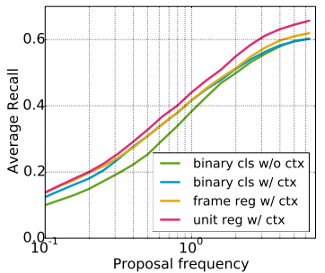
TURN TAP : Temporal Unit Regression Network for Temporal Action Proposals --ICCV 2017
Jiyang Gao1, Zhenheng Yang1, Chen Sun2, Kan Chen1, Ram Nevatia1
1: University of Southern California 2: Google Research
Unit-level action proposal
1. Regress temporal coordinate at unit-level rather than frame-level. Reason: consecutive K frames form a unit, we extract a 4096-dimension feature from this unit. The feature is not discriminative enough to regress coordinate at frame-level. (show in the figure)
2. In this method, the unit is the basic processing block.
The untrimmed video is decompressed into units (e.g., 16/32 frames).
Extract feature from units.
A series of consecutive units form an action proposal, named clip.
Do action classification and regression for each clip.
Experiments:
Binary classification without context
Binary classification with context
Frame-level regression with context
Unit-level regression with context

Slide 6
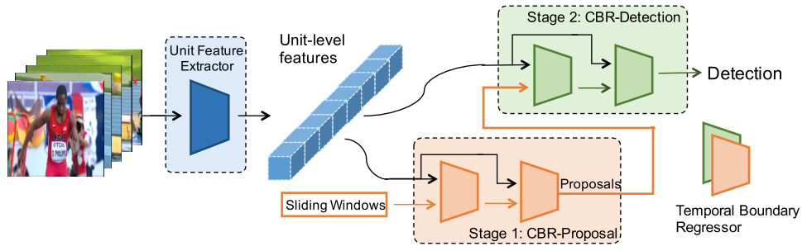
Cascaded Boundary Regression for Temporal Action Detection --BMVC 2017
Jiyang Gao, Zhenheng Yang, Ram Nevatia University of Southern California
Question: How to extract unit-level features
Answer: A unit contain frames, a video with T frames is divided into units. Units do not overlap with each other. (This paper shares the same author with previous one, the operations for unit are the same)

Slide 7
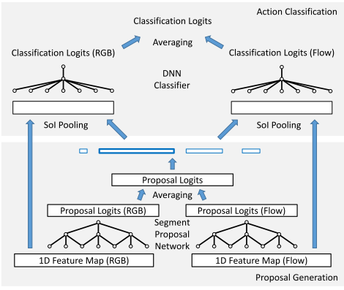
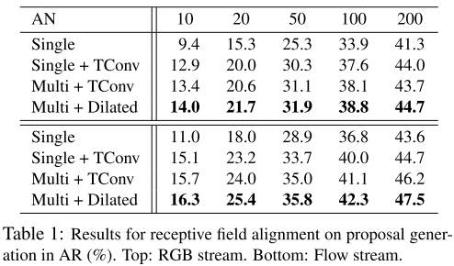
Rethinking the Faster R-CNN Architecture for Temporal Action Localization --CVPR 2018
Yu-Wei Chao1, Sudheendra Vijayanarasimhan2, Bryan Seybold2, David A. Ross2, Jia Deng1, Rahul Sukthankar2
1: University of Michigan 2: Google Research
Work done in part during an internship at Google Research
Question: The core contribution of this paper is Receptive Field Alignment. How about applying interpolation to do 3D RoI Pooling?
Answer: No ablation study discuss the effective of 3D RoI Pooling. The experiment studies the following:
Single: single-tower network with no temporal convolutions
Single + TConv: single-tower network with non-dilated temporal convolutions
(default faster R-CNN architecture)
Multi + TConv: a multi-tower network with non-dilated temporal convolutions
Multi + Dilated: a multi-tower network with dilated temporal convolutions
Supplement:
1. R-C3D uses 3D RoI Pooling in classification sub-net
2. TURN TAP and CBR (Cascaded Boundary Regression) use the unit-level feature, which is the average pool of frame-level feature. This operation is criticized as “loss structure information”.

