Slide 1
Plan
Summary recent papers.
Devote 1.5 hours each day.
1. Task Defination
2. Two-stage methods: R-CNN style methods. Rethinking the Faster R-CNN, R-C3D, TURN, TCN. BSN, SCNN
3. One-stage methods: Single Shot Temporal Action Detection, Decoupling Localization and Classification etc.
New paper: FSN, ASSN
Opinion:
Main challenge. Performance gains? ECCV 18, tools.
Main method. Two-stage, one-stage

Slide 2
Content
1. Task Definition
2. Two Stage Approach
3. One Stage Approach

Slide 3
Task Definition
For a target action class, predict not only its presence in a given video, but also its temporal location (i.e., the starting and ending times of each detected instance). --THUMOS’14 challenge
Evaluation Metric-- tIoU, mAP
Interpolated Average Precision
In THUMOS’14, set the threshold as 0.1:0.1:0.7, report score for each TH individually
In ActivityNet, set the threshold as 0.5:0.05:0.95, calculate the average of these scores
Dataset
THUMOS’14
20 classes. Train: 200 untrimmed videos; Test: 213 untrimmed videos
ActivityNet v1.3
200 classes. Train: 10024 videos; Validation: 4926 videos; Test: 5044 videos

Slide 4
Two Stage Approach: Proposal + Classification

Slide 5
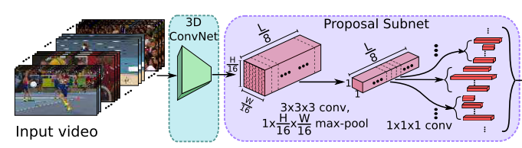
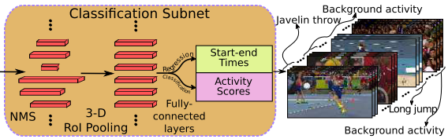
R-C3D: Region Convolutional 3D Network for Temporal Activity Detection (ICCV 2017)
Huijuan Xu, Abir Das, Kate Saenko (Boston University )
1. Feature:
2. Anchor for THUMOS’14
K=[2,4,5,6,8,9,10,12,14,16]
Improvement:
Context information

Slide 6
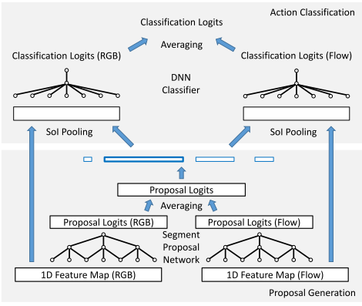
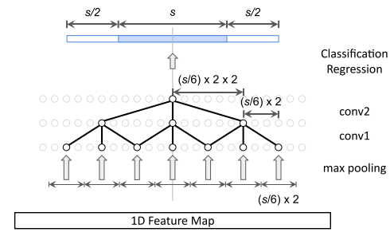
Rethinking the Faster R-CNN Architecture for Temporal Action Localization (CVPR 2018)
Yu-Wei Chao1, Sudheendra Vijayanarasimhan2, Bryan Seybold2, David A. Ross2, Jia Deng1, Rahul Sukthankar2 (1: University of Michigan 2: Google Research)
Receptive Field Alignment
Context Feature Extraction
Late Feature Fusion

