Slide 1
Part 0: Video action localization datasets & evaluation metrics

Slide 2
Dataset
Among 21 recent papers (2016~2019), THUMOS’14 and ActivityNet v1.3 are most frequently used dataset.
Others:
1. Charades: daily life activities, 157 classes, 7985 train, 1863 test videos
ECCV 2016 Hollywood in Homes: Crowdsourcing Data Collection for Activity Understanding
Used: ICCV 2017 R-C3D: Region Convolutional 3D Network for Temporal Activity Detection
2. MEXaction2: Two action categories: "HorseRiding" and "BullChargeCape“. From YouTube clips, UCF101 Horse Riding clips and INA videos
http://mexculture.cnam.fr/xwiki/bin/view/Datasets/Mex+action+dataset
Used: ICCV 2017-Single Shot Temporal Action Detection
CVPR 2016-Temporal Action Localization in Untrimmed Videos via Multi-stage CNNs
3. CVPR 2012-A database for fine grained activity detection of cooking activities
65 classes of cooking activities
Used: CVPR 2016- Temporal Action Localization with Pyramid of Score Distribution Features

Slide 3
Metric
I will add analysis for evaluation code soon.

Slide 4
Part 1: Decoupling Localization and Classification in Single Shot Temporal Action Detection
ICME 2019 Yupan Huang1, Qi Dai2, Yutong Lu1
1: Sun Yat-sen University 2: Microsoft Research Asia,

Slide 5
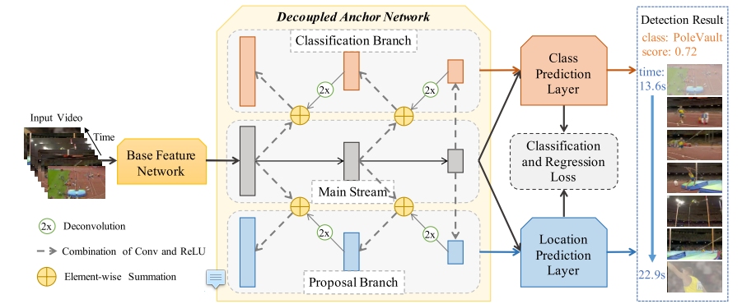
Motivation & Framework
Motivation
1. Decoupling the localization and classification, explore the specialized characteristic of each subtask.
2. Apply high-level semantic feature

Slide 6
Decoupling Localization and Classification in Single Shot Temporal Action Detection
Feature
1. Use two-stream networks to extract spatial and temporal feature
2. Clip length: 512
Main Stream
1. Cascade convolutional layers
2. Produce action proposals in each anchor layer
3. For each proposal, generate 3 predictions: (1) Action classification score
(2) Overlap value. (3) Proposal regression parameter
Unsatisfactory points
1. Ignore the specialized characteristics
2. Lower anchor layers lack the rich semantic clues from deep layers

Slide 7



Decoupling Localization and Classification in Single Shot Temporal Action Detection
Classification Branch:
Feature Map:
Element-wise summation:
Fuse Score:
Proposal Branch is similar with Classification Branch

Slide 8
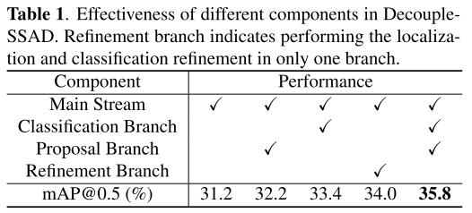
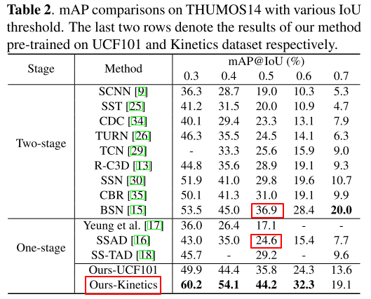
Decoupling Localization and Classification in Single Shot Temporal Action Detection
Classification Branch:
Refinement Branch: The effect of combine lower and deeper feature
Pre-trained feature extractor: Kinetics brings about 10% improvement
SSAD & Main Stream: identical, different setting
24.6% → 31.2%
1. Different features: Snippet-level Action Score → Two-stream feature
2. Hyper-parameter: the number of convolutional filter
3. Post-processing: assign 'cliffDiving' class as 'diving' class too

Slide 9
Part 2: Single Shot Temporal Action Detection
ACM MM 2017 Tianwei Lin1, Xu Zhao1, Zheng Shou2
1: Shanghai Jiao Tong University 2: Columbia University

Slide 10
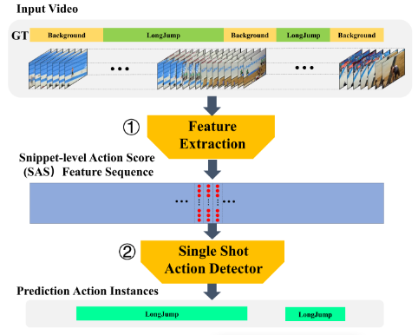
Single Shot Temporal Action Detection
ACM MM 2017 Tianwei Lin1, Xu Zhao1, Zheng Shou2
1: Shanghai Jiao Tong University 2: Columbia University
Drawback of ‘Detection by Classifying Proposal’ framework
1. Proposal generation and classification procedures are separate, not in a joint manner.
2. Sliding windows method: the approximative temporal boundaries keep fixed during classification
Sliding windows methods: pre-determined scales, not flexible
3. The proposal generation or sliding windows requires additional time consumption
Single shoot action detection
1. Base layer: dispose feature, shorten temporal length
2. Anchor layer: generate temporal feature map, associated with anchor action instances
3. Prediction layer: generate categories probabilities, location offsets and overlap scores

Slide 11
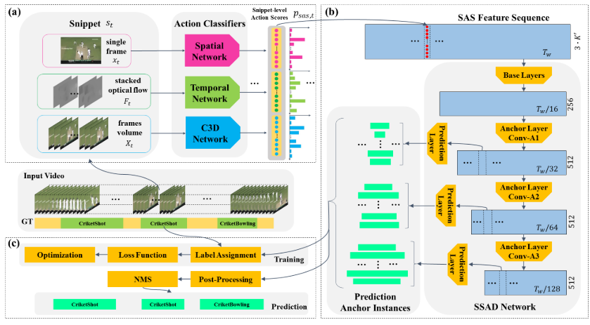
Single Shot Temporal Action Detection

Slide 12
Snippet-level Action Score Feature
Snippet
xt: frame t Ft: stacked optical flow field:
Xt: video frames volume
Apply two-stream network and C3D network, three individual action classifiers
Snippet-level Action Score feature: concatenation output scores of the three classifiers

Slide 13
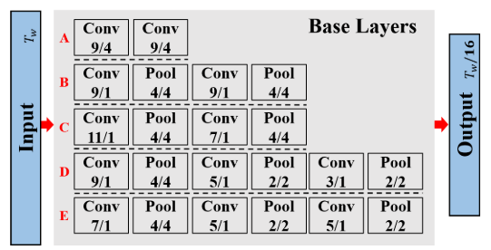
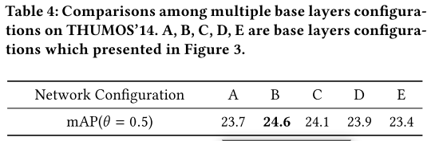
Base Layer
Three Aspects
1. Temporal downsample
Convolutional or pooling?
2. Number of layers
3. Convolutional layer’s kernel size

Slide 14
Multi-scale anchor layer
Use anchor instances of multiple scale ratios from multiple scales feature maps, handle action instance with various scales. (Similar to SSD)
Lower anchor feature map: higher resolution, smaller receptive field → short action instances
Top anchor feature map: reverse
An anchor layer with temporal feature map f, length M,
scale , scale ratio ?: pre-determined, not fixed
anchor instance default width
anchor instance number

Slide 15
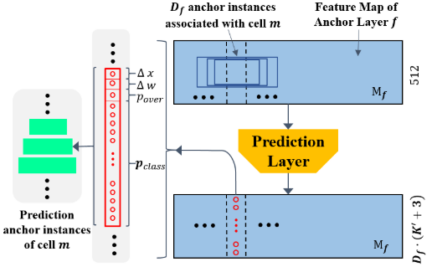
Prediction Layer
For each anchor action instance, simultaneously predict location offsets, categories probabilities and overlap score. (Similar to YOLO9000)

Slide 16

Training & Post-process
Training
Sliding window, overlap 75%, length 512
For 25 fps, ~20 seconds. 99.3% action instances in the training set have smaller length than 20 seconds
Label assignment: highest tIoU > 0.5, positive
Hard Negative Mining
1. imbalanced data ratio between the positive and negative instances
2. negative instances with larger overlap score than 0.5
3. positive and negative instances be nearly 1:1
Mean Snippet-level Action Score:
Prediction:
NMS: threshold 0.1, little overlap between action instances of same category

Slide 17
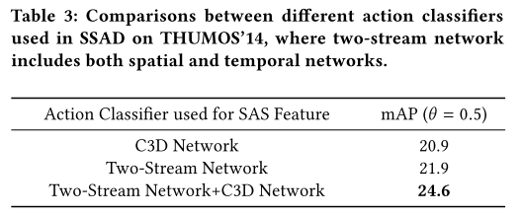
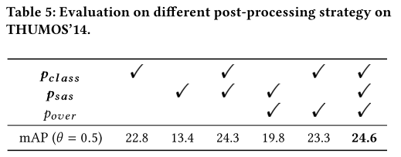
Experiment result

Slide 18
Part 3: Two-stage methods VS. One-stage methods

Slide 19
Decoupling Localization and Classification in Single Shot Temporal Action Detection
Action detection
Two-stage approach Boundary Sensitive Network, Cascade Boundary Regression, Structured Segment Network, etc.
Generate proposals; (2) Classification
Indirect optimization strategy, sub-optimal solution.
One-stage approach:
Single Shot Temporal Action Detection, Single-Stream Temporal Action Detection, End-to-end Learning of Action Detection
Directly produce and classify the action proposals, ignore the specialized characteristic of each subtask.

Slide 20
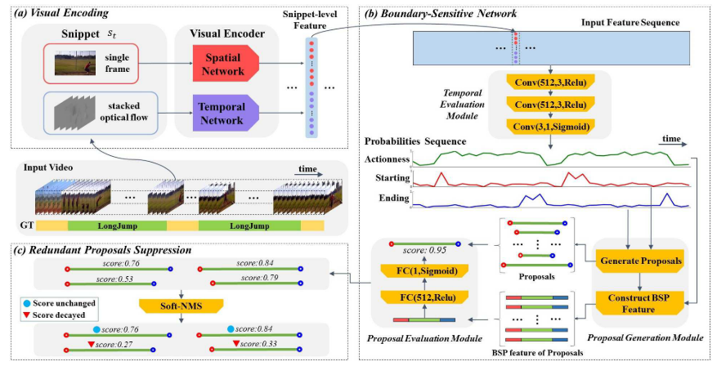
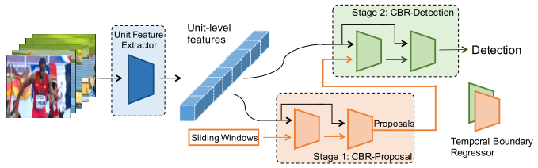
Boundary Sensitive Network
Cascaded Boundary Regression

