Slide 1
Questions
1. Install or not? (\\scratch2\scratch\Philly\philly-fs , philly-fs –mkdir hdfs://gcr/pnrsy/v-jiaygu/data # onPrem)
ssh, local
2. Docker images. For PyTorch phillyzip.imread()
3. select server. (page 11, page 19)
4. Path for data and output (page 24, page 27)

Slide 2
Philly Instruction
Houwen Peng

Slide 3
Preface
To understand Philly further, I suggest everyone read the articles in https://phillydocs.azurewebsites.net/articles/Getting_Started.html.
This slice introduces some key points with examples and best practice to use Philly, although it is only a summary of the official guide.

Slide 4
Trouble Shooting
When you encounter any problem, please contact Philly Team. Their contact info is attached on https://phillydocs.azurewebsites.net/articles/Reporting_Issues.html.
Philly at Yammer: A Twitter-style forum to ask and share questions about Philly

Slide 5
Introduction
The following introduction is a little verbose, but helpful

Slide 6
Introduction
Philly is a GPU cluster with distributed storage system (HDFS)
You could only use Philly within the corporation, and your account for Philly is just your alias
Up to now, Philly has 3 clusters: PhillyOnPrem, PhillyOnAP, PhillyOnAzure.
What we discuss here is mainly for PhillyOnPrem and PhillyOnAzure.

Slide 7
Comparison
Local machine
Philly cluster
User group
Download data
Clone code
Setup environment
Run code
Get outputs
VC (virtual cluster)
Upload data
Upload code
Build docker (Docker include env)
Submit job
Download outputs

Slide 8
Introduction
Docker image is analogy to a step-by-step instruction to computers about how to build a certain environment, including installing Ubuntu system, cuda, python packages and etc.
When you submit jobs, you have to provide docker images, locations of your code and data (how to assign localition?), and extra arguments your codes require.
Philly assign resources to your job, setup the environment by running a docker container, and link directories of your data and code to it. In this docker container, a pre-defined shell script is executed to run your own code/configuration.

Slide 9
Introduction
A typical pipeline of using Philly
Get access to VC
Upload your data
Modify your current project for Philly
Maintain your code
Submit your job (assume someone else has prepared the environment for you)
Download outputs to local
* only once

Slide 10
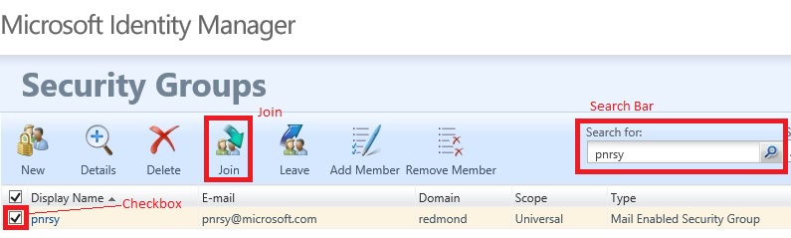
Join pnrsy Group
You need to join pnrsy Group to gain access to GPU Cluster
Visit https://idweb/identitymanagement/aspx/groups/AllGroups.aspx
Search “pnrsy” on with the search bar
Select the checkbox of “pnrsy”
Click “Join” to join it.
Click “My Memberships” to check whether you’ve joined it.
“pnrsy” group has been removed, please use “resrchvc” instead.

Slide 11
Overview
Philly has clusters running OnPrem, OnAzure and OnAP, and offers warm/hot storage for training jobs to read training data and write checkpoint/model/logs. Philly hot storage is also known as Philly scratch storage.
Generally, warm storage is for data and hot storage is for code; however, onAzure use GlusterFS for both.
Up to now, we have three methods to get access to warm storage according to clusters: philly-fs/SMB/HTTPs （tools?）
Philly Clusters | OnPrem/OnAzure/OnAP? | Warm Storage | Hot Storage | SMB access? | External Storage ⇐⇒ Philly Warm Storage (via AEther) | External Storage ⇐⇒ Philly Warm Storage (via philly-fs tool)
rr1/gcr/cam | OnPrem cluster | HDFS | NFS | Yes | Cosmos ⇐⇒ HDFS | Local box ⇐⇒ HDFS
cy4 | OnAP cluster | HDFS | NFS | No | Cosmos ⇐⇒ HDFS | Local box ⇐⇒ HDFS
eu1/eu2/sc1/wu2 | OnAzure cluster | GlusterFS Blobfuse (read-only, expriemental) | GlusterFS | No | Cosmos ⇐⇒ Azure Blob Storage Azure Blob Storage ⇐⇒ GlusterFS | Azure Blob Storage ⇐⇒ GlusterFS Local devbox ⇐⇒ GlusterFS
Table from https://phillydocs.azurewebsites.net/articles/Getting_Data.html
SMB is a protocol, which enables you to browse files through windows explorer.
Special tools like philly-fs are required to access HDFS and GlusterFS.

Slide 12
Example files
Some example data and scripts are attached below. Playing around with them might help you understand Philly better.
The following section also use them to illustrate concepts.

Slide 13
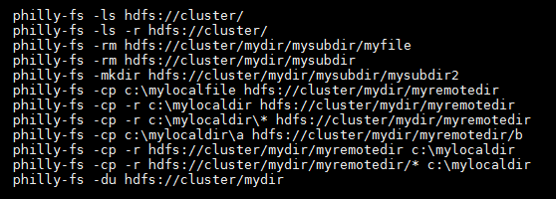
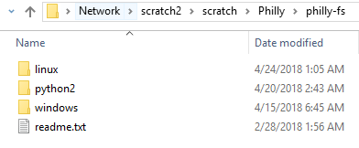
philly-fs
Philly provides \\scratch2\scratch\Philly\philly-fs (A readme is included) to get access to HDFS.
Data should be uploaded to warm storage. Data are usually zipped.
Code could also be uploaded to warm storage.
Philly team ask all the users to avoid uploading many small files to HDFS as HDFS is not designed for intensively random read which might slow all the users. We have implemented reader for reading image and xml in the zip file (attached latter in the slice).
philly-fs example usage
philly-fs directory structure

Slide 14
philly-fs
Before using philly-fs, you should append an environment variable
either set PHILLY_VC=pnrsy
or echo "export PYTHONPATH=$MXNET_HOME/python:$PYTHONPATH" >> ~/.bashrc
Make your directory
philly-fs –mkdir hdfs://gcr/pnrsy/v-jiaygu/data # onPrem
philly-fs –mkdir gfs://eu2/pnrsy/v-jiaygu/data # onAzure
Path format is ${protocol}://${physical cluster}/${virtual cluster}/${alias}
Update your codes
philly-fs –mkdir hdfs://gcr/pnrsy/v-jiaygu/code philly-fs –cp onPrem_test_custom_v1.py hdfs://gcr/pnrsy/v-jiaygu/code # onPrem
philly-fs –mkdir gfs://eu2/pnrsy/v-jiaygu/code philly-fs –cp onAzure_test_custom_v2.py gfs://eu2/pnrsy/v-jiaygu/code # onAzure
Look up for commands with philly-fs -h

Slide 15
HTTPs for onAzure
onAzure supports https to browse GlusterFS
https://storage.eu2.philly.selfhost.corp.microsoft.com/
change eu2 to other cluster if necessary
It is mainly used to download outputs

Slide 16
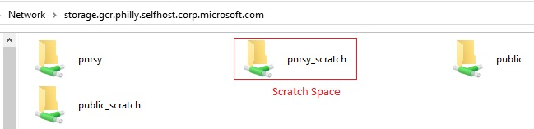
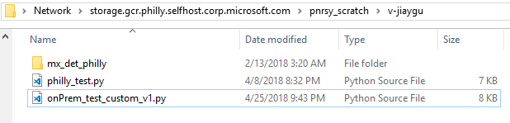
SMB only for onPrem
Use SMB to upload small files
For the GCR cluster, for example, to use SMB go to: \\storage.gcr.philly.selfhost.corp.microsoft.com
For other clusters, replace "gcr" with the name of the cluster of interest (like rr1). Once in that directory in SMB, the subdirectories that end with _scratch are on the scratch space and the directories that do not end with _scratch are on HDFS.
Create a folder named by your alias in the scratch space for your own code.
Usually, codes are uploaded to ${VC}_scratch.
Data Space

Slide 17
Submit custom job v2
Before modifying your code for Philly, it is better to first have an idea of how to submit a job and understand how Philly processes your job.
We recommend all the members to use Custom Job v2 rather than Custom Job.
For how to submit Custom Job, you could resort to older version of this slide.
We could submit jobs by Web Portal or REST API
Example scripts mentioned in above sections are used for example

Slide 18
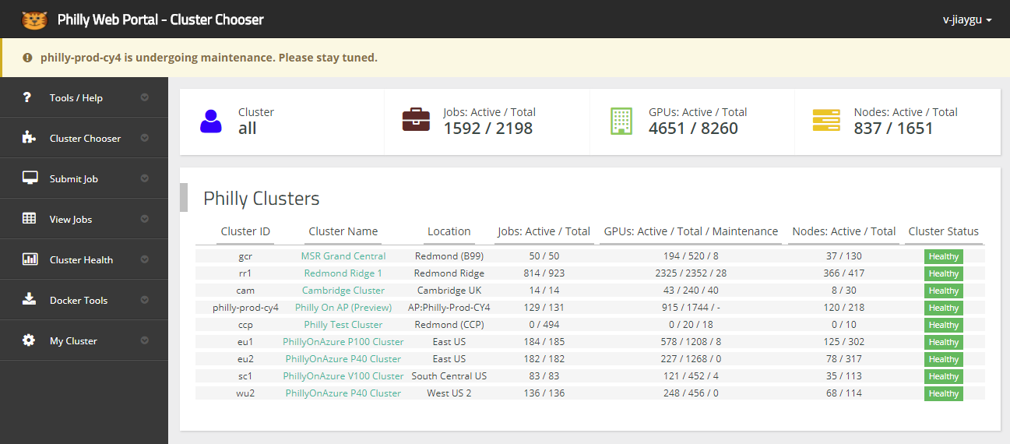
Web Portal
The Philly Web Portal
The link for the Philly Web Portal is https://philly/
All Clusters View
When you click the Philly Web Portal link, the first thing you will see is the "all" Physical Cluster view:
current cluster
click to choose a physical cluster

Slide 19
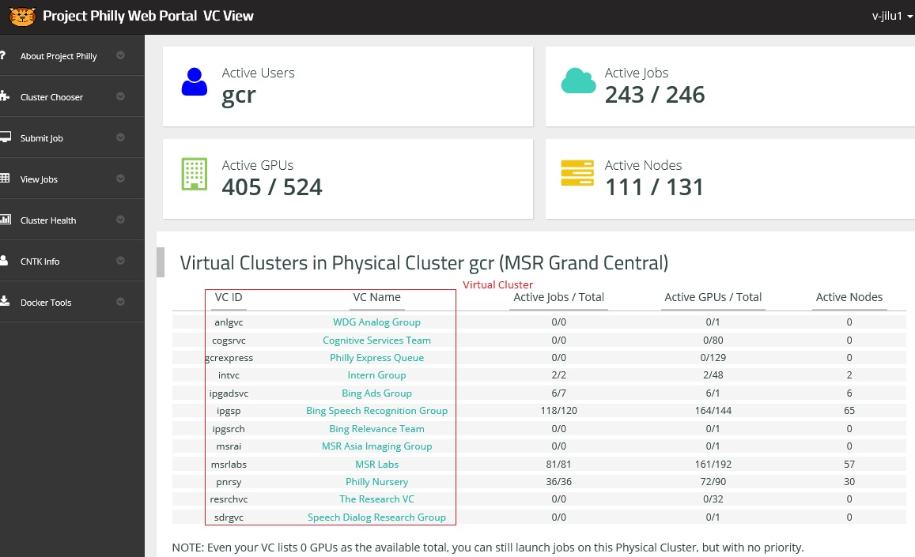
Web Portal
Virtual Clusters View
When you click the Philly Physical Cluster link, the first thing you will see is the "all" Virtual Cluster view:
You can know the usage of the resources of every virtual cluster.
Generally, we use the “pnrsy” virtual cluster as we are in the pnrsy group.

Slide 20
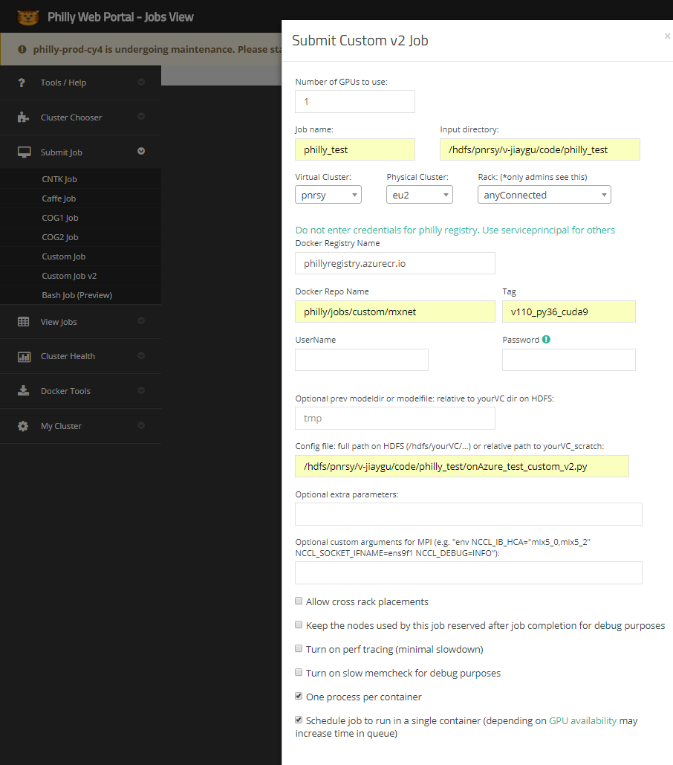
Web Portal Custom Job v2
3. fill in this form
Mapping to hdfs://gcr/pnrsy/v-jiaygu
1. click ‘submit job’
Input directory is mapped in the runtime docker container
We choose eu2 and pnrsy for example
The docker repo we provide here is mxnet v1.10 with python 3.6 and cuda9.0, which could meet our recent need
Optional extra parameters are where your actual arguments should be provided, e.g. --gpus=0,1,2,3 --cfg=experiments/xxx.yaml
2. click ‘custom job v2’
do not change
docker name and tag
Leave empty
Leave empty
Your actual arguments here
If you don’t select this checkbox, multiple processes in one container may be launched
If you don’t select this checkbox, your job may be assigned to multiple containers. In other words, select the checkbox when you need to use multiple machine

Slide 21
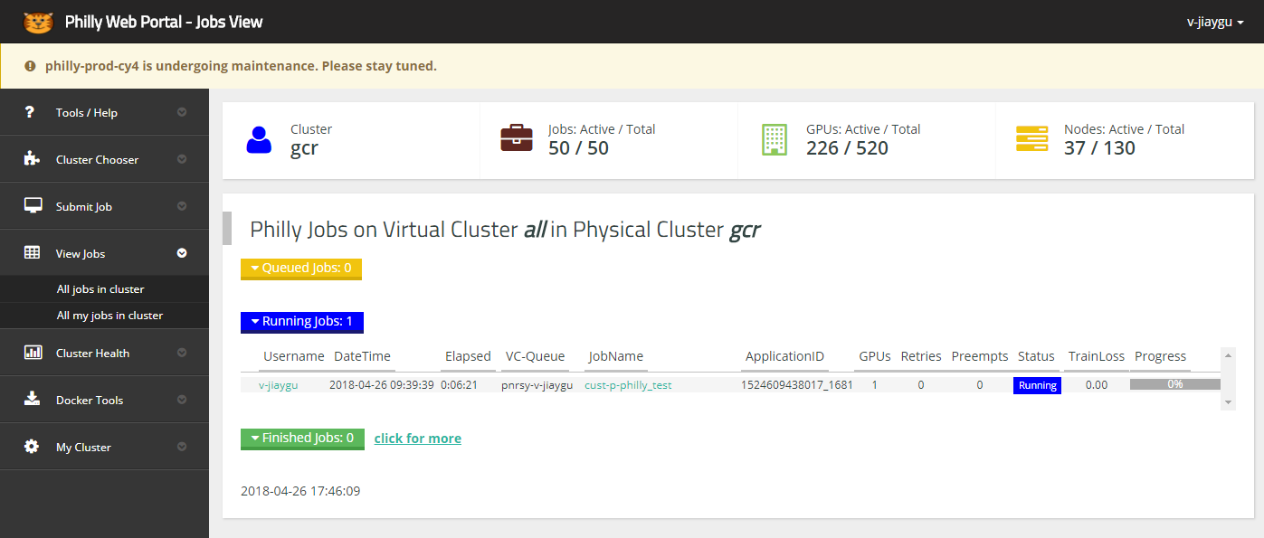
View your job
click to see details
Your job ID

Slide 22
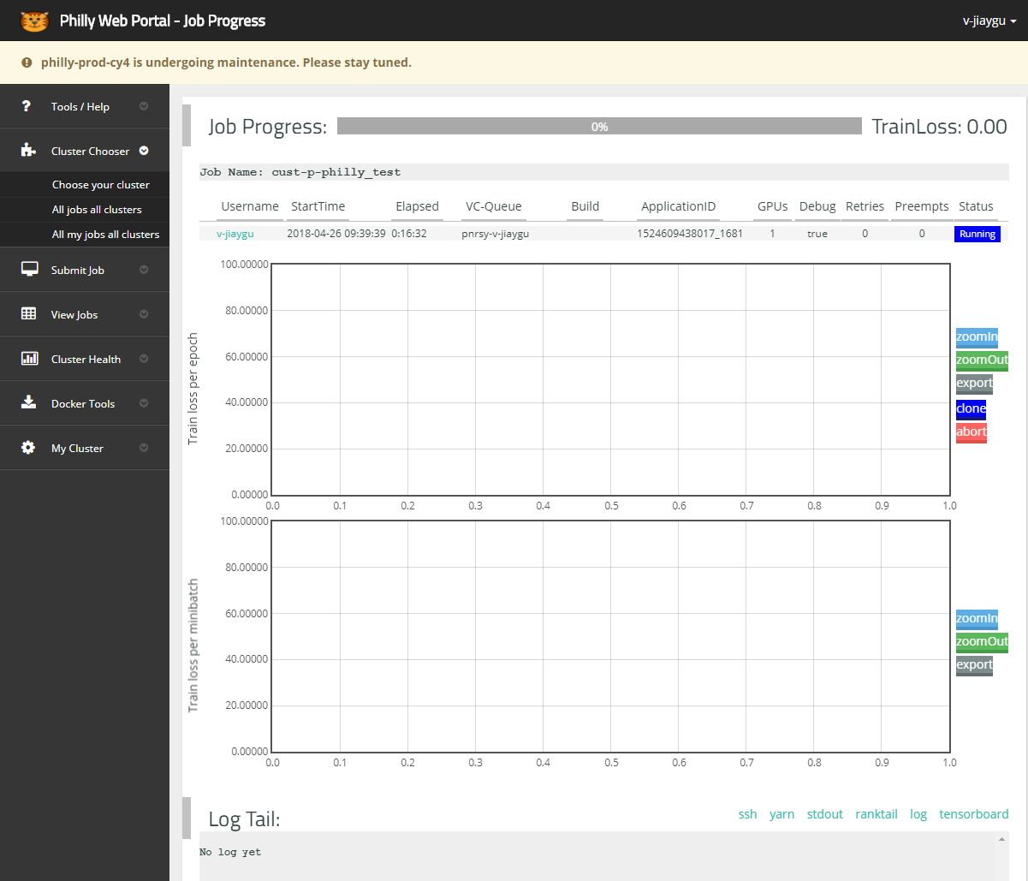
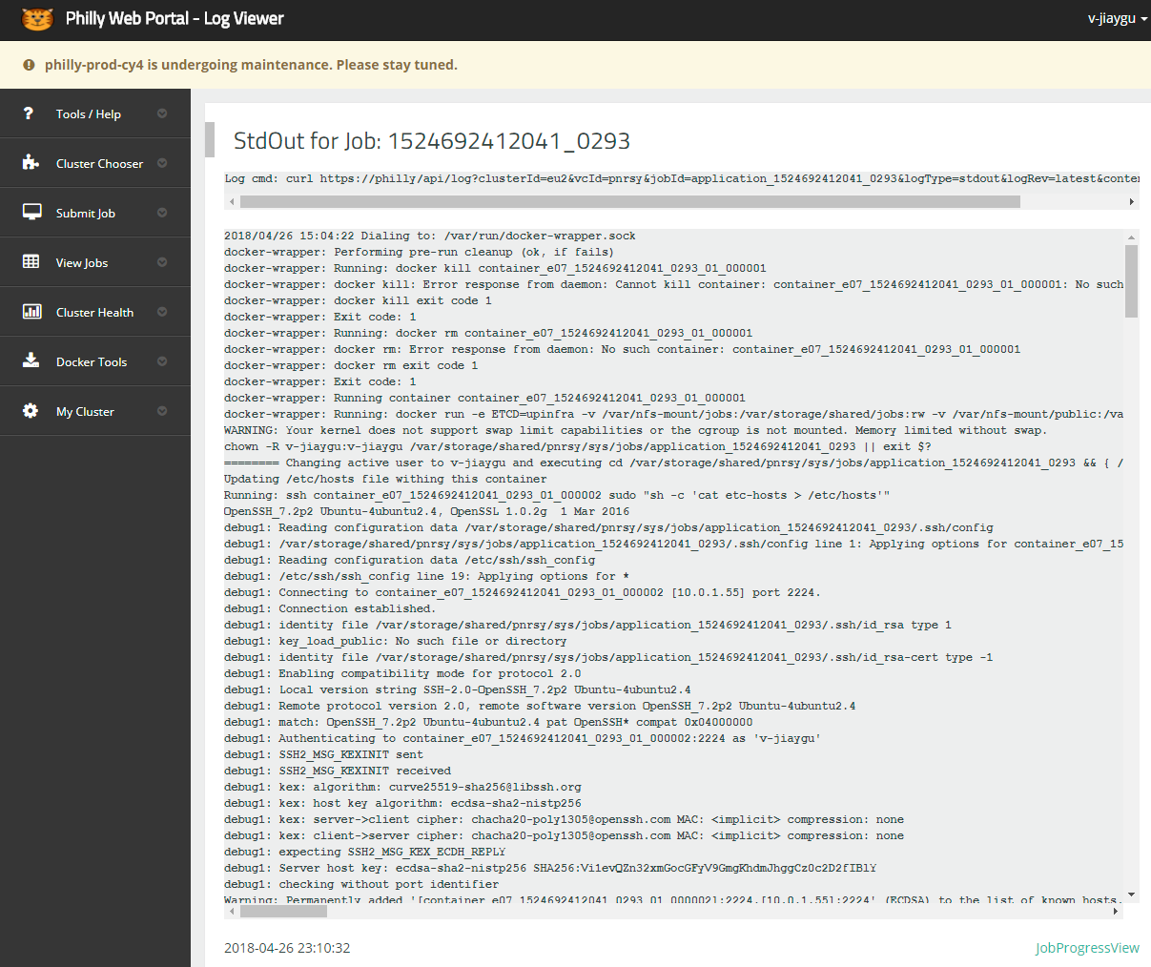
View your job
Your job ID
stdout show the whole process of your job
available only using debug mode
We usually print to stdout instead of
using philly logger

Slide 23
Submit by API
Jobs could be submitted by REST API
https://phillydocs.azurewebsites.net/articles/REST_API.html
Recommend to use curl with json file
curl -k --ntlm --user user:pwd -X POST -H "Content-Type: application/json" --data @submit_v2.json https://philly/api/v2/submit
submit_v2.json is attached

Slide 24
Path format
Remember, you should upload the data to the correct clusters you choose when submitting your job.
The following table shows path format in Philly
From https://phillydocs.azurewebsites.net/articles/storage_path.html
SMB Share (Windows) | philly-fs1 | Philly Web Portal2
\\storage.cam.philly.selfhost.corp.microsoft.com\pnrsy | hdfs://cam/pnrsy | /hdfs/pnrsy
\\storage.gcr.philly.selfhost.corp.microsoft.com\pnrsy | hdfs://gcr/pnrsy | /hdfs/pnrsy
\\storage.rr1.philly.selfhost.corp.microsoft.com​\pnrsy | hdfs://rr1/pnrsy | /hdfs/pnrsy
no SMB in PhillyOnAP | hdfs://philly-prod-cy4/pnrsy3 | /hdfs/pnrsy
no SMB in PhillyOnAzure | gfs://eu1/pnrsy | /hdfs/pnrsy/
no SMB in PhillyOnAzure | gfs://eu2/pnrsy | /hdfs/pnrsy/
no SMB in PhillyOnAzure | gfs://sc1/pnrsy | /hdfs/pnrsy/
no SMB in PhillyOnAzure | gfs://wu2/pnrsy | /hdfs/pnrsy/
NOTES
1: PhillyOnAzure's warm path has some differences, although from Web Portal it looks like hdfs, but underline file system is gfs
2: The cluster name does NOT appear in the path for Philly Web Portal.
3: Please read philly-fs tool for the right tools for PhillyOnAP HDFS.

Slide 25
Arguments to your scripts
What arguments are passed to your scripts?
Philly exposes parts of runtime, services, and setup via environment variables. (https://phillydocs.azurewebsites.net/articles/Environment.html)
Philly use SSH to communicate with docker container
Philly run pre-defined shell script in docker container with fixed arguments
Pre-defined shell run your actual scripts with pre-defined arguments
Usually, a docker image will pass two important arguments to your scripts, data directory and model (output) directory
Data directory might be passed as extra arguments, but model (output) directory must be passed inside the docker as it is only known at runtime

Slide 26
Arguments to your scripts
Because different docker images might have different pre-defined shell, it is better to check their interface before using them.
Trial and error: run test scripts to see the stdout
Find and correct: if you know the source of these docker images, just find them and check
For custom job, we usually pass --model-dir and --data-dir
For custom job v2, we usually pass --modelDir and --dataDir

Slide 27
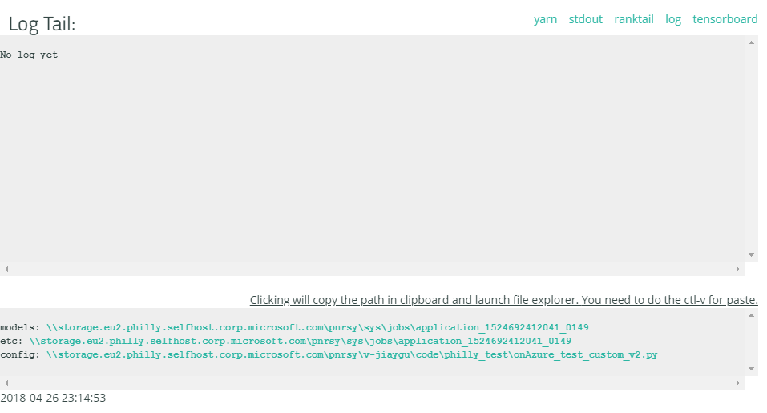
Overview
Exactly, the model (output) directory in docker is named as /hdfs/%VirtualCluster%/sys/jobs/%JobID%/models
You should parse the argument in your code to know where your model should be saved.
Generally, the model directory will be listed at the end of job view

Slide 28
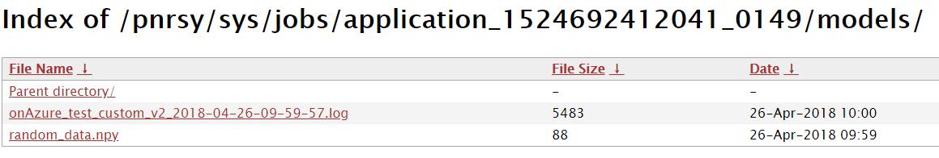
Get the model (onAzure)
Because onAzure share GlusterFS for both warm and hot storage, we could get the outputs from https as well
https://storage.eu2.philly.selfhost.corp.microsoft.com/pnrsy/sys/jobs/application_1524692412041_0149/models/ correspond to a job which runs on eu2/pnrsy with ID 1524692412041_0149

Slide 29
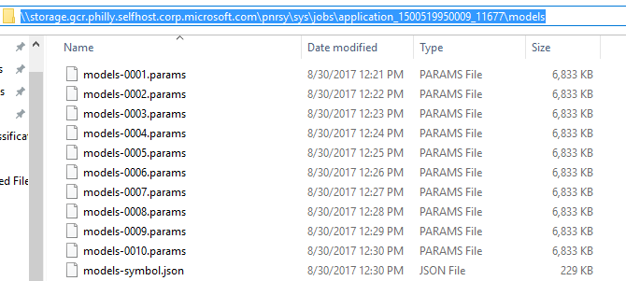
Get the model (onPrem)
The corresponding (SMB) network location is shown below:
\\storage.%PhysicalCluster%.philly.selfhost.corp.microsoft.com\%VirtualCluster\sys\jobs\%JobID%\models
E.g. Virtual Cluster - pnrsy, Physical Cluster - GCR, Job ID - application_1500519950009_11677
So, the model prefix in the system is given as /hdfs/pnrsy/sys/jobs/application_1500519950009_11677/models
The network location is \\storage.gcr.philly.selfhost.corp.microsoft.com\pnrsy\sys\jobs\application_1500519950009_11677\models

Slide 30
1. Philly Zip Reader
As uploading a large number of small files will cause philly storage to slow down for everyone, it’s recommended to upload the zipped data.
To read the data from the zip file in python, we have implemented a reader.
For image, mxnet.phillyzip.imread(filename, flags)
For xml, mxnet.phillyzip.xmlread(filename)
Usage:
Zip your data and upload to the hdfs.
Modify the image and xml path.
Import phillyzip, i.e. “from mxnet import phillyzip” or something equivalent in python.
Use our interface to read the image and xml. In other words, replace “cv2.imread”, “ET.parse” with “phillyzip.imread”, “phillyzip.xmlread”
Warning: We use some global variables in the phillyzip to ignore reading the same zip file multiple times. If not, it will waste too much time on I/O.
After testing, our image interface performs better on philly than “cv2.imread”.

Slide 31
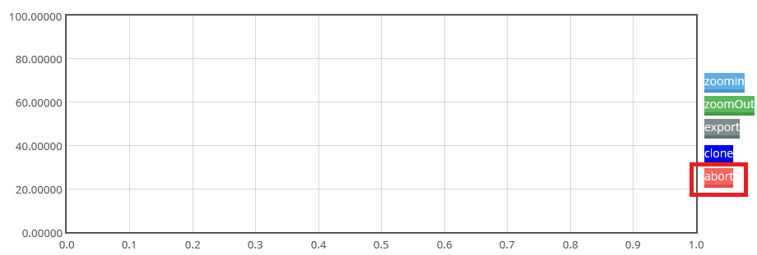
2. Tricks
Philly monitors the progress of the job with progress print in the format “PROGRESS: <num>%”. If you do not use pyphillytools for logging, please add some code to print it out. If not, your job may be considered as time-out.
You can kill your job by clicking the ‘abort’.

Slide 32
Overview
Debug mode enables you to keep a remote machine after your job finishes and it is not limited by ‘time-out’ or ‘heartbeat’.
Abort debug job after you do not need it
Hence, there are a lot of tricks, and please keep it secret even though others might also know.

Slide 33
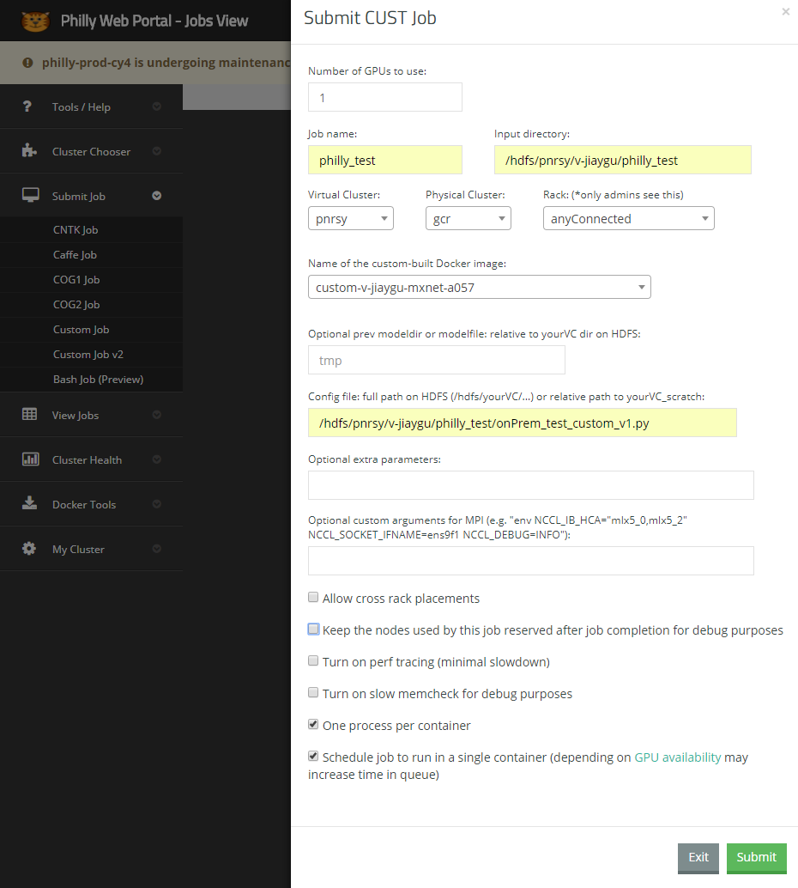
First, enable debug feature when submitting the job
select this box

Slide 34
Second, click ‘ssh’ when the job is running
click here

Slide 35
Then you will see

Slide 36
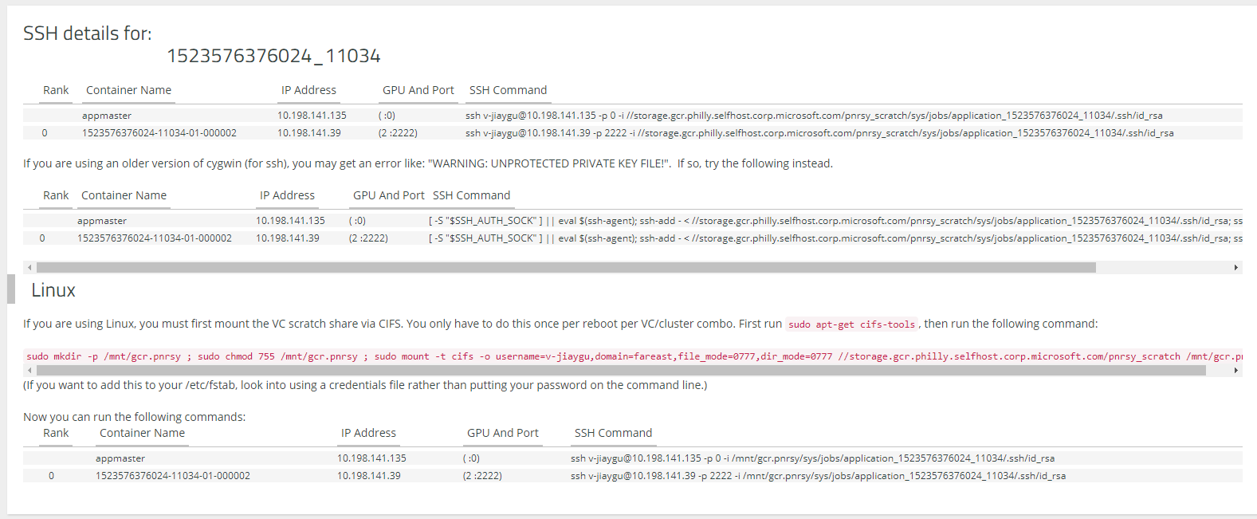
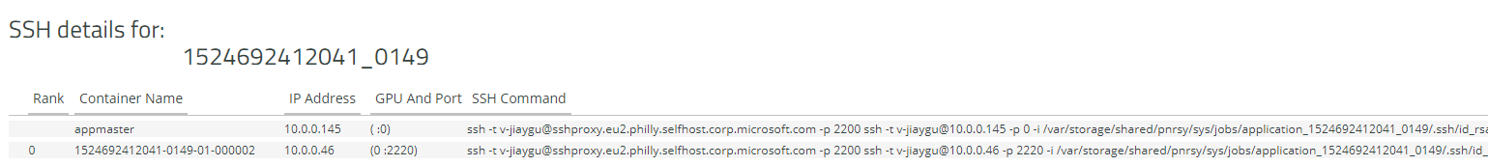
OnPrem
Mount nfs (hot storage) to get ssh keys
Copy this command to your ssh client, like MobaXterm
Then debug just like connecting to a remote machine
OnAzure
Copy this command to your ssh client, like MobaXterm

Slide 37
Overview
Custom docker for custom job create docker images through Jenkins in the old process, which is deprecated
Custom Job v2 is an upgrade to the image creation and consumption
Users push their own docker images to one repository, and Philly team will merge them into master by pull-request

Slide 38
Clone from VSTS
VSTS, like Github, holds a repository for Philly Docker at https://philly.visualstudio.com/commonPhilly (usually we all have access to it)
I suggest using SSH to connect to it if you do not know your username and password for VSTS.
Follow the instruction:
https://docs.microsoft.com/en-us/vsts/git/use-ssh-keys-to-authenticate?view=vsts
Notice to run 'ssh-agent bash' and 'ssh-add xxx' first to enable ssh keys

Slide 39
To be continue
We are trying to figure out the best practice of using custom docker

Slide 40
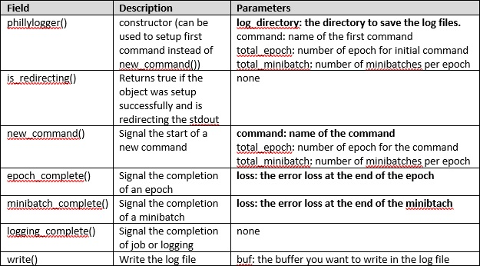
1. Philly Log
If you want to use the log tools for your code, please read the chapter 6.6 of the document carefully.
Philly provides a python module “pyphillytools” to display your job progress.

Slide 41
2. Make Your Code Secret
In order to make your code secret on philly, you’d better compile your python files to pyc files.
The python script "py2pyc.py" is provided for you to compile all of your python code to pyc files.
If you want to submit your code as .pyc file, you should run this python code under the home of mxnet:
python tools/py2pyc.py
This code will make a new folder whose suffix is "_private", and copy the origin file to the new folder, then compile python code to pyc files, finally delete all py files.
Warning: Some tools can decompile your pyc file to py.
If you have better ideas to make our code secret, please contact me (v-jilu1@microsoft.com).

Slide 42
Example of Deformable-ConvNets
We show you the example of Deformable Convolutions Networks running on Philly in the following slides.
Maybe it is a little complex…….

Slide 43
Example of Deformable-ConvNets
Preparation
Clone the Deformable ConvNets repository, and we'll call the directory that you cloned Deformable-ConvNets as ${DCN_ROOT}. Remember, clone to your local directory first.
git clone https://github.com/msracver/Deformable-ConvNets.git
For Linux user, run sh ./init.sh. The scripts will build cython module automatically and create some folders. Remember, make sure the version of numpy is latest. Sorry for Windows user contemporarily.
Data: VOC0712
Please download COCO and VOC 2007+2012 datasets, and make sure it looks like this:
./data/VOCdevkit/VOC2007/
./data/VOCdevkit/VOC2012/
Please download ImageNet-pretrained ResNet-v1-101 model manually from OneDrive, and put it under folder ./model. Make sure it looks like this:
./model/pretrained_model/resnet_v1_101-0000.params
Actually, you can run your code on your local machine (with gpus, mxnet and some necessary python packages) now.

Slide 44
Example of Deformable-ConvNets
Data Upload
Zip the “JPEGImages” and “Annotations”, because they contains too much small files.
./data/VOCdevkit/VOC2007/JPEGImages ➔ ./data/VOCdevkit/VOC2007/JPEGImages.zip
./data/VOCdevkit/VOC2007/Annotations ➔ ./data/VOCdevkit/VOC2007/Annotations.zip
./data/VOCdevkit/VOC2012/JPEGImages ➔ ./data/VOCdevkit/VOC2012/JPEGImages.zip
./data/VOCdevkit/VOC2012/Annotations ➔ ./data/VOCdevkit/VOC2012/Annotations.zip
e.g. run zip –r JPEGImages.zip JPEGImages in ./data/VOCdevkit/VOC2007
Upload “data” to the hdfs.
e.g. c:\Python27\python.exe \\scratch2\scratch\mradmila\philly-fs\python2\philly-fs.pyc -cp -r ./data hdfs://gcr/pnrsy/v-jilu1
Note: this command is for Windows user. Linux user should visit the network location to use the python script.
Move the “VOCdevkit” outside the work directory.
./data/VOCdevkit/ ➔ ../VOCdevkit or “Recycle Bin”
Upload the whole work directory to your scratch space.
${DCN_ROOT} ➔ \\storage.gcr.philly.selfhost.corp.microsoft.com\pnrsy_scratch\v-jilu1\Deformable-ConvNets

Slide 45
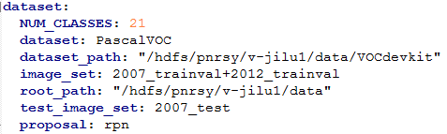

Example of Deformable-ConvNets
Code Modification
Some code should be modified to run on Philly.
Configuration file:
“gpus” – gpus you will use
“pretrained” – the location of your pretrained model, modify the path
“dataset” – the location of your dataset
./rfcn/config/config.py
“update_dir” – modify the output path, add the field at the end of this file

Slide 46
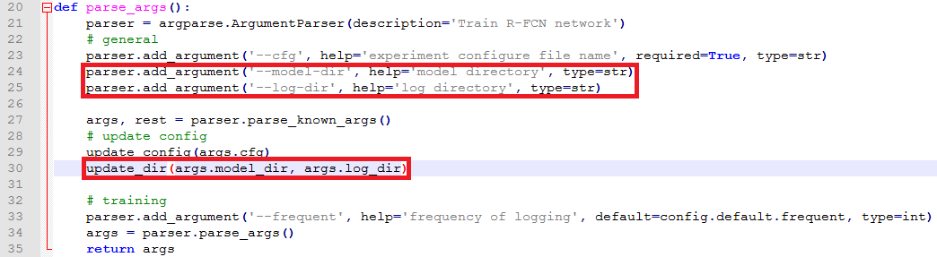
Example of Deformable-ConvNets
Code Modification
./rfcn/train_end2end.py
“parse_args” – add two arguments to specify the model and log directory.
./rfcn/test.py
Add the same sentences above to the corresponding locations.

Slide 47
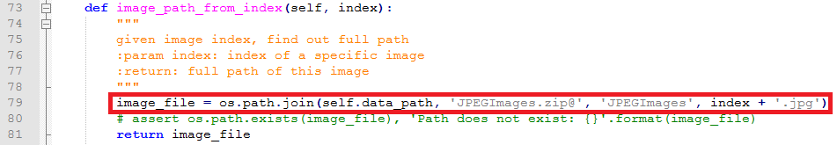
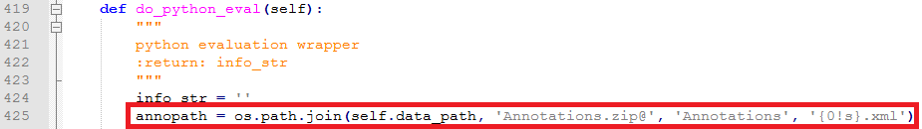
Example of Deformable-ConvNets
Code Modification
./lib/dataset/pascal_voc.py
Import phillyzip
“PascalVOC.image_path_from_index” – update the image path as data is zipped
“PascalVOC.do_python_eval” – update the xml path as data is zipped

Slide 48
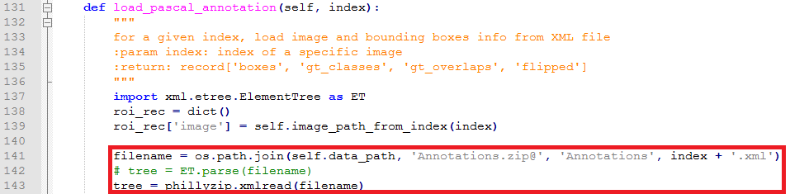
Example of Deformable-ConvNets
Code Modification
./lib/dataset/pascal_voc.py
“PascalVOC.load_pascal_annotation” – update the image path as data is zipped
./lib/dataset/pascal_voc_eval.py
Import phillyzip

Slide 49
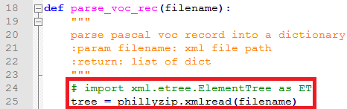
Example of Deformable-ConvNets
Code Modification
./lib/dataset/pascal_voc_eval.py
“parse_voc_rec” – read xml file by our xml interface
./lib/utils/roidb.py
Import phillyzip
“prepare_roidb” – read image by our image interface
./lib/utils/image.py
Import phillyzip
“get_image” – read image by our image interface
“get_segmentation_image” – read image by our image interface

Slide 50
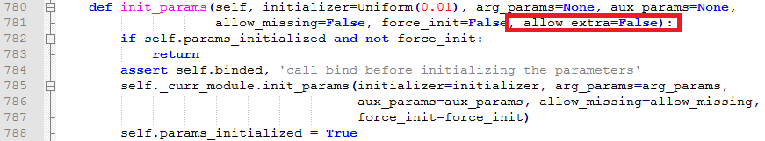
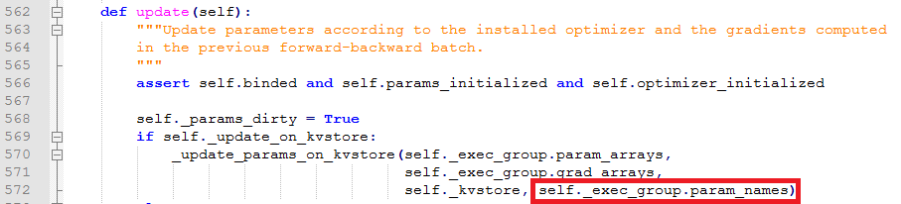
Example of Deformable-ConvNets
Code Modification
./rfcn/core/module.py
As we use the mxnet of latest version, some interfaces should be updated.
“MutableModule.init_params” – miss a parameter
“Module.update” – miss a parameter

Slide 51

Example of Deformable-ConvNets
Code Modification
./rfcn/core/module.py
To avoid being considered as ‘Time-out’, we’d better add the progress output in training loop.
“MutableModule.fit” – add the progress output

Slide 52
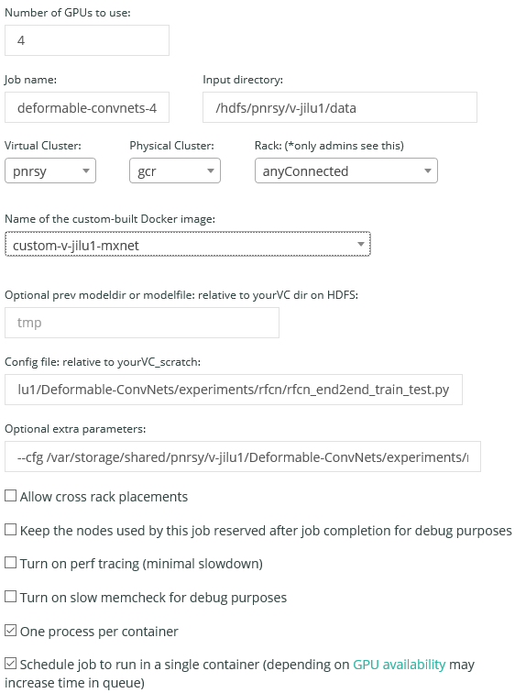
Example of Deformable-ConvNets
Job Submit
Example:
Number of GPUs to use: 4
Job Name: deformable-convnets-4-gpu
Input Directory: /hdfs/pnrsy/v-jilu1/data
Virtual Cluster: pnrsy
Physical Cluster: gcr
Name of the custom-built Docker image: custom-v-jilu1-mxnet
Config file: v-jilu1/Deformable-ConvNets/experiments/
rfcn/rfcn_end2end_train_test.py
Optional extra parameters: --cfg /var/storage/shared/pnrsy/
v-jilu1/Deformable-ConvNets/experiments/rfcn/cfgs/
resnet_v1_101_voc0712_rfcn_dcn_end2end_ohem.yaml
Checkbox: “One process per container” and “Schedule job to
run in a single container”
Submit!

Slide 53
Example of Deformable-ConvNets
Output Files
You will find your output in the models directory assigned by Philly.
You can find the directory at the bottom of the webpage of your job.

