Slide 1

Sass
Syntactically Awsome Stylesheet

Slide 2
Agenda
What is Sass?
Syntax
Sass Features
Nested Rules
Variablen
Mixins
Inheritance
Pros & Cons

Slide 3
What is Sass?
Stylesheet language
Preprocessor of CSS
→ Create a CSS-File
Open-Source program
Programmed with Ruby

Slide 4
Syntax
Sass-Syntax (.sass)
SCSS-Syntax (.scss)
Original Syntax
Indentations to separate code blocks from each other
Line break to separate lines
= Sassy CSS
Curly braces to separate blocks of code
Semicolons to separate lines
→ Added to close the gap to CSS

Slide 5
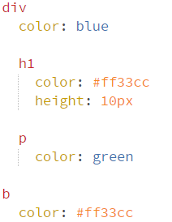
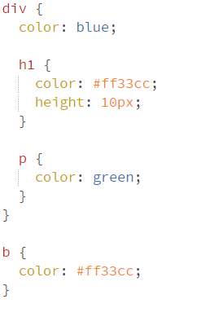
Syntax
Sass-Syntax (.sass)
SCCS-Syntax (.scss)

Slide 6
Sass Features

Slide 7
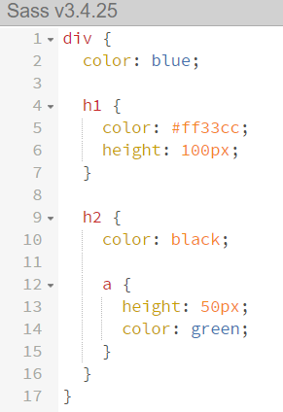
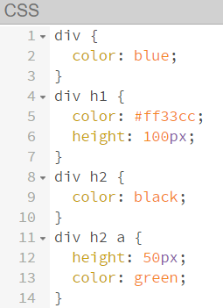
Nested Rules
Selectors can be nested
→ for easy reading and writing

Slide 8
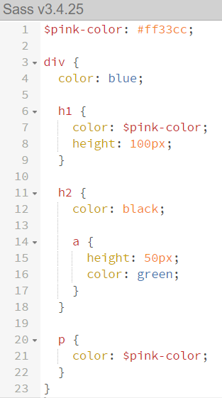
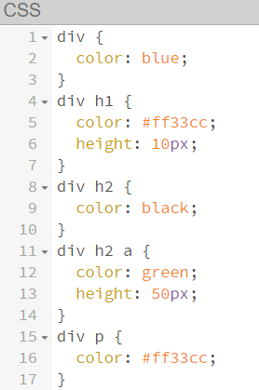
Variablen
Constant values can be set centrally
→ simplifies maintenance

Slide 9
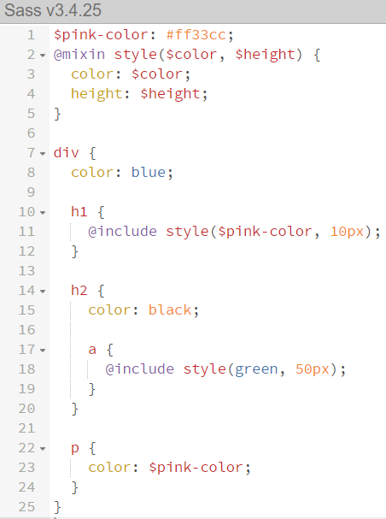
Mixins
Reference a larger part of code so that it can be easily reused elsewhere in the stylesheet.

Slide 10
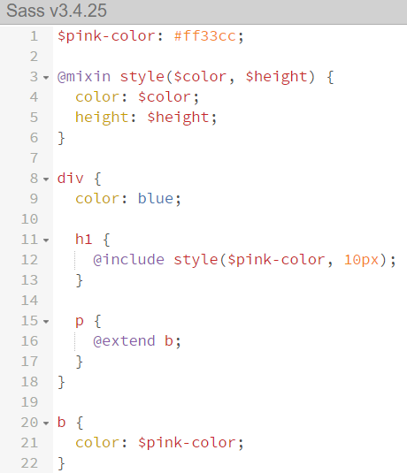
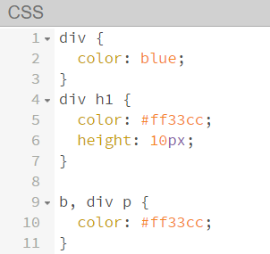
Inheritance
A selector can use the style of another selector without copying the code.

Slide 11
Sass Script
Extends Sass to include functions such as:
basic arithmetic operations
Methods for manipulating color values
Loop constructs (for, each, while)
Case distinctions (if, else)

Slide 12
Pros & CONS

Slide 13
Pros
simplified & extended CSS
Easier maintenance of large stylesheets
Saving of time
Reduce self-written code

Slide 14
Cons
Heavy debugging
Further source of error
Time to learn Sass

Slide 15
Hands-On
Sass Tutorial

