Slide 1


Digital Freelancer:
Managing Freelancing Projects
Project: Working with a Mock Client

Slide 2
Part 1
Project Listing

Slide 3
Part 2
Expression of Interest

Slide 4
Expression of Interest (Provided)
Which Sample Project Listing did you select to respond to?
Answer:
Sample Project Listing #1: Web Development
Please type your initial response to the client below. This should be between 200 - 300 words.
Expression of Interest:
Hello, It's a pleasure to work with you on your nice project, I see that you are looking for someone to convert your PSD files to custom code using HTML, CSS, and JavaScript.
I'm excellent at using libraries such as jQuery and Angular JS or React JS in the conversion process, to create some great features to bring more customers to the website, as they have more wonderful advantages such as earning more money and retaining new customers.
But in fact, it's better to use Angular JS because it has great advantages such as high performance, and efficient usage of MVC, Angular contains multiple filters to format data of different data types, and Filters in Angular JS allow formatting the data without changing the original format and this features will be helpful to the website also Angular JS provides a dynamic approach to efficient web development. It is a highly preferred framework, due to its effectiveness, simplicity, and flexibility, with more and more great features.
I'm a web developer with two years of experience I have nearly 25 clients in different countries, including the United States of America and India, and can complete the work in about a month, not three because I am completely free to work on your project.

Slide 5
Part 3
Project Management Process

Slide 6
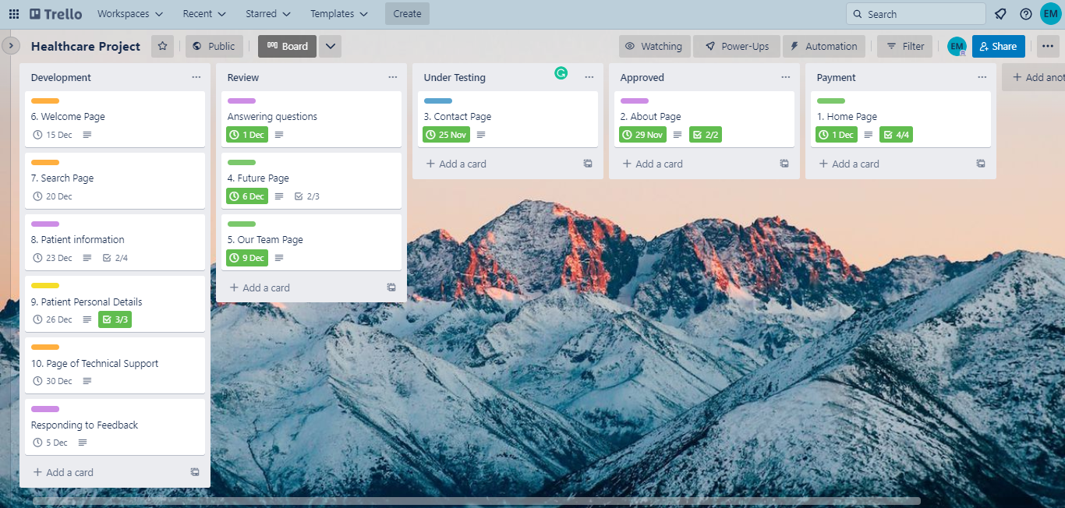
Trello Board
Please include the following information for your Trello board:
A link to your public Trello board should be provided here:
https://trello.com/b/bVVoMn0H/healthcare-project
Include a screenshot of the board below:
Paste screenshot here

Slide 7
Part 4
Invoice and Payment Options

Slide 8
Eslam Mustafa
11 Mohamed Abd EL-Aal St., EL-Tabia, Alexandria, Egypt
Invoice
Recipient:
Udacity Co.
New York, USA
Invoice #: N00241
Date issued: 24th Dec, 2022
Date due: 1st Jan, 2023
Services Rendered (Continue on next page)
Service | Description of Work Done | Hours Spent | Amount Per Hour | Total
PSF File Breaking | Cut the PSD file into small pieces | 3 Hours | $30 | 3 x 30 = $ 90
Generate Directories | create the three primary directories | 5 Hours | $30 | 5 x 30 = $ 150
Create HTML | create a new file and then save it in the main folder that we created with names after the custom location name. then split the codes with HTML5 following the instructions (instructions in Trello ) | 15 Hours | $30 | 15 x 30 = $ 450
Generate Style Files | Create style files for our page, using Bootstrap | 25 Hours | $30 | 34 x 30 = $ 750

Slide 9
Eslam Mustafa
11 Mohamed Abd EL-Aal St., EL-Tabia, Alexandria, Egypt
Invoice
Services Rendered (continued)
Service | Description of Work Done | Hours Spent | Amount Per Hour | Total
Web Design Set Arrangement | Create a web design suite, bringing all the elements together for a solid foundation with HTML and CSS layout | 30 Hours | $30 | 30 x 30 = $ 900
Java Script Interaction | Interact with JavaScript and allow it to interact with HTML and CSS files, configure jQuery to help organize the DOM, create dynamic layouts, and help with front-end coding as well | 18 Hours | $30 | 18 x 30 = $ 540
Final Touch to Make It Responsive | use frameworks to make the file responsive. using Twitter BootStrap, Foundation, Fluid Baseline Grid, etc. for that. To add additional responsive features to the design. | 7 Hours | $30 | 7 x 30 = $ 210
Total |  | 103 Hours | $30 | $ 3090
Total Payment Due: 3090 $
Payment Options:
Paypal: Eslaam.mustafa@Gmail.com
National Bank of Egypt: No: 1234567890000

