Slide 1
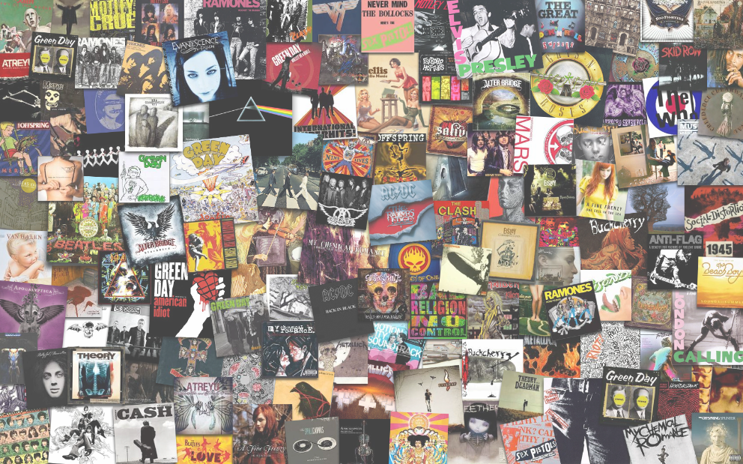
Song Data Analysis
Presented by: Brandi, Lea, Brian, Nikki & Jérôme

Slide 2
BUSINESS OBJECTIVES: We will investigate Top 100 Billboard music dataset from 1950-2015 to determine trends in lyrics over time. Machine learning will predict popularity of song using various datapoints.
RESEARCH QUESTIONS & HYPOTHESES: Do songs from certain genres have more complex lyrics? How does popularity of genres trend over time? Are songs lyrics becoming more repetitive over time? Which artists has spent the most time on the top 100 Billboard charts? Which artist have the most songs on the top 100 Billboard? Are the more successful artist cross over multiple genres?

Slide 3
Data Used: http://www.bobborst.com/popculture/top-100-songs-of-the-year/?year=2015 https://developer.spotify.com/documentation/web-api/ https://en.wikipedia.org/wiki/Billboard_charts
We were able to obtain song information via multiple API calls to Spotify. Additionally, we found a data source that contained the Top Billboard songs of the year from 1950-2017.

Slide 4
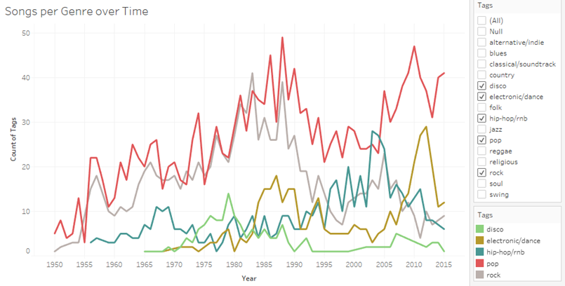
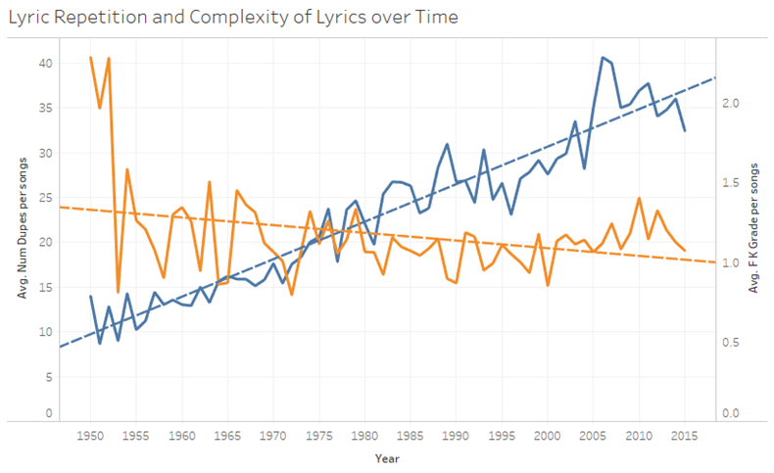
Visualizations using Billboard Data

Slide 5
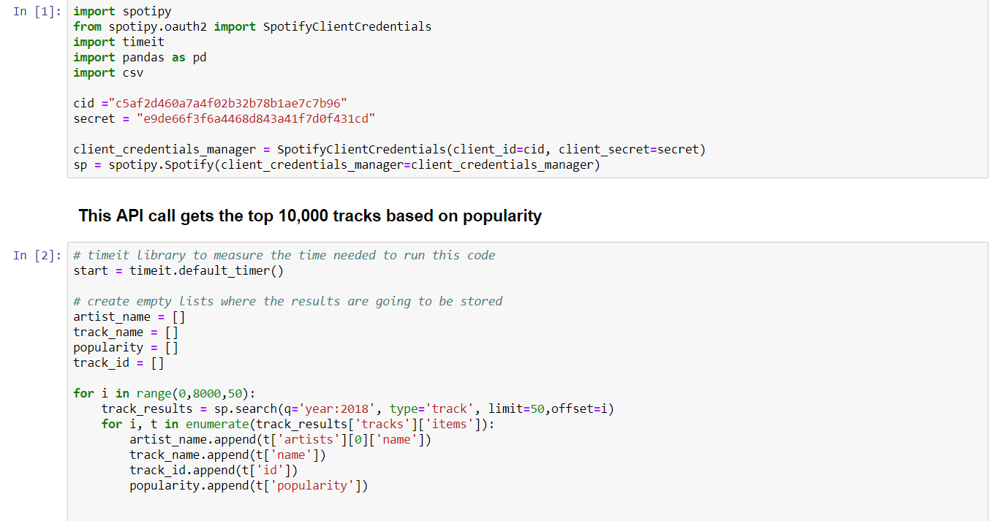
API Code Sample

Slide 6
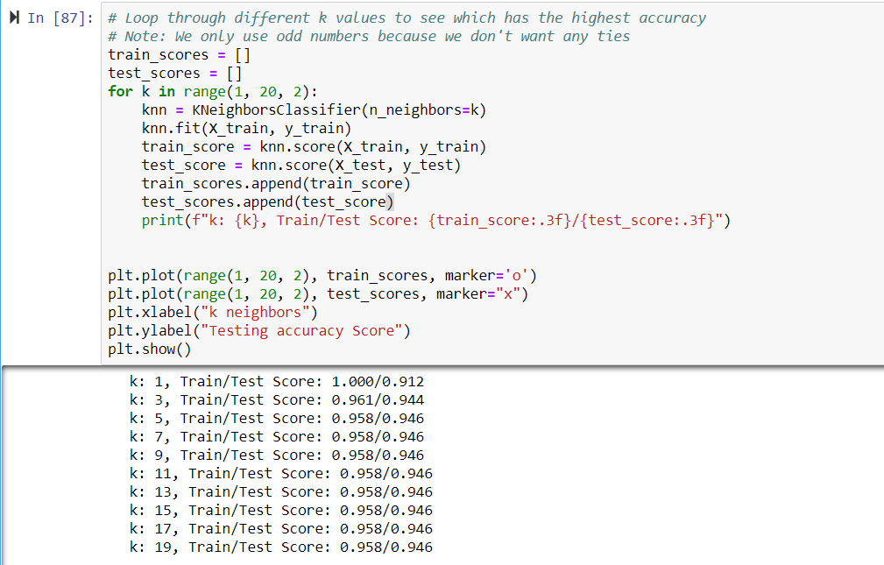
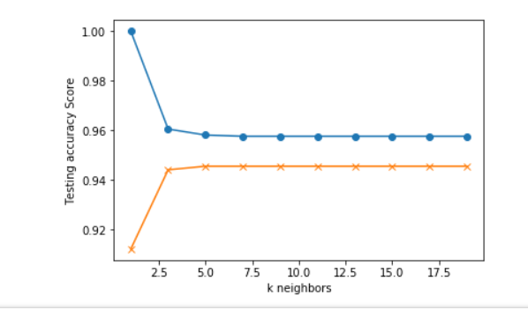
Machine Learning Sample Code:

Slide 7
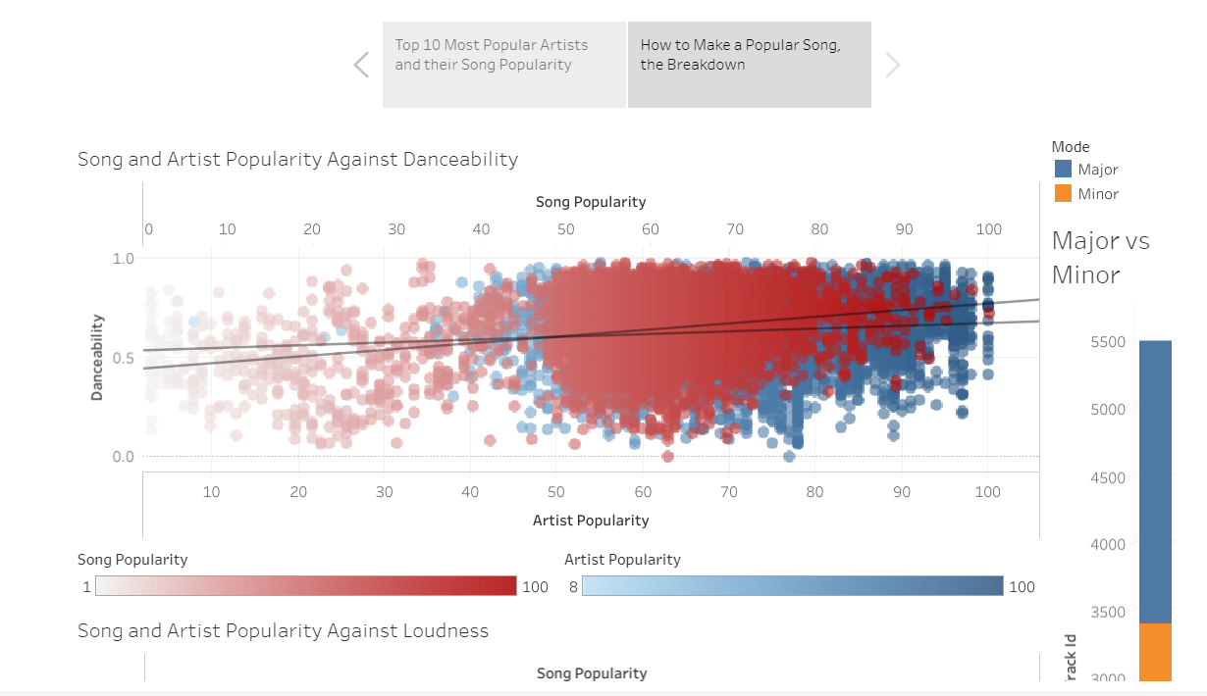
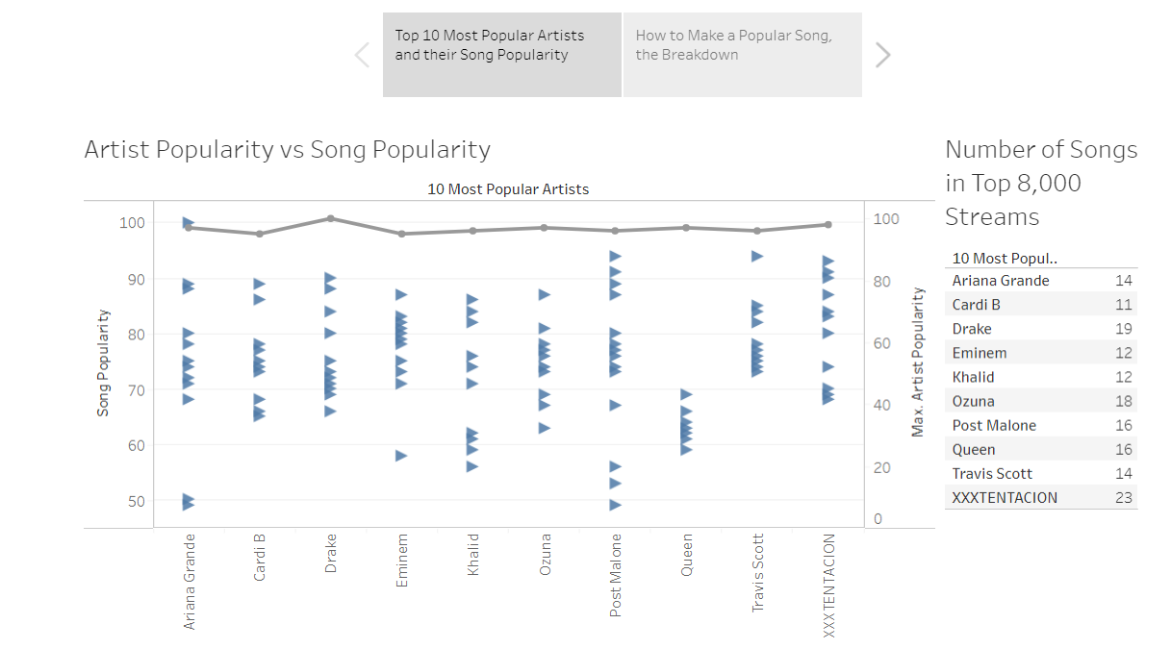
Visualizations brought to us by Tableau

Slide 8
Webpage
Thank you!
Sincerely,
Brandi, Lea, Brian, Nikki & Jérôme

