Slide 1

Investigating the Performance of Fake News Prediction involving Political Activity with the use of Artificial Intelligence
Leander Pace & Silvio Abela
Institute of Information & Communication Technology
MCAST, Paola, Malta

Slide 2


Problem Definition
The dangers fake news presents can be in multiple sectors:
Politics (ie. Elections)
Economical (ie. Stock market)
Health (ie. Covid-19)
Entertainment (ie. Celebrities)
Notes:
Mention the content of the ie

Slide 3
Hypothesis & Research Questions
Hypothesis: In this research study, it is hypothesized that prediction models will offer a greater accuracy when performed on political fake news rather than the more general fake news.
Question 1: Can this research achieve a satisfactory result in detecting political fake news while corresponding with similar research studies?
Question 2: Can this research successfully predict the surge of political fake news?

Slide 4
Literature (Dangers of Fake News)
A few examples of what dangers fake news have presented in the past:
A fake news article headlined “Radiation fear prompt panic buying of salt” made people think salt will help counteract radiation, which lead to countrywide salt shortages. (www.chinadaily.com)
A study conducted by [1] mentioned a hoax about the death of Ethereum’s chief executive, which lead to the company’s market value to drop by $4 billion.
The BBC reported an article headlined “How the war was fought in TV studios”, mentioning a conflict escalation between India and Pakistan due to a fake news article reporting a Balakot strike, killing military personnel. (www.bbc.com)

Slide 5
Literature(Similar Studies)
Papers that have been used as inspiration and contributed towards this study:
For the good accuracy results obtained from using Random Forest, Decision Trees and TF-IDF [2].
For the high accuracy results of LSTM with CV and W2V as NLP techniques [3].
This study was required to be used as the gold standard for this paper due the use of the LIAR dataset aswell as obtaining good accuracy results with SVM [4].

Slide 6
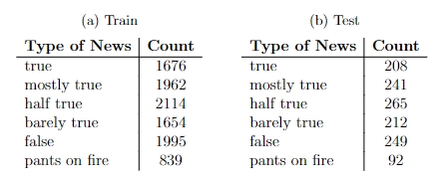
Methodology (Data Sources)
Data Sources:
LIAR dataset [4] and was obtained from www.paperswithcode.com
Train set (10240)
Test Set (1276)
https://paperswithcode.com/dataset/liar
Notes:
Include a footnote for politifact

Slide 7
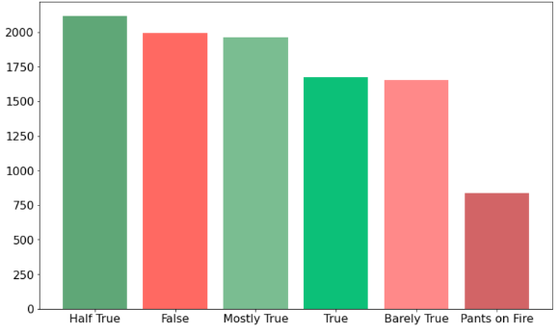
Methodology (Data Sources)
Label distribution of the LIAR dataset for the Train(10240) set. The test set (1276) has an identical label distribution to it having same ratio distribution

Slide 8
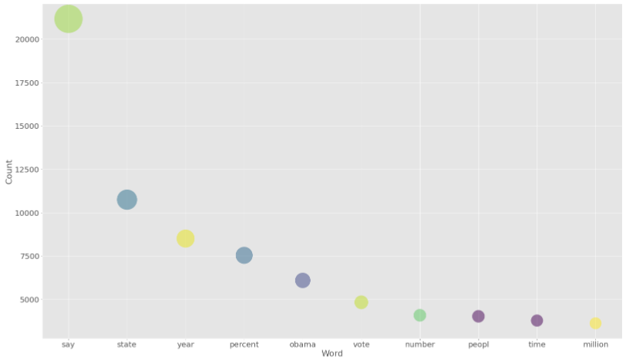
Methodology (Data Sources)
Top 10 words with the highest frequencies after preprocessing LIAR

Slide 9
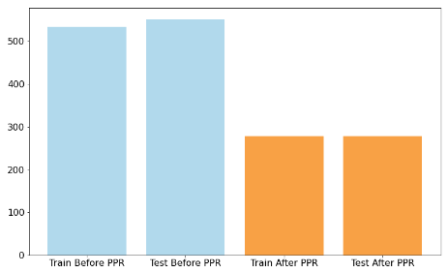
Methodology (Data Sources)
Average Words in dataset
Before & After preprocessing LIAR

Slide 10
Methodology (Models)
NLP Techniques
TF-IDF
CountVectorizer
Word2Vec
Classifiers:
Random Forest
Decision Trees
Support Vector Machine
Long Short-Term Memory

Slide 11




Results (LIAR Dataset)
The following tables are the average results after the base preprocessing plus stemming and lemmatization on the LIAR dataset
Average results of RF
Average results of DT
Average results of SVM
Average results of LSTM

Slide 12

Results (LIAR Dataset)
The following table shows the average results of all models by classifier and NLP technique, outlining the best combination of classifier and NLP technique
Average Accuracy Results of all models

Slide 13
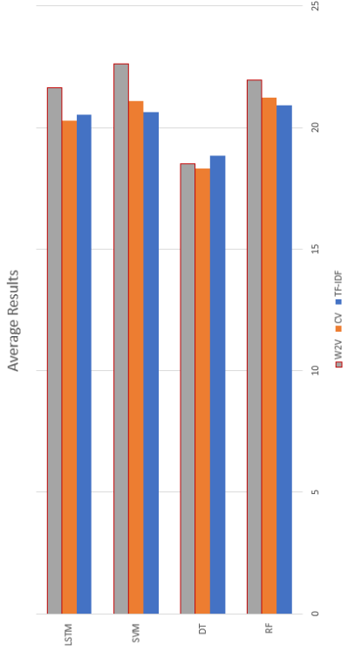

Results (LIAR Dataset)
Average Accuracy Results of all Models
Notes:
Explain a bit better

Slide 14
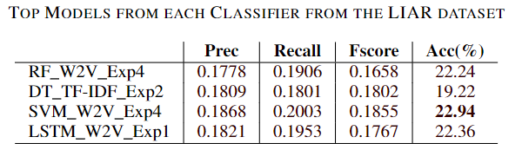
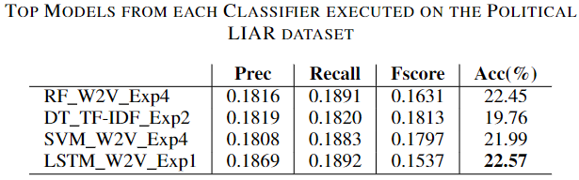
Results (Political LIAR Dataset)
Top 4 models from the LIAR dataset were selected to perform on the Political LIAR dataset, the following tables compares the two
Political LIAR shown some improvements over LIAR except in the SVM model

Slide 15
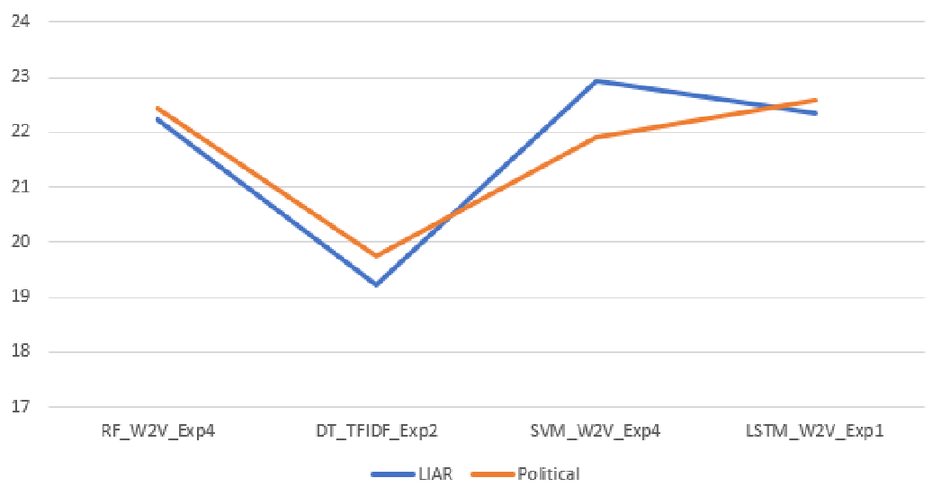
Results (Political LIAR Dataset)
Average Results of LIAR vs Political LIAR

Slide 16
Conclusion (Hypothesis & Research Questions)
Hypothesis: The data obtained from this research study proved the hypothesis to be partially accepted since the accuracy results from the political model shown to have improved the models’ prediction, the difference still does not justify the hypothesis to be a complete success.
Question 1: Can this research achieve a satisfactory result in detecting political fake news while corresponding with similar research studies?
Proven to be a partial success since Political LIAR succeeded over LIAR but failed to surpass similar models from other studies, although some accuracies did come very close.
Question 2: Can this research successfully predict the surge of political fake news?
Unfortunately, this study failed to successfully answer this research question due to the low accuracy from both the prototype and from LIAR itself, the models failed to predict a pattern to determine if a surge in fake news is happening.

Slide 17
Future Recommendations
Use fewer algorithms and NLP techniques depending on the study
Makes the model more precise
Easier to troubleshoot and debug
Conduct more tests to investigate further the performance on the political LIAR dataset

Slide 18
References
[1] Levi, L. (2017), ‘Real fake news and fake fake news’, First Amend. L. Rev. 16, 232.
[2] Jehad, R. & Yousif, S. A. (2020), ‘Fake news classification using random forest and decision tree (j48)’, Al-Nahrain Journal of Science 23(4), 49–55.
[3] Vijayaraghavan, S., Wang, Y., Guo, Z., Voong, J., Xu, W., Nasseri, A., Cai, J., Li, L., Vuong, K. & Wadhwa, E. (2020), ‘Fake news detection with different models’.
[4] Wang, W. Y. (2017), ‘”liar, liar pants on fire”: A new benchmark dataset for fake news detection’, arXiv preprint arXiv:1705.00648 .

Slide 19
Thank you Leander Pace, Silvio Schembri

