Slide 1
PRODUCT VISION · 2026
Designing with clarity
A minimalist system for professional decks
1 · Cover / Title

Slide 2
02
The Approach
2 · Section divider

Slide 3
Professionalism comes from hierarchy, not decoration.
3 · Big statement

Slide 4
OVERVIEW
Heading sits here
Body copy in Graphite, generous line-height. One idea per slide; keep supporting detail tight and scannable.
4 · Heading + body

Slide 5
PRINCIPLES
What guides the design
Hierarchy over decoration
One idea per slide
A single accent, used deliberately
Whitespace is a feature
5 · Minimal list

Slide 6
COMPARISON
Two columns
Left
Right
First column body content sits here.
Second column body content sits here.
6 · Two column

Slide 7
METRICS
Impact at a glance
3.2×
faster to draft
100%
on-brand
12
layouts
7 · Color cards / KPI

Slide 8
KEY POINT
Highlight a term
the one number that matters
Supporting sentence explains why it matters.
8 · Highlight / callout

Slide 9
ARCHITECTURE
How a deck is generated
Content
title · body · concept
Style template
theme + 12 layouts
Claude
python-pptx
.pptx deck
editable
9a · Architecture — flow

Slide 10
SYSTEM
Platform layers
Presentation · UI
SERVE
Application · services & logic
PROCESS
Data · storage & ingest
INGEST
9b · Architecture — layered

Slide 11
ARCHITECTURE
Service boundary
CORE SERVICE
API gateway
Engine
Cache
9c · Architecture — nested

Slide 12
ARCHITECTURE
ML lifecycle across environments
ML TRAINING PIPELINE
HYPERPARAMETER TUNING
DEV
Data Prep
Model Training
Model Validation
Trained model
POC DATA
Data Warehouse
DEPLOY
STAGING / PROD PIPELINE
BATCH FETCH
Perf drop?
STAGING / PROD
Data Prep
Retrain
Validate
YES
9d · Architecture — swim-lane (native, editable)

Slide 13
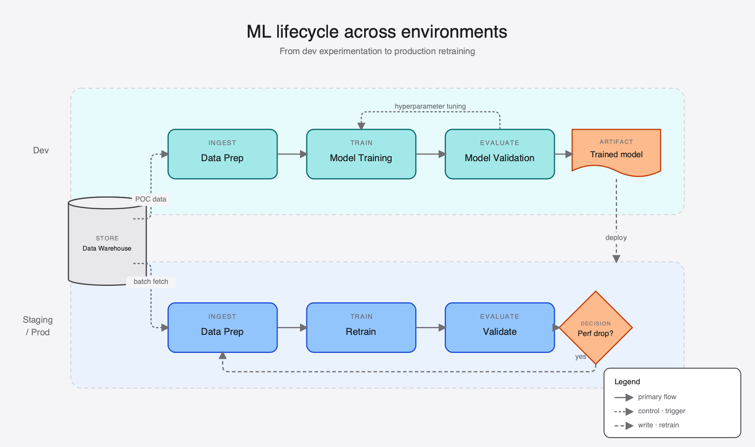
9e · Architecture — swim-lane (SVG, publication-grade)

Slide 14
VISUAL
Image + caption
[ image ]
Body sits left; image fills the right half.
Figure 1 — caption in Slate
10 · Image + caption

Slide 15
“Good design is as little design as possible.”
— Dieter Rams
11 · Quote

Slide 16
Thank you
questions → hello@example.com
12 · Closing

