Slide 1
Bus structure and features of system bus
Presented by:
Adeeb Hassan bsf2003459
Aqib Sultan bsf200

Slide 2
Bus Structure
Bus:
Communication pathway connecting multiple devices.
It is a shared transmission medium.
Multiple devices connected to the bus and any signal transmitted by any one device is received by all devices connected to the bus.
Single instruction is possible at a time.
Multiple signals are destroyed (when present on bus at same time).

Slide 3
System Bus
The system bus is a pathway composed of cables and connectors used to carry data between a computer microprocessor and the main memory.
It is the bus that connects the three major components of the system (CPU, I/O, Memory).
Combines the functions of the three main buses: namely, the data, address and control buses.

Slide 4
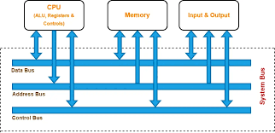
System Bus

Slide 5
Data Bus
Provide a path for moving data among system modules.
Number of lines in data bus are called width of data bus.
Each line carries 1 bit at a time
Number of lines in data bus determines how many bits can be transferred parallel.
Data bus width determines overall system performance.

Slide 6
Address Bus
Specify where to store the data/ from where to retrieve the data (present on the data bus).
Collectively address lines are known as Address Bus
Address bus width determines the memory capacity (total number of unique addresses).
The same address lines can refer to I/O ports.

