Slide 1
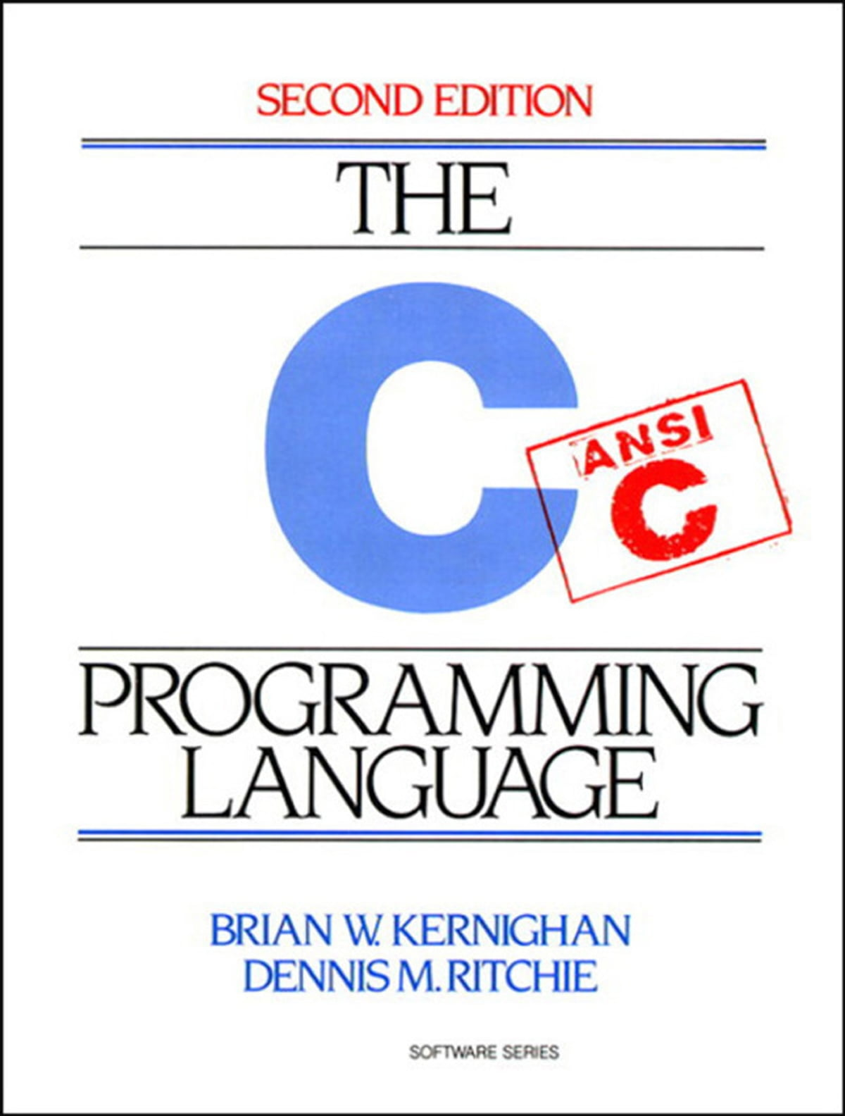
Memory Management

Slide 2
What do I mean “memory management” ?
Programs are stored in memory
Both the actual code
And all the variables, data, etc.
That means someone has to decide where!
And that when it is no longer being used, you get rid of it

Slide 3
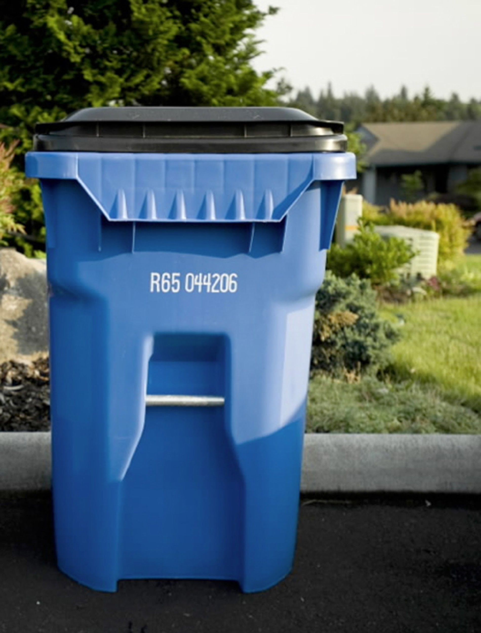
Who manages memory ?
Most modern languages allocate memory automatically
E.g. in Java anytime you use `new Object();` memory is allocated for it
In some languages you might not even think about it
Most also have a way find out when memory is not used
FREE MEMORY
Using what’s called a Garbage Collector
Again, you usually don’t even think about it
So the computer does it?

Slide 4
Well…
We are programming in C
C is great that you can control this yourself
The tradeoff is
You HAVE TO do this yourself
C requires
Explicit memory allocation
And Manual garbage collection
So let’s go through it!

Slide 5
How are programs stored? (in C)
Notes:
But first, we need to briefly know *how* programs are stored
I’ll keep it brief

Slide 6
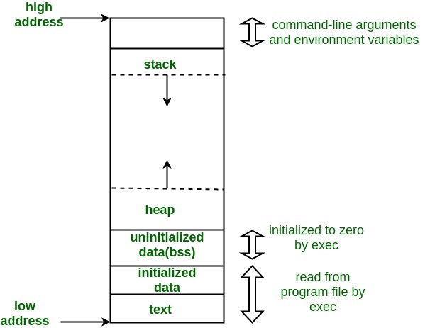
How is memory stored in a C program?
Program in Memory Consists of
Text segment
Initialized data segment
Uninitialized data segment
Heap
Stack
Notes:
Text segment
- executable code
- read only!
Initialized data segment
- global variables, static variables,
- things initialized by the programmer
- ex. `int i = 10;`
Uninitialized data segment (sometimes referred too as BSS)
- declared but with uninitialized values
- be careful of garbage values!
- ex. `int i;`
Stack / Heap
- Grow in opposite directions
- have pointers holding next available space
- when stack pointer = heap pointer no available space
Stack
- automatic variables
- stored here while in scope, and automatically destroyed when exit scope
- recursive functions work here, add a ‘stack frame’ to stack, removed / destroyed when leaving
Heap
- this is where the magic happens, and the majority of this talk
- DYNAMIC MEMORY ALLOCATION
- malloc, calloc, and free all take place here

Slide 7
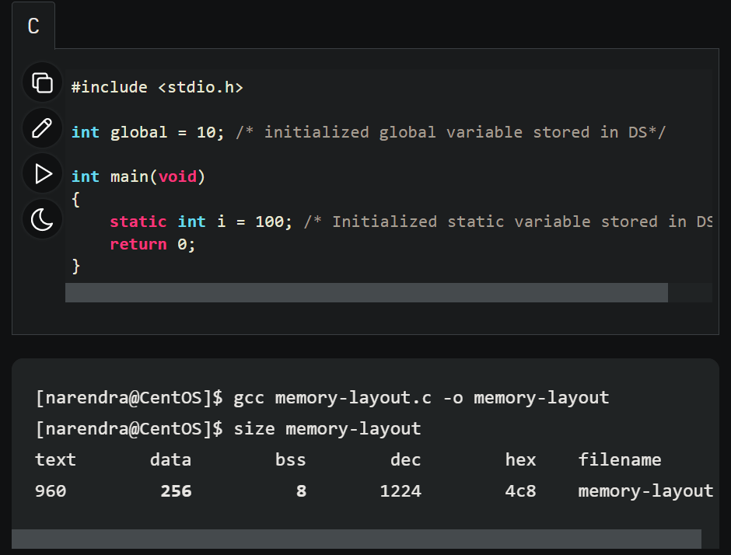
Play around! (if you like)
I encourage you to write a simple program, compile it, see how it changed in size of memory
(at compile time)
Use
`size compiled-program-name.o`
See how adding variables at different points change different parts of memory

Slide 8
Allocating memory (in C)

Slide 9
What are pointers? Again?!
The short answer is: a variable that contains the address of a variable
When allocating data dynamically / at run-time, pointers are used to keep track of where the data being allocated is being kept!
Memory Address
Data
Pointer
Memory

Slide 10

Dynamically Allocate
Just means allocate memory as the program is running
Often required for information that only becomes available at run-time
int *val; val = (int*) malloc (sizeof(int));
sizeof(int) evaluates to 4
Now val points to an area of memory where 4 bytes have been allocated
By default to store an integer

Slide 11

Dynamically Allocate More
int *arr; arr = (int*) malloc (10 * sizeof(int));
The expression inside malloc evaluates to 4 * 10 = 40
Now arr points to an area of memory where 40 bytes have been allocated
This is equivalent to int arr[10], so why don’t we use that?
Variables.
Notes:
The last example was a bit contrived
How would we ACTUALLY use it

Slide 12
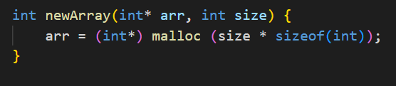
Dynamically Allocate Some other amount?
int newArray(int* arr, int size) { arr = (int*) malloc (size * sizeof(int));
}
The expression inside malloc evaluates to 4 * size = ????
Now arr points to an area of memory where ???? bytes have been allocated
This is equivalent to int arr[????]
Starting to see the use?
Notes:
The last example was a bit contrived
How would we ACTUALLY use it

Slide 13
Validating Memory (in C)

Slide 14
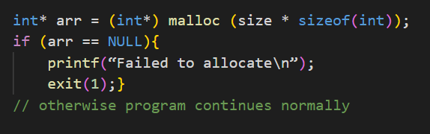
Problems occur!
Dynamically allocating memory does not always work!
We need to be prepared for this
Anytime memory is allocated, if there is a failure, the function returns NULL
We should always check for this
int* arr = (int*) malloc (size * sizeof(int)); if (arr == NULL){
printf(“Failed to allocate\n”);
exit(1);}
// otherwise program continues normally

Slide 15
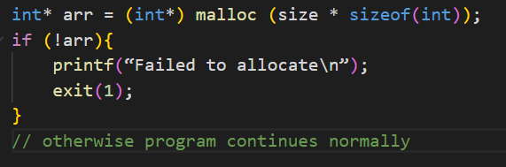
Problems occur!
Just want to make a note of equivalent notation
!arr is the same as arr == NULL, as far as pointers are concered
int* arr = (int*) malloc (size * sizeof(int)); if (!arr){
printf(“Failed to allocate\n”);
exit(1);
}
// otherwise program continues normally

Slide 16
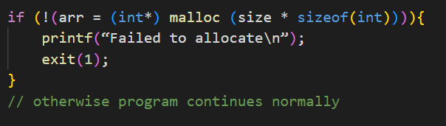
Jamie does it a little funny
Anytime memory is allocated, if there is a failure, the function returns NULL
You might see Jamie evaluate this in a hard to read way
if (!(arr = (int*) malloc (size * sizeof(int)))){
printf(“Failed to allocate\n”);
exit(1);
}
// otherwise program continues normally
Notes:
Putting an expression in an if statement,
The statement evaluates the result of it, including if you do assignment
So to walk you through,
Given that arr points to a piece of memory,
If arr is NULL , then the memory allocation failed, and exit the program

Slide 17
Freeing memory (in C)

Slide 18

The Free Function
free(void * ptr);
Give it the pointer to what you want to free. No need to give it size, type, etc…
Releases the memory acquired so it can be reused later

Slide 19
Key Principle to Remember
However many times you malloc, you need to free that many times.
No. Malloc() = No. Free()

Slide 20
This works the same with all data types
Arrays are arrays, regardless of what is stored in them
Int , char , float , long all act the same with regards to memory management
Structs are no different!

Slide 21
In Summary
Allocate memory dynamically, when required information is given at runtime.
Use Malloc to allocate memory.
Use Pointers to keep track of where the memory sits
Always check if the memory fails
Remember to free, otherwise you will get memory leaks.

Slide 22
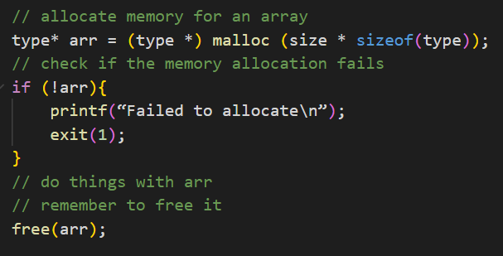
This code goes hard (feel free to sc)

Slide 23
Structs

Slide 24
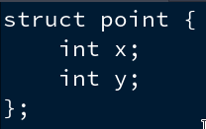
Structures
A structure is a collection of one or more variables, possibly of different types, grouped together under a single name for convenient handling
A basic example of a structure is structure to store a point on a graph i.e. and x and a y value
Structures are defined using the struct keyword

Slide 25
Declaring structures
The struct declaration defines a new type
The variables named in structures are called members
You can declare values to be a structure in the same way as you would when dealing with variables, just make sure to put struct before the name of the structure
You can initialise an instance of a structure with specific values by putting the values in curly braces

Slide 26

Using structures
You can retrieve values from a structure by using the member operator .
Structure-name.member
E.g.
Returns the value 2
As a structure is just some data at a specific place in memory, you can have a pointer to it
If you have a pointer to a structure, you can use the -> operator, which combines dereferencing the pointer and retrieving the value
ptr->y is shorthand for (ptr*).y

Slide 27
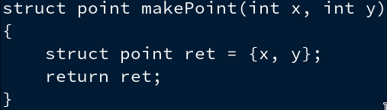
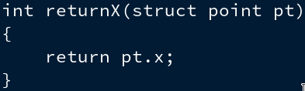
Structures and functions
The only legal operations on a structure are copying it or assigning it as a unit, taking its address with &, and accessing its members
You can’t compare 2 structures to each other using =
Functions can take structures as inputs, and return them as outputs

Slide 28
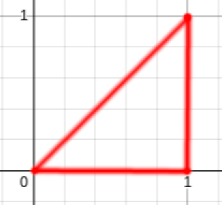
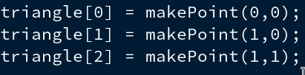
Dynamically allocated array of structures
It is possible to create a dynamically allocated array of structures
Suppose we want an array of 3 length to store 3 points that together represent a triangle
We could declare an array as follows:
We could the put points in the array:

Slide 29
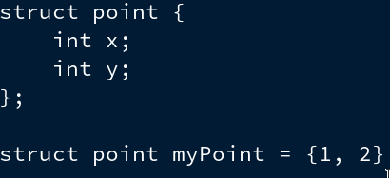
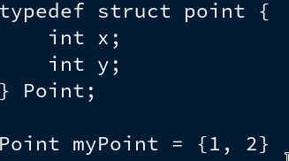
typedef
typedef can be used to create a new data type name for a structure type
It means that you don’t have to write out struct every time you use the structure

