Slide 1
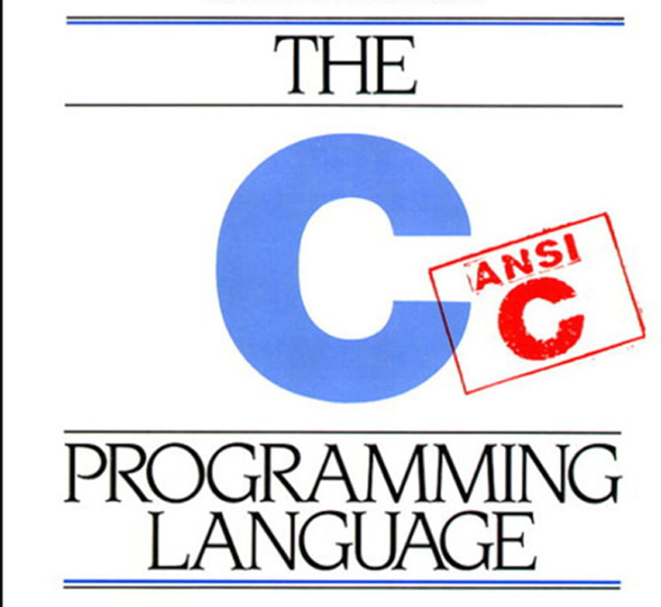
Pointers in

Slide 2
What are pointers?
Answer:
The short answer is: a variable that contains the address of a variable
More specifically: a pointer variable points to a data type (e.g. int, char) of the same type somewhere else in memory
It looks something like the diagram below
Memory Address
Data
Pointer
Variable

Slide 3
How do you use them?
Consider: int x = 1;
You can declare a pointer p to an integer variable: int *p;
The pointer p can then be set to point to the variable x: p = &x
The & is used to find the memory address of the variable x
If you don’t use the & operator, the pointer p would point to the memory address 0x1, instead of the memory address of x
int *p
int x
0x30
1
Address: 0x34
Address: 0x30

Slide 4
Pointer Operations - How do you use them?
Address Operator &
Get’s the address that a variable is stored at
Example Usage
int x = 1;
x // 1 - the value in x
&x // 0x30 - the address of x in memory
Dereference operator *
Gets the value the pointer points to
int x = 2;
int *p = &x;
p // 0x30 - the address (of x) it holds in memory
*p // 2 - the value (of x) it points to
To be clear, printf(“%d\n”, *p) would return 2 and NOT 0x30

Slide 5
Pointer Operations - How do you use them?
& and * are called ‘prefix-operators’, meaning they go before the variable they’re operating on
The dereference operator lets you access and change the data at the memory location stored in the pointer as if you were acting on the variable directly
For our previous example
int x = 2;
int *p = &x;
printf(“%d\n”, *p); // 2
*p = 3;
printf(“%d\n”, x); // 3

Slide 6
Why use pointers?
Pointers make doing some tasks in C easier, whilst for some it’s a necessity. You can’t allocate dynamic memory without them!
They allow you to edit variables inside a function that aren’t local to that function.
Consider a function that increments 2 integers a and b
You can take both values as input parameters, but you would only be able to return 1 value
To solve this problem, instead of returning a new value you can modify the existing values in memory

Slide 7
Why use pointers?
void incrementTwo(int *a, int *b)
{
(*a)++;
(*b)++;
return;
}

Slide 8
Pointers and arrays
Pointers can be set to point to any value in memory, including specific array indices
Consider the array int a[4] = {5,6,7,8};
You can set the value of a pointer p to point to the 1st element: int *p = &a[0];
(Here’s a little secret, arrays are pointers too! So int *p = a; does the same!)
int *p
a[0]
a[1]
a[2]
a[3]
0x50
5
6
7
8
Address: 0x30
Address:
0x50
0x54
0x58
0x5C

Slide 9
Difference between *p++ and (*p)++
++ binds more strongly than *
This means that you have to use brackets to show you want to dereference the pointer first, and then apply the increment after
So what does *p++ do then? AKA *(p++)

Slide 10
Difference between *p++ and (*p)++
++ binds more strongly than *
This means that you have to use brackets to show you want to dereference the pointer first, and then apply the increment after
So what does *p++ do then? AKA *(p++)
POINTER ARITHMETIC!

Slide 11
Pointer arithmetic
If you think about it, a pointer is just a number that represents a memory location you can change add or subtract from it to make the pointer point to a different memory location
When you increment a pointer (of a type) it points to the next address along holding the next value (of the type) in memory.
Some of you might be thinking that different types are different sizes, how does it know how big ‘one space’ really is?
The C compiler knows how big a value of a type is, when you ask it to add ‘one’ it knows how many bytes that refers to get to the next one.

Slide 12
Pointer arithmetic
int *p
a[0]
a[1]
a[2]
a[3]
0x50
5
6
7
8
Address: 0x30
Address:
0x50
0x54
0x58
0x5C
p++;
int *p
a[0]
a[1]
a[2]
a[3]
0x54
5
6
7
8
Address: 0x30
Address:
0x50
0x54
0x58
0x5C

Slide 13
Pointer arithmetic
int *p
p[0]
p[1]
p[2]
p[3]
0x50
5
6
7
8
Address: 0x30
Address:
0x50
0x54
0x58
0x5C
p++;
int *p
p[-1]
p[0]
p[1]
p[2]
0x54
5
6
7
8
Address: 0x30
Address:
0x50
0x54
0x58
0x5C

Slide 14
Pointers and strings
STRINGS ARE ARRAYS OF CHARACTERS
A String Pointer points to the first character in a string. (It holds the address for character 0)
To get to different characters in a string, we implement pointer arithmetic. (string[2] goes to the 2nd index character)
Unless told, we don’t know how long a string is! (or array for that matter)
We don’t want to start accessing unallocated memory, so how do we know where a string ends?
End Character : `\0` (backslash zero in single quotes) indicates the end of a string

Slide 15
Pointers and Strings
int *p
word[0]
word[1]
word[2]
word[3]
word[4]
word[5]
0x50
‘H’
‘E’
‘L’
‘L’
‘O’
‘\0’
Address: 0x30
Address:
0x50
0x54
0x58
0x5C
0x60
0x64
char word[10] = {‘H’, ‘E’, ‘L’, ‘L’, ‘O’, ‘\0’}; char *p = word; int length, i = 0,; while (p[i] != ‘\0’) { i++;} length = i;

Slide 16
Pointers to pointers
As a pointer can hold any address, it can hold the address to another pointer
This means you can chain together pointers
You declare a pointer to a pointer using ** instead of just * - e.g. int **p
N.B. *’s in pointer declarations aren’t the dereference operator, they are just part of the syntax used to define pointers
int **p1
int *p2
int x
0xA0
0xD0
1
Address: 0x30
Address: 0xA0
Address: 0xD0

Slide 17
Multidimensional arrays vs. pointers
Multidimensional arrays allow us to store a sort of “grid” of data instead of a list like one-dimensional arrays.
For example a two-dimensional array of integers, declared as int my_array [3][4]={0,1,2,3,4,5,6,7,8} can be visualised like so
Where you could access the integer 4 with my_array[1][1]
0
1
2
0 1 2
0 | 1 | 2
3 | 4 | 5
6 | 7 | 8

Slide 18
Multidimensional arrays vs. pointers
So what’s the difference between something like int a[10][20]; and int * b[10];?
a is true two-dimensional array with 200 int-sized locations set aside, b has allocated 10 pointers but does not initialise them with values
Each element of b could point to a 20 element array making it technically equivalent to a, but each pointer within b could also point to an array of size 5, 50 or 0.
Basically the advantage of pointer arrays over multidimensional arrays is that you can customise the size of each individual row of elements!

Slide 19
Memory Allocation
Sometimes you have arrays and you don’t know how big it will be until runtime!
You should be doing this next week.
Here you can use malloc.
Quick and dirty template.
int ARRAY_SIZE= 10; int *p; p = (int *) malloc (ARRAY_SIZE * sizeof(int));
free(p); // when you’re done with the array remove it

