Slide 1

PATHSEEKER
APPLIED RESEARCH PROJECT
CSIS 4495
DOUGLAS COLLEGE
Submitted by:
Ajaypal Singh 300370907
Saruchi Sharma 300364537
Submitted to:
Padmapriya

Slide 2

Project Overview
What is PathSeeker?
A mobile app helping users evaluate if their current or future jobs align with their skills, interests, and goals.
Purpose:
To guide users in choosing suited and personalized career decisions.
Target Audience:
Job seekers, career changers, professionals, and students.

Slide 3

Novelty
Combines AI with real-time jobs market data.
Goes through interests and offers skill-job matching
Suggests dynamic career paths and growth recommendations.
Tracks market trends live for accurate guidance.

Slide 4
Utility
Helps users in deciding if they should stay with their job, shift roles, or pursue new opportunities.
Ideal for:
Job changers
Recent Graduates
Professionals seeking jobs
Boosts career satisfaction and planning through data-driven suggestions.

Slide 5
Tech Stack
Frontend: React Native
Backend: Python
AI: Gemini
Database: Firebase
Tools: VS Code, GitHub, Android Studio, Expo

Slide 6
Challenges Faced
Working with new language is always a challenge
Handling bugs and API failure
How to use AI was the biggest challenge
Ensuring accurate skill matching
Creating an intuitive UI/UX
Managing overall running of project

Slide 7
Lessons Learned
Time Management is most important
You should make check list while doing any project
In coding, we learnt a new language i.e. React Native
Practical use of AI in real-world apps

Slide 8
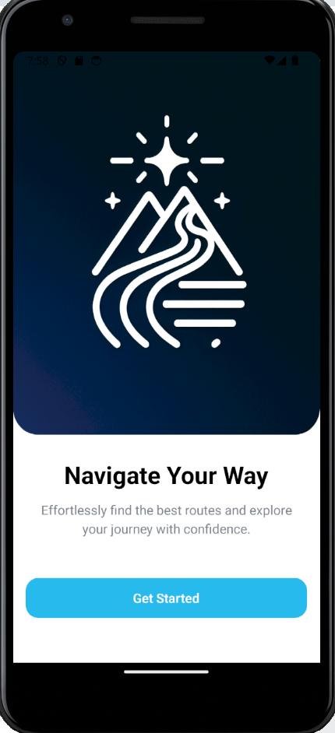
Some Snapshots of Working Application
This is the main landing page where user will start the app

Slide 9
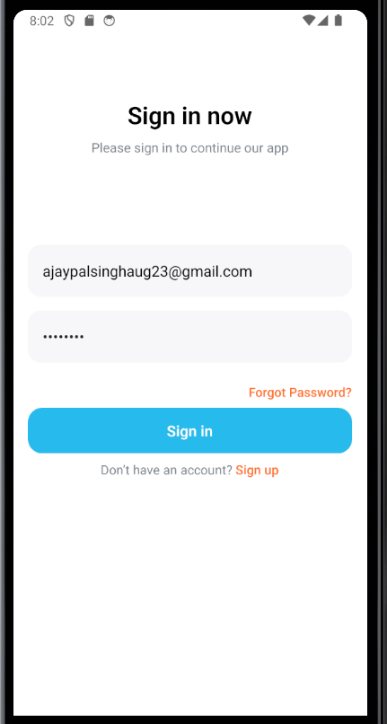
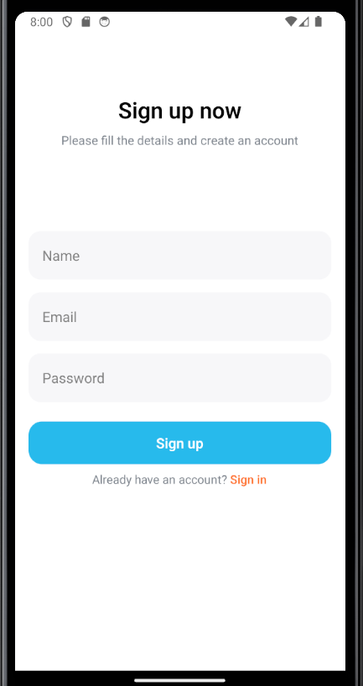
Signup and Sign in Page
Here the new users will sign up and only existing users can sign in which will are saved in the Database

Slide 10
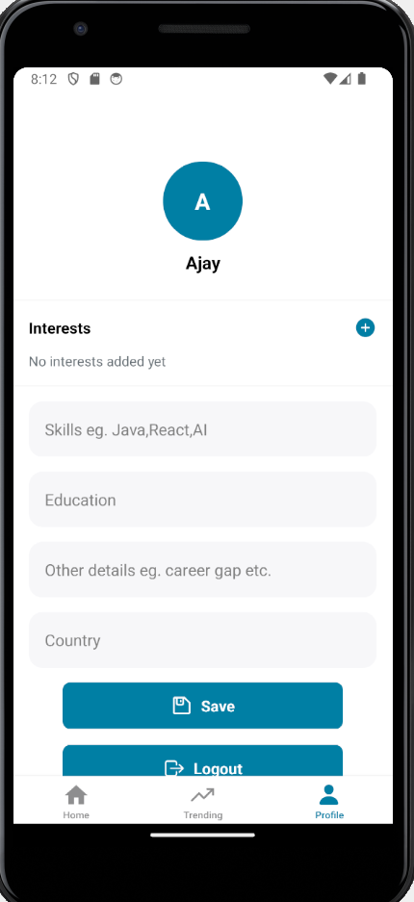
Profile Page
This is the Profile where users can choose interests and fill in other details
Users can also logout from here.

Slide 11
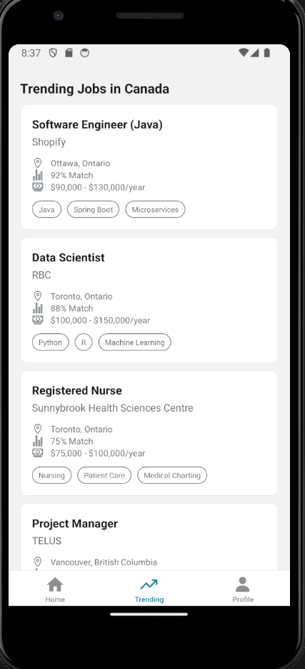
Trending Page
This is the trending page which will show the most trending jobs in particular Country

Slide 12
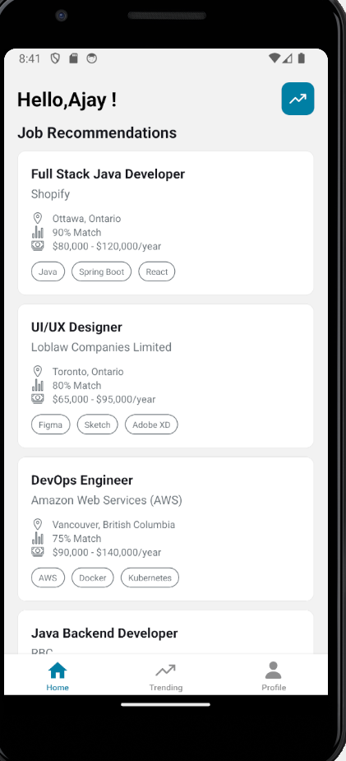
Job Recommendations Page
This is the Home Page of app which shows the recommended jobs according to data filled in Profile page.

Slide 13
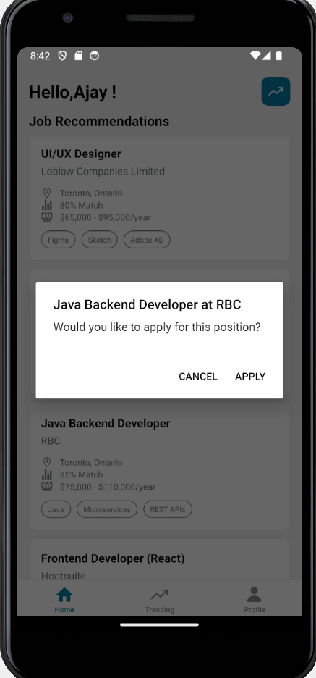
Apply option
If user click on any job, it will prompt an option to apply or cancel, if user click on apply it will open the URL of the job and user can directly apply the job on portal

Slide 14
SUMMARY
PathSeeker empowers users with smart, data-driven career guidance.
Built with AI market insights.
Aims to help users make confident and better job decisions.

Slide 15
Thank You!
Live Demo Coming Up

