Slide 1

Moosic
Asli
Rasika
Osveh

Slide 2
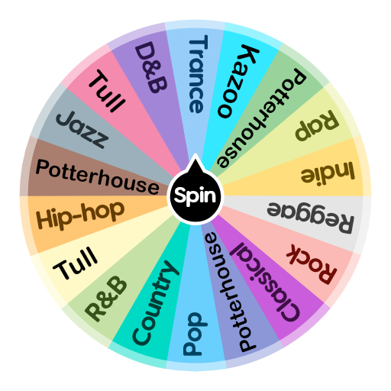




Introduction
Notes:
Moosic creates playlists curated by music experts and specialists in old and new trends.
Spotify provides about its audio features.

Slide 3
Open Questions
Is K-Means a good method to create playlists?
Are Spotify’s audio features able to identify “similar songs”, as defined by humanly detectable criteria?

Slide 4
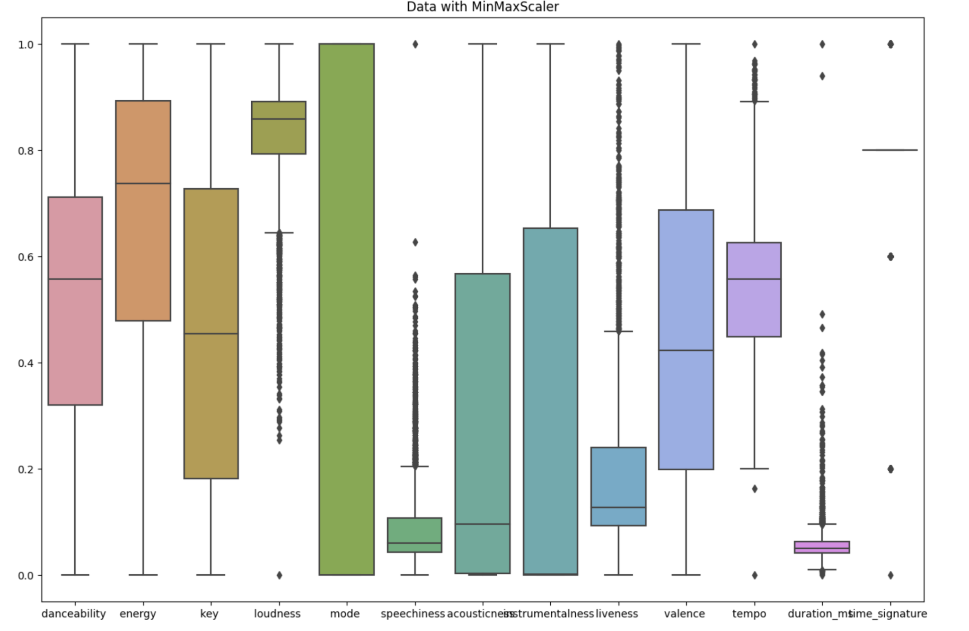
Features
Notes:
Box plot

Slide 5
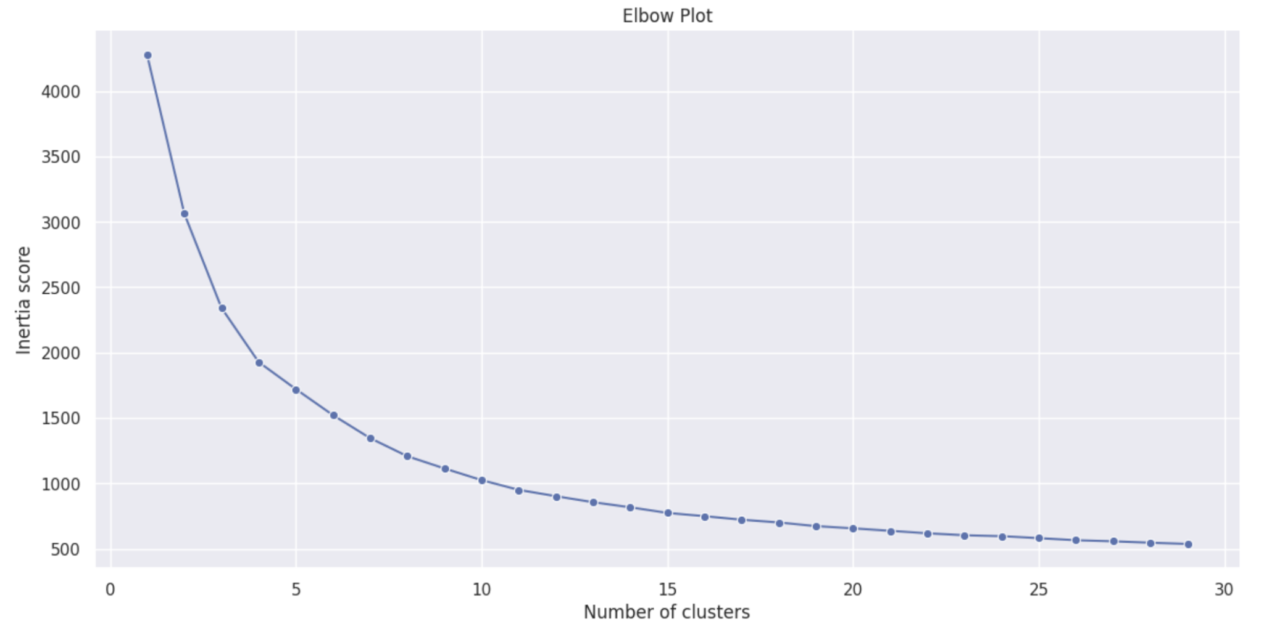
Clusters - I

Slide 6
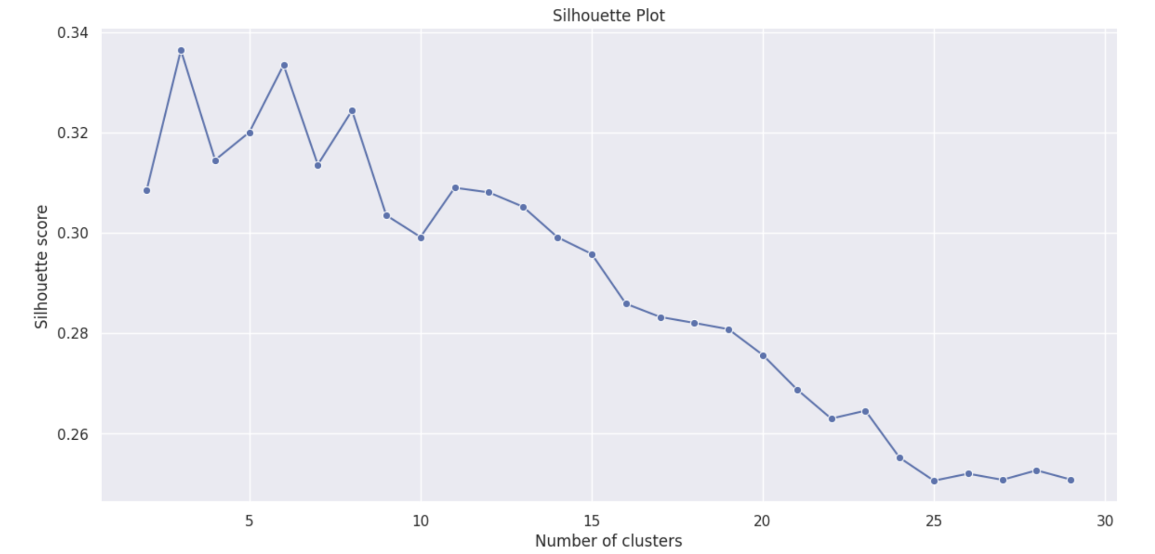
Clusters - II

Slide 7
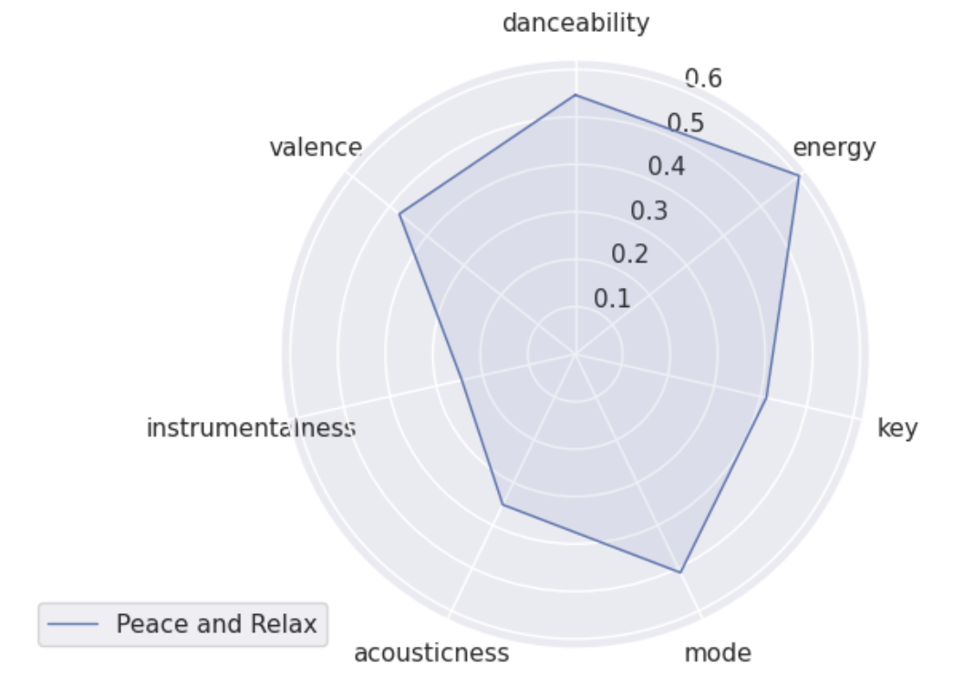
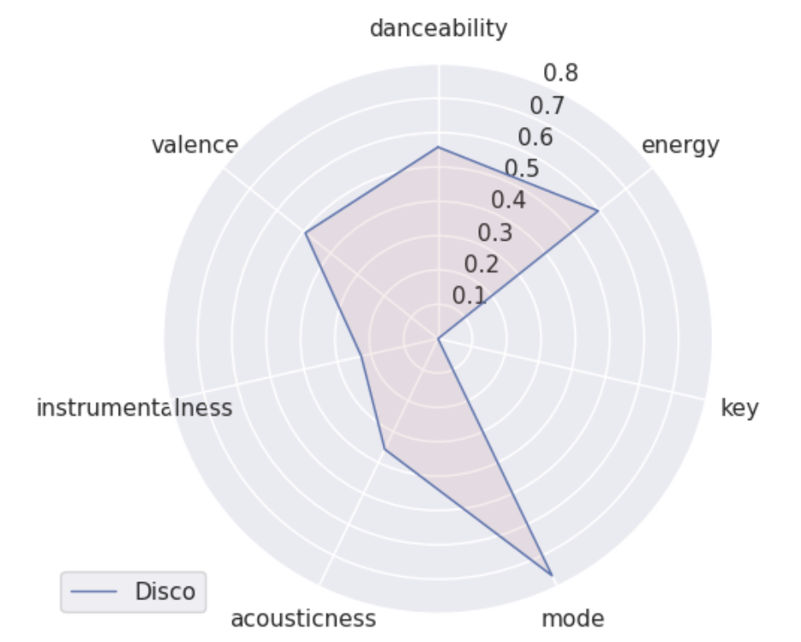
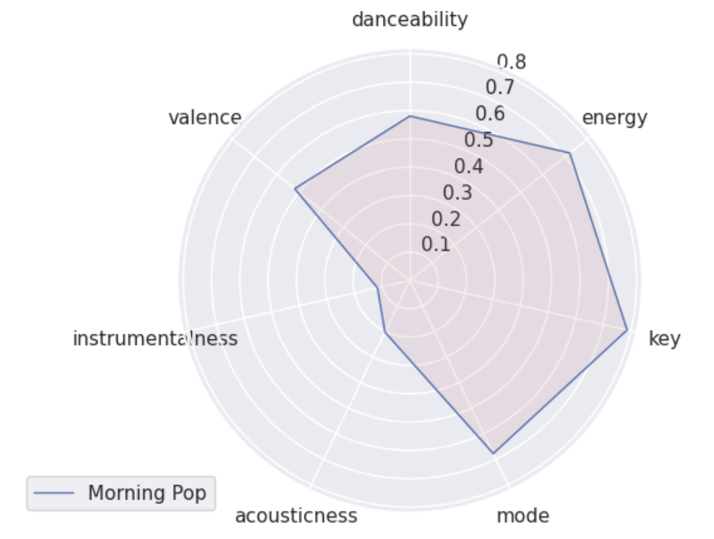
Playlists
Notes:
Notice they are on different scale. (Finding the mood based on listen to music in this 3 clusters and see the genre of music in internet)

Slide 8
Q1: Is K-Means a good method to create playlists?
Limitations of K-means:
Limited capture of musical diversity:
What about subjective/humanly measures?
Sensitivity to initialization
Our first centroids can jinx the results.
Notes:
K-means clustering is a popular unsupervised machine learning algorithm utilized for grouping similar data points. In our context, it has been employed to cluster Spotify tracks based on various audio features such as tempo, danceability, and energy. However, while K-means provides a foundation for playlist generation, it alone may not deliver fully satisfactory outcomes.
K-means clustering operates solely on the given audio features, potentially overlooking other crucial aspects that contribute to a satisfying playlist, such as genre, mood, and artist information.
But “genre, mood, and artist” all can be engineered into our systems in the future.
K-means is sensitive to the initial centroids, which can lead to different clustering results. This variability may affect the quality and consistency of the generated playlists.

Slide 9
Suggested supplementary methods for K-Means
Collaborative Filtering:
By incorporating collaborative filtering techniques, we can leverage user preferences and behavior to personalize the generated playlists. This method takes into account the listening habits and history of individual users, leading to more tailored and satisfying recommendations.
Content-Based Filtering:
Content-based filtering involves analyzing the intrinsic characteristics of the tracks themselves. By considering additional features such as lyrics, acoustic properties, and music genres, we can enrich the clustering process, allowing for a more comprehensive representation of user preferences.
Hybrid Approach:
Combining both collaborative filtering and content-based filtering can exploit the strengths of each method. This hybrid approach enables us to leverage both user data and track features, providing a well-rounded and more accurate playlist recommendation system.

Slide 10
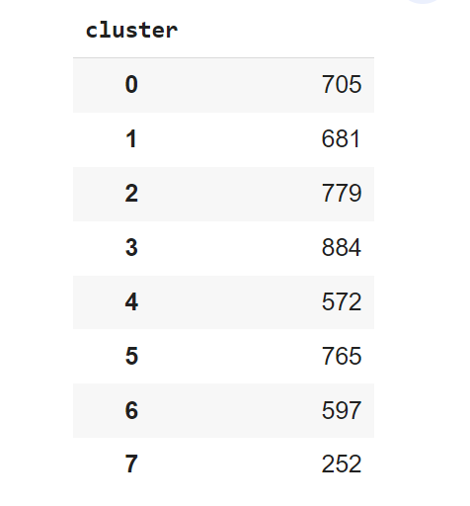
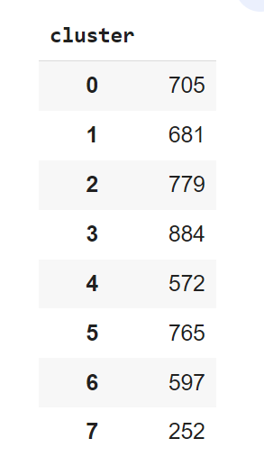
Q2: Are Spotify’s audio features able to identify “similar songs”, as defined by humanly detectable criteria?
K-Means
PCA
Notes:
While these audio features quantitative insights, they may not fully capture subjective elements like personal preferences, emotional nuances, or contextual interpretations of similarity. Human perception of similarity can also be influenced by factors such as lyrics, melody, artist style, and cultural context, which are not explicitly captured by Spotify's audio features. Therefore, while Spotify's audio features are a valuable tool for quantifying certain aspects of similarity between songs, they should be considered as one factor among several when determining similarity or relatedness in a more holistic and humanly detectable sense.
30% of all plays on Spotify are generated from editorial playlists, according to Jeremy Erlich (Head of Music Strategy) in an interview he gave to Forbes in 2020.

Slide 11
Conclusion
K-means clustering – valuable starting point!
Improvements possible:
Account for subjective measures
30% of all plays on Spotify are generated from editorial playlists (Forbes, 2020)
Filtering
collaborative filtering (to elevate user preferences)
content-based filtering (track properties e.g. genre, year of released, …)
hybrid approach
Notes:
K-means clustering - valuable starting point for music playlist generation, it is essential to acknowledge its limitations and explore supplementary methods for optimal results. By incorporating 123 we can overcome these limitations and offer users a more satisfying and personalized music playlist experience.
Collaborative Filtering:
By incorporating collaborative filtering techniques, we can leverage user preferences and behavior to personalize the generated playlists. This method takes into account the listening habits and history of individual users, leading to more tailored and satisfying recommendations.
Content-Based Filtering:
Content-based filtering involves analyzing the intrinsic characteristics of the tracks themselves. By considering additional features such as lyrics, acoustic properties, and music genres, we can enrich the clustering process, allowing for a more comprehensive representation of user preferences.
Hybrid Approach:
Combining both collaborative filtering and content-based filtering can exploit the strengths of each method. This hybrid approach enables us to leverage both user data and track features, providing a well-rounded and more accurate playlist recommendation system.

Slide 12
Thanks for listening!

