Slide 1


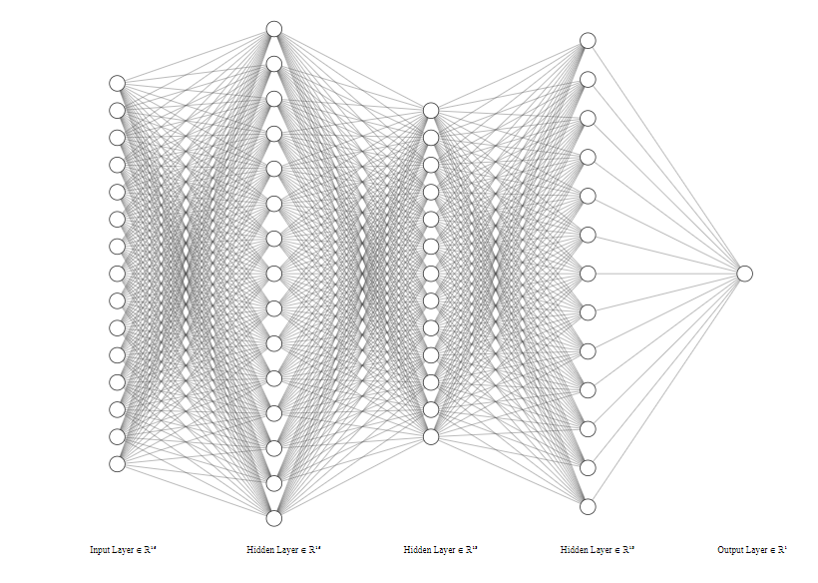

CARDIOVASCULAR DISEASE PREDICTION
V Sreejith | C Sudarshan | M Sukul
Dr. Tanveer Ahmed
Abstract
The main objective of our project is to predict if a person has a chance of getting a cardiovascular disease based on the person’s medical examination readings (Age ,BMI , Blood pressure , Cholesterol etc).
Introduction
The human cardiovascular system is made up of the heart and blood vessels. Cardiovascular disease (CVD) is a set of disorders related to the heart and blood vessels .Annually large number of people die from CVD . Globally it is the number one cause of death.
The most common cardiovascular disease is coronary artery disease, which can lead to heart attacks , chest pain or stroke. Diagnosing the heart condition of the patient is a challenging task . Heart diseases are diagnosed from the signs , symptoms and physical examination of the patient. There are several factors that increase the risk of heart disease, such as smoking habit, body cholesterol level, obesity, high blood pressure, and lack of physical exercise.
A major challenge faced by health care organizations, such as hospitals and medical centres, is the provision of quality services at affordable costs. Our project aims to predict the presence of cardiovascular disease in a person using important features .
Neural Network model with 5 layers
Experimental Results and Discussion
We trained our model using the Cardiovascular Disease dataset from Kaggle which consists of 70,000 records .
We achieved an accuracy of 73% with almost all Machine Learning Models and Artificial Neural Networks.
We analysed the data in the dataset and pre processed the data by removing duplicate entries , removing outliers in the dataset , removing abnormal entries ,one hot encoding categorical variables .
The processed dataset had about 40,000 records.
Various Machine Learning Models like Logistic Regression, Random Forest etc and Artificial Neural Networks were applied on the processed dataset .
We achieved an accuracy of 83.7% in Random Forest Classifier and an accuracy of 83.6% in Artificial Neural Networks.
Proposed Method
Traditional Machine Learning Models :
Logistic Regression
Support Vector Machine
K Nearest Neighbours
Random Forest
Decision Tree
Multi Layer Perceptron
Ensemble Techniques used :
1. Max Voting
2. Stacking
3. Bagging
4. Boosting
Neural Networks:
Artificial Neural Network with 5 layers
Conclusions
In this project , we developed a model for predicting cardiovascular disease based on a given dataset. We achieved an accuracy of 83% using various Machine Learning Models and Artificial Neural Network Models.
References
[1] https://www.kaggle.com/sulianova/eda-cardiovascular-data
[2] https://www.kaggle.com/ronitf/predicting-heart-disease
[3] https://machinelearningmastery.com/

