Slide 1


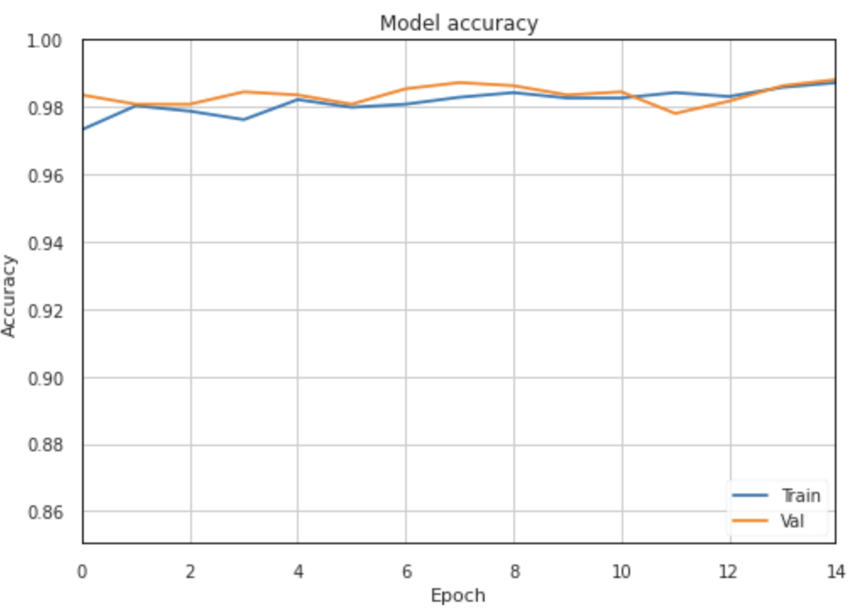
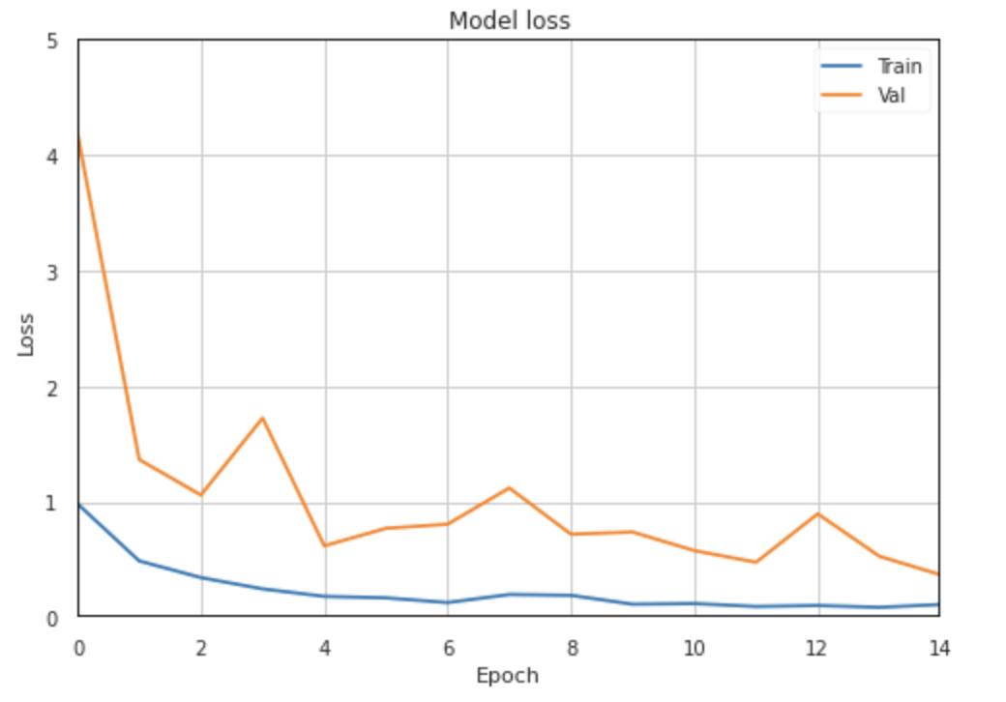
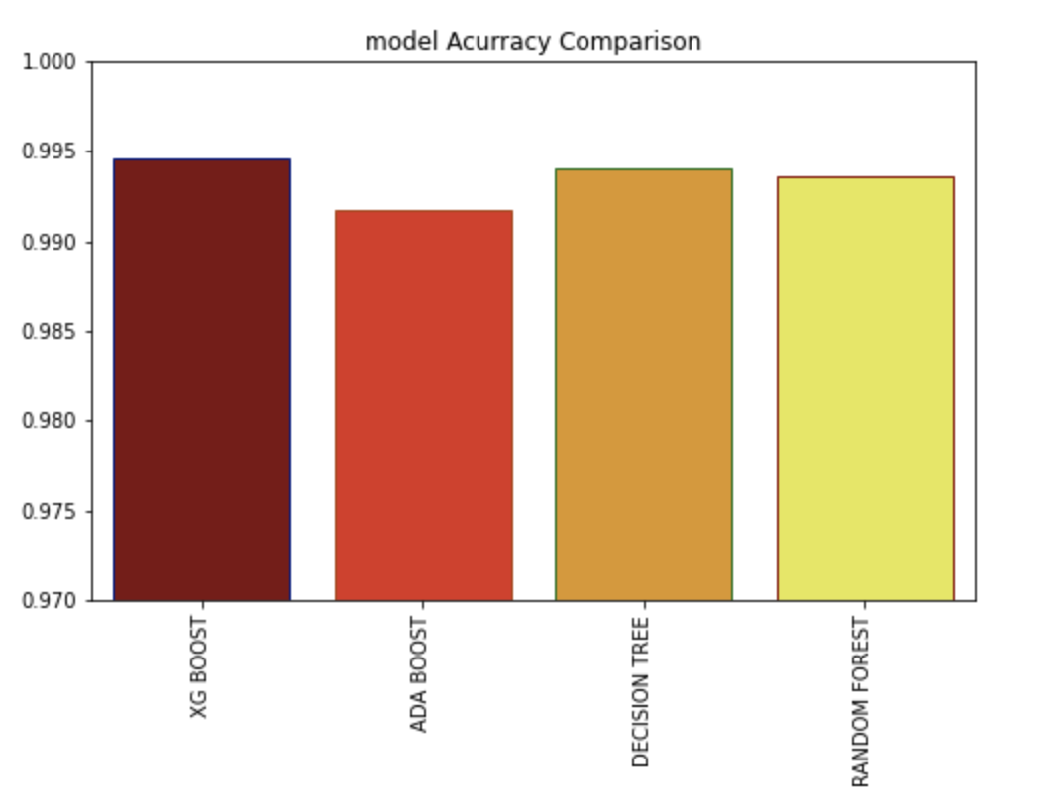

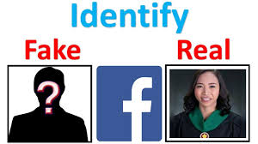


Detecting Fake Profiles On Social Media
Umita Deepak Joshi , Vanshika, Ajay Pratap Singh, Tushar Rajesh Pahuja ,
Mentors: Dr. Gaurav Singal, Smita Naval
Abstract
1- Accuracy graph of Neural Network
Accuracy: 98.2%
Epochs: 15
2- Loss graph of Neural Network
Loss: 0.11
Epochs: 15
3- Comparison of different model accuracy
XG Boost: 99.46%
ADA Boost: 99.10%
Decision Tree: 99.40%
Random Forest:99.3%
Social media is an integral part of our lives, yet it posses some problems. Hence, today we discuss detecting a social media profile as real or fake. Here we first, provide the introduction to social media then list the models used. Further, we discuss the results, and finally, we state the conclusion and future work.
Introduction
Social media has become a vital part of our lives. From sharing attractive extravagant photographs to follow celebrities to chat with close and far away friends, everyone is active on social media. It is a great platform to share information and interact with people.
But everything has a downside. Every social media platform is facing the problem of fake profiles these days.
The goal behind creating fake profiles is mainly spamming, phishing, and obtaining more followers. The malicious accounts have full potential to commit cyber crimes.
Conclusions
1- Implemented various Supervised Learning Algorithms
and Neural Network .
2- Highest Accuracy was given by XG Boost Algorithm.
3- Limitations : ➢ Works only on visible data
➢ No real time application
4- Future work can be assembling a real-time model
by including other parameters.
Proposed Method
Artificial Neural Network:
We used a multi layer neural network.
Activation function: ReLU and Sigmoid
Optimiser: Adam
Extreme Gradient Boosting(XGBoost):
Uses stochastic gradient boosting algorithm
LSTM Network:
This a type of recurrent neural network.
Classifies based on tweets.
References
Gergo Hajdu, Yaclaudes Minoso, Rafael Lopez, Miguel Acosta, Abdelrahman Ellei- thy: Use of Artificial Neural Networks to Identify Fake Profiles.
Est ́ee Van Der Wal: Using Machine Learning to Detect Fake Identities: Bots vs Humans.
Aleksei Romanov, Alexander Semenov, Oleksiy Mazhelis and Jari Veijalainen: De- tection of Fake Profiles in Social Media.
Stefano Cresci, Roberto Di Pietro, Marinella Petrocchi, Angelo Spognardi, Maur- izio Tesconi: Fame for sale: Efficient detection of fake Twitter followers
https://play.google.com/store/apps/details?id=com.twitter.android&hl=en_IN
Experimental Results and Discussion
Team No. - 5

