Slide 1


FLU SHOT LEARNING: PREDICT H1N1 AND SEASONAL FLU VACCINES
Srividya Inampudi Dr. Kuldeep Chaurasia
Greshma Johnson
Jay Jhaveri
Niranjan.S

Slide 2
Introduction
The H1N1 Flu that came into existence in 2009 in the U.S. and spread to the rest of the world had a great impact on the lives of people around the world.
Since it continues to circulate seasonally worldwide vaccination was the first and most important step to be carried out .
So a vaccination campaign was organized by the United States government and it was monitored by the National 2009 H1N1 Flu Survey (NHFS) .
In this paper, we use the data from the survey to develop a model that predicts how likely people got H1N1 and seasonal flu vaccine.

Slide 3
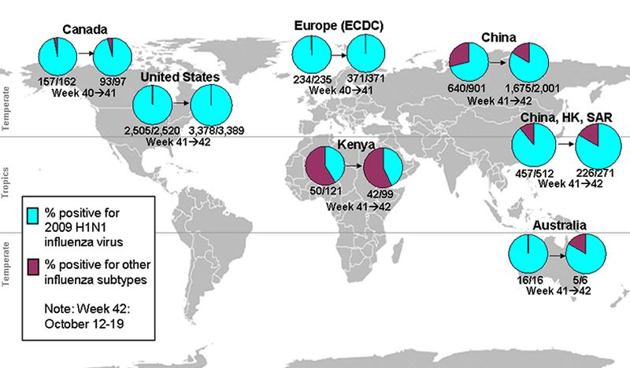
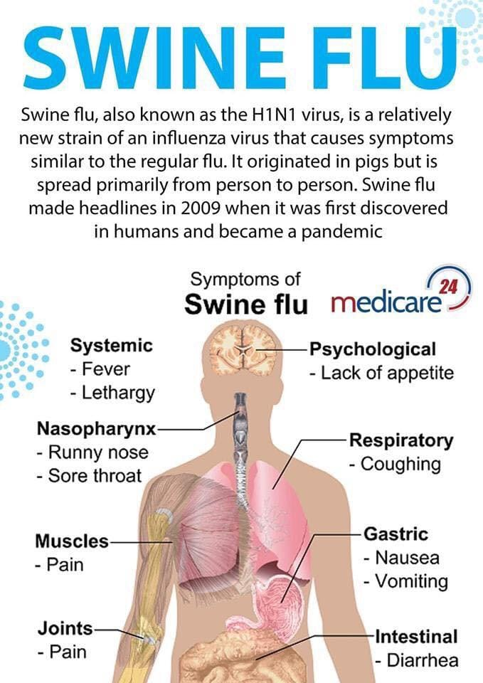


Slide 4
Dataset Used
The dataset used is from the National 2009 H1N1 Flu Survey (NHFS).
The survey was conducted since the 2010-11 influenza season by the Centers for Disease Control and Prevention (CDC).
Its main aim was to monitor and evaluate H1N1 flu vaccination efforts among adults and children.
It provides us details like flu-related behaviors, opinions about flu vaccine safety and effectiveness, recent respiratory illness, and pneumococcal vaccination status in addition to H1N1 and seasonal flu vaccination status of adults and children.

Slide 5
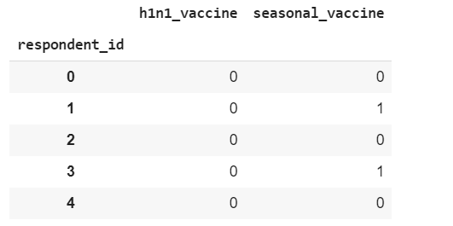
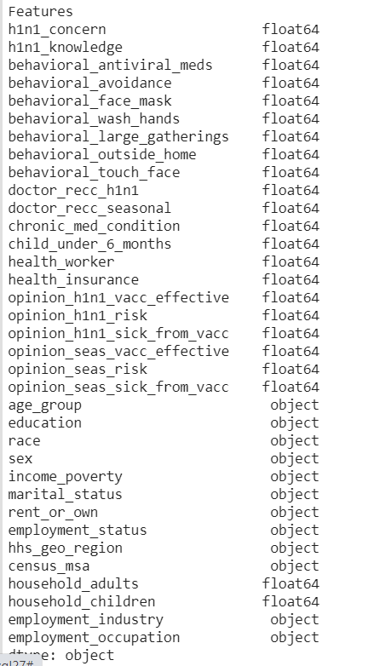
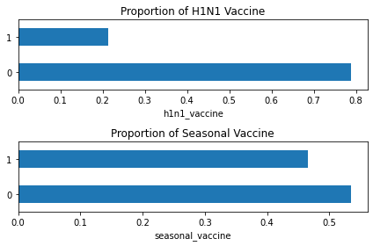
Training Set and Test Set Features
Training Set Labels
Proportion of people received
H1N1 vaccine and Seasonal Flu Vaccine

Slide 6
Methodology / Model Used
Scikit-learn, an open-source Python library is used which allow us to implement many machine learning, pre-processing, cross-validation and visualization algorithms.
We have used Linear regression, Support Vector Regression, Random Forest Regression, Logistic Regression, Ridge Regression, K Nearest Neighbors, and XGBoost.
Finally we used Artificial Neural Network (ANN) with different optimizers such as Adam, RMSprop, SGD.
The best results we got were from executing ANN.

Slide 7
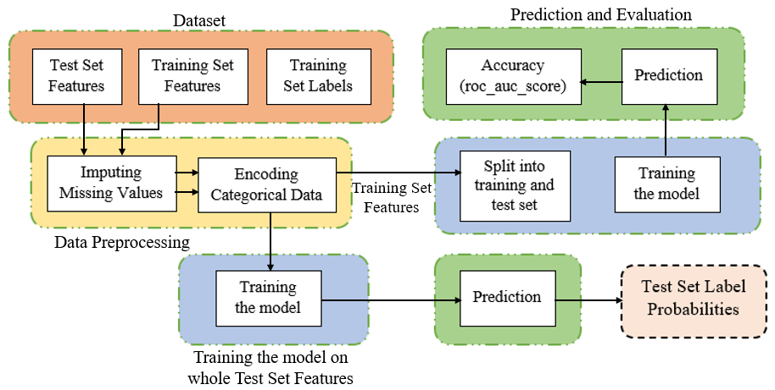
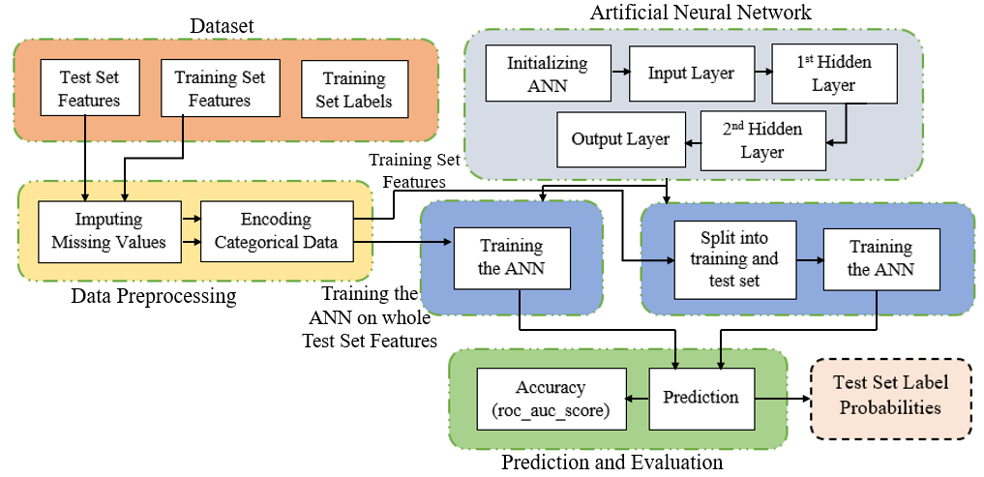
System Architecture of Machine Learning Models
System Architecture of Artificial Neural Network

Slide 8
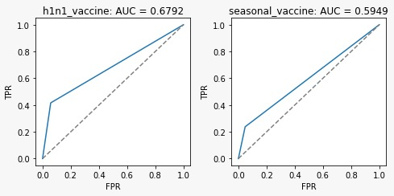
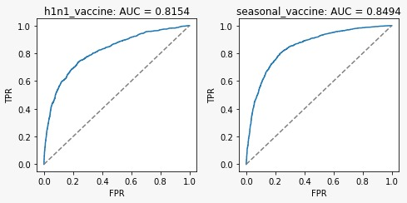
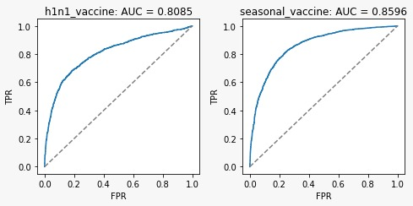
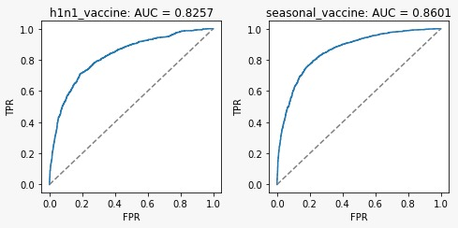
Results Achieved
Best test Accuracy is achieved by the ANN Model with accuracy of 82.57% for H1N1 and 86.01% for seasonal flu.
Logistic Regression
Random Forest
SVM RBF
Best Model: -Artificial Neural Network (ANN)
Model | H1N1 Flu Score | Seasonal Flu Score
svm | 0.8085 | 0.8596
random_forest | 0.8154 | 0.8494
logistic_regression | 0.6792 | 0.5949
ANN | 0.8257 | 0.8601

Slide 9
Future Research Scope and Conclusion
In future with advancements in technology the quality and the quantity of data could increase which could result in better performance and analysis of the issue. More information about the seasons, especially non-pandemic seasons could be very helpful for our analysis of this project.
In future we also look forward to exploring more machine learning algorithms, methods and deep learning techniques so that we can obtain more optimal results.
Prediction of H1N1 vaccine is done best by the help of SVM model with RBF kernel using hyperparameter tuning and seasonal flu vaccination prediction is done best with Artificial neural network.
In has been observed that hyperparameter tuning yielded better results for H1N1 flu vaccination prediction.
For Seasonal flu vaccination prediction hyperparameter tuning didn’t obtain expected accuracy hence we conclude that ANN have worked best for Seasonal flu vaccination prediction.

Slide 10
References
2009 H1N1 Flu ("Swine Flu") and You, Centres for Disease Control and Prevention, February 10, 2010. Accessed on: May 22, 2020. [Online]. Available: https://www.cdc.gov/h1n1fl u/qa.htm/h1n1flu/diagnosis/
2009 H1N1 Flu, Centres for Disease Control and Prevention, August 11, 2010.Accessed on: May 22,2020.[Online].Available: https://www.cdc.gov/h1n1fl u/
J. Huang, T. Lin, W. Chang and W. Hsieh, "Aptamer-modified CNTFET biosensor for detecting H1N1 virus in droplet," The 4th IEEE International NanoElectronics Conference, Tao-Yuan, 2011, pp. 1-2, doi: 10.1109/INEC.2011.5991640.

Slide 11
Thank You

