Slide 1


HUMAN INTERACTION WITH NAO HUMANOID
[Jashwanth .D, Indraneel .S, Supriya .R, Shashank Yadav ] [Mentored By: Tapas Badal]

Slide 2
Introduction
NAO is a Humanoid Robot developed by Softbank Robotics and built with the help of artificial intelligence
In order to achieve the ability of the NAO to communicate with humans and help the people to get navigated to places in an organization. The techniques we used,
Face Detection
Speech Recognition
Movements

Slide 3
Methodology / Model Used
The ability of the Nao Humanoid to communicate with humans is achieved with the help of CHOREGRAPHE .
CHOREGRAPHE is a sort of stimulator and using the internet connection the choregraphe can be connected to the NAO Humanoid in order to change the NAO Humanoid’s Behaviour.
CHOREGRAPHE contains dialog boxes which is responsible for each and every action done by NAO.

Slide 4
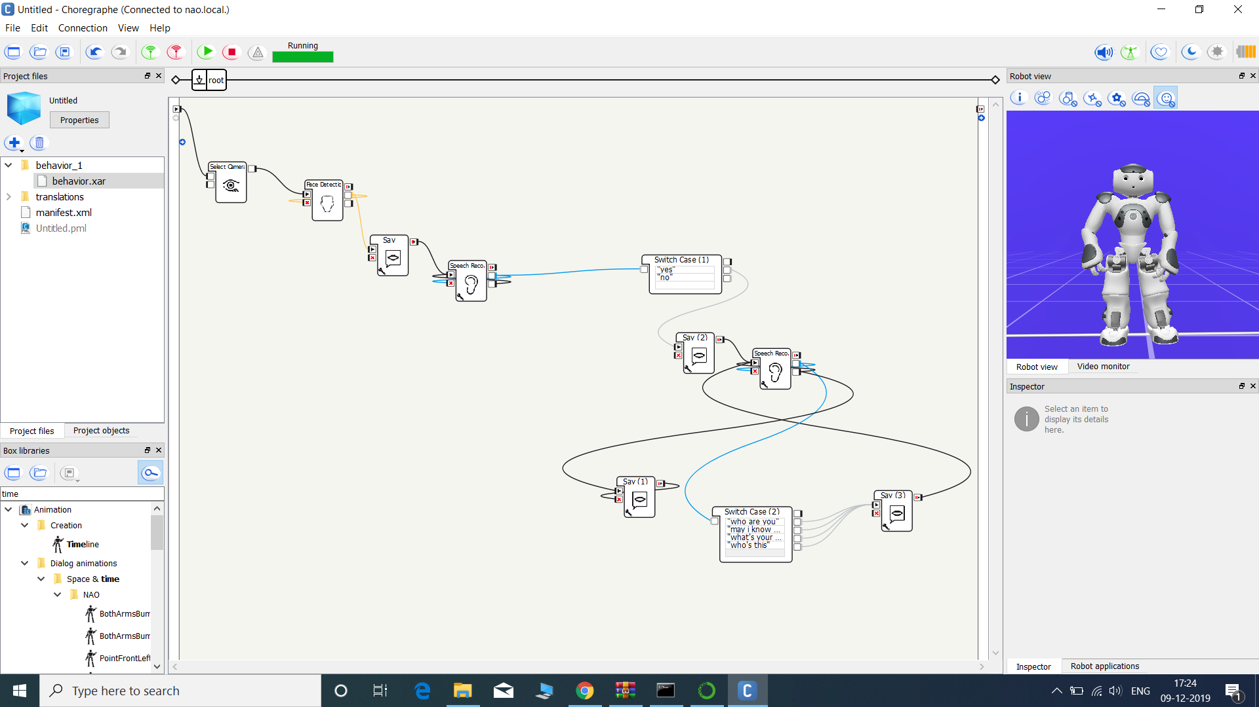
Methodology / Model Used
The Dialog boxes in the choregraphe are built based on Python Scripting Language.
The Sample appearance of the Choregraphe is given below:

Slide 5
Results Achieved
The NAO Humanoid is stimulated in such a way that it can interact with people and attend to visitors and deal with the inquiries. Supply the information regarding the organization to general public, clients and customers.

Slide 6
Conclusion
The NAO robot is able to interact with its clients as a receptionist.
The limitation in our project is that the NAO Humanoid can only respond to questions asked in English.
The further implementation and advancement of this project is to make the NAO communicate in different languages.

Slide 7
References
D.Gouaillier, V.Hugel, P.Blazevic, C. Kilner, P.Lafourcade, B.Marnier,…B. Maisonnier, “The NAO humanoid: a combination of performance and affordability” 2008, pp.1-10.
D. Maisonnier et al., “Mechatronic design of NAO humanoid” IEEE international conference on Robotics and Automation, Japan, 2009, pp.769-774.
D.Gouaillier, C.Collette and C.Kilner,”Omni-directional closed-loop walk for NAO”,10th IEEE-RAS International conference on Humanoid Robots, 2010, pp. 448-454.
S.K.Yun and A.Goswami, “Hardware experiments of humanoid robot safe fall using Aldebaran NAO” IEEE International conference on Robotics and Automation, 2012, pp.71-78.
L.Ismail et al, “Face detection technique of humanoid robot NAO for application in Robotic Assistive Therapy”, IEEE international conference on Control system, Computing and Engineering, 2011, pp.517-521.
http://doc.aldebaran.com/21/home_nao.html

Slide 8
Video Reference
https://youtu.be/Vv2CgmbBPAA

Slide 9
Thank You

