Slide 1


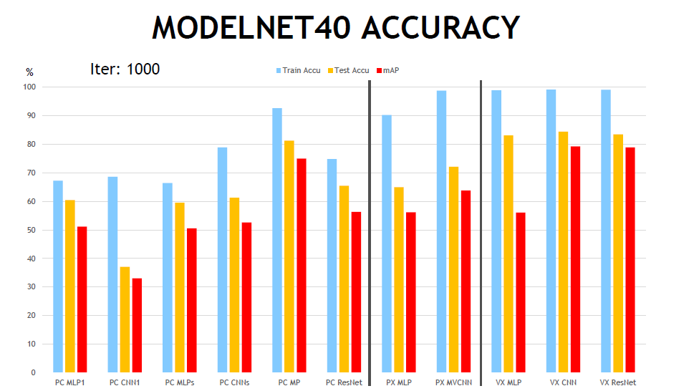
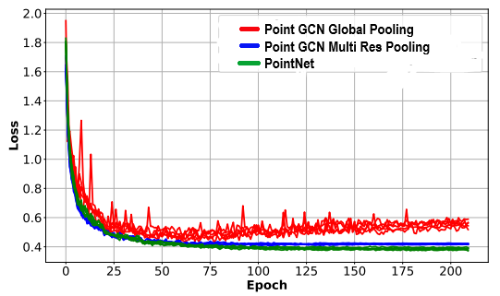
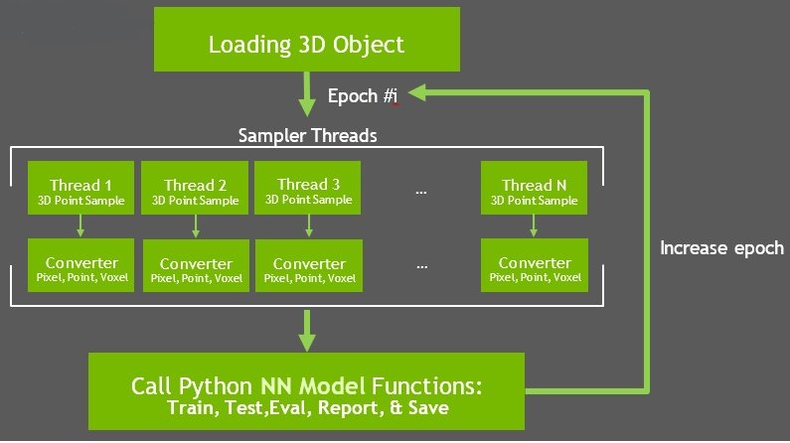
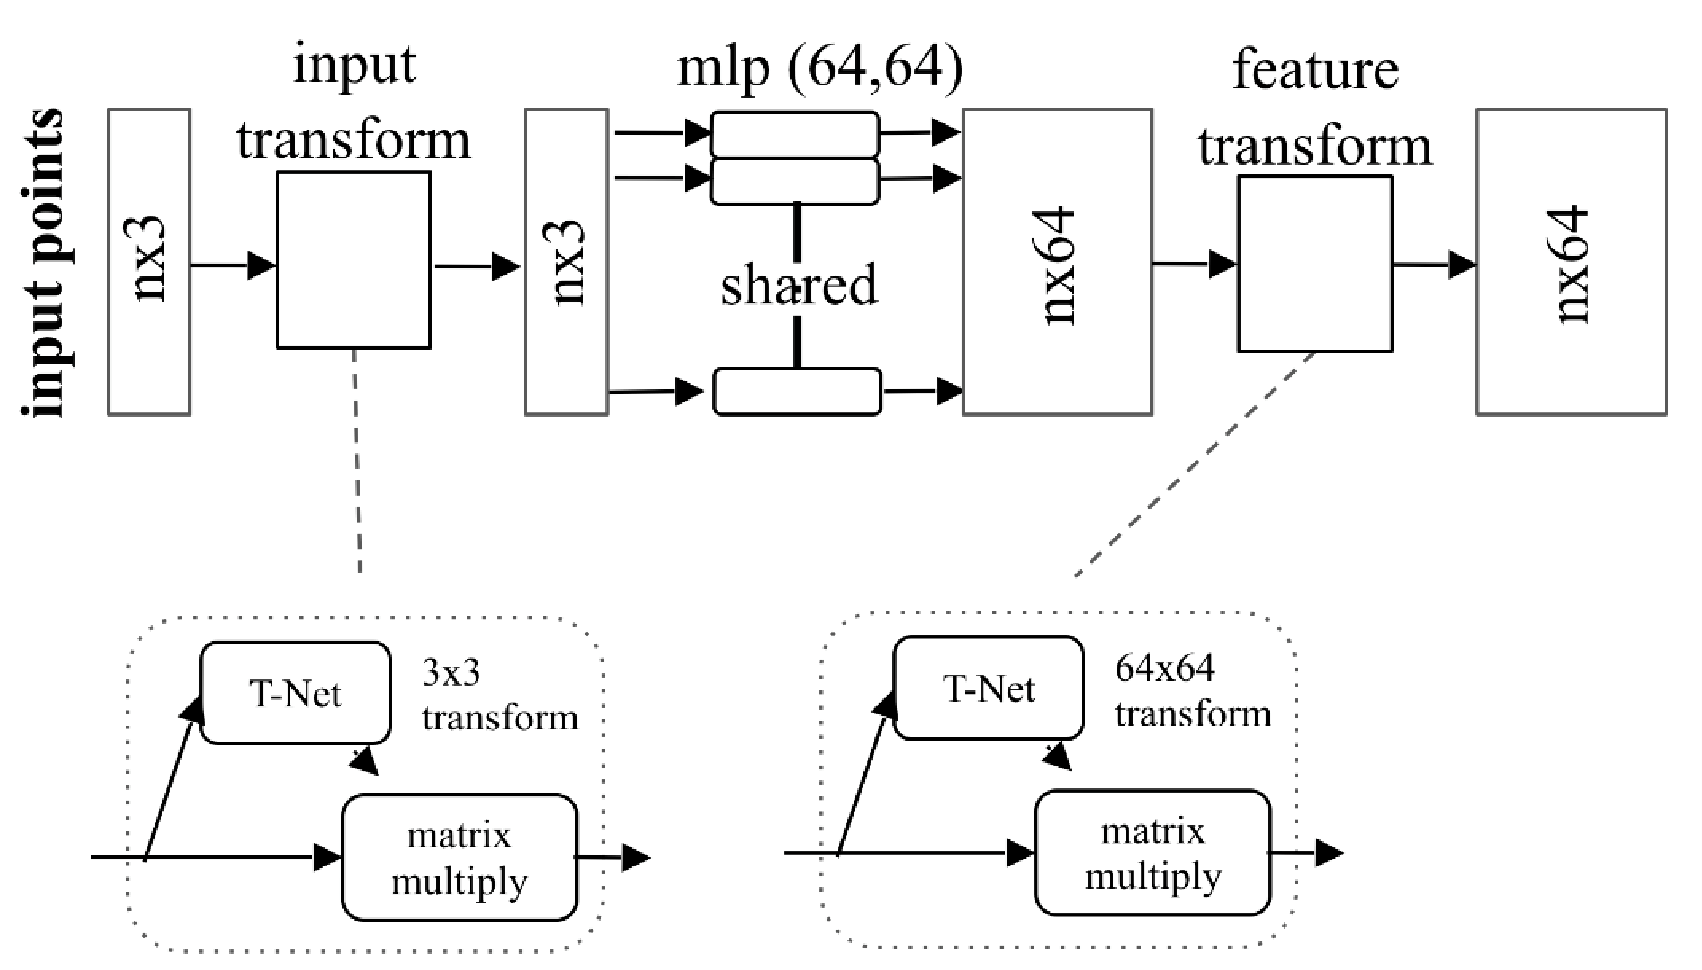
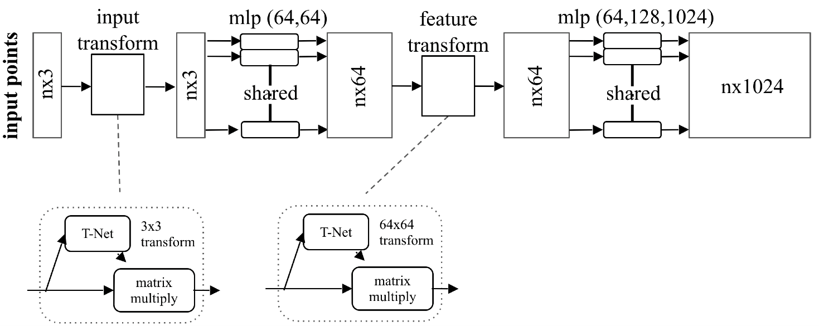
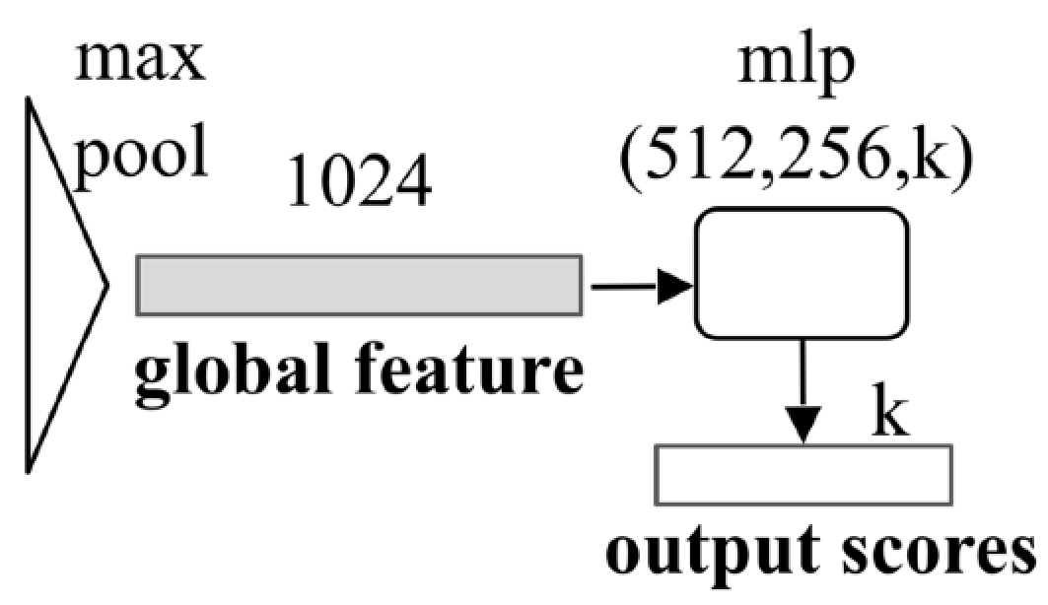

SEMANTIC LABELLING OF 3D POINT
Akhil Krishna ​
Jyoti Kumari​
Priyanshi Chirania​
Tanmay Pachpande​
Dr. Suneet Kumar Gupta
Mr. Sahibnoor
Mr. Yash Raj Saxena
Abstract
3D Point Cloud is a way of generating 3 dimensional data(x,y coordinates are generated as in 2D approach and z is generated by rotating the model by 30 degrees along the gravity direction) using LIDAR sensor.
3D object classification approaches are getting more attentions.
For this approach we used a special type of Neural Network called PointNet.
Used in variety of applications such as robot perception,augmented reality and autonomous cars.
Introduction
In this Project,we want to solve Semantic Labelling Of Each 3D Point on the 3D domain and try to achieve human level accuracy using PointNet Neural Network.
There was no data for the 3D image classification a few years ago, now with the increase in demand, the data is being generated by using sensors like LiDAR and Depth Sensors.
The most commonly used approach for this problem is transforming the point cloud data into 3D voxel grids. This renders data unnecessarily voluminous and causes issues. Our network, PointNet directly consumes point clouds. PointNet is highly effective and efficient.
PointNet architecture can able to learn directly from unordered point clouds.
Thread 3
Proposed Method
We propose a novel type of neural network(PointNet) that directly consumes point clouds(set of points) without voxelization or rendering.
The PointNet architecture learns both local and global features providing a simple,efficient and effective approach for a number of 3D recognition tasks.
Conclusions
The idea of 3D Object classification or processing can be used to solve many real-life problems due to which this project has some future work which can be done by increasing the number of classes and converting a real-life image and converting into a 3D Point Cloud which can actually solve many problems like object detection and all. 3D point cloud classification is a paramount job with applications in robotics, AR (augmented reality) and urban planning.
Experimental Results and Discussion
We evaluate our algorithm on ModelNet40 dataset for 3D Object Classification in which there are 12,311 CAD models of 40 different categories. Which we have divided into 9,843 for training and 2,468 for testing. The best accuracy is obtained once the model is trained till 40 epochs. We get the accuracy of every class in the dataset ModelNet40. The images of the same are attached.
References
http://stanford.edu/~rqi/pointnet/docs/cvpr17_pointnet_slides.pdf
https://github.com/maggie0106/Graph-CNN-in-3D-Point-Cloud-Classification - classification project using Graph CNN
https://github.com/charlesq34/pointnet - classification and segmentation using PointNet
Team No. - 31

