Slide 1
Blockchains
405530008 姚馭博
405530027 郭鋒驛
405530038 陸柏宏

Slide 2
Categories
Introduction
Features
Security
Example
Question & Answers

Slide 3
Introduction
NOT a single innovation technology
Cryptography, Mathematics, Algorithm, Economic Model, and uses peer to peer Internet.
Base on the mathematic can establish trusts, and even don’t need the based on mutual trust.

Slide 4
Features
Decentralization
Openness
Self-governing
Tamper resistant
Time stamps

Slide 5
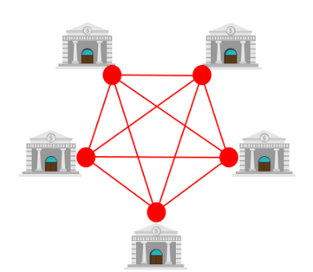
Decentralization
Distributed Architectures
Everyone is both communicator and verifier

Slide 6
Openness
Block Chain’s system is public
Data and source code is also in public
ONLY private in node’s private key

Slide 7
Self-governing
Rules
Freedom, Safety, Accessibility
Human-Human -> Human-Machine

Slide 8
Tamper resistant
Based on hash function & Asymmetric encryption
Information integrity

Slide 9
Time stamps
Stored all history data
Last part has the hash value from the front

Slide 10
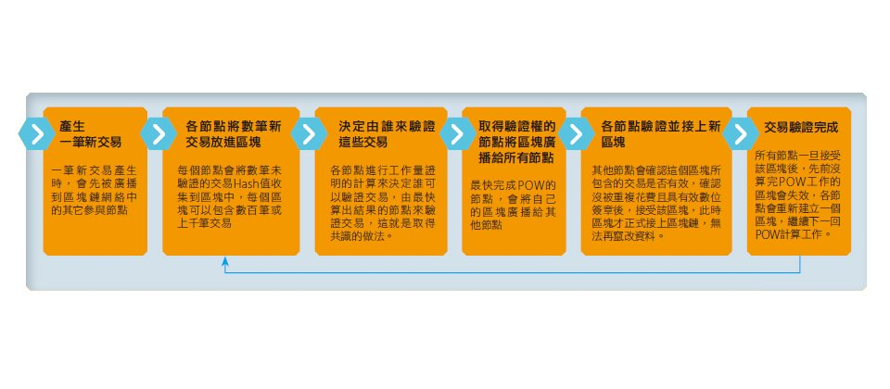
Transactions
Exchange occurred
All nodes take hash value in the block
Decide who to verify the transaction
Broadcasts the block to all nodes
Verify and chain the new block

Slide 11
Blockchain Security
Hash uniqueness
Cryptographic security
Authentication
Decentralized distributed design
Transmission security

Slide 12
Hash uniqueness
Each block and hash is a one-to-one correspondence
Each hash is calculated from the block header by SHA256

Slide 13
Cryptographic Security
All data storage and records have digital signatures as credentials, asymmetric encryption guarantees the reliability of payments

Slide 14
Authentication
All data transfer will be verified
Find the last transaction to confirm the currency source
Calculate the fingerprint of the other party's public key and compare it with its address to ensure the authenticity of the public key
Unwrap digital signature using public key to ensure authenticity of private key

Slide 15
Decentralized distributed design

Slide 16
Transmission security
In the process of transmission, data is processed using HTTP+SSL to ensure that data is protected from tampering and encryption during network transmission.

Slide 17
Question
Answer
A. What is the main feature of the block chain?
Decentralization
B. Block Chain is a single innovation technology (T/F)
F
C. What is the virtual currency apply on block chain?
Bitcoin

Slide 18
Reference
https://www.ithome.com.tw/news/105373
https://www.hbrtaiwan.com/article_content_AR0007296.html
Template : FPPT.com

Slide 19
Thanks For Listening

