Slide 1
Blockchain
405530008 姚馭博
405530027 郭鋒驛
405530038 陸柏宏

Slide 2
Categories
Introduction
Features
Security
Example
Question
Answer

Slide 3
Introduction
Blockchain is not a single innovation technology
Cryptography, Mathematics, Algorithm, Economic Model, and uses peer to peer Internet.
Base on the mathematic can establish trusts, and even don’t need the based on mutual trust.

Slide 4
Features
Decentralization
Public Ledger
Tamper resistant
Time stamps
Confliction resolution

Slide 5
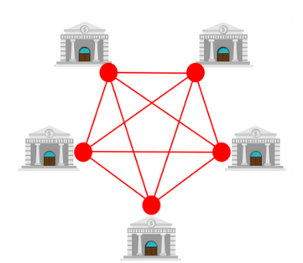
Decentralization

Slide 7
Question
A. What is the main feature of the block chain?
B. Block Chain is a single innovation technology (T/F)
C. What is the virtual currency apply on block chain?

Slide 8
Answer
A. Decentralization
B. F
C. Bitcoin

