Slide 1



Continuous Integration / Continuous Testing
Seminary Part

Slide 2
Concept
You are going to act as a true Software Engineer in a DevOps environment (“DevOps Engineer” – in marketing terms)
Based on a given architecture you are going to juggle between all the DevOps main functional areas (System Administration, Infrastructure, Platform and Site Reliability Engineering) and set-up from scratch the necessary tools and a Continuous Delivery System on top.

Slide 3
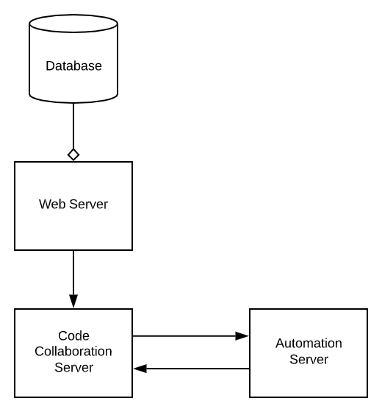
Arch – Infrastructure

Slide 4
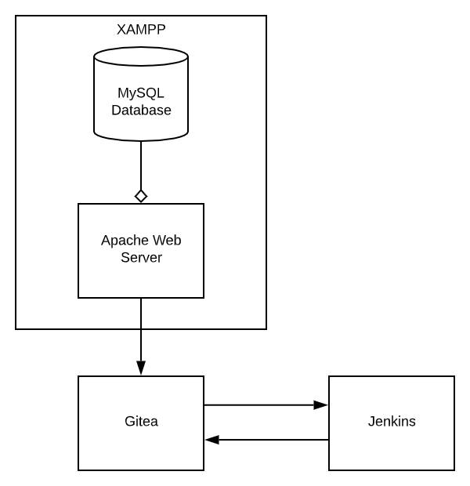
Arch – Infra – Toolchain

Slide 5
1st Part: System Administration Ops (SysOps)
Purpose: install and set-up the necessary tools
Points: 1 / 5

Slide 6
Resources
Python 3.x installed
https://www.python.org/downloads/
Git installed
https://git-scm.com/downloads
Gitea: https://github.com/go-gitea/gitea/
Windows: https://github.com/go-gitea/gitea/releases/download/v1.9.4/gitea-1.9.4-windows-4.0-386.exe
Linux: https://github.com/go-gitea/gitea/releases/download/v1.9.4/gitea-1.9.4-linux-386
XAMPP: https://www.apachefriends.org/
Windows: https://www.apachefriends.org/xampp-files/7.3.10/xampp-windows-x64-7.3.10-0-VC15-installer.exe
Linux: https://www.apachefriends.org/xampp-files/7.3.10/xampp-linux-x64-7.3.10-0-installer.run
Jenkins: https://jenkins.io/
Windows: https://jenkins.io/download/thank-you-downloading-windows-installer-stable
Linux: https://pkg.jenkins.io/debian-stable

Slide 7
File System Layout
Create the following directory structure either in your main Drive on Windows or in your user home space on Linux
D:\cd-seminary
├───code
└───infra
├───gitea
├───jenkins
└───xampp

Slide 8
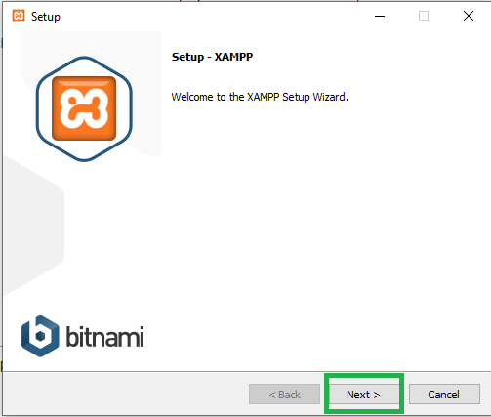
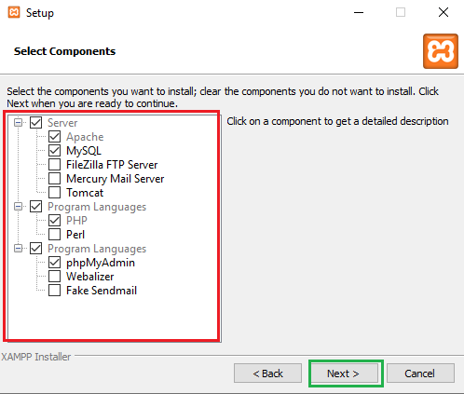
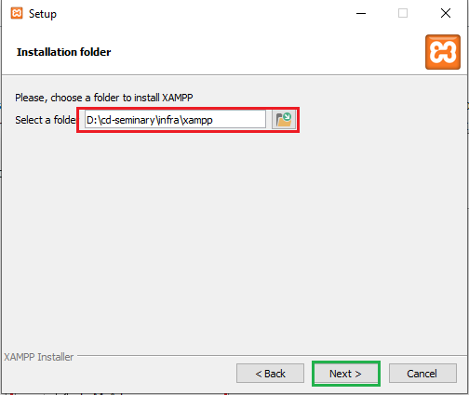
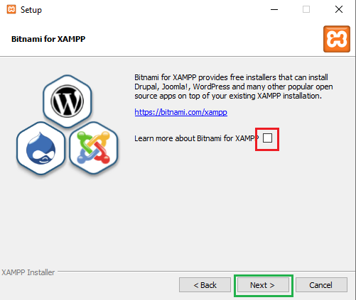
XAMPP Installation
Please follow the same steps to avoid issues! Install only selected applications like in the print screen!

Slide 9
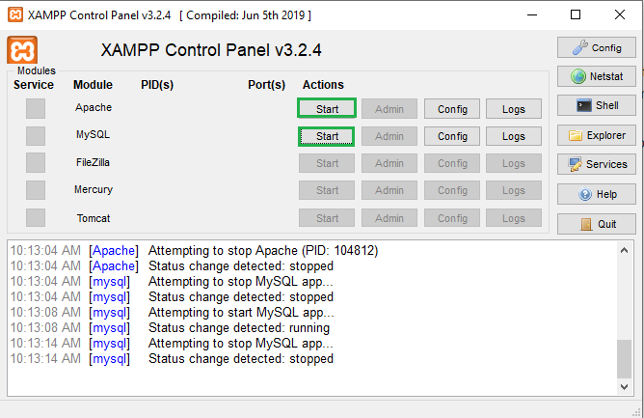
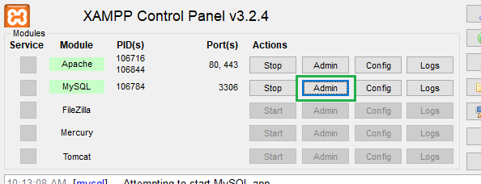
XAMPP Bring-up
Start the Apache Web Server & MySQL Database
Now access MySQL via the phpMyAdmin interface
A new tab into your default browser should be open on http://localhost/phpmyadmin/

Slide 10
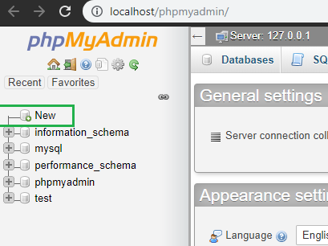

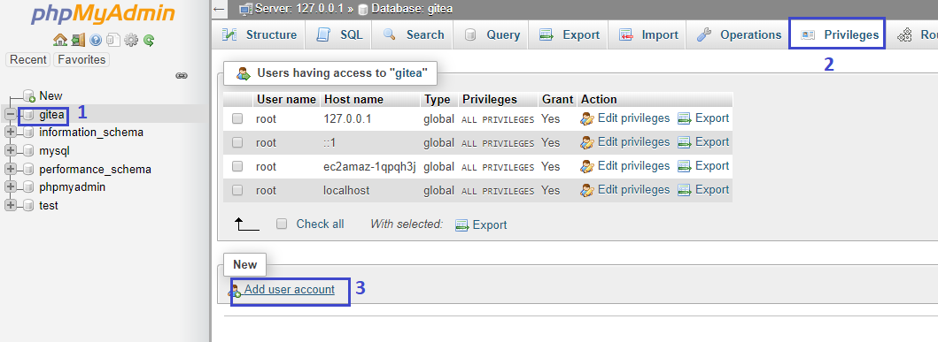
MySQL set-up
A new database has to be created in order to be populated with tables by the Gitea server.
A separate user has to be created to be used by the Gitea server

Slide 11
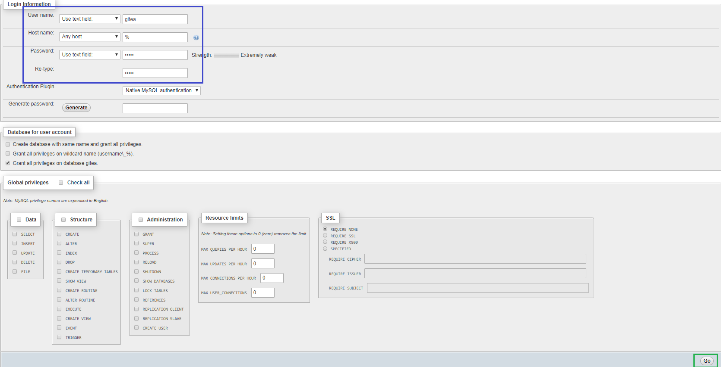
username: gitea | password: gitea

Slide 12
Gitea Bring-up
Copy the Gitea binary (.exe) into cd-seminary/infra/gitea and run it.
After the initialization, Gitea should be up on localhost:3000, open the page in a browser.
Click on either one of the Register or Sign In buttons for the Initial Configuration
Proceed by filling the fields as shown in the next pages

Slide 13
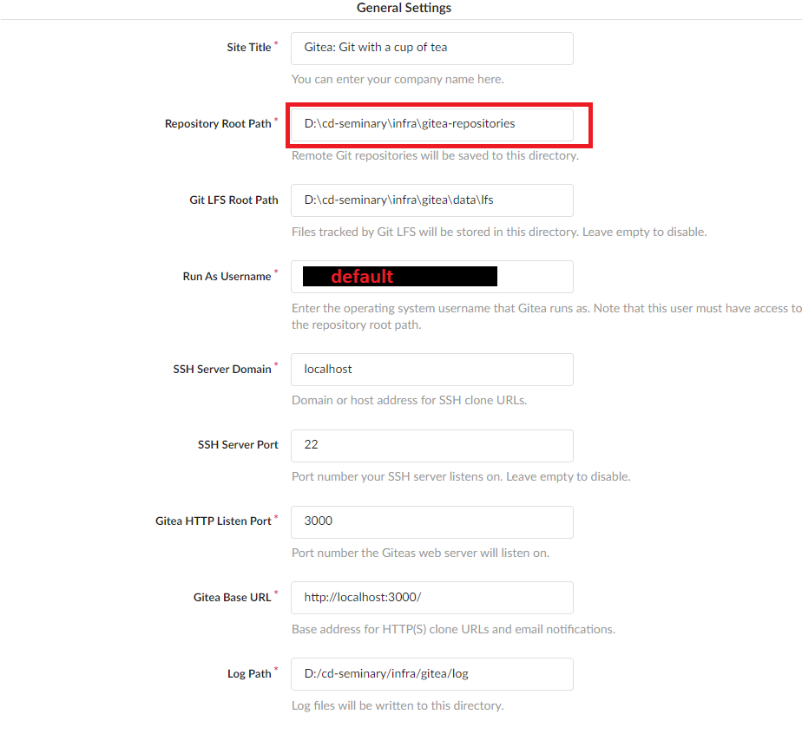
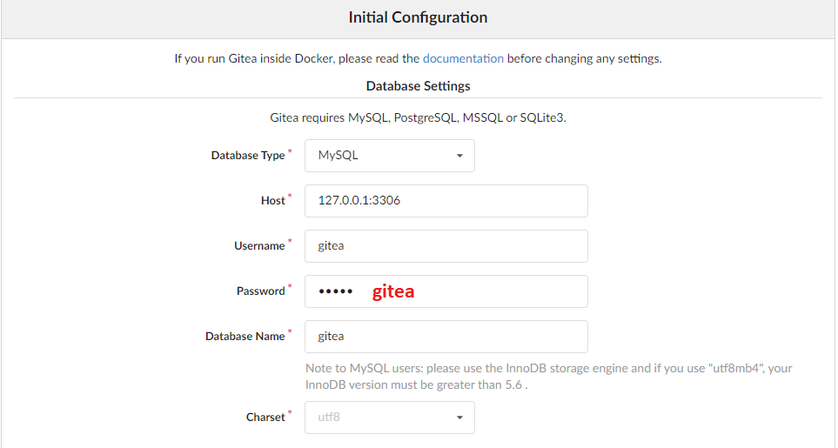
Part 2 / 3
Part 1 / 3

Slide 14
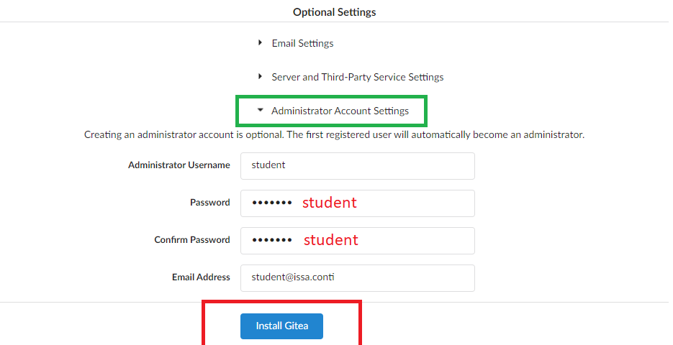
Part 3 / 3

Slide 15
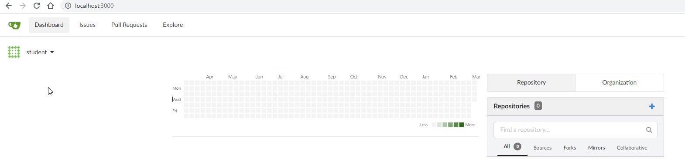

Slide 16
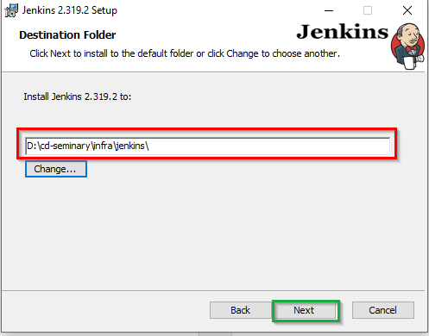
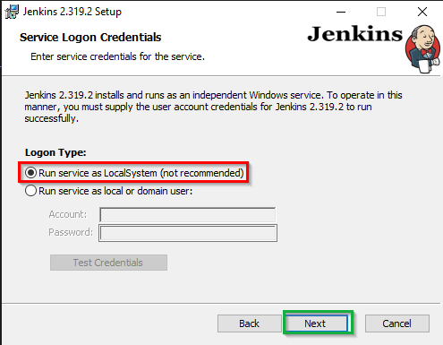
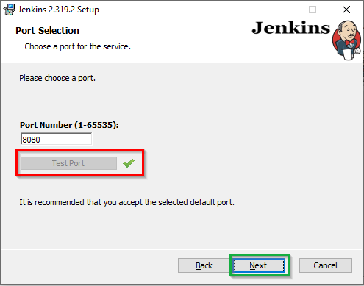
Jenkins Bring-up
Run the Jenkins binary and proceed to install it as shown in the next images.
During Jenkins installation, you can test the port. If it is already used, please deactivate that application from services.msc
After the installation ends. Jenkins will be available at localhost:8080

Slide 17
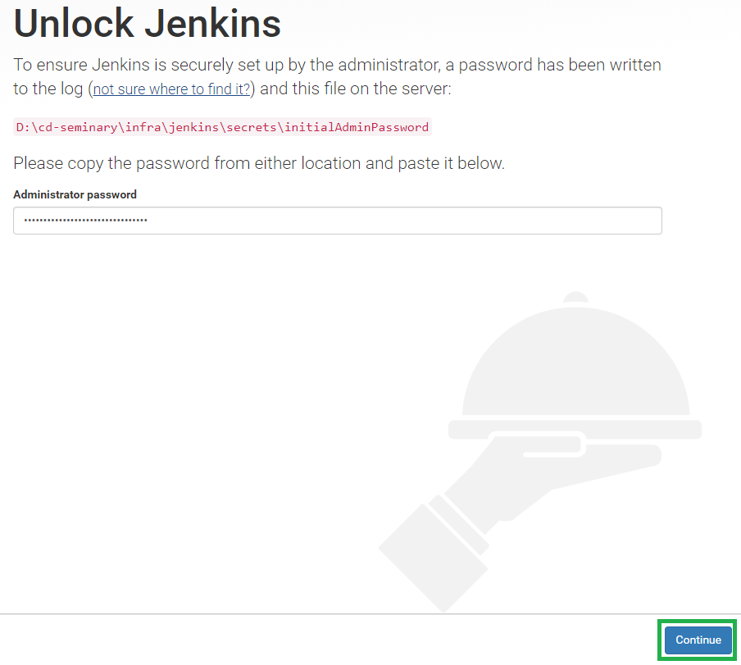
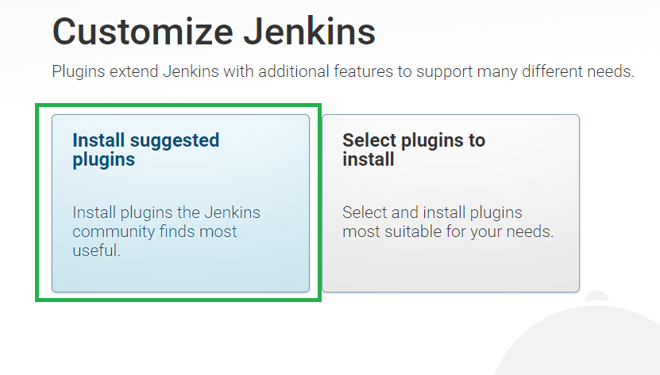
If you encounter an error installing plugins, see links below:
https://www.phpflow.com/misc/devops/how-to-manually-install-jenkins-plugin/
https://www.jenkins.io/doc/book/installing/offline/

Slide 18
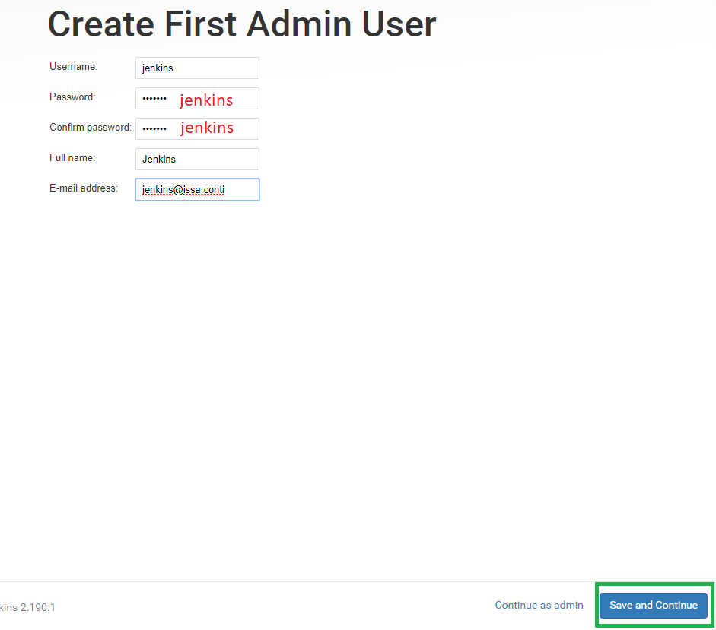
Keep the defaults on the next step
Save & Finish
Jenkins should be up and you should be logged in with the ‘jenkins’ account

Slide 19
2nd Part: Infrastructure Ops (InfraOps)
Purpose: Set-up the needed configurations that link the tools in between.
Points: 1 / 5

Slide 20
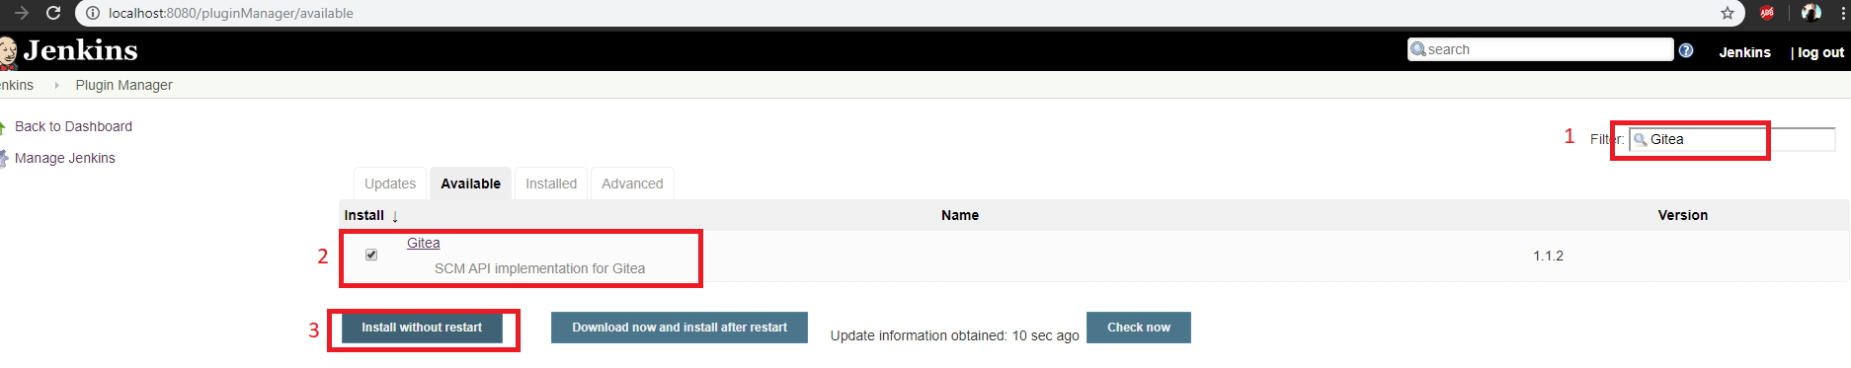
Install Gitea Jenkins plug-in
Access Jenkins pluginManager service and check for Gitea and install it. http://localhost:8080/pluginManager/available

Slide 21
Perform a Jenkins Safe Restart
Access http://localhost:8080/safeRestart
Click on Yes
Wait for the restart
Log in again (user: jenkins, password: jenkins)

Slide 22
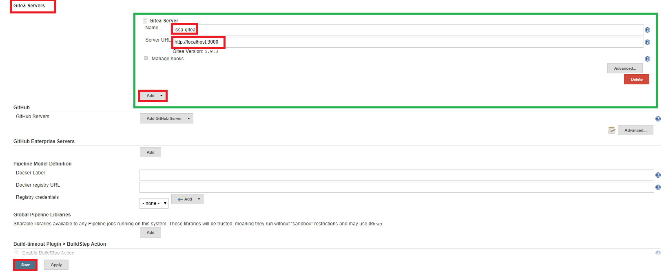
Add Gitea server in Jenkins global scope
This is done in the system configuration page http://localhost:8080/configure
Scroll down to the Gitea Server section and Add a new one and then click on Save
If Jenkins can access the server, it should display the Gitea Version

Slide 23
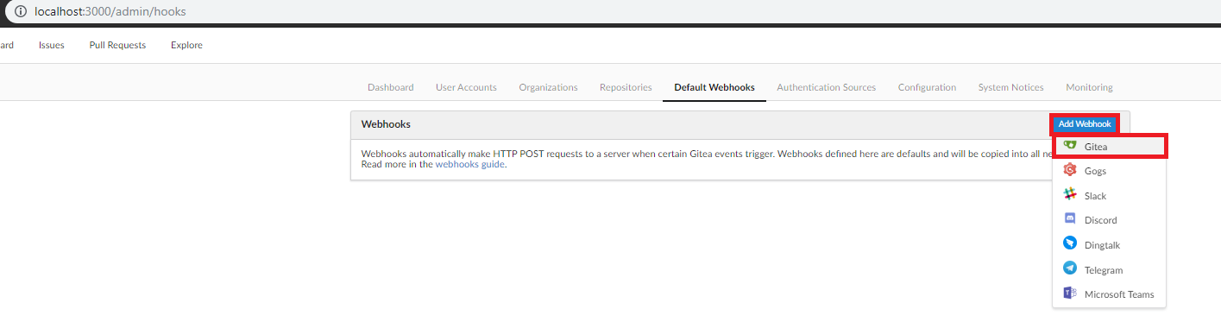
Set-up the Gitea to Jenkins webhook
We are going to set-up a webhook were Gitea will perform HTTP POST requests each time a new event happens globally.
This is done on the Gitea side, in site admins settings, in the Webhooks tab. Here is the direct link to it http://localhost:3000/admin/hooks

Slide 24
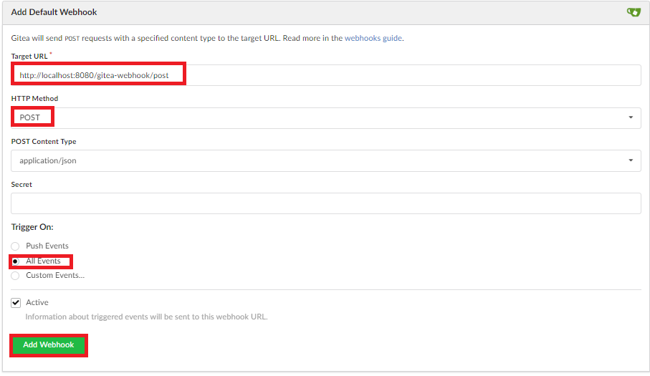

Slide 25
3rd Part: Platform Ops
Purpose: set-up the Continuous Delivery environment in Jenkins
Points: 1 / 5

Slide 26
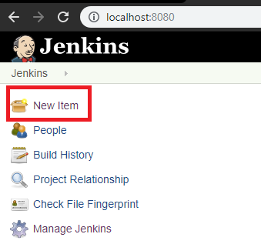
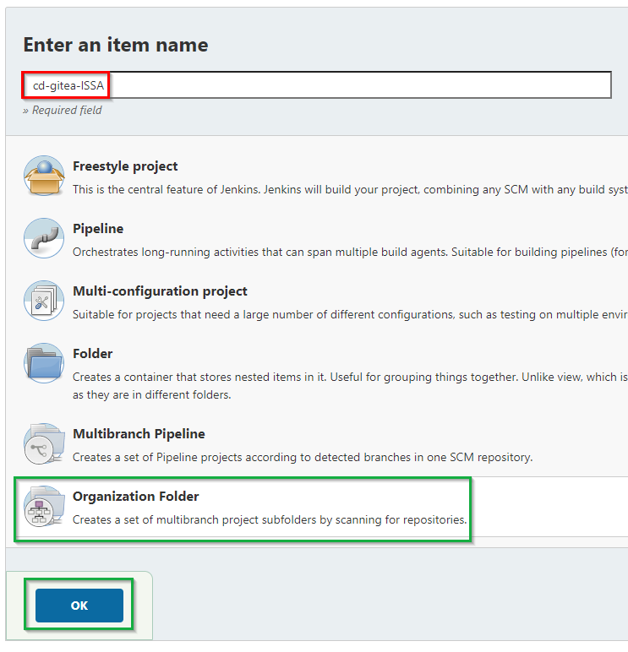
Create the Gitea organization folder using the plugin
In the Jenkins home page, click on New Item
Then proceed to create a Gitea Organization folder
1 / 6
2 / 6

Slide 27
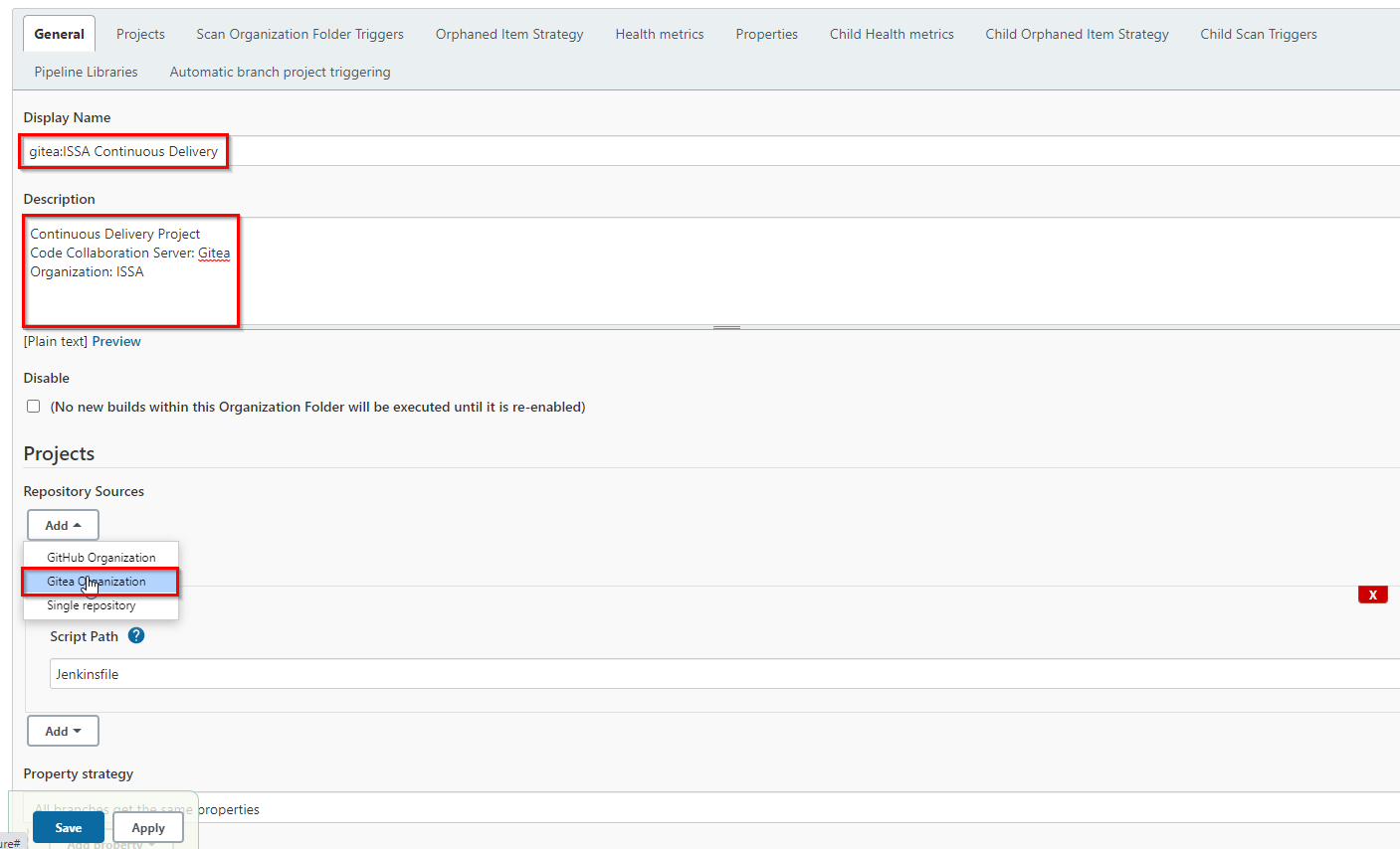
You will be prompted to the Job configuration Page, don’t save yet.
3 / 6

Slide 28
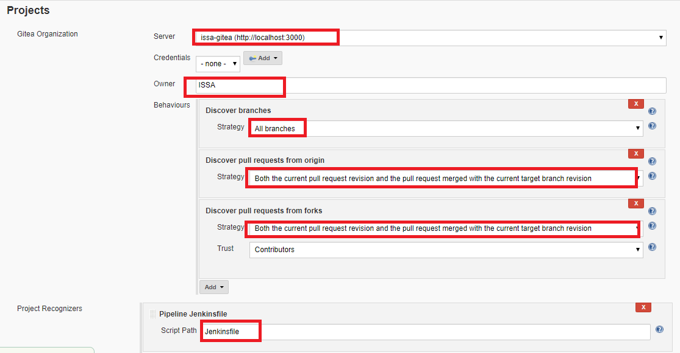
You will be prompted to the Job configuration Page, don’t save yet.
4 / 6

Slide 29
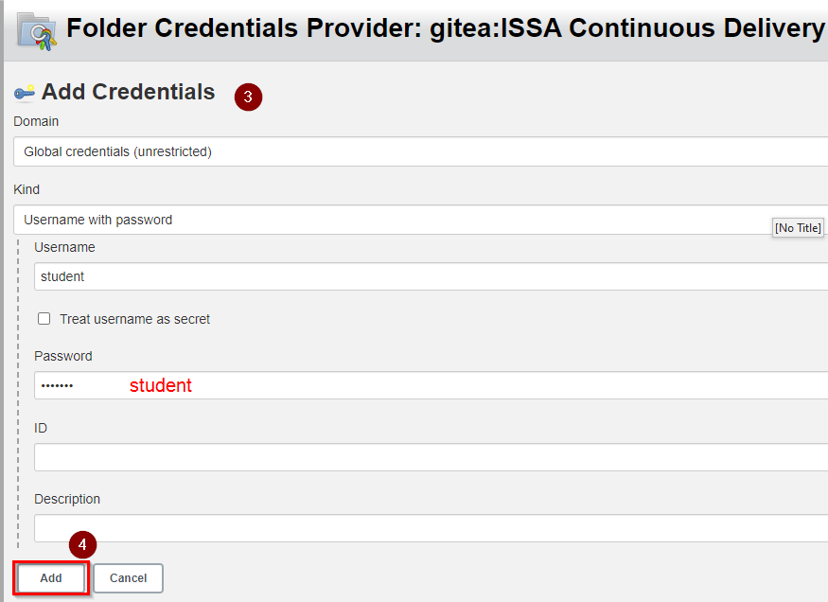
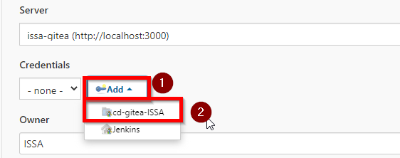
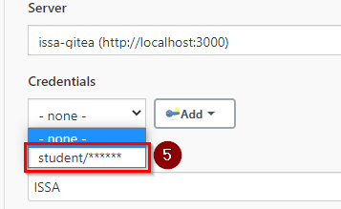
Also you have to add the credentials that have access to the specified organization (Owner)
These credentials are going to be available only for cd-gitea-ISSA
5 / 6

Slide 30
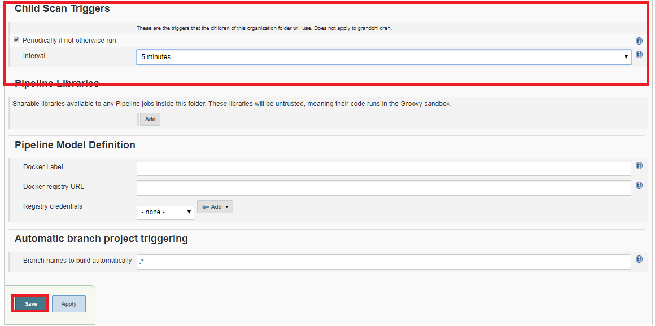
Go down into the job configuration page and update the following configurations and Save
6 / 6

Slide 31
4th Part: Site Reliability Engineering Ops (SREOps)
Purpose: set-up the production environment, software development environment and the required configuration management particularities
Points: 1 / 5

Slide 32
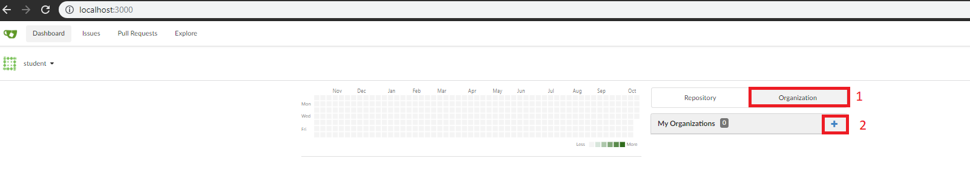
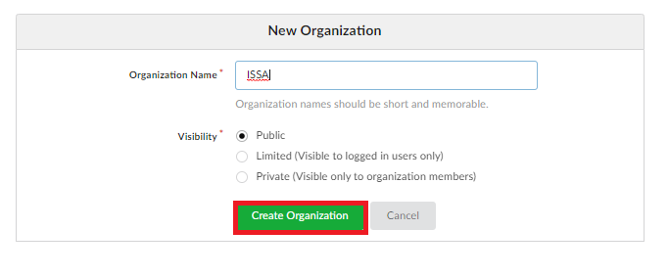
Create a new Gitea organization
Access Gitea homepage http://localhost:3000/ and proceed creating your ISSA organization

Slide 33
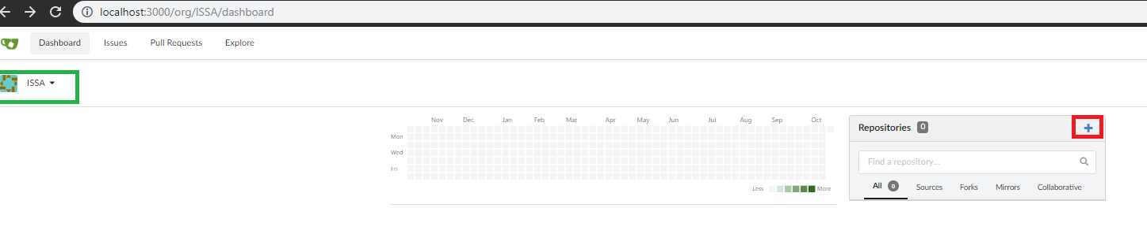
Create your project Git repository
From your ISSA’s organization dashboard page http://localhost:3000/org/ISSA/dashboard, proceed creating your project’s Git repository

Slide 34
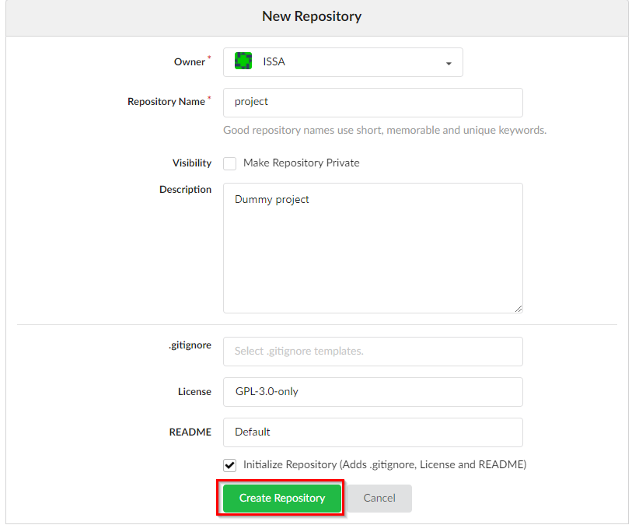

Slide 35
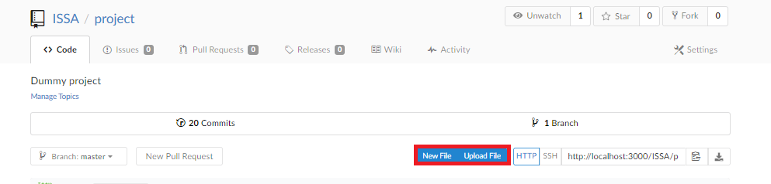
How to commit a new file(s)
From your repository page http://localhost:3000/ISSA/project. Via the New File or Upload File
The New File will prompt your to a page where you can specify the file name (or relative path) and edit it on the spot.
The Upload File will prompt your to a page where you can drag and drop files to be committed

Slide 36
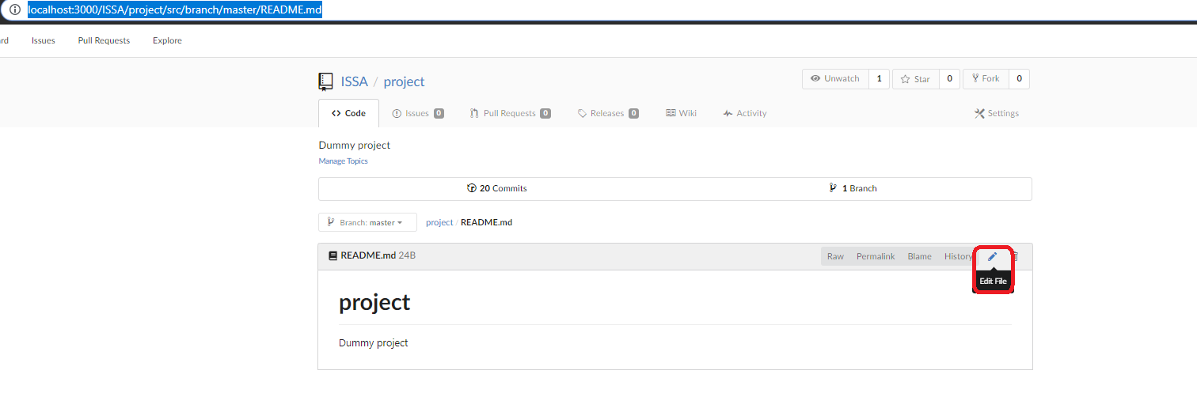
How to edit a committed file
From your repository page http://localhost:3000/ISSA/project. Navigate to the desired file to be edited. README.md for example http://localhost:3000/ISSA/project/src/branch/master/README.md and click on the edit button.

Slide 37
Initial Jenkinsfile
Commit a new file called Jenkinsfile
It should have only one line
sleep 10
After that go to http://localhost:8080/job/cd-issa-gitea/, the Gitea Jenkins Project that you created at the 3rd Step.
From the menu of the left, click on Scan Gitea Organization Now.
Now the ISSA/project repository should have it’s own project folder with it’s own Jenkins job for the master branch that only sleeps 10 seconds at each new change / commit.

Slide 38
Add your project source code
Go to https://github.com/whymex/issa-cd-fii and port the following files, keeping the directory structure in your Gitea repository
dev-requirements.txt
requirements.txt
project/__init__.py
project/project.py
Commit each file individually. 4 Jenkins builds (that still do nothing) should get triggered.

Slide 39
Jenkinsfile code
Edit the Jenkinsfile from your Gitea repository and copy paste the code from https://github.com/whymex/issa-cd-fii/blob/master/Jenkinsfile
Observe what’s happening in Jenkins and check the Console Output
Hint: In case of error, check system environment variable for python
Observe what happened in Gitea after the pipeline execution

Slide 40
Fix the code style and make the pipeline succeed
Fix the variables naming from project/project.py by replacing x and y with first_number and second_number
Commit the changes and analyze the Jenkins pipeline execution

Slide 41
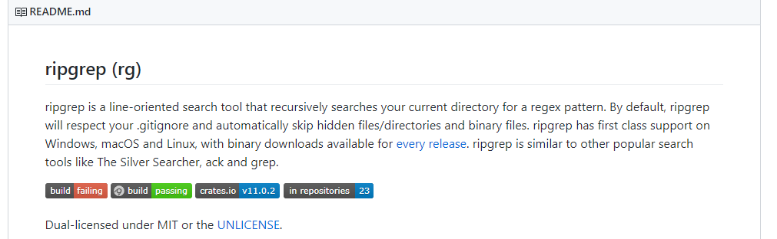
Exercise: Add a build badge to README.md
Points: 1 / 5
The majority of the opensource project have inside their README.md a badge like icon that displays the build / pipeline execution status.
Example: https://github.com/BurntSushi/ripgrep
Hints:
Use the following plug-in and check it’s documentation how to set it up and add the necessary links to your README.md https://github.com/jenkinsci/embeddable-build-status-plugin
Allow anonymous users read access at Jenkins.

