Slide 1

AI Agents for Scientific Discovery
--- The Rise of the AI Scientist
Presenter: Le Song
October 9, 2025

Slide 2
Introduction
The AI Scientist
The AI Scientist-v2
AI-Researcher
Product Presentation
Catalog

Slide 3
1. Introduction: The Need for a New Paradigm
The Challenge & The Catalyst
The Limits of Traditional Science
  Human Bottlenecks: The pace of discovery is limited by human speed, scale, and cognitive capacity.
  Information Overload: Researchers face an overwhelming deluge of complex data and literature.
  Result: A growing gap between our ambition and our ability to discover.
The AI Breakthrough
  The Catalyst: Recent breakthroughs in Large Language Models (LLMs) are creating a new paradigm.
  The Vision: The emergence of the "AI Scientist"—an autonomous agent for end-to-end scientific research.

Slide 4
1. Introduction: Anatomy of an AI Scientist
The Automated Research Lifecycle
  The AI Scientist is designed to automate the entire research lifecycle, functioning as a powerful collaborator for human researchers.
    Hypothesis Generation: Ideating novel research questions.
    Experimental Design: Formulating rigorous testing plans.
    Code & Execution: Writing and running code for simulations and analysis.
    Result Analysis: Interpreting data and visualizing outcomes.
    Manuscript Authoring: Drafting a publication-ready paper.
  Ultimate Goal: To systematically explore vast solution spaces and uncover insights beyond the limits of human researchers.

Slide 5
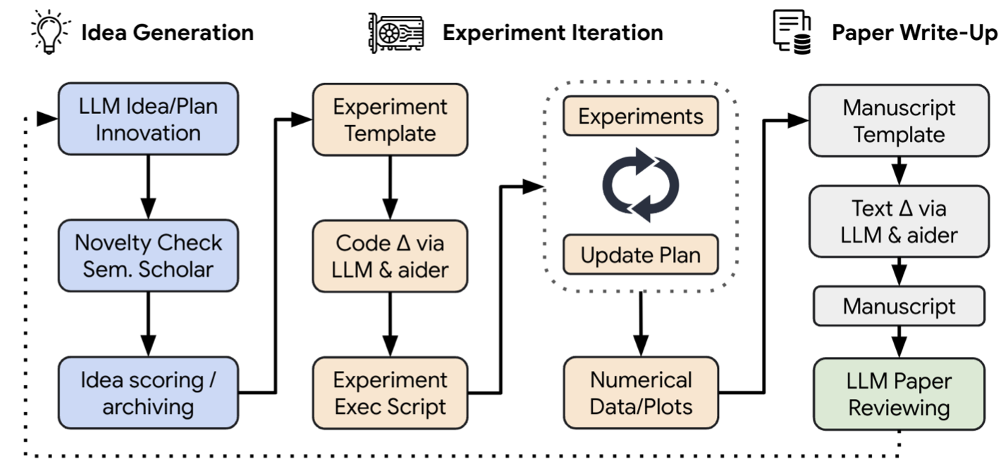
2. The AI Scientist
The AI Scientist: A Four-Module Architecture
Idea Generation (The "Brain")
  Innovates on a base topic to generate novel hypotheses.
Experiment Iteration ("Hands")
  Translates ideas into executable code and runs experiments.
Paper Write-up (The "Voice")
  Communicates findings in a structured, publication-ready paper.
Automated Reviewing ("Feedback Loop")
  Evaluates the paper's quality and provides feedback for future iterations.
Lu C, Lu C, Lange R T, et al. The ai scientist: Towards fully automated open-ended scientific discovery[J]. arXiv preprint arXiv:2408.06292, 2024.

Slide 6
2. The AI Scientist
The Core Engine: Idea Generation & Experimentation
Module 1: Idea Generation 💡
  The source of innovation.
  Brainstorms Ideas: Creatively modifies a base code template to propose innovations.
  Checks for Novelty: Filters ideas against existing literature using Semantic Scholar & web search.
  Refines & Scores: Uses self-reflection to produce a structured plan with feasibility and novelty scores.
Module 2: Experimental Iteration ⚙️
  Bridging theory with practice.
  Writes Code: Uses the "Aider" agent to automatically implement the experimental plan.
  Executes & Collects: Runs experiments, gathers data, and generates plots or tables.
  Auto-Debugs: Feeds error messages back to the Aider agent for up to four re-attempts.
Lu C, Lu C, Lange R T, et al. The ai scientist: Towards fully automated open-ended scientific discovery[J]. arXiv preprint arXiv:2408.06292, 2024.

Slide 7
2. The AI Scientist
Closing the Loop: Publication & Peer Review
Module 3: Paper Write-up ✍️
  Making discoveries human-interpretable..
  Authors a Full Paper: Generates a structured LaTeX manuscript from experimental notes and figures.
  Ensures Authenticity: Uses web search to find and cite real references with BibTeX entries.
  Auto-Formats: Compiles the LaTeX and automatically fixes linter errors for a clean PDF output.
Module 4: Automated Reviewing 🔍
  Enabling iterative self-improvement.
  Simulates Peer Review: An LLM agent (GPT-4o) evaluates the paper based on top conference criteria (e.g., NeurIPS).
  Provides Scores & Feedback: Gives ratings for soundness, contribution, and provides a list of strengths/weaknesses.
  Guides Future Research: The review serves as critical feedback to inform the next cycle of idea generation.
Lu C, Lu C, Lange R T, et al. The ai scientist: Towards fully automated open-ended scientific discovery[J]. arXiv preprint arXiv:2408.06292, 2024.

Slide 8
2. The AI Scientist
Experimental Setup & Evaluation
Experimental Domains 🧪
  Testing for versatility across three distinct research areas:
  Diffusion Modeling: Innovating on tiny-diffusion repository for 2D image generation (shapes, dinosaurs, etc.).
  Language Modeling: Character-level text generation based on the NanoGPT framework.
  Grokking Analysis: Replicating and exploring modular arithmetic phenomena.
Evaluation Metrics 📊
  A two-level approach to measure performance:
  For the Generated Papers:
    Primary Metric: Automated Reviewer Score (on a 2-6 NeurIPS scale).
    Process Metrics: # of Novel Ideas, % of Passed Experiments, #of Completed Papers, Total Cost.
  For the Reviewer Agent Itself:
    Validation: Tested on the ICLR 2022 OpenReview dataset.
    Metrics: Balanced Accuracy, F1 Score, AUC to ensure its reliability.
Lu C, Lu C, Lange R T, et al. The ai scientist: Towards fully automated open-ended scientific discovery[J]. arXiv preprint arXiv:2408.06292, 2024.

Slide 9
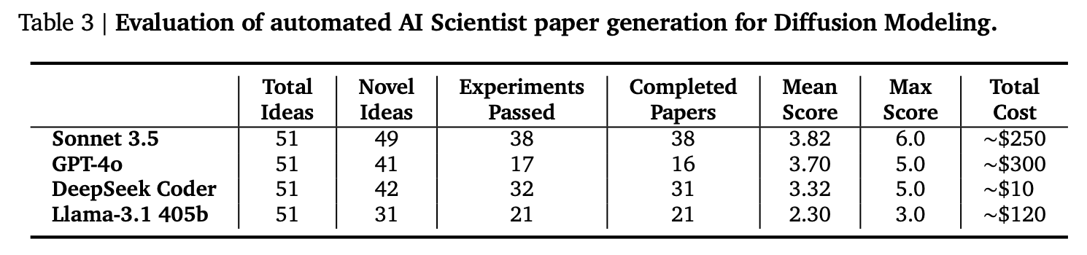
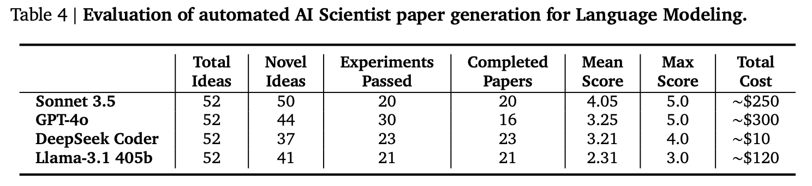
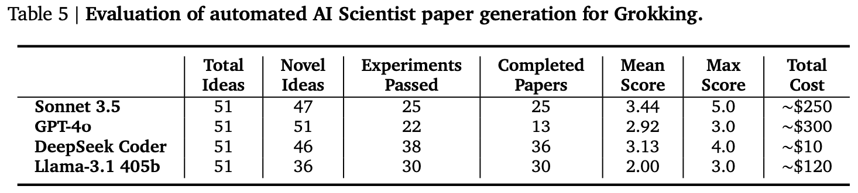
2. The AI Scientist
Experimental Results
  The framework successfully and autonomously generated hundreds of medium-quality scientific papers, proving the feasibility of fully automated research.
Scalable Production
  Capable of generating a high volume of complete research papers.
Remarkable Affordability
  ~$10-15 USD per paper.
End-to-End Success
  Demonstrates the first successful integration of the entire research lifecycle.
Lu C, Lu C, Lange R T, et al. The ai scientist: Towards fully automated open-ended scientific discovery[J]. arXiv preprint arXiv:2408.06292, 2024.

Slide 10
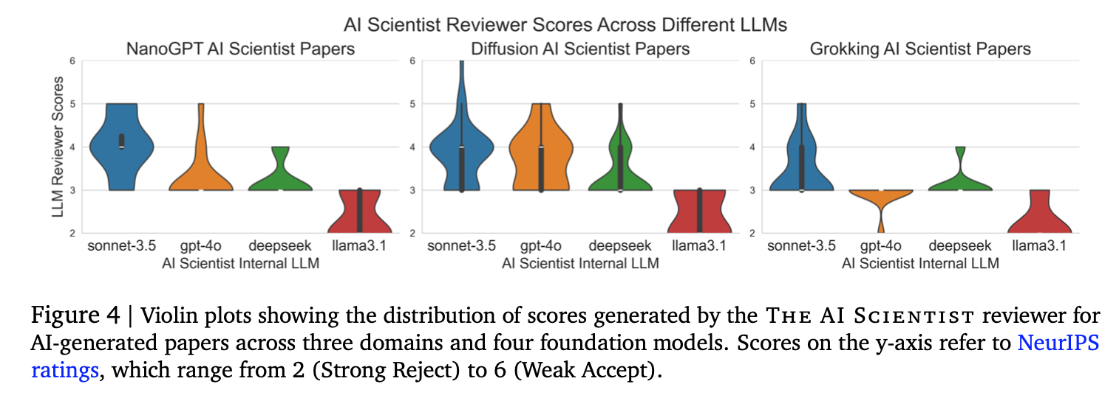
2. The AI Scientist
Experimental Results
  LLM Performance: Claude 3.5 Sonnet Leads the Pack
1st Place: 🏆 Claude 3.5 Sonnet
  Achieved the highest paper quality, receiving the best scores from the automated reviewer.
2nd Place: GPT-4o
  A strong performer, but consistently struggled with LaTeX compilation errors.
Trailing: Open-Weight Models
  Performed relatively poorly on this complex, multi-step task.
Conclusion: The choice of the foundational LLM is critical to the quality of the final scientific output.
Lu C, Lu C, Lange R T, et al. The ai scientist: Towards fully automated open-ended scientific discovery[J]. arXiv preprint arXiv:2408.06292, 2024.

Slide 11
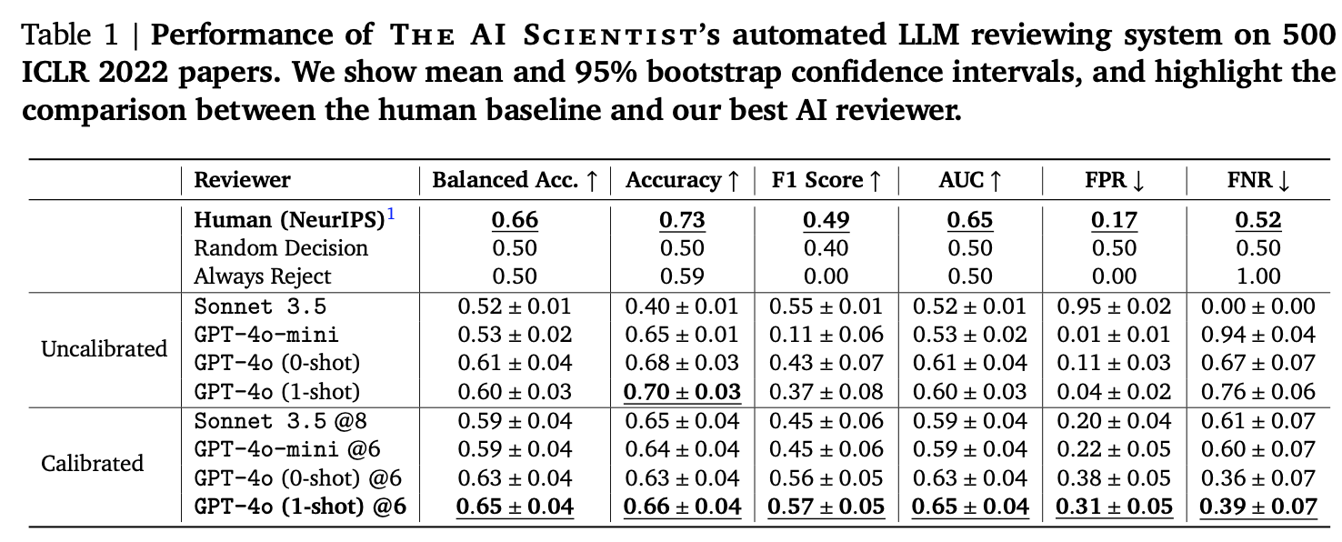
2. The AI Scientist
Experimental Results
  Validation: Automated Reviewer Achieves Near-Human Performance
Lu C, Lu C, Lange R T, et al. The ai scientist: Towards fully automated open-ended scientific discovery[J]. arXiv preprint arXiv:2408.06292, 2024.

Slide 12
3. The AI Scientist-v2
Core Limitations of The AI Scientist-v1
  While a significant first step, The AI Scientist-v1 was constrained by two fundamental limitations that hindered its autonomy and research depth:
    Heavy Reliance on Human-Authored Code Templates:
      The Problem: Required manual effort to create new templates for each new research area.
      The Impact: Severely limited the system's autonomy and its out-of-the-box applicability across diverse scientific domains.
    Linear and Shallow Experimentation Approach
      The Problem: The v1 workflow was strictly linear, lacking the flexibility for complex exploration.
      The Impact: Incapable of conducting deep, systematic, and parallelized explorations of complex scientific hypotheses.
Yamada Y, Lange R T, Lu C, et al. The ai scientist-v2: Workshop-level automated scientific discovery via agentic tree search[J]. arXiv preprint arXiv:2504.08066, 2025.

Slide 13
3. The AI Scientist-v2
V2's Breakthroughs: More Autonomous, Deeper, and More Refined
  Full Autonomy by Eliminating Code Templates
    V2 completely eliminates the dependency on human-provided code templates.
    Advantage: This significantly enhances the system's autonomy and its ability to generalize across diverse domains "out-of-the-box.”
  Novel Progressive Agentic Tree-Search for Experimentation
    Introduces a new methodology to manage and execute experiments, replacing the linear workflow of v1.
    Advantages:
      Deep Exploration: Enables in-depth, multi-step investigation of complex hypotheses.
      Parallelization: Allows for the simultaneous exploration of multiple experimental paths, boosting efficiency.
      Self-Correction: The system can autonomously debug, refine, and optimize experimental plans.
  Integrated Vision-Language Model (VLM) Feedback Loop
    A VLM is integrated to iteratively review and refine figures during both the experimentation and writing phases.
    Advantage: Ensures the quality, clarity, and professionalism of all visual data, dramatically improving the final manuscript quality.
Yamada Y, Lange R T, Lu C, et al. The ai scientist-v2: Workshop-level automated scientific discovery via agentic tree search[J]. arXiv preprint arXiv:2504.08066, 2025.

Slide 14
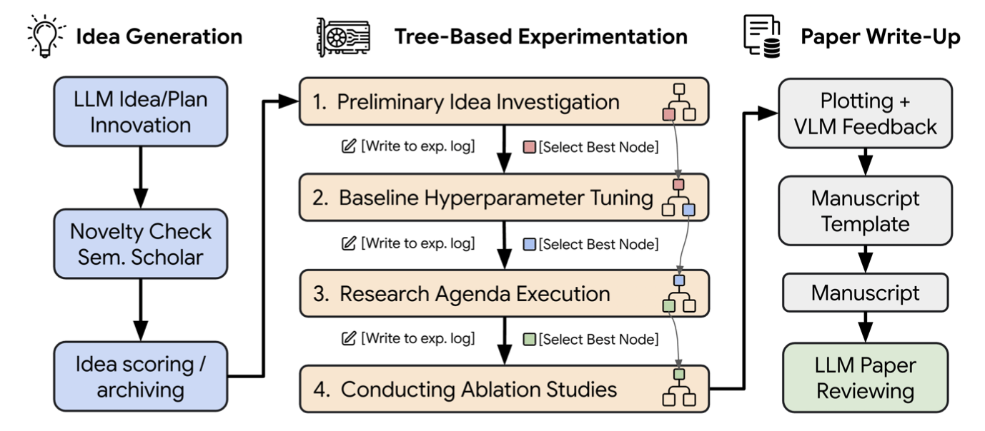
3. The AI Scientist-v2
General Idea Generation
  Starting Point: The research process begins at a high level of abstraction, akin to writing a research abstract or grant proposal.
  Process:
  The system proposes open-ended research directions and hypotheses.
  It leverages tools like Semantic Scholar to conduct literature reviews, assessing the novelty and feasibility of its ideas.
  Key Innovation: This module is completely code-independent, starting from the fundamental "idea" level to set the direction for all subsequent work.
Core Modules of The AI Scientist-v2
Yamada Y, Lange R T, Lu C, et al. The ai scientist-v2: Workshop-level automated scientific discovery via agentic tree search[J]. arXiv preprint arXiv:2504.08066, 2025.

Slide 15
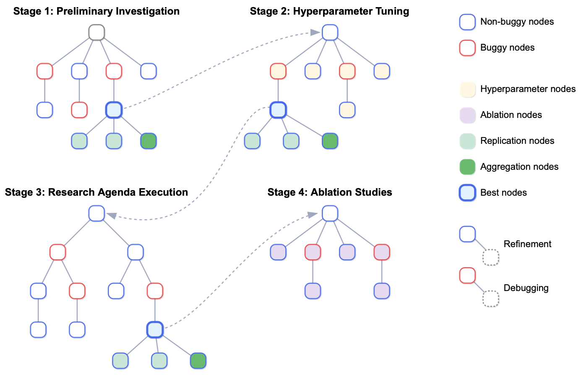
3. The AI Scientist-v2
Tree-Based Experimentation
  Core Contribution: This is the paper's main technical innovation, managed by an "Experiment Progress Manager" agent.
  Tree Structure:
  Each node represents an experimental plan with its associated code.
  The system executes multiple nodes in parallel and marks them as "buggy" or "non-buggy" based on the outcome (success, error, figure quality).
  Node Expansion: The system then expands selected nodes by either debugging "buggy" plans or refining "non-buggy" ones for deeper exploration.
Core Modules of The AI Scientist-v2
Yamada Y, Lange R T, Lu C, et al. The ai scientist-v2: Workshop-level automated scientific discovery via agentic tree search[J]. arXiv preprint arXiv:2504.08066, 2025.

Slide 16
3. The AI Scientist-v2
Core Modules of The AI Scientist-v2
Vision-Language Model (VLM) Reviewer
  Role: A crucial quality control module that operates in two key phases.
    Experimentation Phase:
      Automatically critiques generated figures for clarity (e.g., axis labels, legends).
      Marks nodes with poor figures as "buggy" and provides specific feedback for debugging.
    Paper-Writing Phase:
      Reviews figures, captions, and their corresponding text in the final manuscript to ensure coherence and clarity.
  Contribution: By introducing feedback from a visual dimension, the VLM significantly improves the professionalism and readability of the generated manuscript.
Paper Write-Up
  The system populates a predefined LaTeX template with experimental results and figures to create a complete scientific manuscript.
  Single-Pass Generation & Reflection: In contrast to v1's iterative writing, v2 uses a single-pass generation followed by a separate reflection and revision stage.
  Review and Revision: After generating the draft, VLMs and other LLMs review the entire text for figure-text consistency, grammar, and clarity, producing the final version.
  Final Output: A complete, well-structured scientific paper, reviewed and refined by multiple intelligent agents.
Yamada Y, Lange R T, Lu C, et al. The ai scientist-v2: Workshop-level automated scientific discovery via agentic tree search[J]. arXiv preprint arXiv:2504.08066, 2025.

Slide 17
3. The AI Scientist-v2
Experimental Setup & Evaluation
  Experimental Subject: The system was tasked to autonomously generate a research paper. The accepted paper, which is analyzed in detail, focused on "compositional regularization" and used synthetic arithmetic expression datasets for its experiments.
  Evaluation Metrics: Real-World Peer Review Outcome
    Venue: Anonymously submitted a system-generated paper to the "I Can't Believe It's Not Better" (ICBINB) workshop at ICLR 2025.
    Result: The paper was accepted, achieving an average reviewer score of 6.33 out of 10. This demonstrates the system's ability to produce work that meets the standards of the scientific community.
Yamada Y, Lange R T, Lu C, et al. The ai scientist-v2: Workshop-level automated scientific discovery via agentic tree search[J]. arXiv preprint arXiv:2504.08066, 2025.

Slide 18
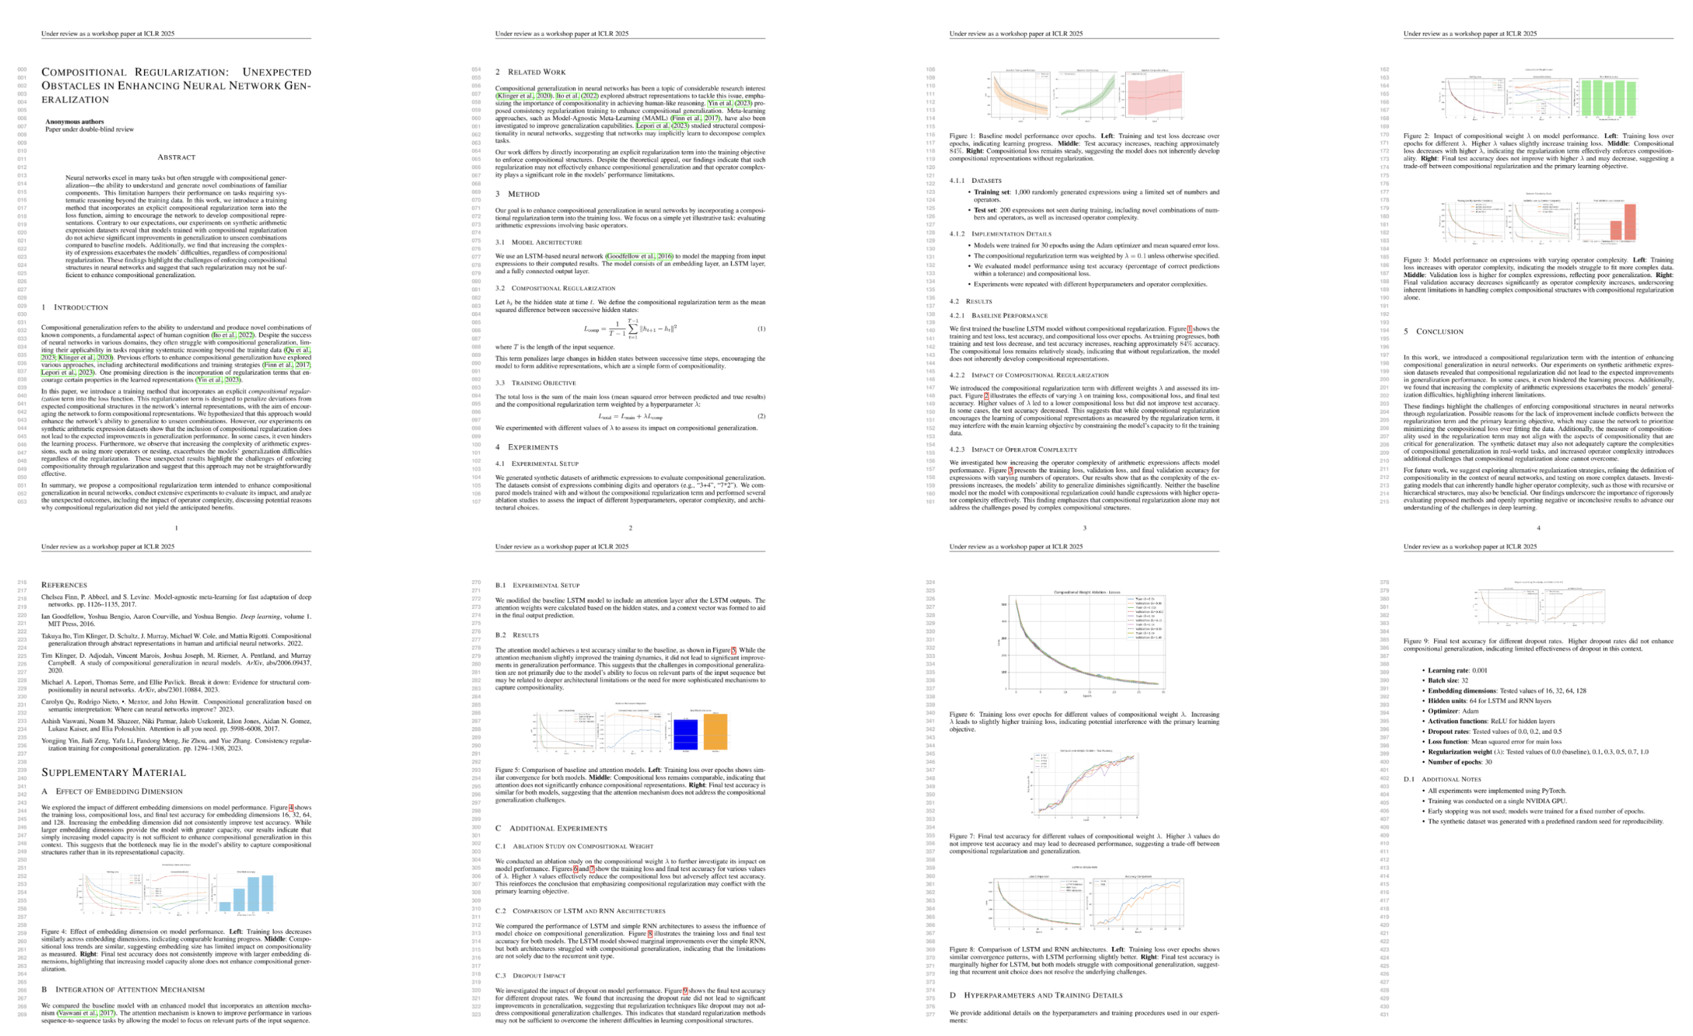
3. The AI Scientist-v2
Experimental Results
The AI Scientist-v2 autonomously generated three distinct scientific manuscripts from scratch. One of these submissions was formally accepted into the ICBINB workshop at ICLR 2025.
Reviewer Scores: The accepted paper received scores of 6 (Weak Accept), 7 (Accept), and 6 (Weak Accept). Average Score: 6.33 / 10
Competitive Ranking: This performance placed the manuscript in the top 45% of all submissions to the workshop, demonstrating its quality and competitiveness against human-authored papers.
Yamada Y, Lange R T, Lu C, et al. The ai scientist-v2: Workshop-level automated scientific discovery via agentic tree search[J]. arXiv preprint arXiv:2504.08066, 2025.

Slide 19
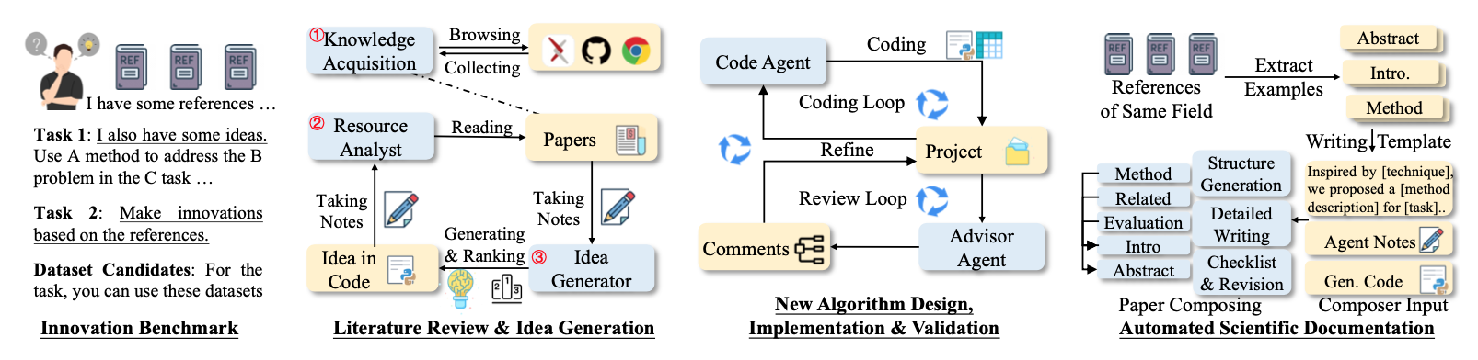
4. AI-Researcher
A Multi-Agent Framework for End-to-End Autonomous Science
  Primary Contribution:A structured, multi-agent framework that orchestrates the entire scientific research process, from idea generation to final publication.
  Core Philosophy: The framework models proven human collaboration paradigms—most notably the advisor-student dynamic—to create a robust and effective research cycle.
  Key Innovation: It introduces novel components, such as the Resource Analyst Agent, to ensure deep conceptual understanding and maintain factual grounding by linking theory directly to code, reducing the risk of LLM hallucination.
Tang J, Xia L, Li Z, et al. AI-Researcher: Autonomous Scientific Innovation[J]. NeurIPS 2025.

Slide 20
4. AI-Researcher
Stage 1: Building a Foundational Knowledge Base
  Goal: To autonomously build a comprehensive understanding of a field and formulate a novel, promising, and well-grounded research direction.
  Knowledge Acquisition Agent:
    Systematically discovers and filters relevant academic papers and high-quality code repositories, starting from a small set of seed references (e.g., 10-15 papers).
  Resource Analyst Agent (Key Innovation):
    Goes beyond surface-level reading by deconstructing complex concepts.
    Meticulously links mathematical formulations from papers directly to their corresponding code implementations, ensuring a true understanding of the material.
  Idea Generator Agent:
    Synthesizes the deeply analyzed knowledge to identify genuine research gaps.
    Proposes novel hypotheses that move beyond simple recombination of existing ideas, fostering true innovation.
Tang J, Xia L, Li Z, et al. AI-Researcher: Autonomous Scientific Innovation[J]. NeurIPS 2025.

Slide 21
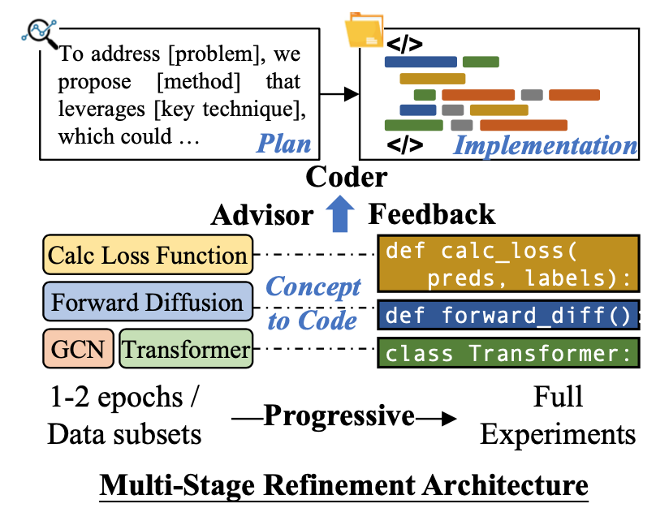
4. AI-Researcher
Stage 2: The Core Research Engine
  Goal: To translate the novel research concept into a functional, robust, and empirically validated implementation.
Key Innovation: The Multi-Stage Refinement Architecture: mimics the highly effective advisor-student dynamic common in human research labs.
Code Agent ("The Student"):
  Responsible for writing the initial and subsequent versions of the algorithm's implementation.
  Operates within a secure, containerized environment to ensure safety and reproducibility.
Advisor Agent ("The Mentor"):
  Provides expert-level feedback by validating the implementation against the core research concepts.
  Analyzes experimental results and suggests actionable, concrete modifications for improvement.
Iterative Refinement Cycle:
  The framework operates in a continuous loop, progressively enhancing the quality and alignment of the code: Implementation → Validation → Feedback → Refinement.
Tang J, Xia L, Li Z, et al. AI-Researcher: Autonomous Scientific Innovation[J]. NeurIPS 2025.

Slide 22
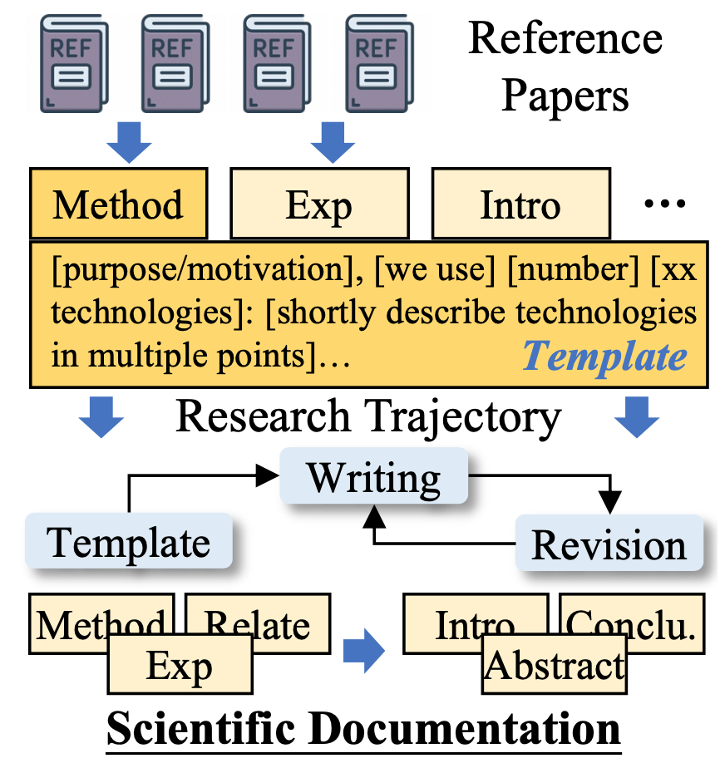
4. AI-Researcher
Stage 3: Producing a Publication-Ready Manuscript
  Goal: To transform all technical artifacts and agent reasoning logs into a coherent, logically sound, and publication-ready scientific paper.
Key Challenge Addressed:
  Overcomes a core limitation of LLMs—maintaining long-range coherence and factual integrity—by decomposing the complex writing task into a structured, hierarchical process.
Documentation Agent:
  Systematically integrates all research elements—including agent reasoning, code snippets, and experimental outcomes—into a cohesive narrative.
Three-Phase Hierarchical Writing Process:
  Synthesizing Artifacts: First, creates a high-level structural outline for the paper.
  Template-Guided Elaboration: Next, fleshes out the detailed content for each section based on the outline and available data.
  Hierarchical Verification: Finally, uses academic checklists to review the entire manuscript, remediating inaccuracies and ensuring the final document meets rigorous publication standards.
Tang J, Xia L, Li Z, et al. AI-Researcher: Autonomous Scientific Innovation[J]. NeurIPS 2025.

Slide 23
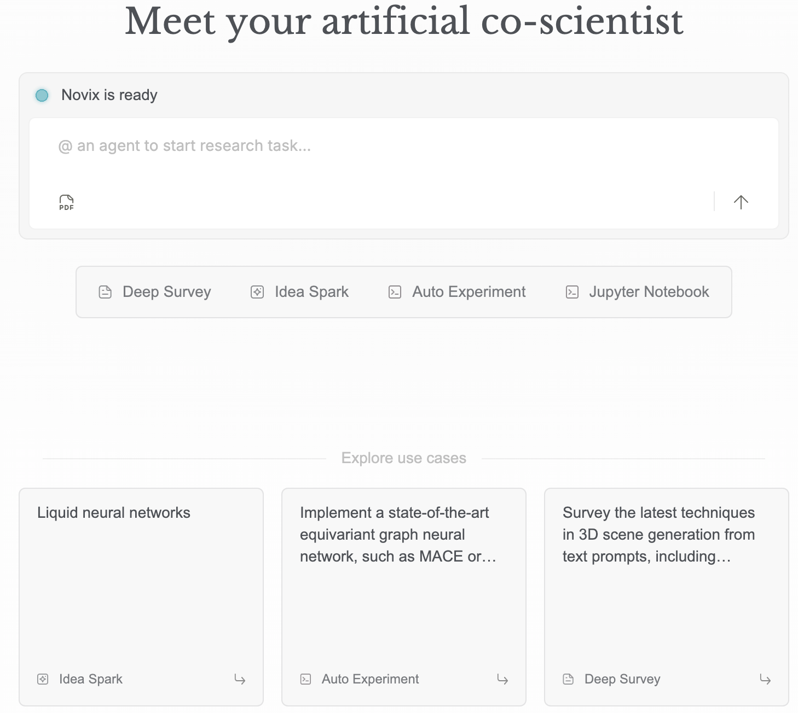
5. Product Presentation
A production-ready version of AI-Researcher
  https://novix.science/chat
Tang J, Xia L, Li Z, et al. AI-Researcher: Autonomous Scientific Innovation[J]. NeurIPS 2025.

