Slide 1

AI Agents for Scientific Discovery
--- The Code Structure of Biomni
Presenter: Xingbo, Harry, Duzhen
October 17, 2025

Slide 2
Introduction
System Architecture
  Configuration System
  Data Infrastructure
  LLM Integration Layer
  Agent Layer
  Tool Ecosystem
Catalog

Slide 3
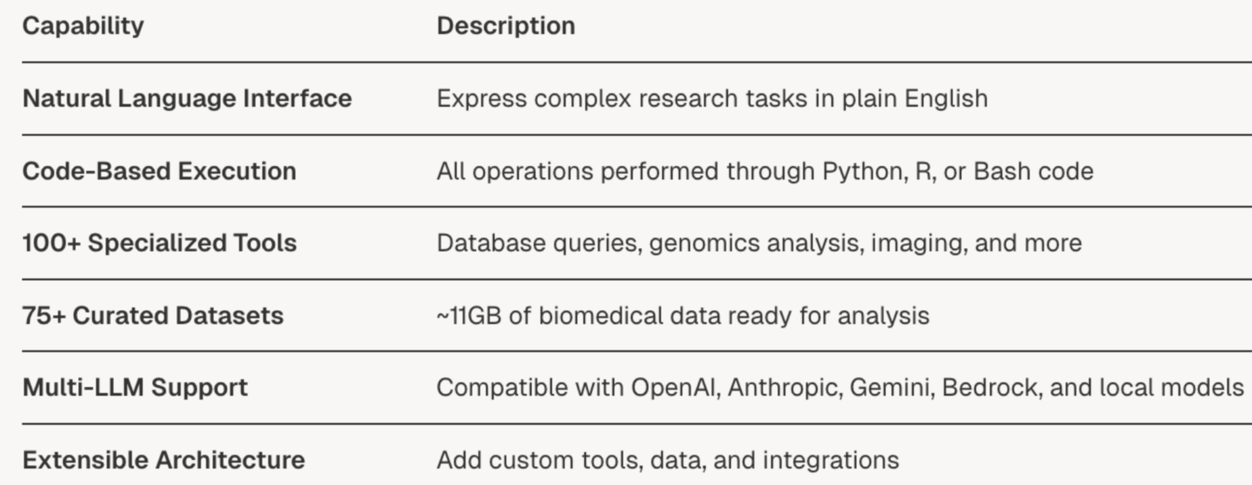
1. Introduction
Natural Language to Code Execution
  Biomni is an AI agent system that translates natural language research questions into executable code. The system features:

Slide 4
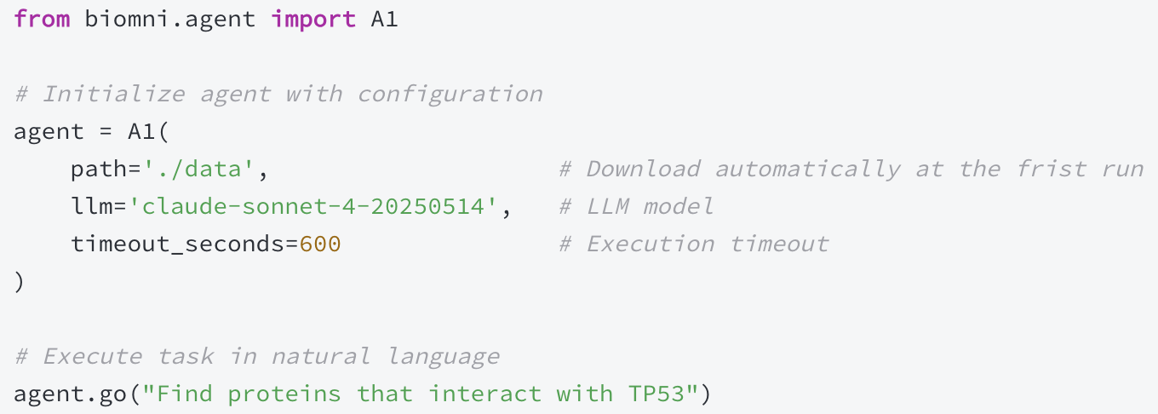
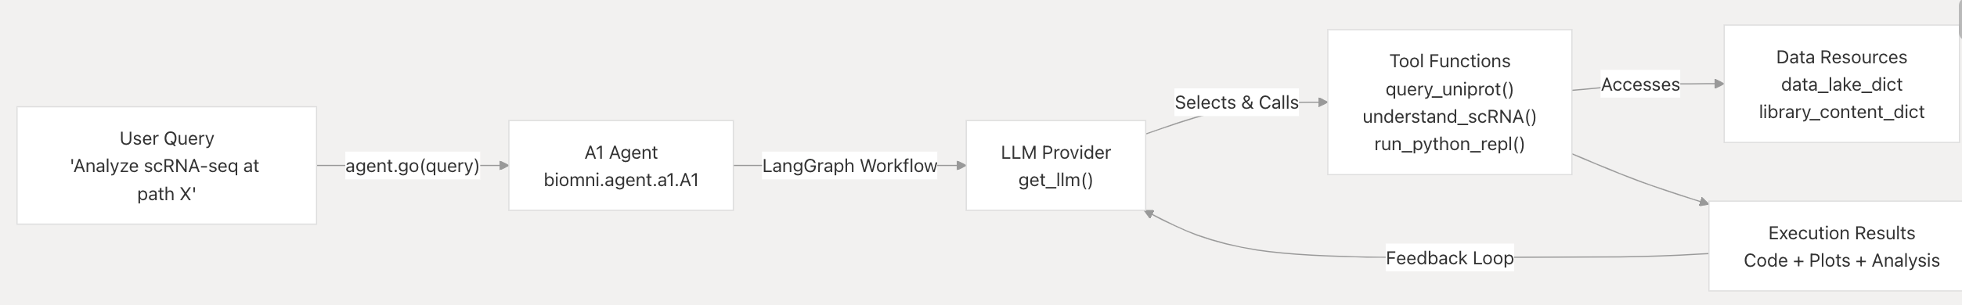
1. Introduction
Program Entry
High-Level System Flow

Slide 5
2. System Architecture
The architecture consists of five major layers: Configuration System, Data Infrastructure, LLM Integration Layer, the Agent Layer and Tool Ecosystem.
Configuration System
  It manages settings for LLM providers, execution parameters, and resource paths throughout the platform.
Data Infrastructure
  It manages access to 75+ curated biomedical datasets (~11GB total), 100+ software tool catalogs, and API schema databases.
LLM Integration Layer
  It provides a single abstraction for interacting with multiple language model providers.
Agent Layer
  It includes AI agent core, Tool Registry and Retrieval.
  Tool Ecosystem
  It covers database query capabilities, genomics analysis tools, pharmacology functions, cancer biology workflows, and systems biology modeling tools.

Slide 6
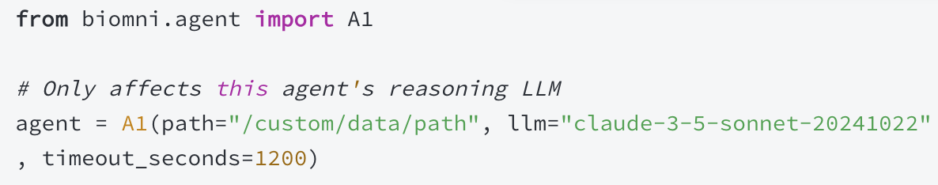
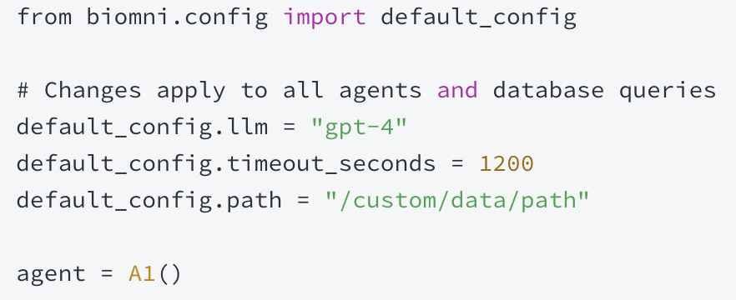
2. System Architecture: Configuration System
The Configuration System in Biomni manages settings for LLM providers, execution parameters, and resource paths throughout the platform.
Direct Parameters (Use with Caution)
  Direct parameters passed to A1() constructor or get_llm() function provide instance-specific overrides. Important: These only affect the specific agent instance, not database queries.
Runtime Configuration (Recommended for Scripts)
  The default_config singleton provides runtime configuration modification. Changes to this object affect all subsequent operations, including both agent reasoning and database queries.

Slide 7
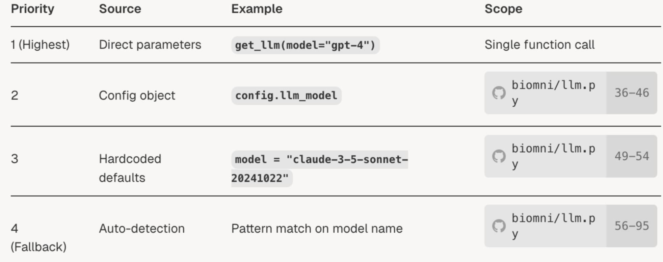
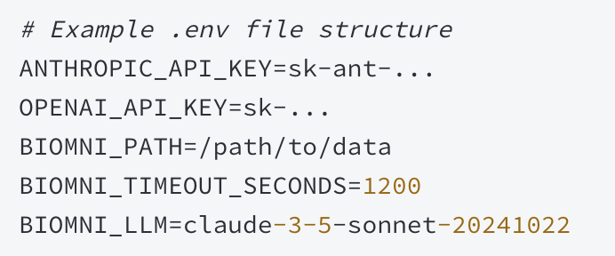
2. System Architecture: Configuration System
The Configuration System in Biomni manages settings for LLM providers, execution parameters, and resource paths throughout the platform.
Environment Variables (Recommended for Production)
  Create a .env file in your project. The .env file provides project-specific configuration that is automatically loaded when Biomni initializes. This is the recommended method for managing API keys and project settings.
Resolution Priority Table
  The get_llm function implements a four-tier parameter resolution system with automatic provider detection.

Slide 8
2. System Architecture: Configuration System
Key Configuration Parameters
  path
    Type: str
    Default: "./data”
    Description: Root directory for the data lake. Automatically created if it doesn't exist.
  llm_model / llm
    Type: str
    Default: "claude-sonnet-4-20250514"
    Description: Model identifier. Can be provider-prefixed (e.g., "azure-gpt-4o") or use convention-based detection (e.g., "gpt-4" auto-detects OpenAI).
  use_tool_retriever
    Type: bool
    Default: true
    Description: Enable prompt-based tool retrieval to select relevant tools from the 100+ available tools based on the user query.

Slide 9
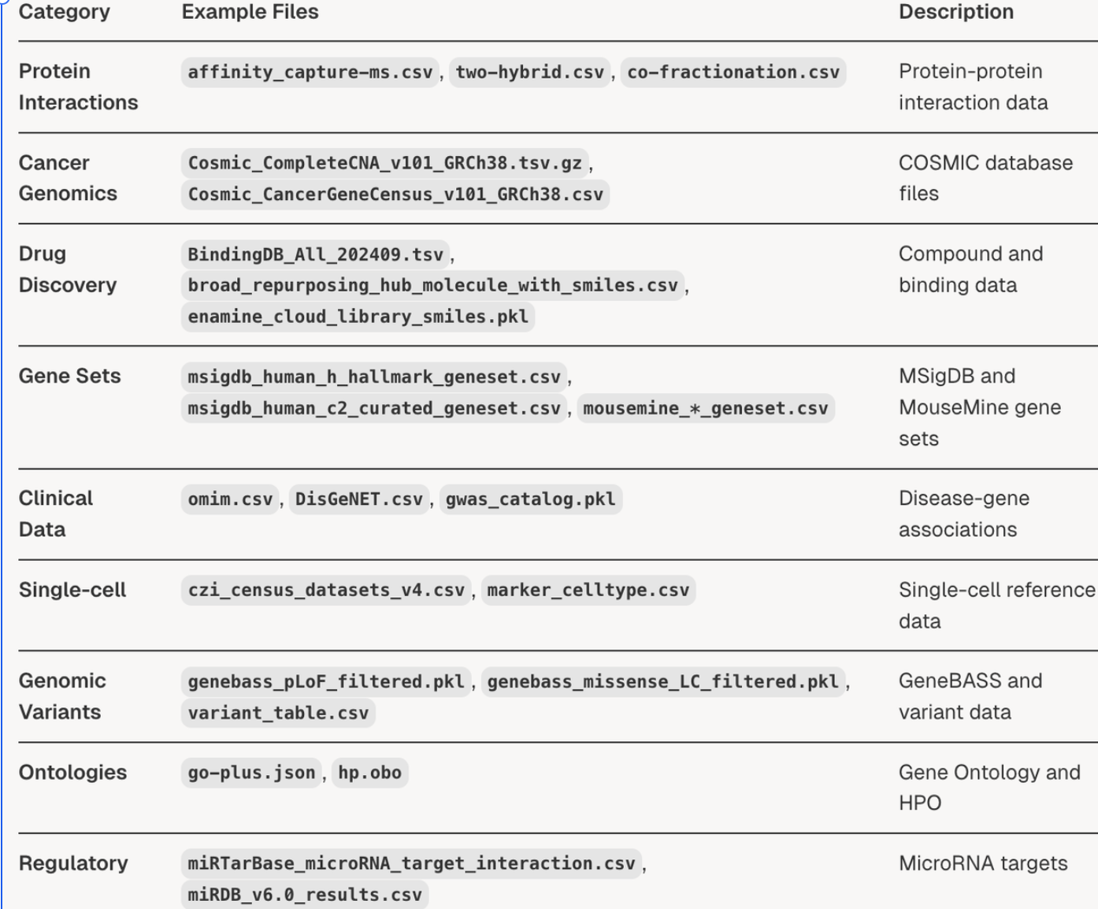
2. System Architecture: Data Infrastructure
Biomni's data infrastructure layer manages access to 75+ curated biomedical datasets (~11GB total), 100+ software tool catalogs, and API schema databases.
The data infrastructure serves as the foundation for database query tools, genomics analysis, and bioimaging functions, providing standardized metadata and access patterns for all data resources.
The data lake contains approximately 75 datasets organized by scientific domain (download automatically at the frist run):

Slide 10
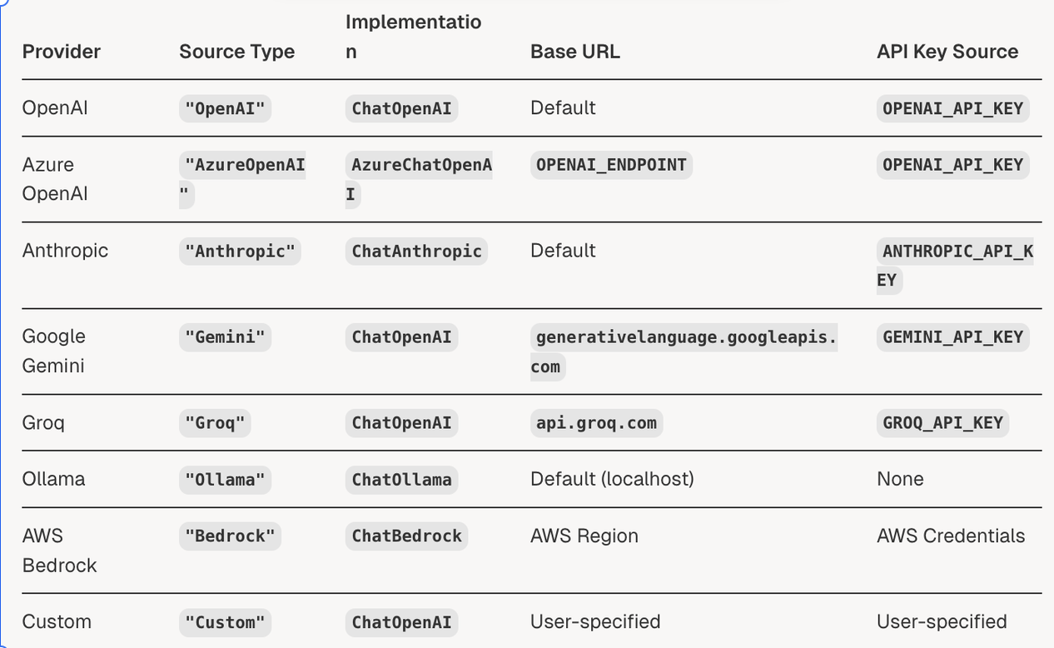
2. System Architecture: LLM Integration Layer
Biomni's unified LLM integration layer provides a single abstraction for interacting with multiple language model providers.
The system supports automatic provider detection based on model names, seamless configuration management, and consistent interfaces across different LLM services.
The LLM integration layer supports eight distinct provider types through the SourceType literal definition. Each provider has specific instantiation logic and configuration requirements.

Slide 11
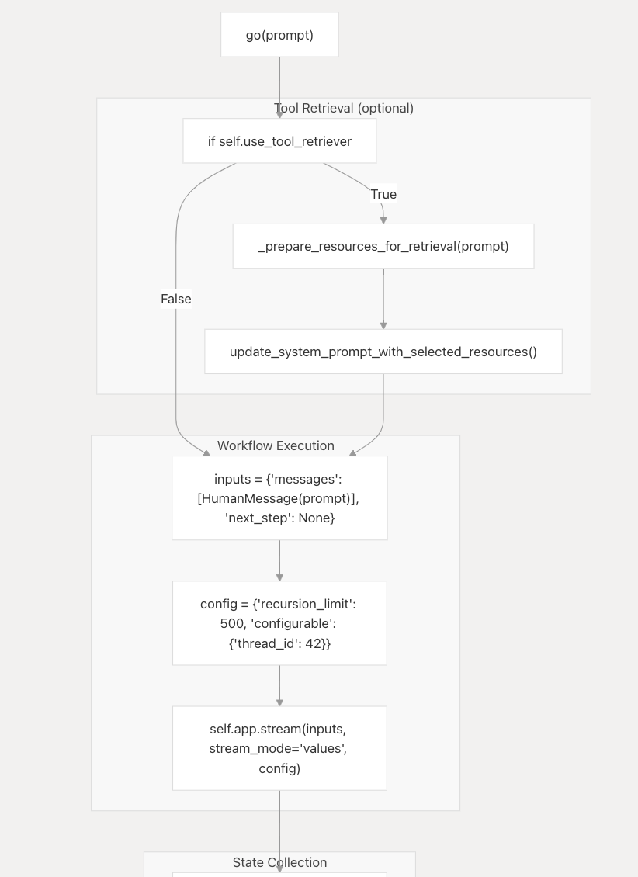
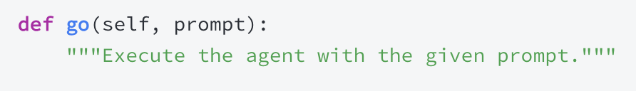
2. System Architecture: Agent Layer
A1 Agent Core
  go() orchestrates a full agent run from a natural-language prompt to a final message, optionally performing tool retrieval before execution.
  The go() method (biomni/agent/a1.py) executes the agent workflow:
Return
  log: List of formatted message strings that capture the full trace (plans, tool invocations, observations).
  content: Final message content returned to the caller.

Slide 12
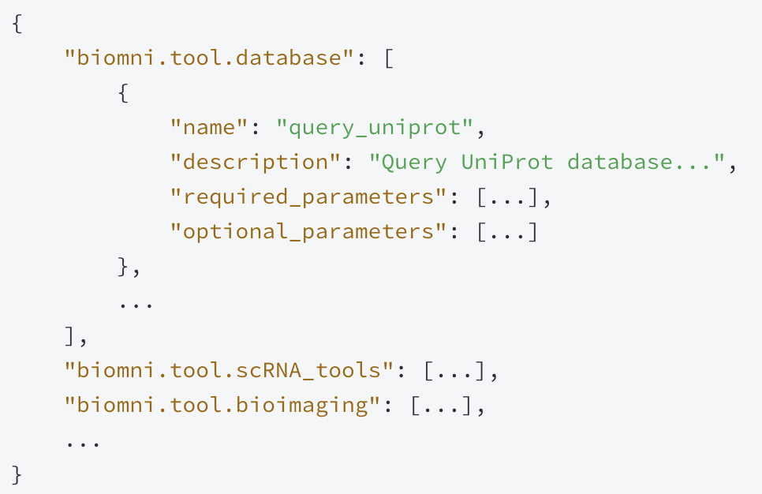
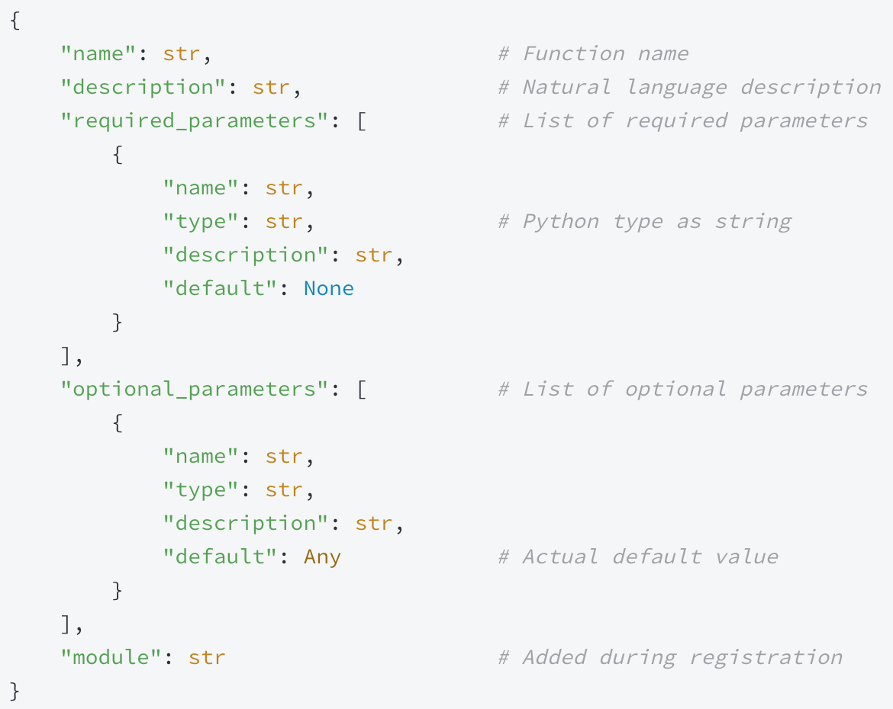
2. System Architecture: Agent Layer
Tool Organization Structure
  module2api Dict: The module2api dictionary is the central data structure for organizing tools. It maps module names to lists of tool schemas.

Slide 13
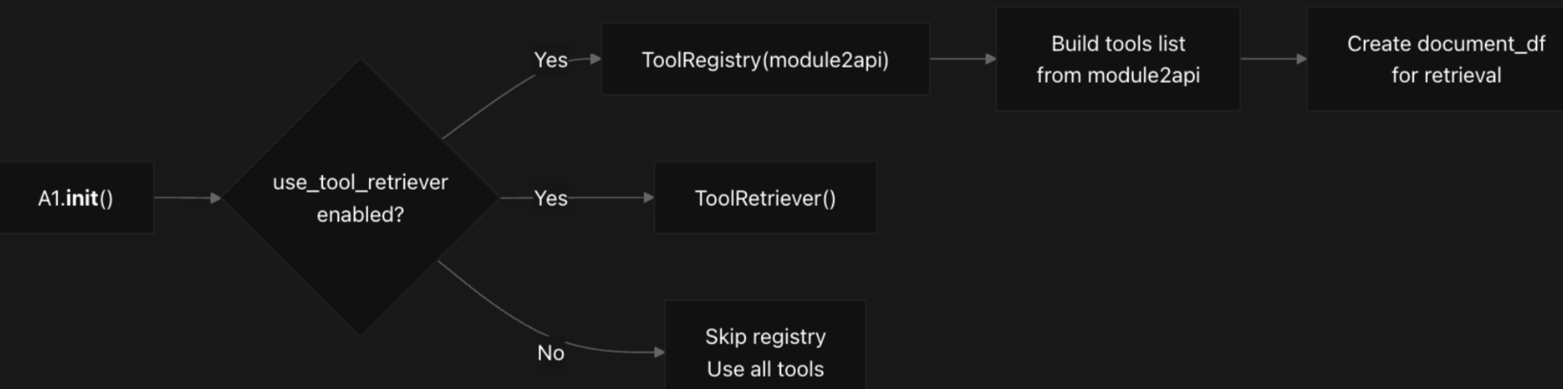
2. System Architecture: Agent Layer
Tool Registry Flow
  A1.__init__() calls read_module2api()
  read_module2api() imports tool descriptions from 20 modules
  If use_tool_retriever=True, creates ToolRegistry(module2api)
  Registry builds internal data structures for efficient retrieval

Slide 14
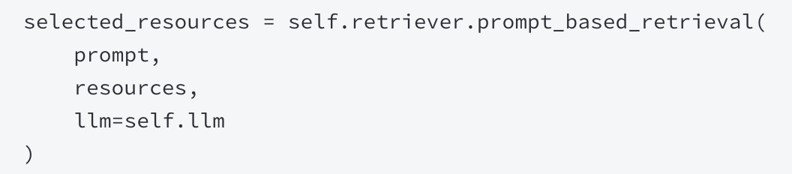
2. System Architecture: Agent Layer
Tool Retrieval System
  Prompt-Based Selection: When use_tool_retriever=True, the agent uses LLM-based retrieval to select relevant tools for each query.
  Gather all registered tools (ToolRegistry), data lake entries, and software library notes.
    Tools: (all registered tools) self.tool_registry.tools
    Data Lake: File paths with descriptions from self.data_lake_dict
    Libraries: Software names with descriptions from self.library_content_dict
  Select relevant names via _prepare_resources_for_retrieval(prompt) (LLM-ranked).
Constrain the system prompt using update_system_prompt_with_selected_resources() so only the chosen tools/resources are advertised to the model.

Slide 15
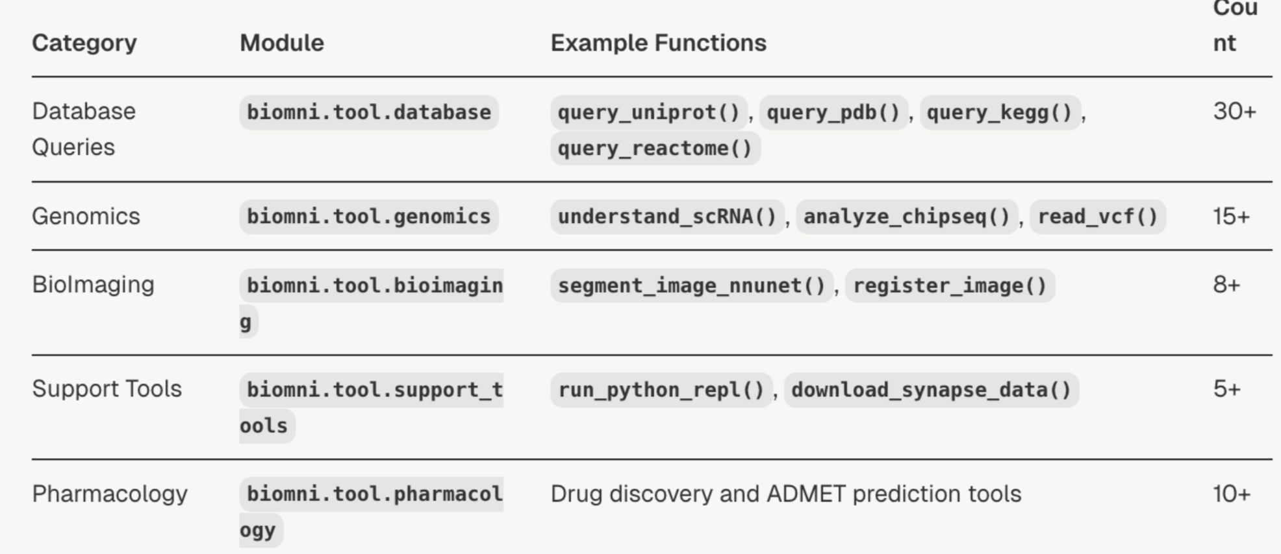
2. System Architecture: Tool Ecosystem
Biomni's built-in tool ecosystem covers database query capabilities, genomics analysis tools, pharmacology functions, cancer biology workflows, and systems biology modeling tools.
Tool Categories and Key Functions
All tools are registered in module2api dictionary at biomni/utils.py and organized by scientific domain.

