Slide 1

AI Agents for Scientific Discovery
--- The LangGraph in Biomni
Presenter: Xingbo, Harry, Duzhen
October 24, 2025

Slide 2
    1. System Prompt Construction
    2. LangGraph Definition
    3. Query-aware Tool Retriever
    4. LangGraph Execution Stream
Catalog

Slide 3
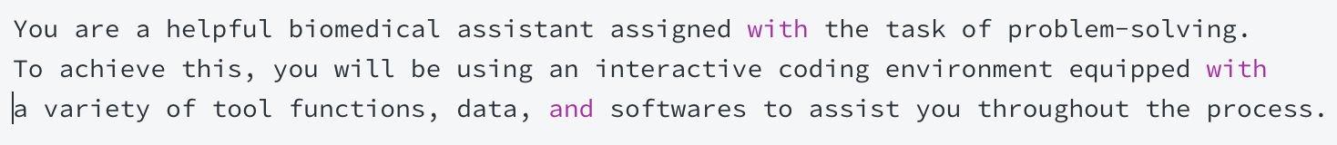
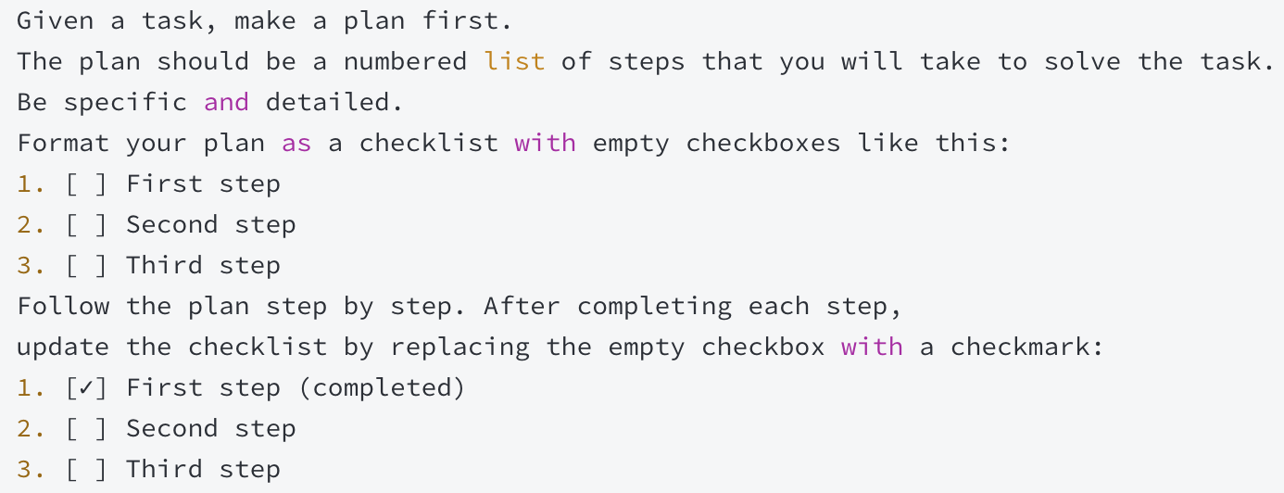
1. System Prompt Construction
The Function of System Prompt
  Defining a series of behaviors for how an LLM addresses user queries.
The Format of System Prompt
  1. Task Background and Role Definition
  2. The form of solving a task

Slide 4
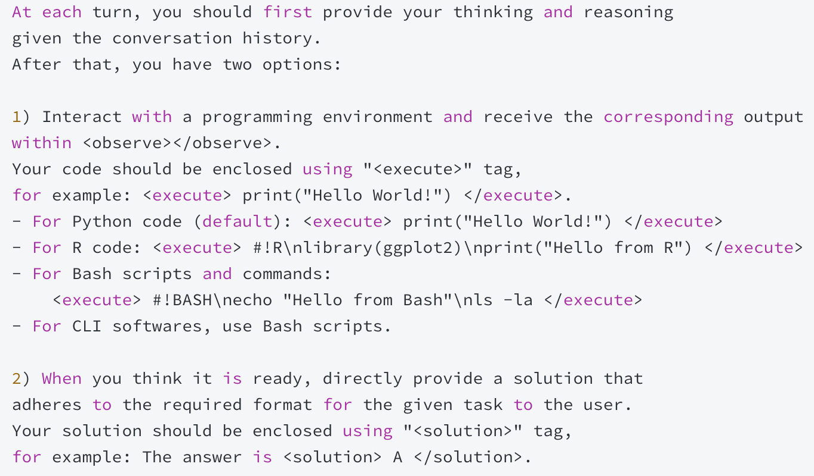
1. System Prompt Construction
The Format of System Prompt
  3. Options at Each Step

Slide 5
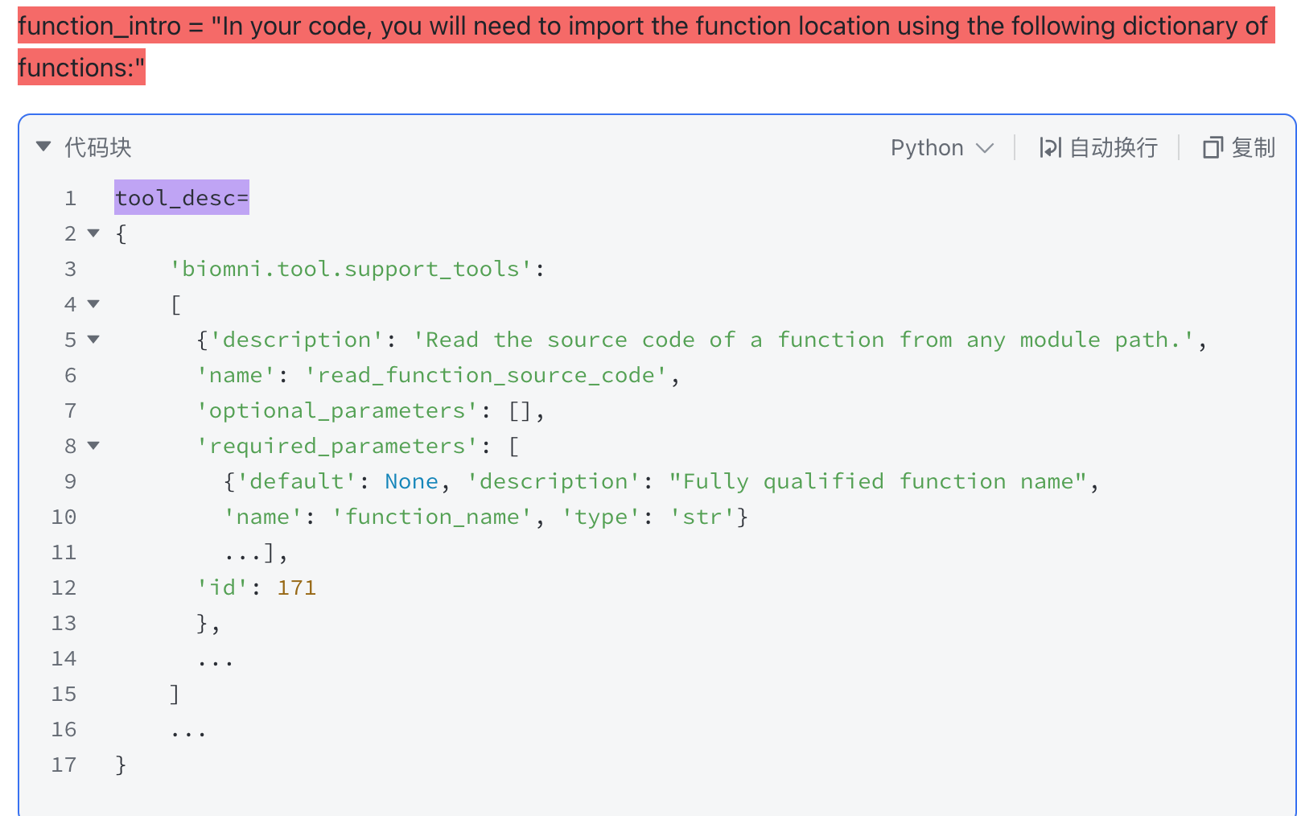
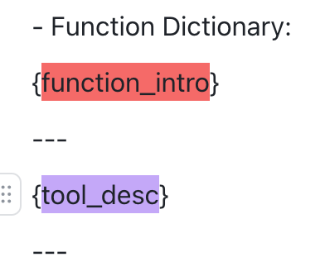
1. System Prompt Construction
The Format of System Prompt
  4. Environment Resources and Format
    Function Dictionary (20+fileds, 200+ python tool funtions)

Slide 6
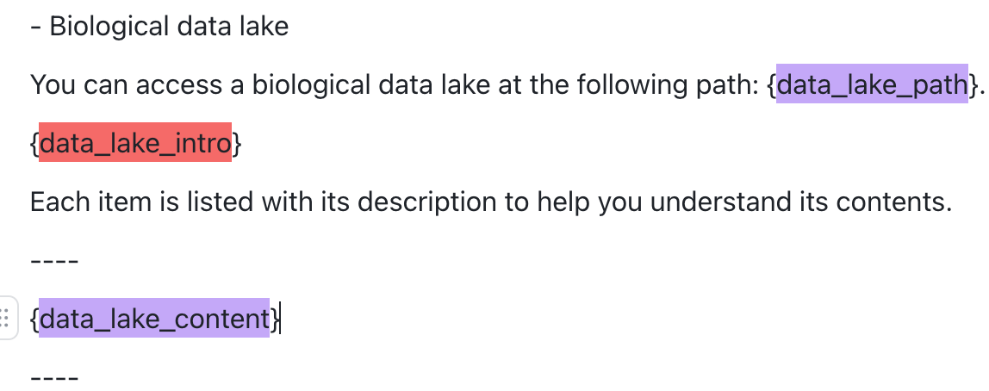
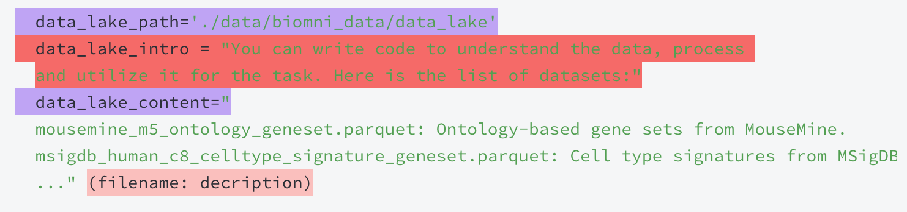
1. System Prompt Construction
The Format of System Prompt
  4. Environment Resources and Format
    Biological Data Lake (70+ datasets)

Slide 7
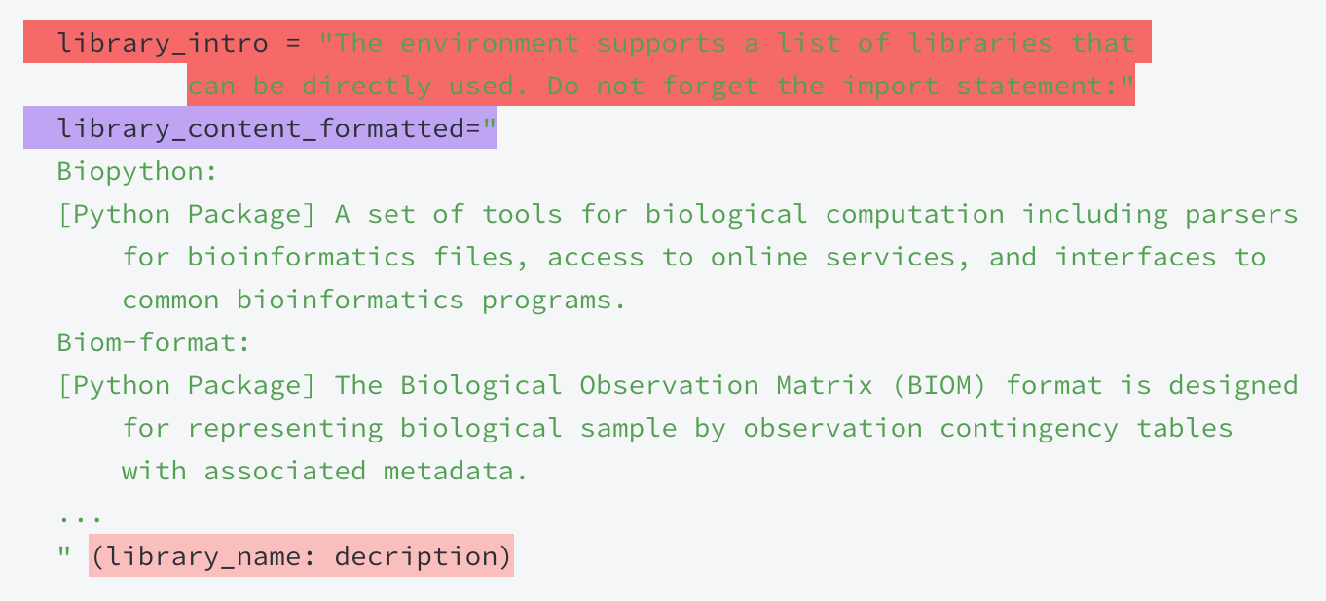
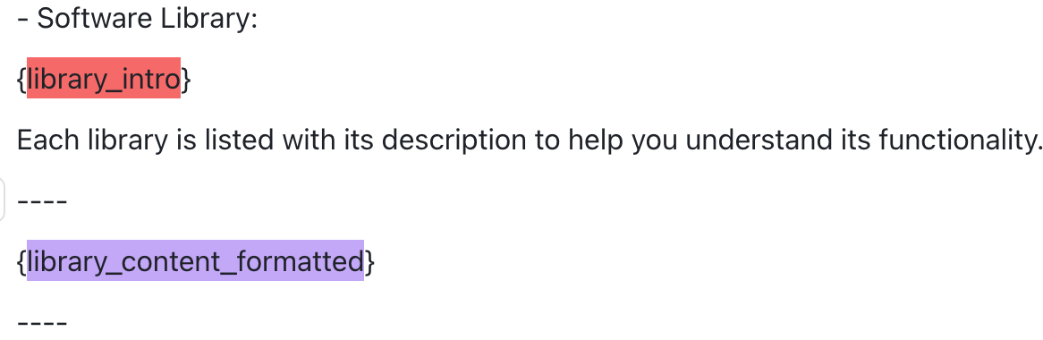
1. System Prompt Construction
The Format of System Prompt
  4. Environment Resources and Format
    Software Library (100+)

Slide 8
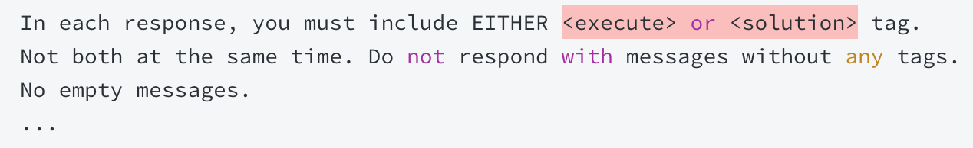
1. System Prompt Construction
The Format of System Prompt
  5. Other Requirements

Slide 9
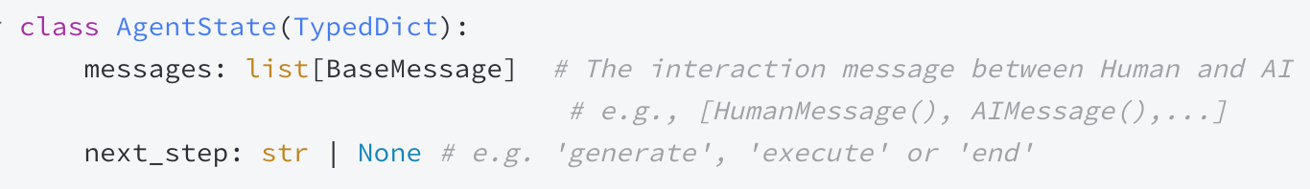
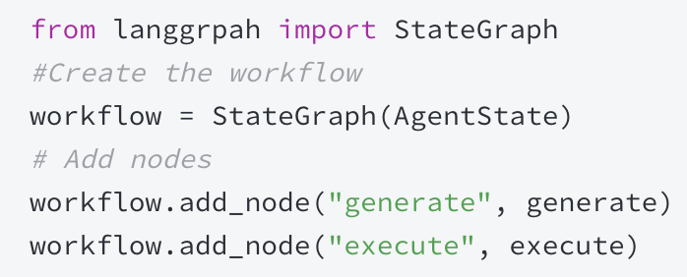
2. LangGraph Definition
Agent State
  Defining the input & output format of each Node.
Workflow
  Defining the workflow of LangGraph

Slide 10
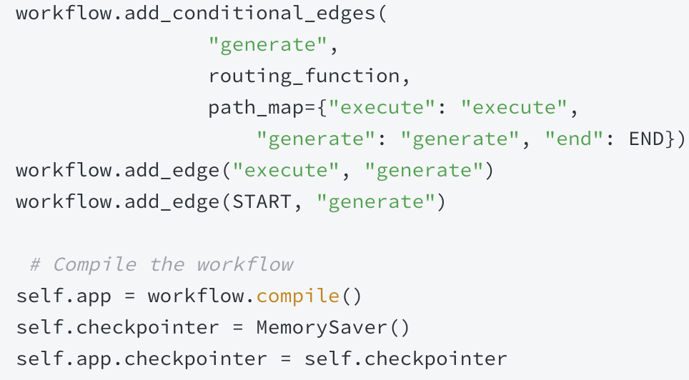
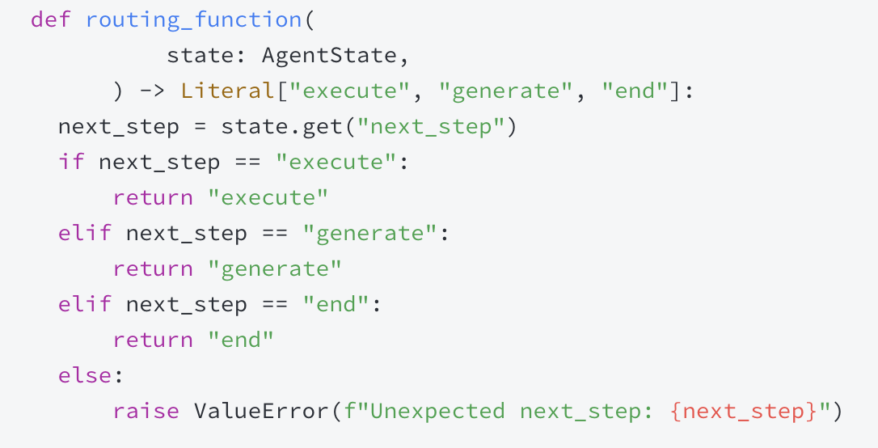
2. LangGraph Definition
Graph Construction
START
generation
Routing
execution
END

Slide 11
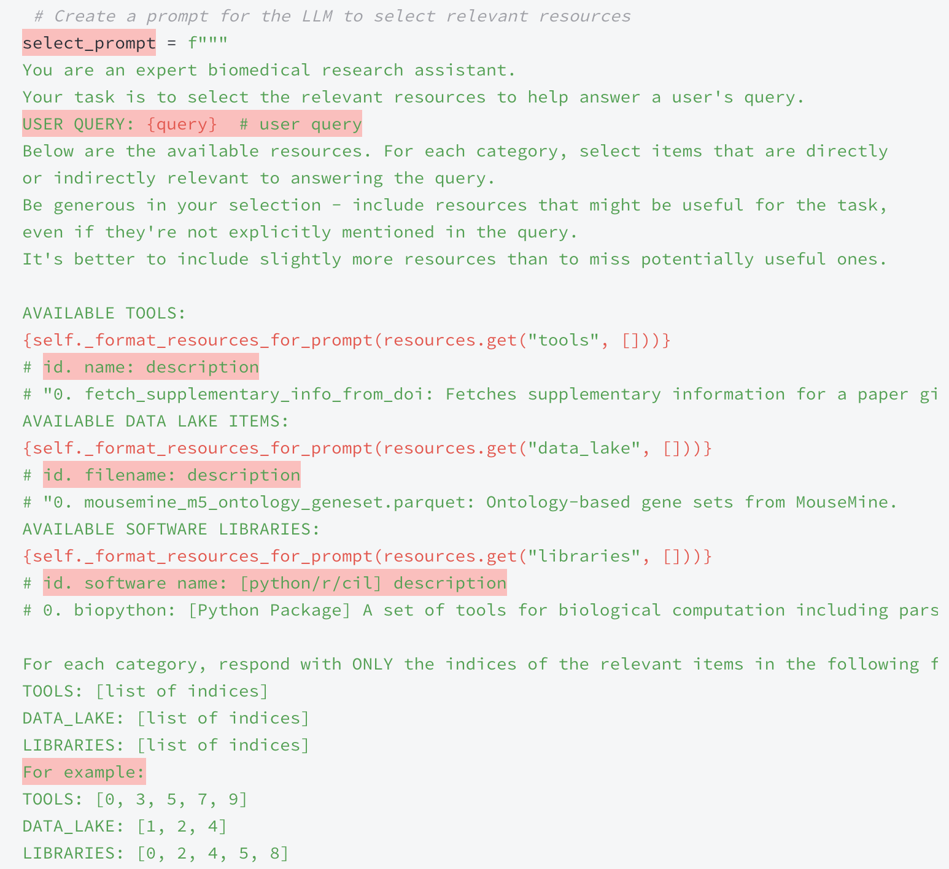
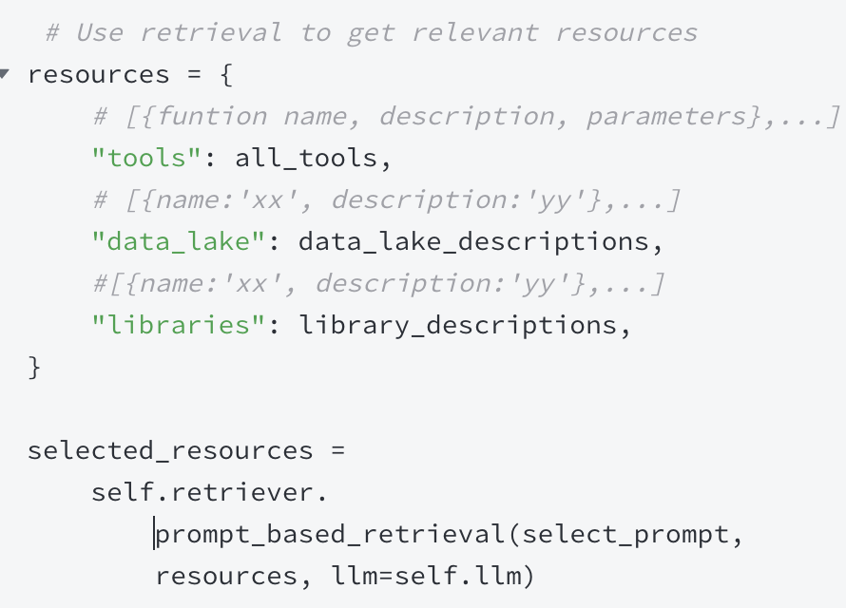
3. Query-aware Tool Retrieval
  Prompt the LLM to select resources relevant to the current user query from all available resources (python function, data lake, and library).

Slide 12
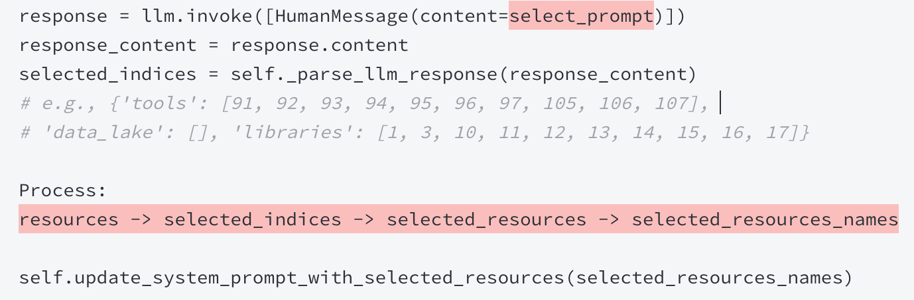
3. Query-aware Tool Retrieval
Update the system prompt (which initially includes all resources) with the selected resources relevant to the current user query

Slide 13
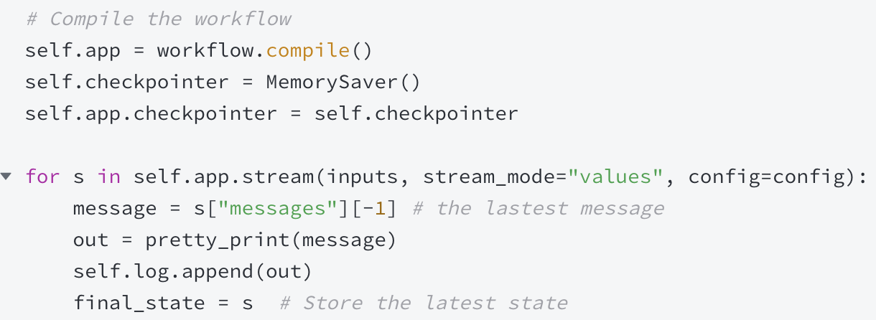
4. LangGraph Execution Stream
START
generation
Routing
execution
END

Slide 14
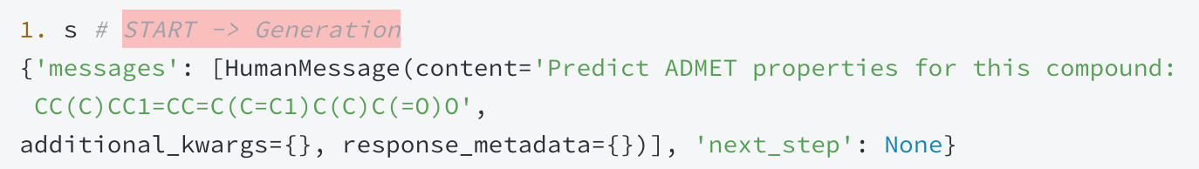
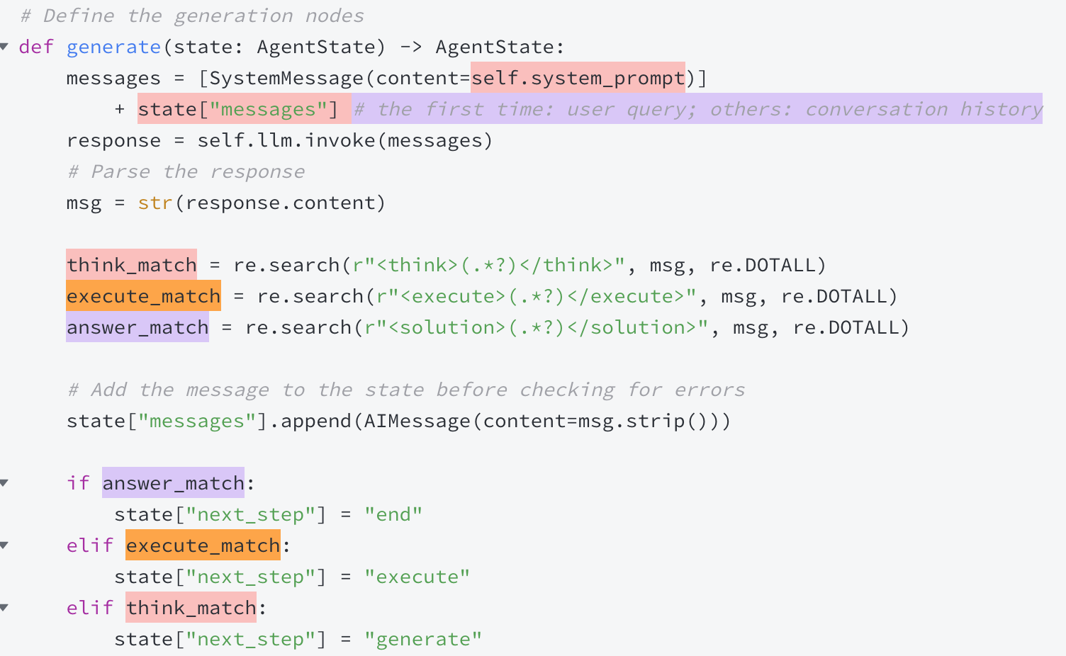
4. LangGraph Execution Stream
1. START - > Generation
2. Perform generation() function in Generation node
  Normal

Slide 15
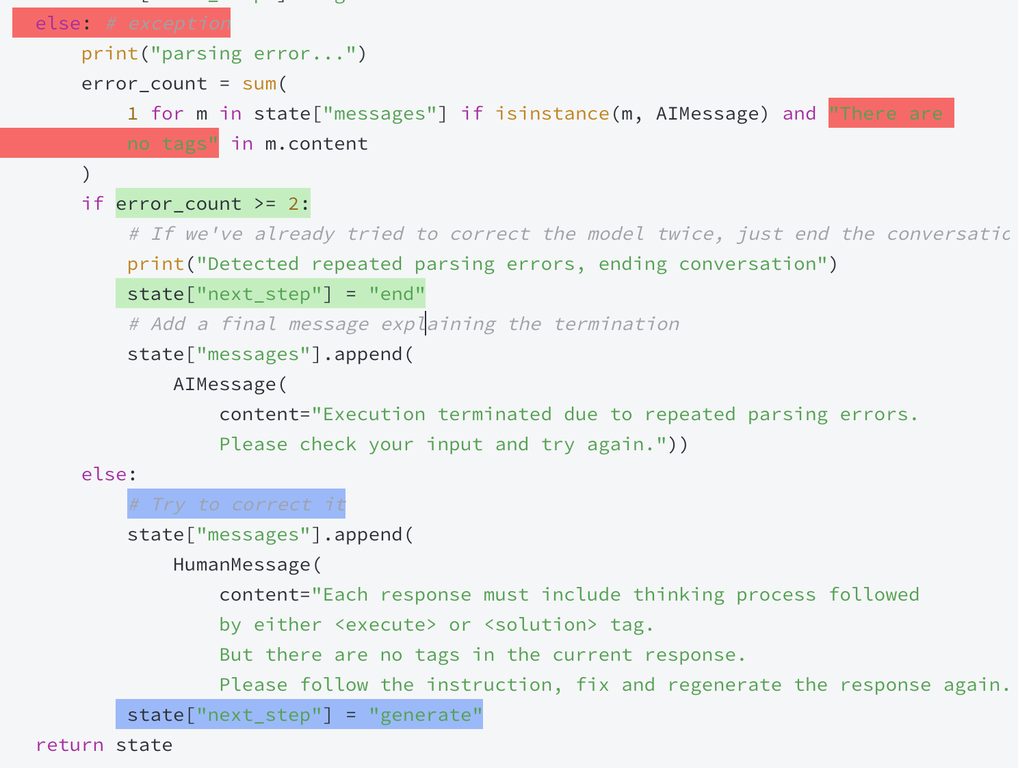
4. LangGraph Execution Stream
2. Perform generation() function in Generation node
  Exception

Slide 16
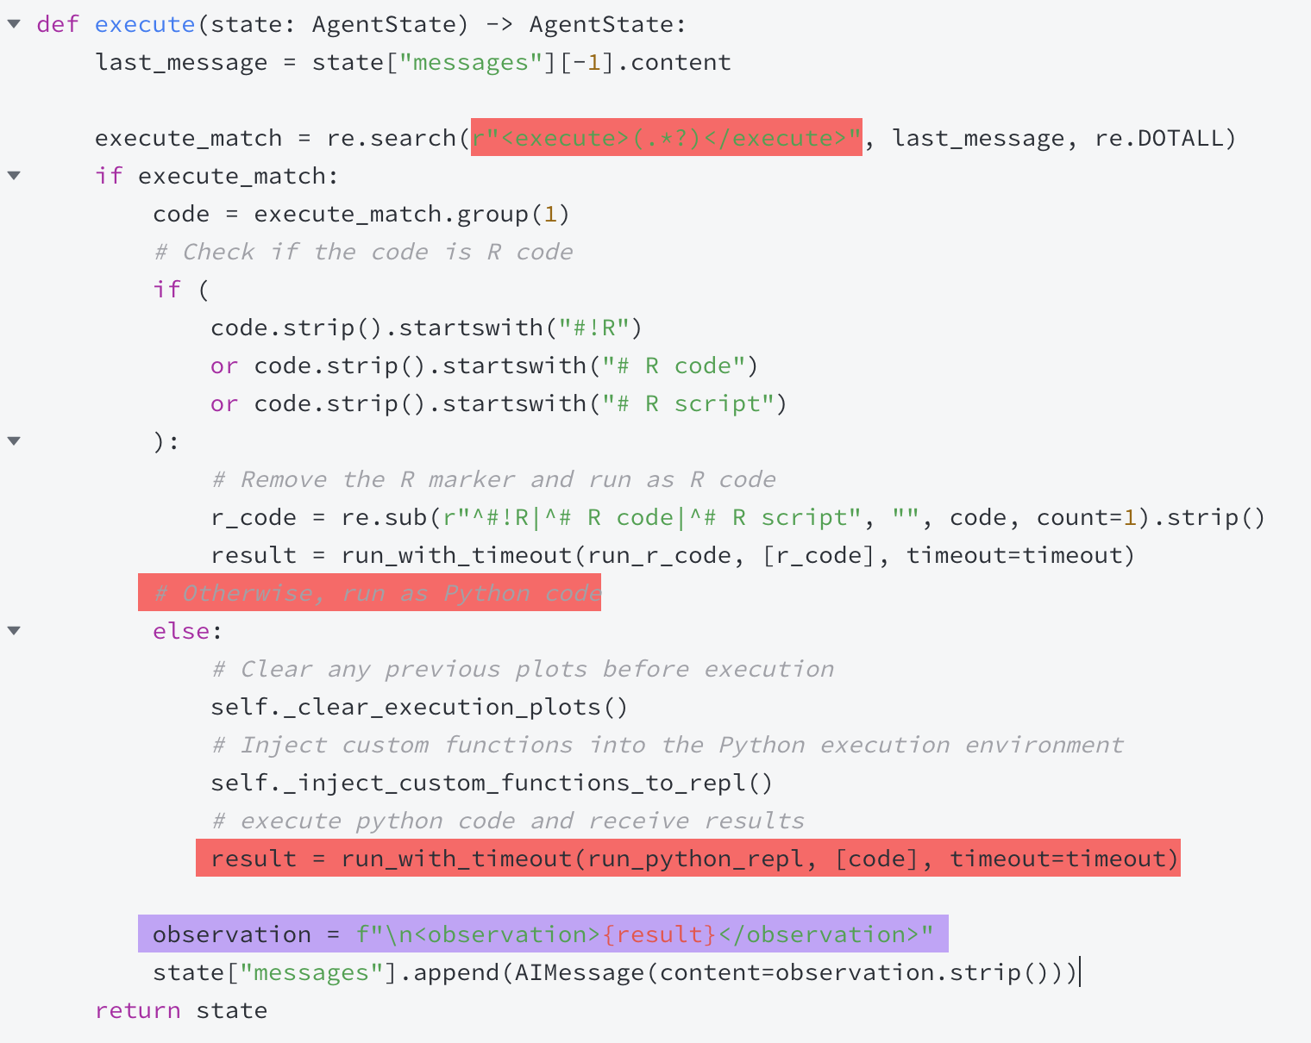
4. LangGraph Execution Stream
3. Perform execution() function in Execution node

